Slide 1




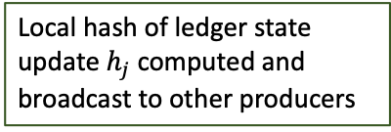


















Catalyst_Cycle.png
Construction
Campaigning
Voting
Synchronization
$$h_{j}=H\left(∆L_{n,j}\right) || Id_{j}$$
Computation and broadcast of ${c_{j}=f(h}_{∆j}^{maj}$)
$o_{j}=A_{n}|| \#(L_{n}(vote)$) $||{ Id}_{j}$
$$h_{∆j}$$
Collection of candidates $c_{k}$
$${A_{n}:DFS address for ∆L}_{n}$$
The ledger cycle starts
Local hash of ledger state update $h_{j}$computed and broadcast to other producers
Broadcast $H_{L}$ to users
Computation and broadcast of votes $v_{j}$ (including rewards)
Access ${∆L}_{n}$ from DFS
Pool flushed
Transactions in the mempool collected
Collection of $h_{k}∀ k∈P/j$
Votes $v_{k}$ collection
A new cycle starts
0s
30s
60s
$$∆t_{p0}$$
$$∆t_{c0}$$
$$∆t_{v0}$$
$$∆t_{s0}$$
$$∆t_{c}$$
$$∆t_{s}$$
$$∆t_{v}$$
$$∆t_{p}$$
$$h_{∆j}^{maj}=max⁡[h_{∆k}]$$
$$∆t_{freeze}$$
Transactions collected and stored in memory pool
1 ledger cycle
$$∆t_{cycle}$$

Slide 2












Catalyst_Database.png
Catalyst Database
Current Ledger Partitions State
Smart Contract- based
Accounts
(dApps)
Standard Accounts
Confidential Accounts
$$L_{S}$$
$$L_{C}$$
Distributed File System (DFS)
$${∆L}_{S1}$$
$${∆L}_{C1}$$
$$∆_{2}$$
$${∆L}_{S2}$$
$$∆_{2}$$
$${∆L}_{C2}$$
$${∆L}_{S3}$$
$${∆L}_{C3}$$
$${∆L}_{S4}$$
$${∆L}_{C4}$$
Recent Ledger Partitions State Updates
Historical Ledger Partitions State updates
Smart Contract
Files
dApps Files
Large Files storage

Slide 3





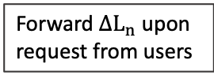








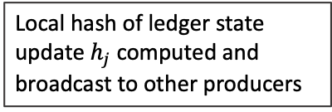




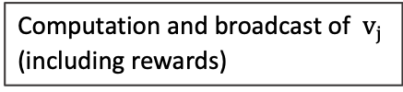


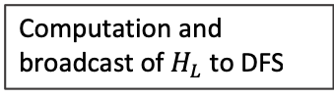
Catalyst_Cycle.png (Black and White)
Construction
Campaigning
Voting
Synchronization
$c_{j}=h_{∆j}^{maj} || \#(L_{j}(prod)$) $||{ Id}_{j}$
$v_{j}=H\left(LSU_{j}\right) || \#(L_{j}(vote)$) $||{ Id}_{j}$
$$h_{j}=h_{∆j}|| Id_{j}$$
Computation and broadcast of $c_{j}$
$H_{L}=H\left({∆L}_{n}\right) || \#(L_{n}(vote)$) $||{ Id}_{j}$
Ledger cycle starts
Local hash of ledger state update $h_{j}$computed and broadcast to other producers
Collection of candidates $c_{k}∀ k∈P/j$
Computation and broadcast of $H_{L}$ to DFS
Computation and broadcast of $v_{j}$ (including rewards)
Forward ${∆L}_{n}$ upon request from users
mempool flushed
Collection of $h_{k}∀ k∈P/j$
Collection of votes $v_{k}∀ k∈C_{n}/j$
new ledger cycle starts
0s
30s
60s
$$∆t_{p0}$$
$$∆t_{c0}$$
$$∆t_{v0}$$
$$∆t_{s0}$$
$$∆t_{p}$$
$$∆t_{c}$$
$$∆t_{v}$$
$$∆t_{s}$$
$$h_{∆j}^{maj}=max⁡[h_{∆k}]$$
$$H\left({∆L}_{n}\right)=max⁡[H(LSU_{k})]$$
$$∆t_{freeze}$$
Transactions collected and stored in memory pool
1 cycle = 1min
$$∆t_{cycle}$$

Slide 4
Catalyst_Database.png (Black and White)
Catalyst Database
Current Ledger Shards State
Smart Contract- based
Accounts
(dApps)
Standard Accounts
Confidential Accounts
$$L_{S}$$
$$L_{C}$$
Distributed File System (DFS)
$${∆L}_{S1}$$
$${∆L}_{C1}$$
$$∆_{2}$$
$${∆L}_{S2}$$
$$∆_{2}$$
$${∆L}_{C2}$$
$${∆L}_{S3}$$
$${∆L}_{C3}$$
$${∆L}_{S4}$$
$${∆L}_{C4}$$
Recent Ledger Shards State Updates
Historical Ledger Shards State Updates
Smart Contract
Files
dApps Files
Large Files storage

Slide 5
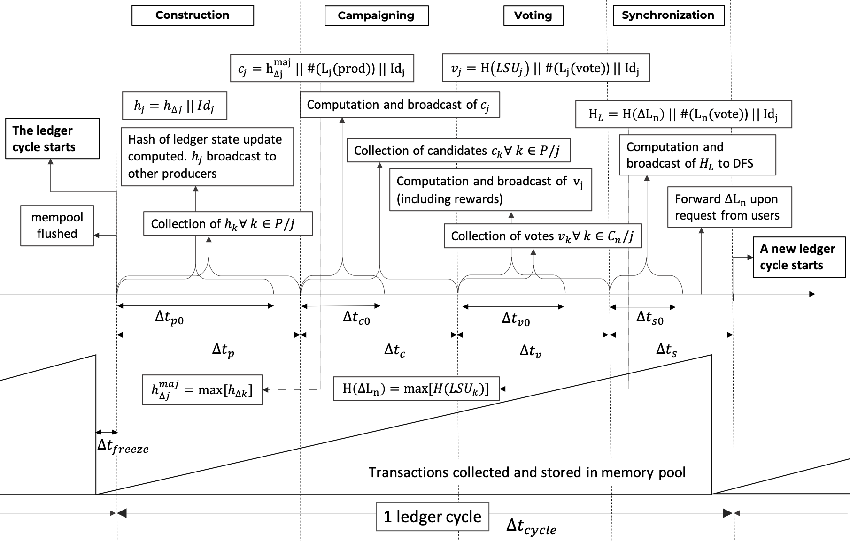

Slide 6







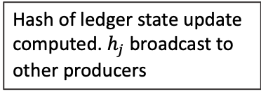
Catalyst_Cycle.png (Black and White)
Construction
Campaigning
Voting
Synchronization
$c_{j}=h_{∆j}^{maj} || \#(L_{j}(prod)$) $||{ Id}_{j}$
$v_{j}=H\left(LSU_{j}\right) || \#(L_{j}(vote)$) $||{ Id}_{j}$
$$h_{j}=h_{∆j} || Id_{j}$$
Computation and broadcast of $c_{j}$
$H_{L}=H\left({∆L}_{n}\right) || \#(L_{n}(vote)$) $||{ Id}_{j}$
The ledger cycle starts
Hash of ledger state update computed. $h_{j}$ broadcast to other producers
Collection of candidates $c_{k}∀ k∈P/j$
Computation and broadcast of $H_{L}$ to DFS
Computation and broadcast of $v_{j}$ (including rewards)
Forward ${∆L}_{n}$ upon request from users
mempool flushed
Collection of $h_{k}∀ k∈P/j$
Collection of votes $v_{k}∀ k∈C_{n}/j$
A new ledger cycle starts
$$∆t_{p0}$$
$$∆t_{c0}$$
$$∆t_{v0}$$
$$∆t_{s0}$$
$$∆t_{p}$$
$$∆t_{c}$$
$$∆t_{v}$$
$$∆t_{s}$$
$$h_{∆j}^{maj}=max⁡[h_{∆k}]$$
$$H\left({∆L}_{n}\right)=max⁡[H(LSU_{k})]$$
$$∆t_{freeze}$$
Transactions collected and stored in memory pool
1 ledger cycle
$$∆t_{cycle}$$

Slide 7
Catalyst_Database.png (Black and White)
Catalyst Database
Current Ledger Partitions State
Smart Contract- based
Accounts
(dApps)
Standard Accounts
Confidential Accounts
$$L_{S}$$
$$L_{C}$$
Distributed File System (DFS)
$${∆L}_{S1}$$
$${∆L}_{C1}$$
$$∆_{2}$$
$${∆L}_{S2}$$
$$∆_{2}$$
$${∆L}_{C2}$$
$${∆L}_{S3}$$
$${∆L}_{C3}$$
$${∆L}_{S4}$$
$${∆L}_{C4}$$
Recent Ledger Partitions State Updates
Historical Ledger Partition State Updates
Smart Contract
Files
dApps Files
Large Files storage

Slide 8



Catalyst_Cycle.png
Construction
Campaigning
Voting
Synchronization
$$h_{j}=H\left(∆L_{n,j}\right) || Id_{j}$$
Computation and broadcast of ${c_{j}=f(h}_{∆j}^{maj}$)
$H_{L}=H\left({∆L}_{n}\right)|| \#(L_{n}(vote)$) $||{ Id}_{j}$
The ledger cycle starts
$$h_{∆j}$$
Collection of candidates $c_{k}$
Broadcast $H_{L}$ to DFS
Local hash of ledger state update $h_{j}$computed and broadcast to other producers
Computation and broadcast of votes $v_{j}$ (including rewards)
Forward ${∆L}_{n}$ upon request from users
Pool flushed
Transactions in the mempool collected
Collection of $h_{k}∀ k∈P/j$
Votes $v_{k}$ collection
A new cycle starts
0s
30s
60s
$$∆t_{p0}$$
$$∆t_{c0}$$
$$∆t_{v0}$$
$$∆t_{s0}$$
$$∆t_{c}$$
$$∆t_{s}$$
$$∆t_{v}$$
$$∆t_{p}$$
$$h_{∆j}^{maj}=max⁡[h_{∆k}]$$
$$∆t_{freeze}$$
Transactions collected and stored in memory pool
1 ledger cycle
$$∆t_{cycle}$$

Slide 9


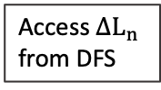



Catalyst_Cycle.png (Black and White)
Construction
Campaigning
Voting
Synchronization
$c_{j}=h_{∆j}^{maj} || \#(L_{j}(prod)$) $||{ Id}_{j}$
$v_{j}=H\left(LSU_{j}\right) || \#(L_{j}(vote)$) $||{ Id}_{j}$
$$h_{j}=h_{∆j} || Id_{j}$$
Computation and broadcast of $c_{j}$
$o_{j}=A_{n} || \#(L_{n}(vote)$) $||{ Id}_{j}$
The ledger cycle starts
Hash of ledger state update computed. $h_{j}$ broadcast to other producers
Collection of candidates $c_{k}∀ k∈P/j$
$${A_{n}:DFS address for ∆L}_{n}$$
Computation and broadcast of $v_{j}$ (including rewards)
Broadcast of $o_{j}$ to users
mempool flushed
Access ${∆L}_{n}$ from DFS
Collection of $h_{k}∀ k∈P/j$
Collection of votes $v_{k}∀ k∈C_{n}/j$
A new ledger cycle starts
$$∆t_{p0}$$
$$∆t_{c0}$$
$$∆t_{v0}$$
$$∆t_{s0}$$
$$∆t_{p}$$
$$∆t_{c}$$
$$∆t_{v}$$
$$∆t_{s}$$
$$h_{∆j}^{maj}=max⁡[h_{∆k}]$$
$$H\left({∆L}_{n}\right)=max⁡[H(LSU_{k})]$$
$$∆t_{freeze}$$
Transactions collected and stored in memory pool
1 ledger cycle
$$∆t_{cycle}$$

Slide 10
