Slide 1

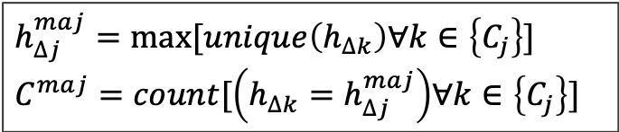

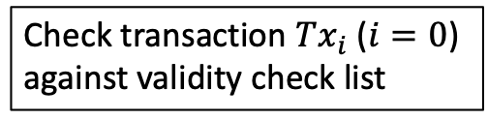


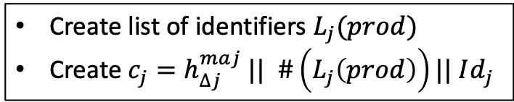











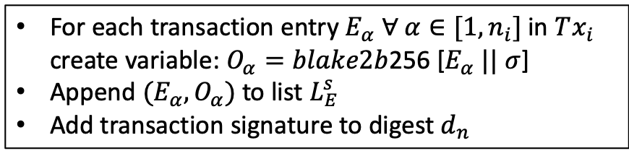



A
Peer receives a transaction from its peers and checks said transaction against validity check list (signature, balance) during period of time $∆t_{cycle}+∆t_{freeze}$
no
Transaction valid
Transaction discarded
yes
Broadcast transaction to peers
yes
no
worker peer?
Store transaction in mempool
s: salt = hash tree of previous ledger update
B
Local_Ledger_Computation.png
$d_{n}$: hash tree or other data structure
START
$$t=t_{p}$$
Check transaction $Tx_{i}$ ($i=0$) against validity check list
Transaction valid
no
Transaction discarded
yes
For each transaction entry $E_{α} ∀ α∈[1,n_{i}]$ in $Tx_{i}$ create variable: $O_{α}=blake2b$256 [$E_{α} || σ$]
Append ${(E_{α},O}_{α})$ to list $L_{E}^{s}$
Add transaction signature to digest $d_{n}$
no: $i→i+1$
Last transaction ($i=m_{n−1}$)
Sort $M$ transaction entries in $L_{E}^{s}$ in ascending order using ${\left\{O_{β}\right\}}_{β=1,..,M}$
Create $L_{E}^{f}={\left\{E_{β}\right\}}_{β=1,..,M}$ with
$$O_{1}<O_{2}<…<O_{β}<…<O_{M}$$
${∆L_{n,j }= L}_{E}^{f} || d_{n}$
yes
Create $h_{j}=h_{∆j }|| Id_{j}$ with $h_{∆j}=H(∆L_{n,j })$
$$t≤t_{p}+∆t_{p0}$$
no
yes
Forward $h_{j}$ to other producers
STOP
Collect $h_{k}$ from other producers
$$t≤t_{p}+∆t_{p}$$
no
yes
C
Local_Vote_Broadcast.png
START
$$t=t_{c}$$
$$C_{j}≥C_{min}$$
no
STOP
yes
$$h_{∆j}^{maj}=max⁡[unique\left(h_{∆k}\right)∀k∈\left\{C_{j}\right\}]$$
$$C^{maj}=count⁡[\left(h_{∆k}=h_{∆j}^{maj}\right)∀k∈\left\{C_{j}\right\}]$$
$C^{maj}≥C_{threshold}$
no
yes
Create list of identifiers $L_{j}(prod)$
Create $c_{j}=h_{∆j}^{maj} || \#\left(L_{j}\left(prod\right)\right)|| Id_{j}$
$$t≤t_{c}+∆t_{c0}$$
no
yes
Collect $c_{k}$ from other producers
Forward $c_{j}$ to other producers
no
$$t≤t_{c}+∆t_{c}$$
yes

Slide 2

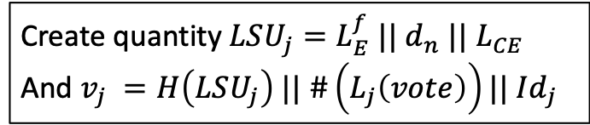


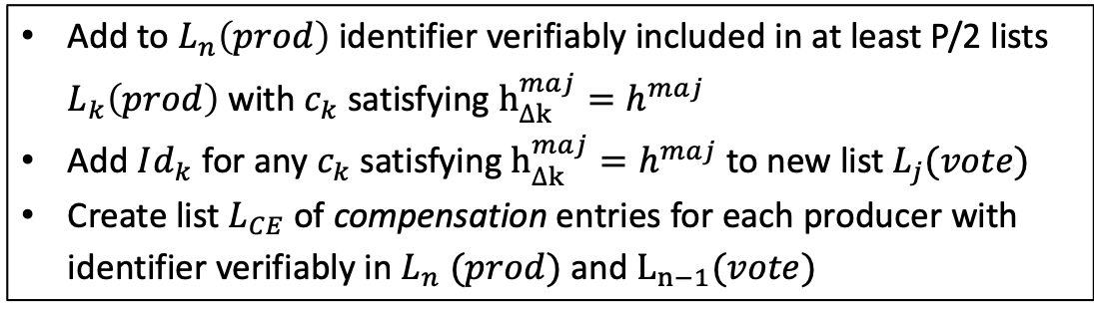

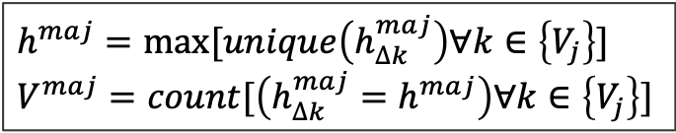




D
Global_Vote_Broadcast.png
no
START
$$t=t_{v}$$
$$V_{j}≥V_{min}$$
STOP
yes
$$h^{maj}=max⁡[unique\left(h_{∆k}^{maj}\right)∀k∈\left\{V_{j}\right\}]$$
$$V^{maj}=count⁡[\left(h_{∆k}^{maj}=h^{maj}\right)∀k∈\left\{V_{j}\right\}]$$
$$h_{∆j}=h^{maj}$$
no
yes
$$V^{maj}≥V_{threshold}$$
Add to $L_{n}\left(prod\right)$identifier verifiably included in at least P/2 lists $L_{k}\left(prod\right)$ with $c_{k}$satisfying $h_{∆k}^{maj}=h^{maj}$
Add $Id_{k}$ for any $c_{k}$satisfying $h_{∆k}^{maj}=h^{maj}$ to new list $L_{j}(vote)$
Create list $L_{CE}$ of compensation entries for each producer with identifier verifiably in $L_{n} (prod)$ and $L_{n−1}(vote)$
Forward $v_{j}$ to the other producers
Create quantity $LSU_{j}=L_{E}^{f} || d_{n}$ $||$ $L_{CE}$
And $v_{j} =H\left(LSU_{j}\right) || \#\left(L_{j}\left(vote\right)\right)|| Id_{j}$
yes
no
$$t <t_{v}+∆t_{v0}$$
Collect $v_{k}$ from other producers
$$t≤t_{v}+∆t_{v}$$
no
yes

Slide 3
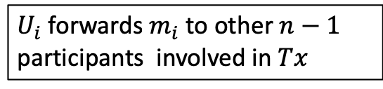
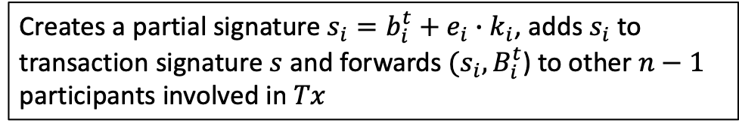

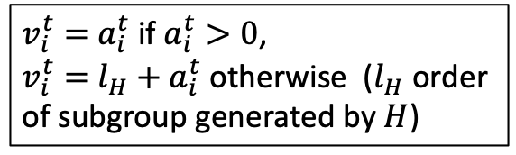
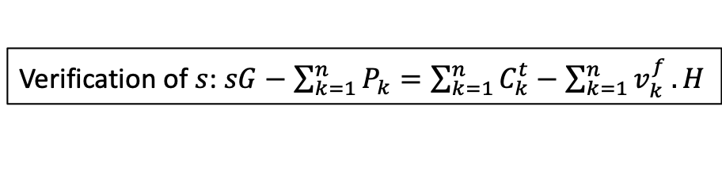
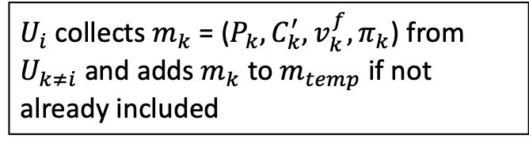

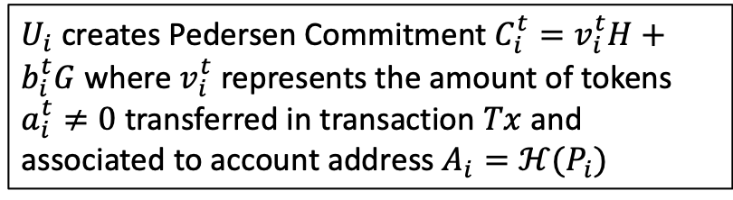




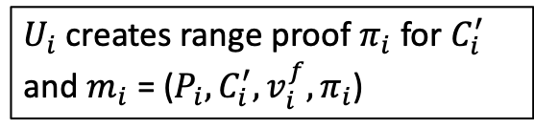

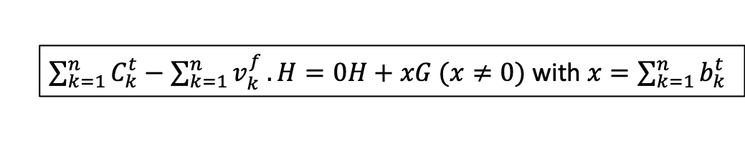


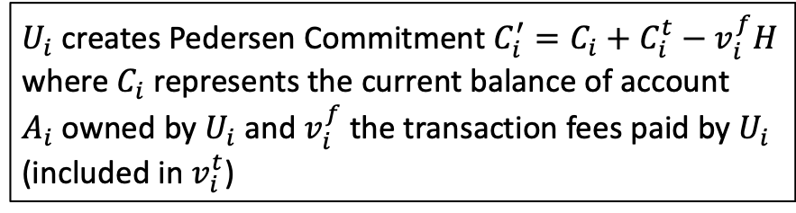
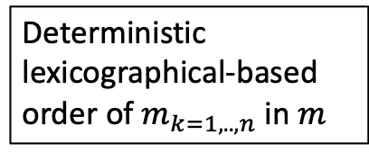


E
START
Participant $U_{i}$ creates empty message $m_{temp}$
$U_{i}$ creates Pedersen Commitment $C_{i}^{t}=v_{i}^{t}H+b_{i}^{t}G$ where $v_{i}^{t}$ represents the amount of tokens $a_{i}^{t}≠0$ transferred in transaction $Tx$ and associated to account address $A_{i}=ℋ(P_{i})$
$v_{i}^{t}=$ $a_{i}^{t}$ if $a_{i}^{t}>0$,
$v_{i}^{t}=$ ${l_{H}+a}_{i}^{t}$ otherwise ($l_{H}$ order of subgroup generated by $H$)
$U_{i}$ creates Pedersen Commitment $C_{i}^{′}=C_{i}+C_{i}^{t}−v_{i}^{f}H$ where $C_{i}$ represents the current balance of account $A_{i}$owned by $U_{i}$ and $v_{i}^{f}$ the transaction fees paid by $U_{i}$ (included in $v_{i}^{t}$)
$U_{i}$ creates range proof $π_{i}$ for $C_{i}^{′}$
and $m_{i}$ = ($P_{i},C_{i}^{′},v_{i}^{f},π_{i}$)
$U_{i}$ forwards $m_{i}$ to other $n−1$ participants involved in $Tx$
$U_{i}$ collects $m_{k}$ = ($P_{k},C_{k}^{′},{v_{k}^{f},π}_{k}$) from $U_{k≠i}$ and adds $m_{k}$ to $m_{temp}$ if not already included
$U_{i}$ adds $m_{i}$ to $m_{temp}$
no
All $m_{k} ∀ k ∈[1,n]$ in $m_{temp}$ ?
STOP
yes
Deterministic lexicographical-based order of $m_{k=1,..,n}$ in $m$
Reorder $m_{k} ∀ k ∈[1,n]$ in $m_{temp}$ and creates $m$
Creates a challenge $e_{i}$ function of $m$ and list of public keys $P_{1},…,P_{n}$
Creates a partial signature $s_{i}=b_{i}^{t}+e_{i}{∙k}_{i}$, adds $s_{i}$ to transaction signature $s$ and forwards $(s_{i},B_{i}^{t}$) to other $n−1$ participants involved in $Tx$
$$B_{i}^{t}=b_{i}^{t}G$$
Collects $(s_{k},B_{k}^{t})$ from participant $U_{k≠i}$
$$s_{k}G=B_{k}^{t}+P_{k}$$
$$P_{k}=k_{k}G$$
yes
$\sum_{k=1}^{n}{C_{k}^{t}}−\sum_{k=1}^{n}{v_{k}^{f}}.H=0H+xG (x≠0)$ with $x=\sum_{k=1}^{n}{b_{k}^{t}}$
Add $s_{k}$ to $s$
$s$ complete
no
Verification of $s$: $sG−\sum_{k=1}^{n}{P_{k}}=\sum_{k=1}^{n}{C_{k}^{t}}−\sum_{k=1}^{n}{v_{k}^{f}}.H$
yes
$s$ valid
no
yes
Broadcasts $Tx=m+s$ to network

