Slide 1



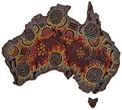
CMKb- integrating Australian customary medicinal plant knowledge with the framework of Atlas of Living Australia
Jitendra Gaikwad and Shoba Ranganathan
Macquarie University, Sydney, Australia
jgaikwad@chem.mq.edu.au

Slide 2
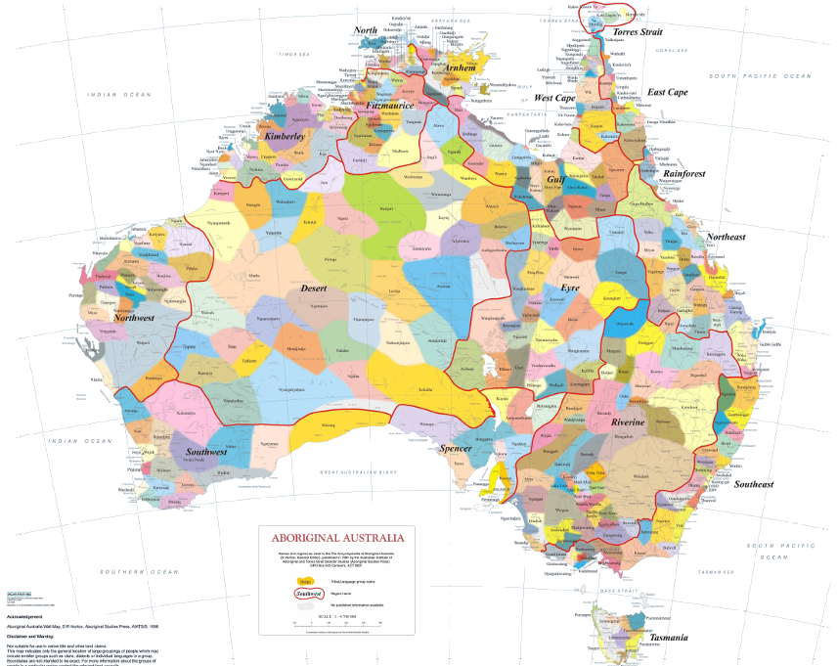
Indigenous Australia
Inhabitants for last 50,000 years (approx).
Extensively used and relied on biological resources such as plants with medicinal properties.
Australian Aboriginals
possess vast knowledge of
medicinal use of plants.
Traditional knowledge passed
from generation to generation
orally.

Slide 3
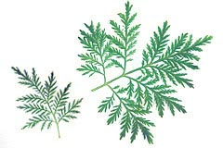
Indigenous Medicinal Knowledge
Major drug discoveries based on native medicinal plant knowledge
Artemisia annua
  the antimalarial, Artemisinin from Artemisia annua,¹ has been used in China since 200 BC.
  Duboisia – (commonly called Corkwood Tree) used for the preparation of Buscopan® for stomach pain
Klayman DL. Qinghaosu (artemisinin): an antimalarial drug from China. Science 1985; 228: 1049–1055

Slide 4
Issues regarding Australian customary medicinal plant use
Loss of valuable knowledge: oral tradition, death of elders.
No estimate of how many customary medicinal plants are used in Australia.
Data is fragmented and represents only a fraction of the known flora.
Data integration issues, especially data available in different formats.
Unavailability of Standards, Schema and Ontology

Slide 5
Online medicinal plant databases
Prelude Medicinal Plants Database (Africa)
http://www.metafro.be/prelude
Rain Tree (Amazon)
http://www.rain-tree.com/plants.htm
3. Brazilian medicinal plants database (Brazil)
http://www.brazilian-plants.com/en/
Chinese medicinal plants database (China) http://www.chinese.botanicals.at/?lang=_en
Plants for a future (England)
http://www.pfaf.org/database/index.php
Encyclopedia of Indian Medicinal plants (India)
http://www.frlht.org.in/meta/
Foundation for Revitalisation of Local Health Traditions (India) http://www.frlht.org.in/informatics.htm
Native American Ethnobotany database, University of Michigan (US)
http://herb.umd.umich.edu/
Dr Duke’s Phytochemical and Ethnobotanical databases (US)
http://www.ars-grin.gov/duke/
No such database for Australia.

Slide 6
What is the solution? Needs…
A single integrated multi disciplinary knowledgebase.
Prototype for integrating, visualizing and analysing data on customary medicinal plants.
Information resource for researchers, policy makers,
students, and Aboriginal communities.
A single knowledgebase for holistic
plant-derived discovery of therapeutics.
Biological assays
Phytochemistry
Biodiversity informatics
Ethnobotany

Slide 7
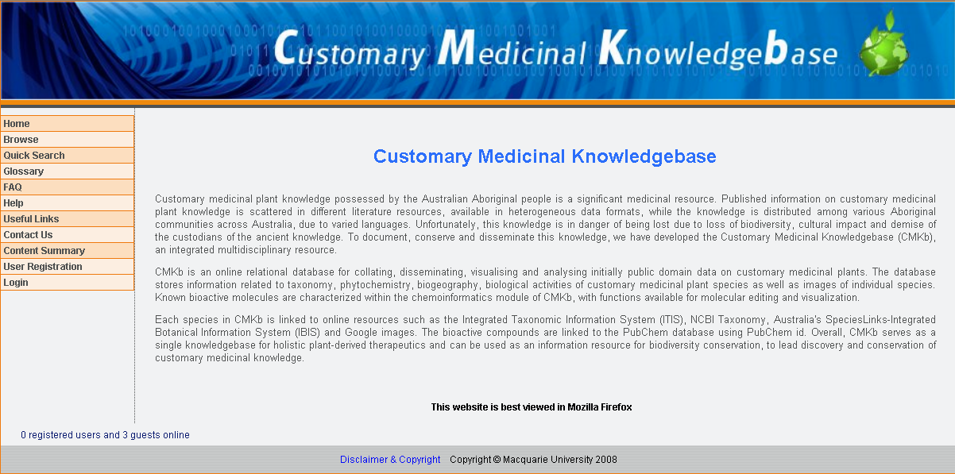
Customary Medicinal Knowledgebase
http://biolinfo.org/cmkb

Slide 8
Different components of CMKb
Data Source Number (DSN)
Title
Chemical info
Reference type
Chemical name
Reference language
Chemical common name
Author
Extraction method
Publication year
CAS No
Reference name
Formula
Volume
Chemical structure sequence
CMKb
Pages
Species info
Publisher
ISSN/ISBN
Family
Scientific name
Field Source Number (FDSN)
Authority & Year
Native name
Source name
Common name
Age
Habit
Bioactivity
Biogeography info
Multimedia
Medicinal info
Sex
Habitat
Assay type
Locality
Format (Image/Audio/Video)
Parts used
Community affiliation
Synonyms
Assay used
State
Used for
Language
Variety
Endpoint
Country
Media name
Quantity
Interview date
Remarks
Latitude
Media Author
Preparation method
Interview by
Longitude
Media Contributor
Application method
Venue
Description
Remarks

Slide 9
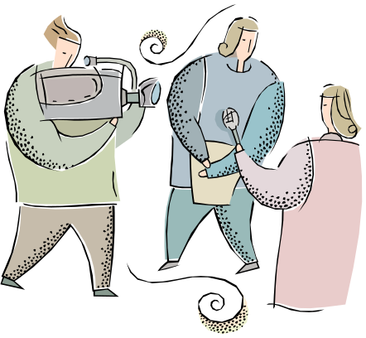

Data in CMKb
Primary data (Interviews)
  What are the medicinal plants used?
  What part of the plant is used?
  What is the preparation method?
  How it is used?
Secondary data (scientific literature)
  taxonomy
  phytochemistry
  bioactivity
  biogeography
  medicinal use and application

Slide 10
Handling IP issues
Primary data
Ethics approval from MQ
Collaborative agreement with Aboriginal communities
Password protected
Information totally owned by communities
Scientific outcomes will be jointly shared
Secondary data
Freely accessible

Slide 11
Significance of CMKb
Addresses goals of the National research priorities.
  Sustainable use of Australia’s biodiversity.
  Smart use of information.
Protects and aids in knowledge conservation.
Integration of multi-disciplinary studies.
Can lead to novel drug discovery.

Slide 12
Integrating CMKb with Atlas of Living Australia (ALA)
Partial compliance with Darwin Core and Dublin Core.
Use of APNI and Australian Plant Census as organizational framework for botanical data by ALA.
Tools from ALA for analysis.
Development of standard schemas and ontology for customary medicinal knowledge.

Slide 13
Acknowledgment
Macquarie University for MQRES scholarship
Supervisor and Co-supervisors@ MQ
Mrs Karen Wilson (Royal Botanic Gardens, Sydney)
Mr David Harrington
Mr Varun Khanna
Mr Doan Le
Northern NSW Aboriginal communities (Yaegl)
Mr Vishwas Chavan (GBIF, Copenhagen)
Colleagues and friends at Macquarie University.

Slide 14
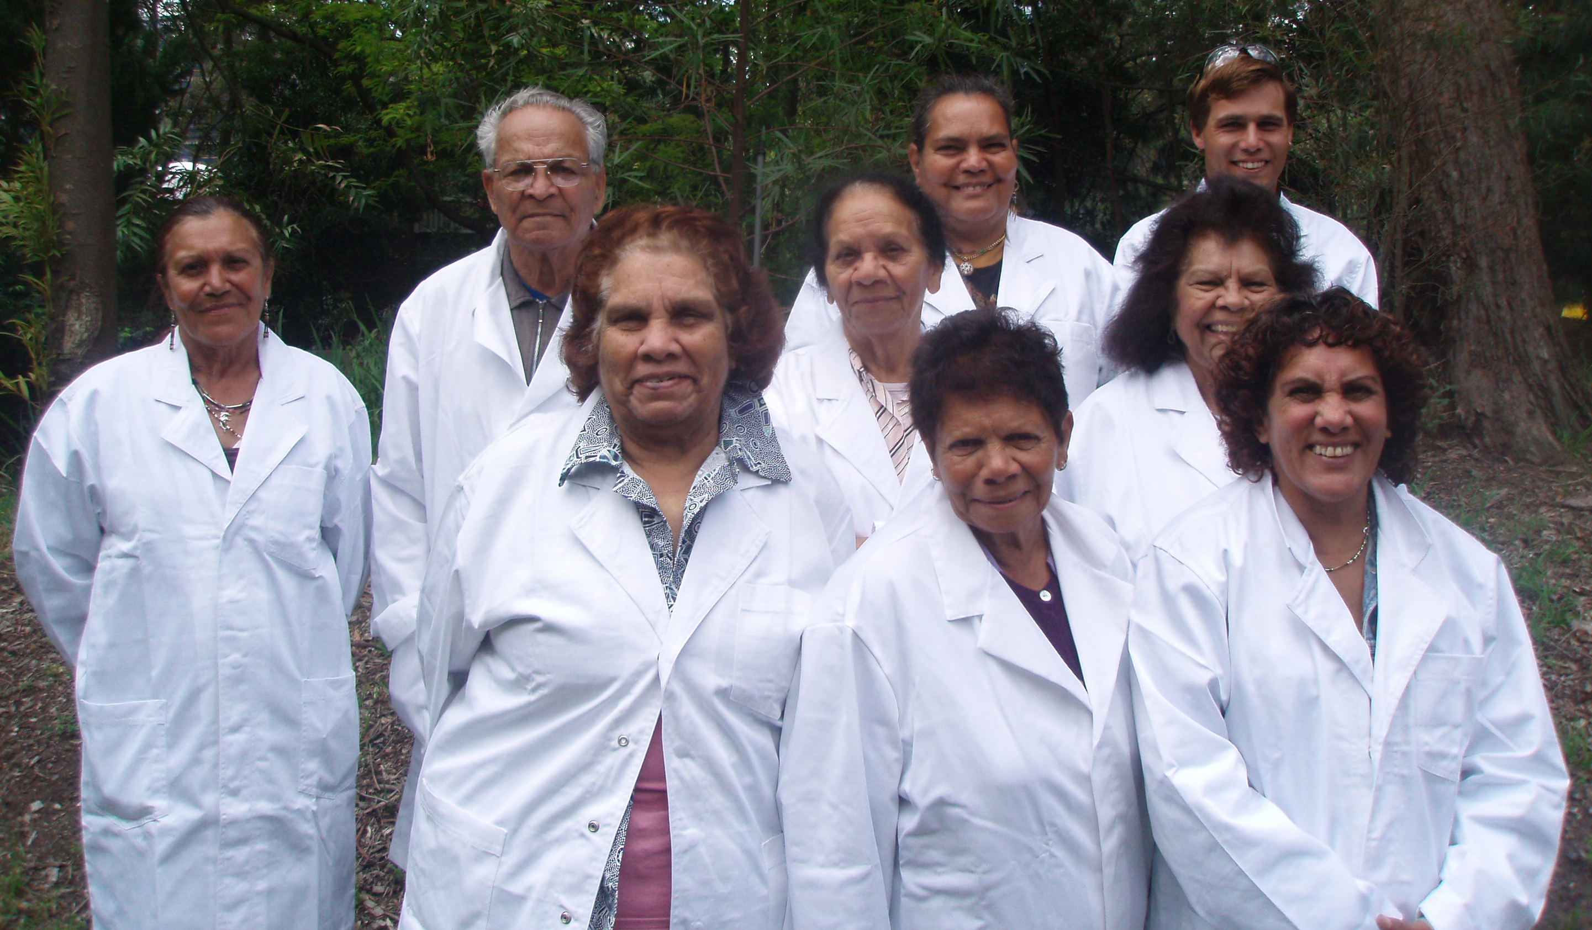
Questions ?
Elders from Yaegl community, Maclean, Northern NSW, Australia.

