Slide 1
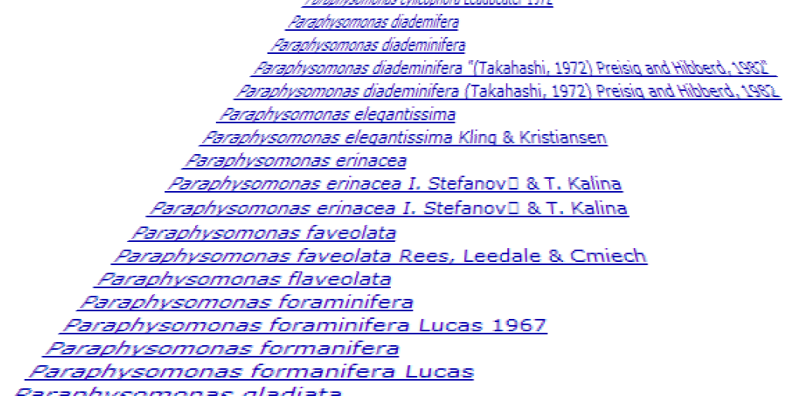
TAXAMATCH, a “fuzzy” matching algorithm for taxon names, and potential applications in taxonomic databases
Tony Rees
CSIRO Marine and Atmospheric Research, Australia
TDWG 2008 Annual Conference – Perth, October 2008

Slide 2
The problem
    A given taxon name can exist in multiple variants (legitimate and / or misspellings), for example… (from uBio site):
(etc., etc…)

Slide 3
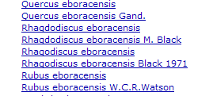
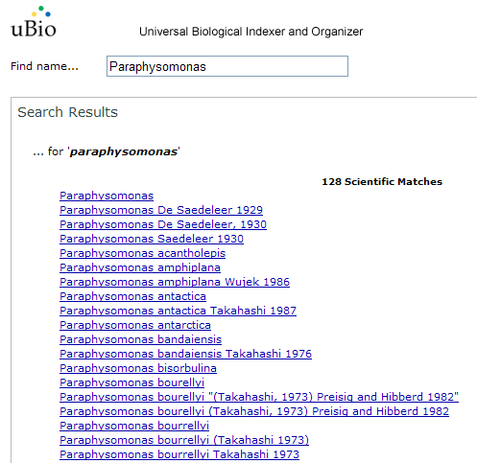
The problem (other parts)
Genus discrepancies…
same?
Authority discrepancies…
same?
…need to consider potential errors in species epithet alone, genus alone, or both (and also authority similarity).

Slide 4
Error types (simple classification for this study) - all real examples
Type 1: single character error (in genus or species epithet alone):
  Type 1a: extra / missing / different character (except at word start)
    flaveolata / faveolata (extra character)
    antactica / antarctica (missing character)
    tricarinatus / tricarinatum (different character)
  Type 1b: transposed character (except at word start)
    Acropaginula / Arcopaginula
    abrohlensis / abrolhensis
  Type 1c: error at word start
    Meosarmatium / Neosarmatium
    janthina / ianthina
Type 2: 2 character error (in genus or species epithet alone) (excl. 2-char transpositions)
    carchias / carcharias
    triangulatum / triangulum
Type 3: multi character error (in genus or species epithet alone), plus 2-char transpositions
    capricornicus / capricornensis
    serrulatus / serratulus (2-char transposition)
Type 4: error in both genus and species epithet
    Soleniscus stolonifera / Soleneiscus stolonifer
    Eogynodiastylus aganaktilos / Eogynodastylis aganaktikos
(NB, each type potentially includes both phonetic + non-phonetic errors.)

Slide 5
Error types (simple classification for this study) - all real examples
Type 1: single character error (in genus or species epithet alone):
  Type 1a: extra / missing / different character (except at word start)
    flaveolata / faveolata (extra character)
    antactica / antarctica (missing character)
    tricarinatus / tricarinatum (different character)
  Type 1b: transposed character (except at word start)
    Acropaginula / Arcopaginula
    abrohlensis / abrolhensis
  Type 1c: error at word start
    Meosarmatium / Neosarmatium
    janthina / ianthina
Type 2: 2 character error (in genus or species epithet alone) (excl. 2-char transpositions)
    carchias / carcharias
    triangulatum / triangulum
Type 3: multi character error (in genus or species epithet alone), plus 2-char transpositions
    capricornicus / capricornensis
    serrulatus / serratulus (2-char transposition)
Type 4: error in both genus and species epithet
    Soleniscus stolonifera / Soleneiscus stolonifer
    Eogynodiastylus aganaktilos / Eogynodastylis aganaktikos
(NB, each type potentially includes both phonetic + non-phonetic errors.)
- Types 3, 4 are rarest (5% or less), but arguably as important to detect as the others (if not more so)
- Phonetic errors are rapid to detect, but typically comprise only 40-50% of all errors, i.e. need edit distance type approach as well (slow!!)

Slide 6
The perfect algorithm…
  Maximum recall (find all “true” target near matches) and high precision (few false hits)
  Traps both phonetic and non-phonetic errors
  Executes in (e.g.) <2 sec. (average) per input name in real-world use (e.g. web interface against 1.4m target names), faster for deduplication runs
  Available off-the-shelf methods inadequate in either recall, precision, or efficiency (e.g. Edit Distance tests typically slow if all names tested, large nos. of false hits as threshold widened to catch “all” hits)
  Result of this work: hybrid approach developed over 2007-8, termed “TAXAMATCH” – based on 2 custom comparison methods:
    “Rees near match 2007” phonetic algorithm, and
    “Modified Damerau-Levenshtein Distance” [MDLD] test (Boehmer & Rees in press, 2008)
  …plus rule-based filtering, in a cascading model (i.e. test genus portion first, then species as second / contingent step).

Slide 7
Key components used in this approach
  Pre-filtering (a.k.a. “blocking”)
    Avoid testing all names (e.g. test ~2% of genera, 0.02% of species) – to avoid long process times
  Testing
    Use of a custom edit distance-based test pulls in some of the more complex matches; phonetic algorithm traps others
  Post-filtering
    Use heuristic rules to improve precision (discriminate “true” from “false” matches of equal similarity)
  Result shaping (dynamic filter)
    Look for more distant hits only if no close ones detected (can disable if needed, for more complete result set, but with increase in false hits)
  Authority similarity measure
    Can be useful in distinguishing between homonyms, or near homonyms of same numeric similarity
  … plus initial pre-processing (parsing and normalization) – split into correct name elements, remove bad char’s and other qualifiers (cf., aff., etc.), + more.

Slide 8
TAXAMATCH block diagram (developer’s view)
Input genus + species (+ auth.)
Available genus + species names (+ auth’s)
Available genus names
(genus pre-filter)
Normalized
input genus
(genus test)
Genus names tested
(genus post-filter)
Available species
Genus near matches
(species pre-filter)
Normalized
input species
(species test)
Species tested
(species post-filter)
Species near matches
Species authorities
(ranking + result shaping)
Normalized
input authority
(auth. comparator)
Species near matches displayed

Slide 9
TAXAMATCH block diagram (user’s / deployer’s view)
Input genus + species (+ auth.)
Available genus + species names (+ auth’s)
Input name
Available genus names
(genus pre-filter)
Normalized
input genus
(genus test)
Genus names tested
(genus post-filter)
magic
stuff
Available species
Genus near matches
(species pre-filter)
Normalized
input species
(species test)
Species tested
(species post-filter)
Species near matches
Species authorities
(ranking + result shaping)
what you actually wanted
Normalized
input authority
(auth. comparator)
Species near matches displayed

Slide 10
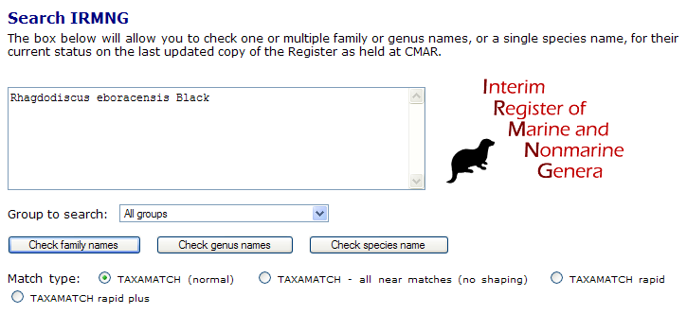
Does it work?
…Testbed is the author’s “IRMNG” database, mainly for genera, but also holds 1.45m species names from a range of (generally) “reliable” sources
Web access point (taxamatch-enabled) is at www.cmar.csiro.au/datacentre/irmng/ :

Slide 11
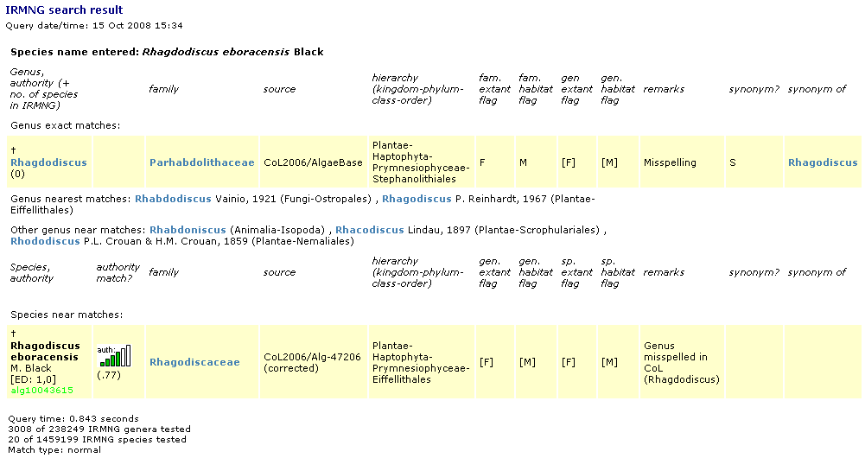
Sample TAXAMATCH performance (via IRMNG web interface)
Type 1a error (= 1-character mismatch)
(NB, initial access time can be slow while data loads into memory, subsequent accesses are fast)

Slide 12
Sample TAXAMATCH performance (via IRMNG web interface)
Type 1a error (= 1-character mismatch)

Slide 13
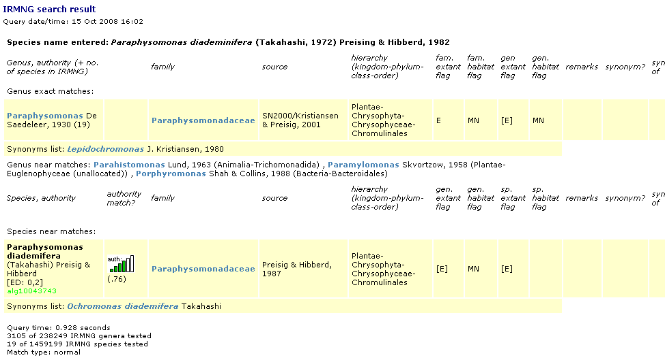
Sample TAXAMATCH performance (via IRMNG web interface)
Type 2 error (= 2 character mismatch)

Slide 14
Sample TAXAMATCH performance (via IRMNG web interface)
Type 2 error (= 2 character mismatch)

Slide 15
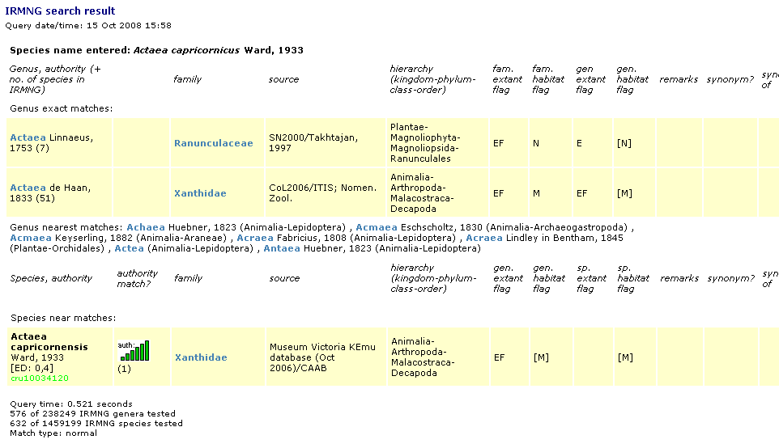
Sample TAXAMATCH performance (via IRMNG web interface)
Type 3 error (= 3+ character mismatch)

Slide 16
Sample TAXAMATCH performance (via IRMNG web interface)
Type 3 error (= 3+ character mismatch)

Slide 17
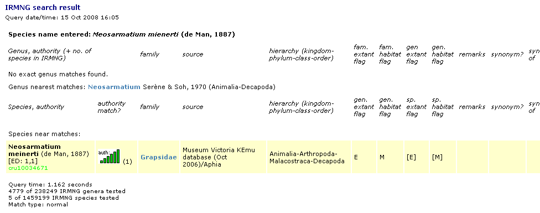
Sample TAXAMATCH performance (via IRMNG web interface)
Type 4 error (= error in both genus and species)

Slide 18
Sample TAXAMATCH performance (via IRMNG web interface)
Type 4 error (= error in both genus and species)

Slide 19
Indicative performance…
    Finds 99.7% of known errors in “normal” mode, 100% with result shaping disabled (where multiple near matches exist)
    False hits <20% of total, <5% with result shaping on (for genuine misspellings) (these figures are for binomens; values for genera alone are considerably higher as genus level results are only lightly filtered in the present configuration)
    cf…
      True phonetic algorithms:
        <40% of known errors detected
      Soundex (sloppy phonetic algorithm):
        more true hits found, but many more false ones too; performs worst with complex and/or non-phonetic errors
      Off-the-shelf Levenshtein Distance, n-gram tests:
        tradeoff between recall and precision (high recall -> low precision and vice versa)
      Google API:
        50% of true hits at best, no concept of taxonomic names / dependencies, no control over reference database consulted (or term frequency therein)

Slide 20
Use as a “taxonomic spell checker”??
    Need to deploy over an “authoritative, complete” reference database, ideally covering all groups / habitats / extant taxa + fossils
    Currently using IRMNG database (= Cat. of Life + more), could deploy over other DB’s as desired
    Potential to offer result as web service if suitable interchange format designed
    (Need to be aware, however, that there will always be taxa not in the reference database, unless this is locally or thematically complete).

Slide 21
Range of use cases…
    Misspelled user web input
      548 ways to spell “Britney Spears”
    Query expansion for distributed queries (potential variants & misspellings in provider DB’s) – already a fact of life for GBIF, OBIS, etc.
    Review pre data aggregation / ingestion
      assign data held under misspelled names to desired “correct” home (avoid creating near-duplicate rows, e.g. with relevant content split / replicated)
    Review, deduplication of names post data aggregation
      a.k.a. “merge-purge” (common in other domains e.g. customer databases, business names + street addresses, etc.)
    Another parallel is “record linkage” in medical domain
      find all records of 1 patient through time (names, addresses, date of birth, social security numbers can be variously represented, some can change as well)
    …Deduplication example shown with IRMNG database (species table, 1.4m names)… (NB, extra clause in genus pre-filter reduces processing time from ~400 to ~100 hrs)

Slide 22
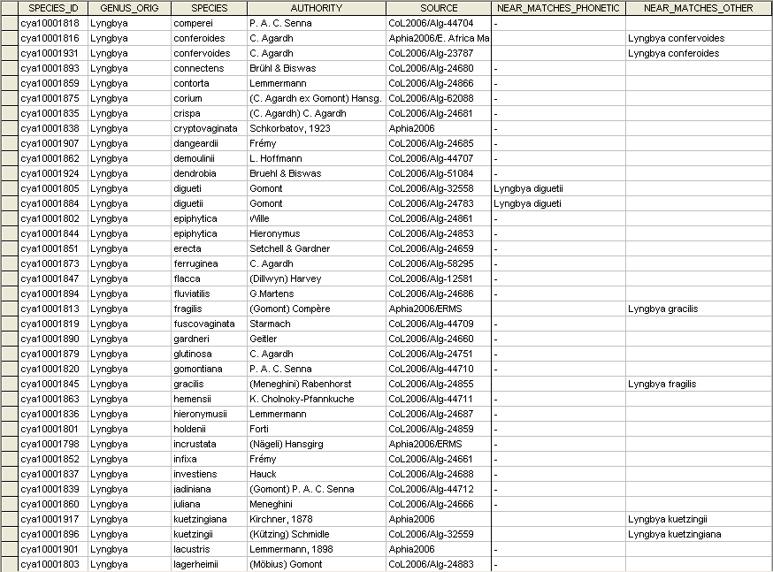
Real-world deduplication example

Slide 23
Real-world deduplication example
true
true
false
false ?

Slide 24
Real-world deduplication example
true
true
false
NB, candidate name pairs do not always sort together (e.g. when a genus error is involved, or leading character error)
false ?

Slide 25
Summary
    Fuzzy matching for taxonomic databases needs to be able to cope satisfactorily with errors of a range of complexity
    Phonetic errors comprise only ~half of all errors encountered
    Cannot presume that initial letter is always correct, or that there will not be errors in both genus and species epithet
    Need to assess algorithm performance on recall (are all “true” near matches retrieved), precision (minimize false hits), and efficiency (time taken to test any one name), against multiple error types
    TAXAMATCH seems to be the best solution developed to date, although speed is a potential area for further improvement (e.g. ~100 hours (+) to deduplicate very large existing systems)
    Manual review of offered suggestions is still required (not all false hits are eliminated, although most are)
    Use as “spell checker” is promising option, contingent on availability of adequate reference database/s.

Slide 26
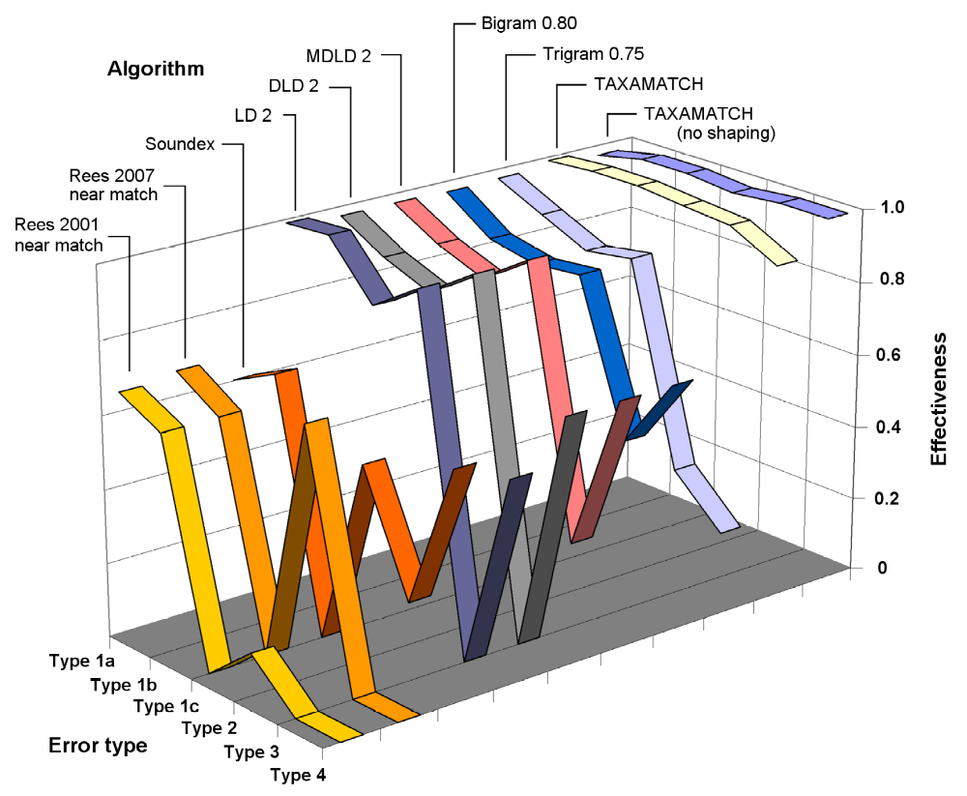
TAXAMATCH on test (versus 8 other algorithms)
effectiveness = harmonic mean of recall and precision, on 0-1 scale

Slide 27


CSIRO Marine and Atmospheric Research
Hobart, Tasmania, Australia
Tony Rees
Manager, Divisional Data Centre
Phone: +61 3 6232 5318
Email: Tony.Rees@csiro.au
Web: www.cmar.csiro.au/datacentre/
Thank you
Contact Us
Phone: 1300 363 400 or +61 3 9545 2176
Email: Enquiries@csiro.au Web: www.csiro.au

