Slide 2
Introducing Australia’s Virtual Herbarium (AVH) 3
Ben Richardson
Western Australian Herbarium,
Department of Environment and Conservation / CHAH / HISCOM
Notes:
Hi, my name is Ben Richardson, and I’m going to show you around the latest version of Australia’s Virtual Herbarium. I’m presenting this on behalf of the Council of Heads of Australasian Herbaria (CHAH) and the Herbarium Information Systems Committee (HISCOM).

Slide 3
What is AVH?
In concept, AVH began as an electronic flora of Australia
  Taxon names, specimens, descriptions, illustrations
  We decided that the specimen feature would be completed first
  First prototype built in 1999
  Latest is version 3, nearing public release
Collaboration between Commonwealth, State and Territory governments of Australia
Notes:
An electronic flora of Australia consisting of specimen and taxon name/concept data plus illustrations and descriptions

Slide 4











Participants

Slide 5
Funding
Australian Commonwealth, State and Territory Governments
Charitable Foundations:
  John T. Reid Charitable Trust
  Thyne Reid Foundation
  The Myer Foundation
  The R E Ross Trust
  The Ian Potter Foundation
Notes:
Fit in a mention of NHT via ABRS and the Weeds CRC.

Slide 6

Development
eResearchSA (formerly SAPAC)
      (South Australian Partnership for Advanced Computing)
HISCOM
      (Herbarium Information Systems Committee)
  Data, web service clients, project management
Notes:
South Australian Partnership for Advanced Computing

Slide 7
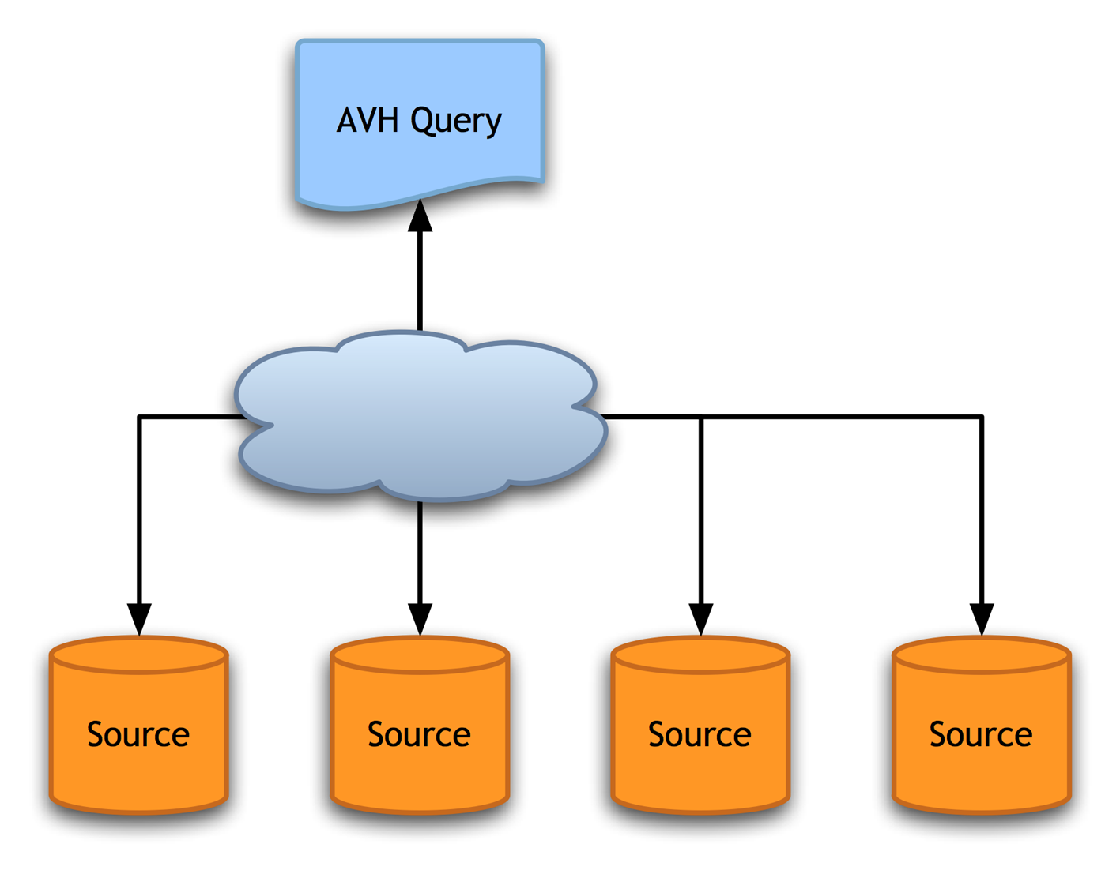
Design of AVH 2

Slide 8
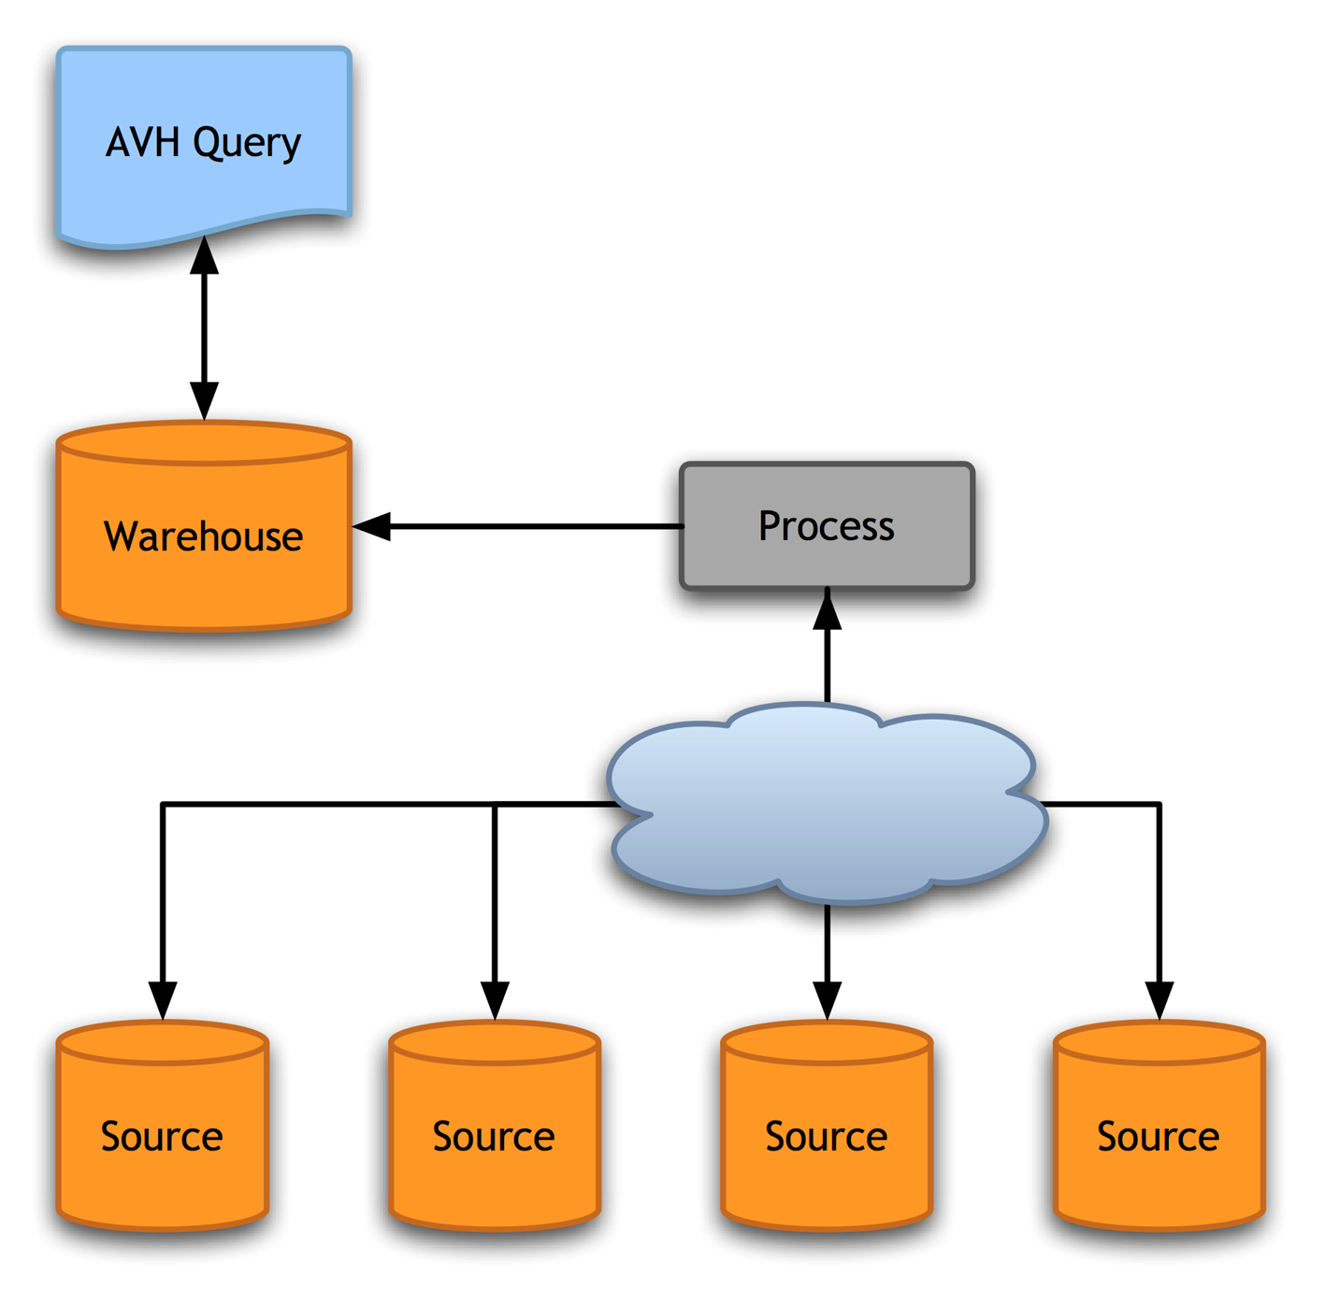
Design of AVH 3

Slide 9
Design of AVH 3
Servlet/JSP application with clients for:
  BioCASE
  TAPIR
Consumes ABCD data to build the data warehouse for direct queries

Slide 10
Why ABCD?
At the time
  ABCD contained almost all the data elements required by the project
  Ontologies: All too new

Slide 11
Why BioCASE?
At the time
  BioCASE was the only web service capable of delivering ABCD data
  TAPIR was in early development

Slide 12
Why AVH?
Plant distributions ignore borders
Many studies (esp. statistical) benefit from access to more data
Decrease the effort required by clients to build a comprehensive dataset

Slide 13
Why AVH?
Clients need this!
  Environmental impact assessment
    What specimens are/were known to occur in an area?
  Research and development, education
  Horticulture, agriculture
    Where are the weeds? Has the geographical range of any changed recently?
  Ecotourism
  Conservation
  And more…
Notes:
Conservation groups (Bushcare, Streamwatch, Landcare, Coastcare), Education

Slide 14
Why AVH?
We (herbaria) need this!
  Validation of data
  Discovery of collecting gaps
  To act as a catalyst for the modernisation of herbarium databases (for better standards support)

Slide 15
Status
All herbaria are at least 85% databased and validated for their vascular plant collections
Some important non-vascular collections are being added

Slide 16
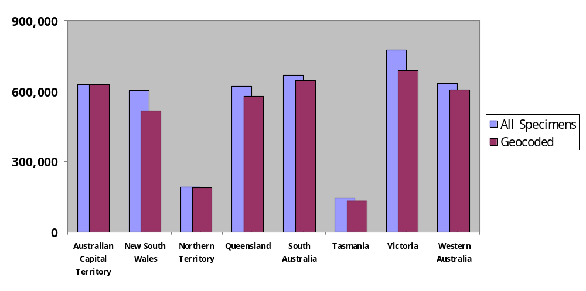
Status
4.3M records

Slide 17
Data Consistency
Infraspecific Rank
  Subspecies, subsp., ssp.
Spatial Datum
  GDA94, AGD66, “Bloodwood to 9m, …”

Slide 18
Data Consistency: Synonyms
We needed a better way to handle synonyms
  A name may be recognised in some jurisdictions but not all
  Users of AVH would want data for all synonyms in use
  Australian Plant Census

Slide 19
Two Access Classes
Public access
  Fewer options, clearer choices
Extended query
  More options for clients with specific requirements

Slide 20
Public Access
For the general public, no password required
Data display/output
  In browser HTML, or as a CSV file
Points plotted on a map
  Downloaded as JPEG, PDF, PNG

Slide 21
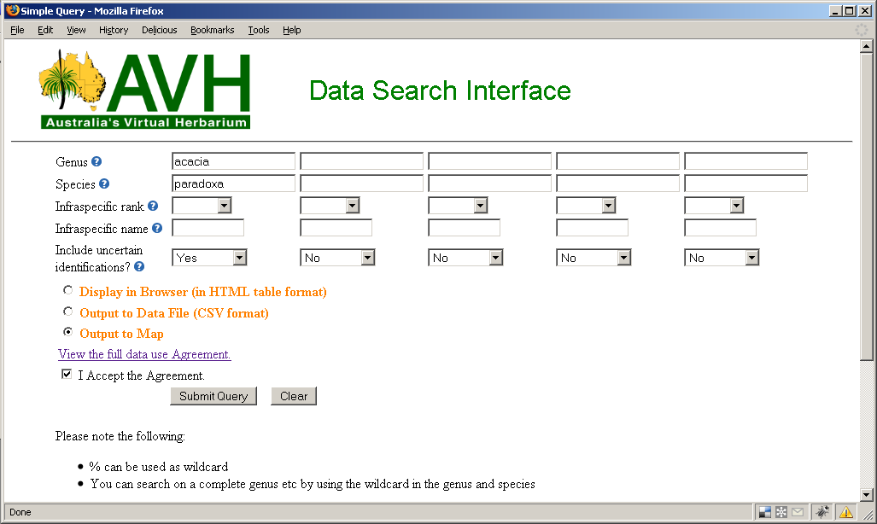
Public Access Query

Slide 22
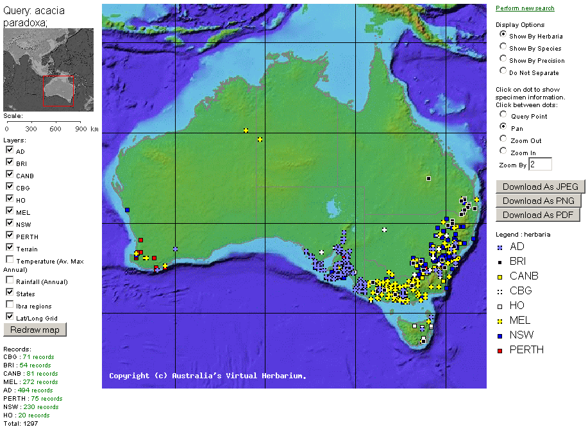
Public Access Map

Slide 23
Extended Query
Available to major clients, herbarium staff, password protected
Data display/output
  As for Public Access plus ABCD, HISPID3
  Sent as email
Large set of extra query fields

Slide 24
Extended Query: Location Page
Country, state, herbarium, nearest named place
Geographical coordinates
  Decimal range
  DMS range or centroid
  Cartesian centroid

Slide 25
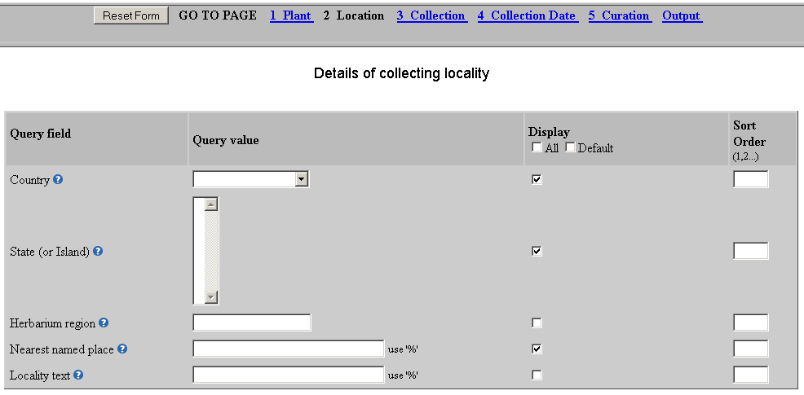
Extended Query: Location Page

Slide 26
Extended Query: Collection Page
Primary Collector
Other Collectors
Collector’s Field Number
Accession Number
Altitude, Depth
And more…

Slide 27
Extended Query: Collection Date Page
Exact date
Range query
Set of date ranges
  1981-1982, 1985-1987 and 1990-1991

Slide 28
Extended Query: Curation Page
(Not yet enabled)
Location of replicate specimens
Loan and Exchange Numbers
Donor information
Validation information
Dates for the creation and modification of the data

Slide 29
Our Experiences
Synchronisation of data between a herbarium and AVH is slow
BioCASE has been difficult to install on Solaris, which has slowed its adoption

Slide 30
To Do For 3.0
New design
Continue to address data consistency issues by correcting at the source
Convert the remaining herbaria to web services

Slide 31
Licensing
Mozilla Public License
Source code available on SourceForge
  big.sourceforge.net

Slide 32
The Future
Incorporate data from regional herbaria, e.g. universities
Provide access to:
  Taxon names
  Descriptions
  Illustrations (photos and maps)
  Validation tools
ALA?

Slide 33
www.eresearchsa.edu.au/avh/

