Slide 1
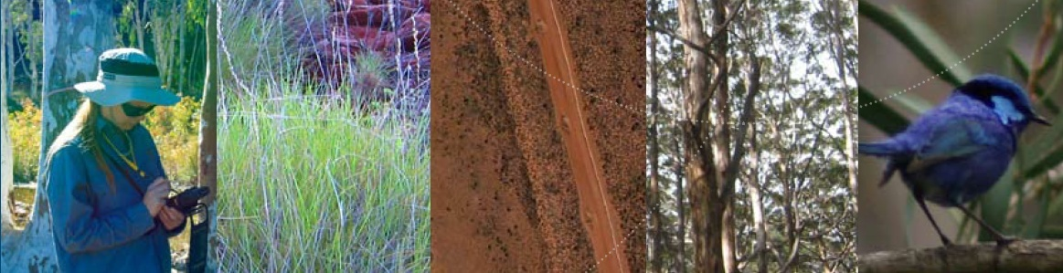

GAIA RESOURCES
Field Data Collection
Citizen Science and the Atlas of Living
Australia
Piers Higgs
Gaia Resources
P088; Presented in Canberra, 27th March, 2008
Presented at GER Workshop, Canberra, 4th March 2011

Slide 2
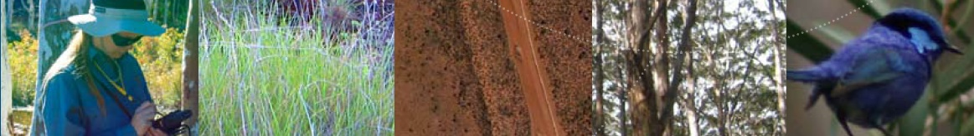
OVERVIEW
Overview
Overview of “Citizen Science” Functionality
Who’s using it now?
Demonstration
What’s on our plans from here?

Slide 3
ATLAS OF LIVING AUSTRALIA
Our Brief
Developing flexible, open source web-based software that will enable a wide range of parties to record and manage records of Australian biodiversity
…and it has to work on mobile devices.
record & manage
open source
flexible
web-based
building freely available software

Slide 4
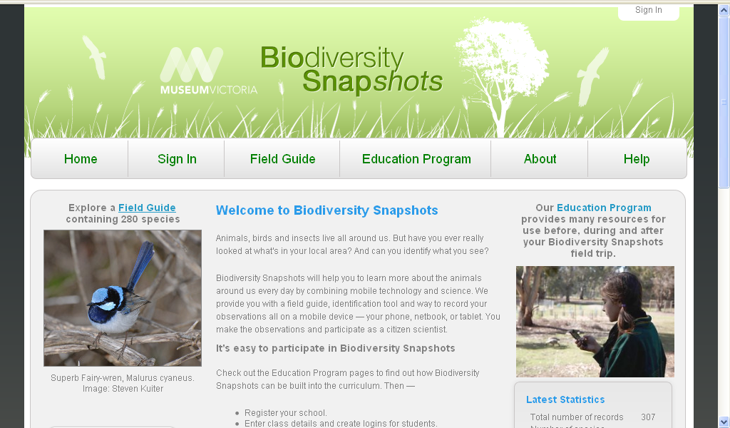
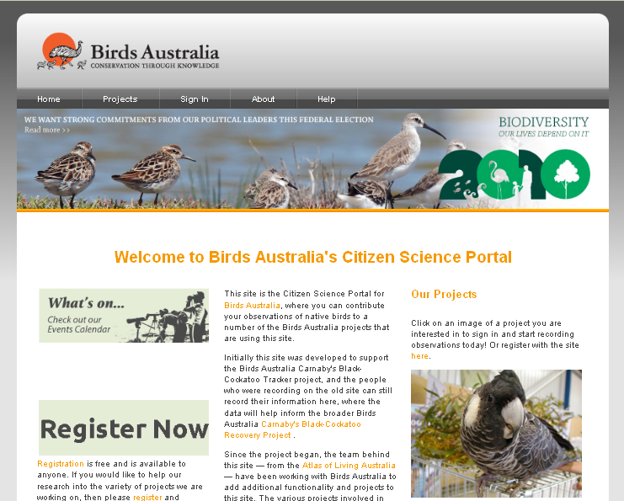
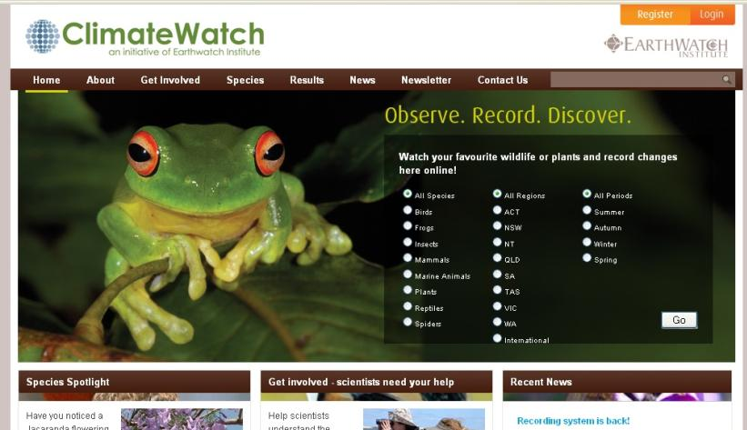
ATLAS OF LIVING AUSTRALIA
Our Sites so far…

Slide 5
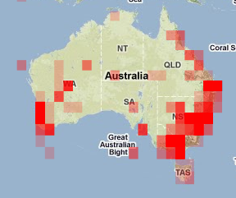
ATLAS OF LIVING AUSTRALIA
Who is using our Sites so far…?
Birds Australia – Birds Australia members, and the general public – 853 users, 4,300 records in 1 year.
Climatewatch – the general
public (recording across Australia)
Biodiversity Snapshots – teachers
and students in primary schools
in Victoria (6 schools, via Museum
Victoria)

Slide 6
FUNCTIONALITY
Overview
web
mobile
Field
Guide
Record a
Sighting
Record a
Sighting
Field
Guide
Identify
Tools
Review
Sightings
Review
Sightings
Identify
Tools
Teacher
& Class
Setup
Admin
Functions

Slide 7
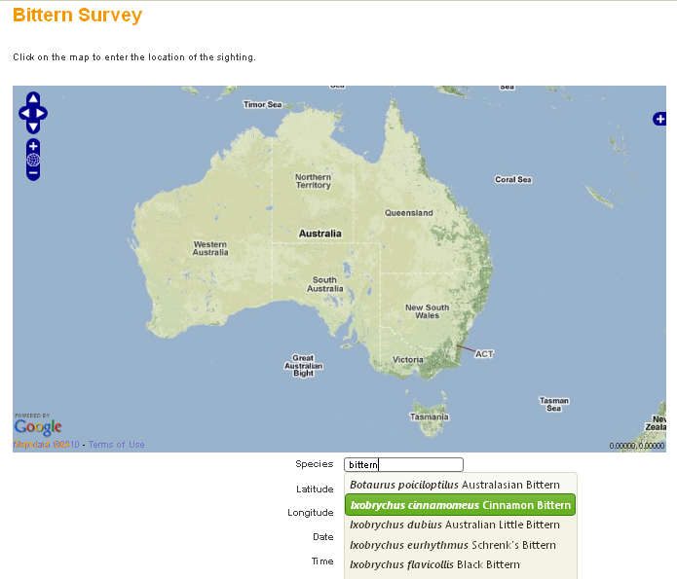
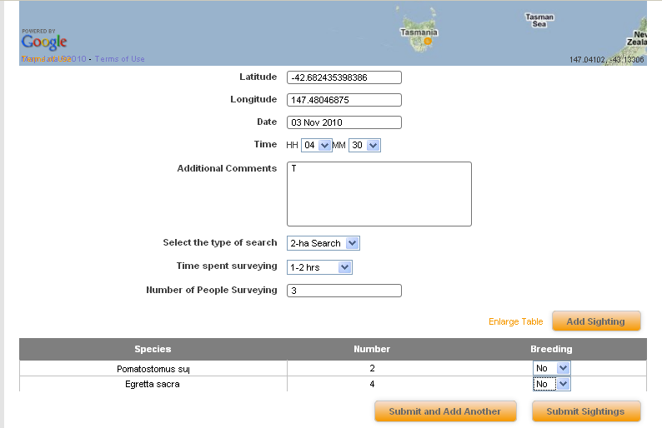
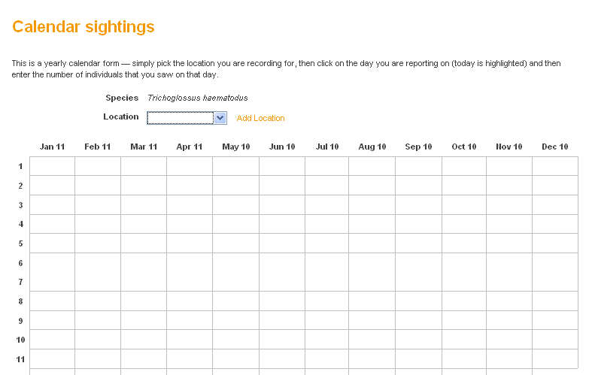
RECORD
1
2
3
Record an observation

Slide 8
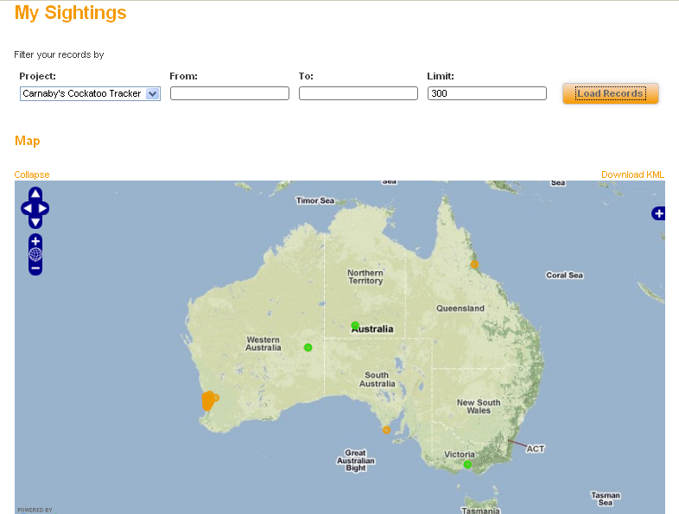
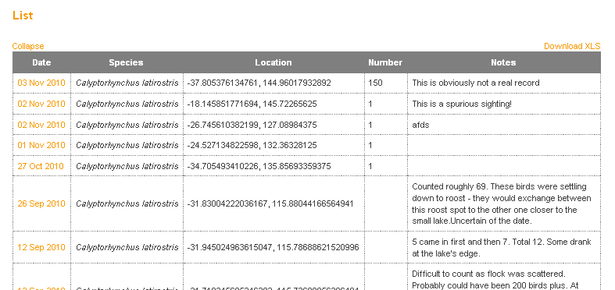
RECORD
1
Review your observations

Slide 9
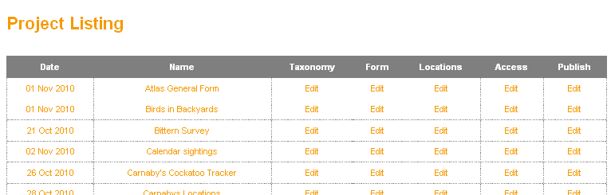
RECORD
1
Administration functions

Slide 10
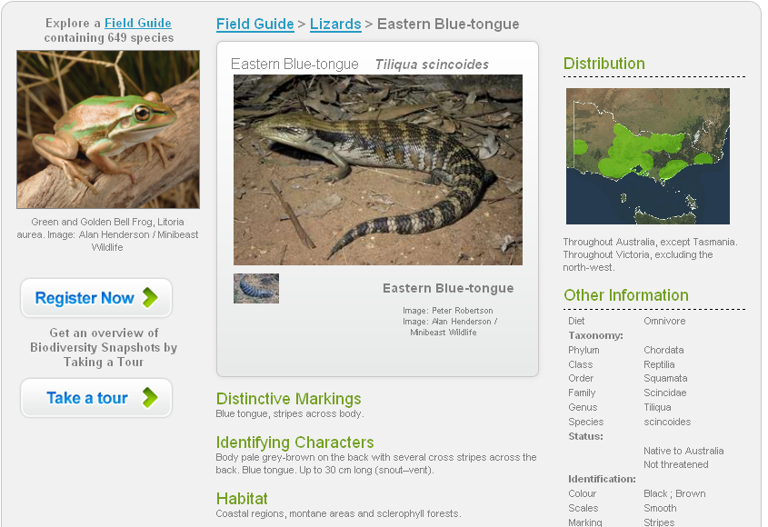
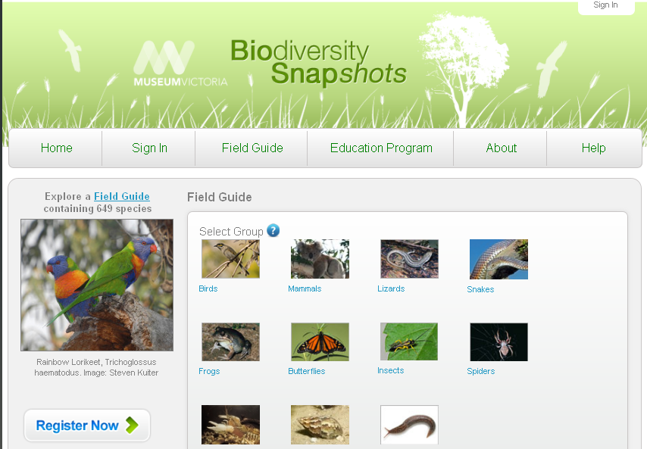
RECORD
1
Field Guide

Slide 11
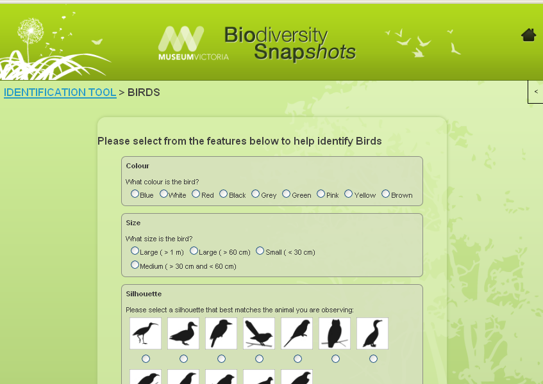
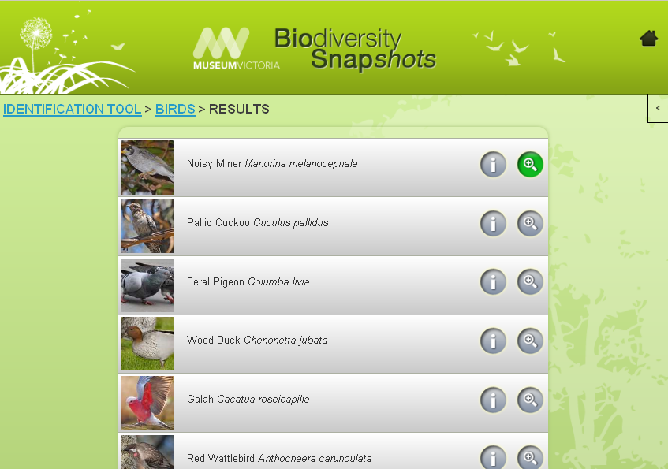
RECORD
1
Identify Tools
…

Slide 12
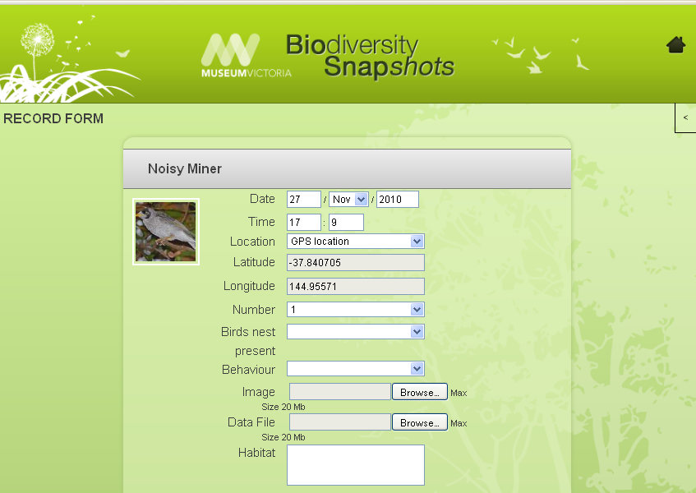
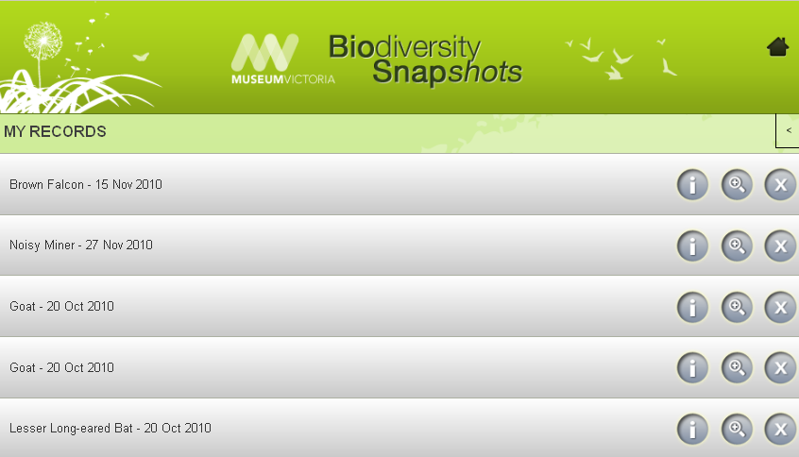
RECORD
1
Mobile Tools
…

Slide 13
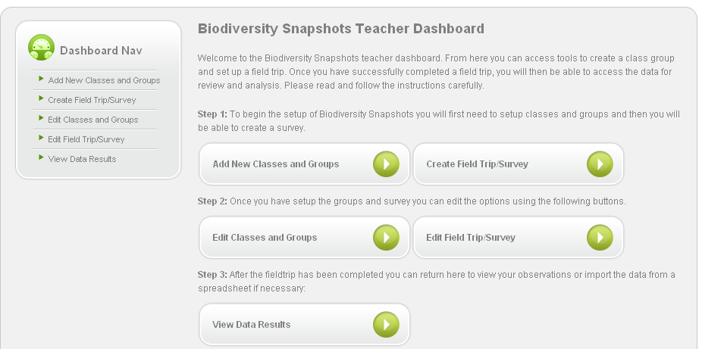
RECORD
1
Teacher and Class Setup
…

Slide 14
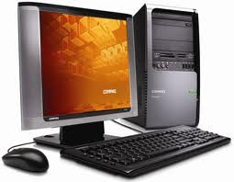

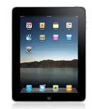
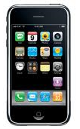
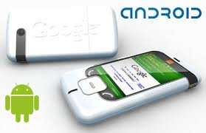
MOBILE
An end to platform dependence?
We have developed our mobile applications in HTML5, meaning:
It works on and offline
One code base works on many systems
Further work being done on other platforms

Slide 15
WHERE TO FROM HERE?
Thoughts on the future…
Open source software release (end of) March 2011
More ALA “citizen science” projects and programs coming on-line in the meantime, streamed as:
  Generic sites: naturalist groups, not-for-profit
  Educational sites: educational organisations
  Research sites: collecting institutions, research

Slide 16
WHERE TO FROM HERE?
Thoughts on the future…
On our schedule for the next few months:
  Atlas of Living Australia itself!
  TERN’s Ausplots Program
  Queensland Museum & Quest newspapers
  South Australian Government – end2end
  Australian National Wildlife Collection, Australian National Insect Collection, Australian National Herbarium, Bushblitz
  Commercial organisations as well using this system for biological data management

Slide 17
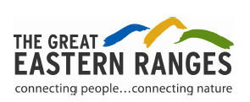
WHERE TO FROM HERE?
Thoughts on the future…
K2C Native Grassland
Ecosystem Monitoring
Southern Highlands
Flame Robin Story
K2C Reptile Surveys
Hunter Valley
Monitoring
K2C Threatened Eucalypts
Hunter Valley Bird Indicators
Border Ranges Site Assessments
Frogwatch
Waterwatch

Slide 18
QUESTIONS?
Questions? Comments?
Keep an eye on the ALA website
Contact Piers directly:
piers@gaiaresources.com.au
Office: 08 92277309
Mobile: 0411 754 006
Keep up to speed via our web site; blog, Twitter

