Slide 1

Environmentally Sustainable Australia
Atlas of Living Australia presentation to Environmentally Sustainable Australia Expert Working Group
Donald Hobern, Donald.Hobern@csiro.au
Director, Atlas of Living Australia
Canberra, 24 February 2011

Slide 2
ALA - current investment
Australian Government funding to June 2012
  NCRIS 2006-2011: $8.2M
  EIF Super Science 2009-2012: $30.0M
  ALA partner in-kind contributions: $26.5M
Mission
  To develop an authoritative, freely accessible, distributed and federated biodiversity data management system
Partners
Representative bodies:
  Council of Heads of Australasian Herbaria
  Council of Heads of Australian Faunal Collections
  Council of Heads of Australian Entomological Collections
  Council of Heads of Australian Collections of Microorganisms
  Council of Australasian Museum Directors
State museums:
  Australian Museum
  Museum and Art Gallery of the Northern Territory
  Museum Victoria
  Queensland Museum
  South Australian Museum
  Tasmanian Museum and Art Gallery
  Western Australian Museum
Government:
  CSIRO – lead agent
  Department of the Environment, Water, Heritage and the Arts
  Department of Agriculture, Fisheries and Forestry
Universities:
  Southern Cross University
  University of Adelaide

Slide 3
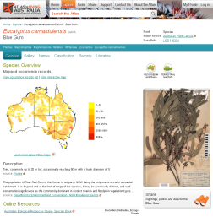
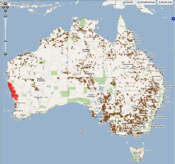
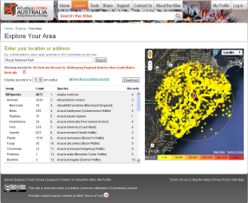
ALA Resources and Services
Species Names & Classification
ABRS
CHAH
Available
Development
Planning
Digital Literature
Biodiversity Heritage Library, Journals, Species Pages
Taxonomic and ecological research, Conservation, Biosecurity
Geospatial Context
Gazetteers, Climate, Geology, Land-use, Etc.
Images and Multimedia
MorphBank and other image libraries
GIS products
Species overviews
Regional reporting
Data normalisation,
validation and cleansing
Species information
Statutory Lists
Conservation &
Biosecurity Agencies
Identification Keys
IdentifyLife (Lucid, DELTA, dichotomous keys, etc.)
Aggregated occurrence data
Specimen Data
Natural History Collections
AVH, OZCAM, APPD, AMRiN, OBIS
Monitoring Data
Government
TERN/IMOS
Resource Managers
Observations
Birds Australia
EarthWatch
Citizen Science
Flickr
User Feedback
Annotations, Corrections,
Quality Review
Molecular Data
Barcode of Life,
GenBank

Slide 4
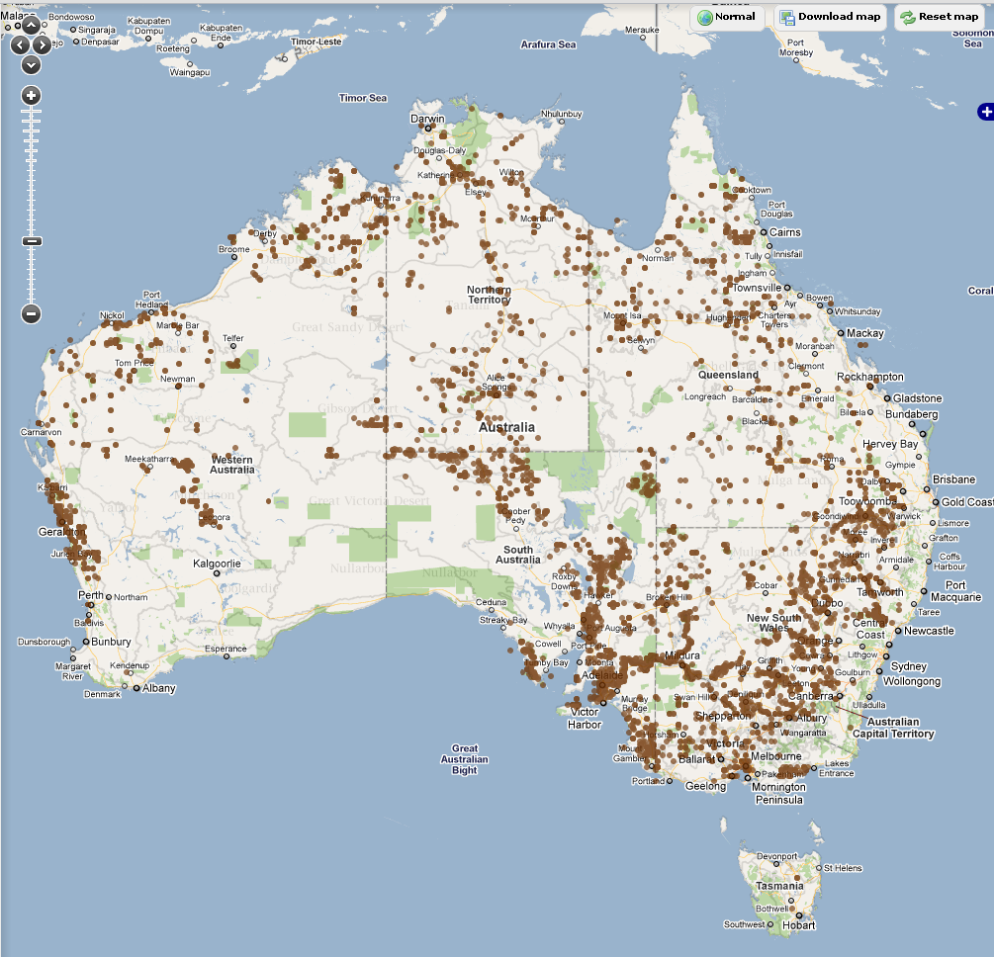
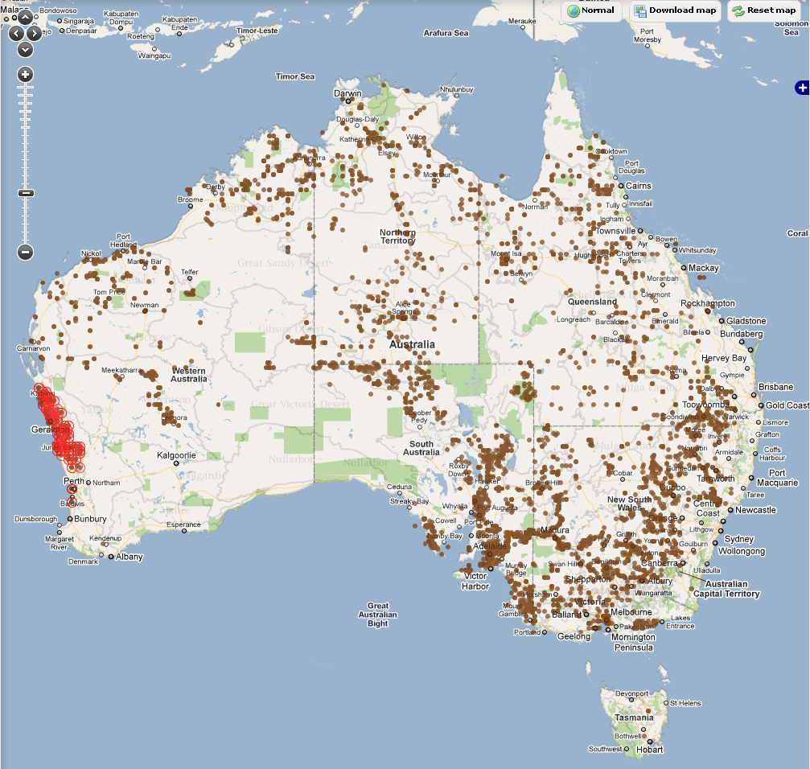
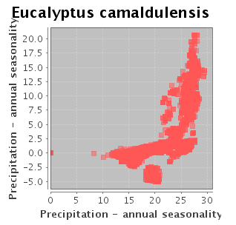
Example – environmental exploration
Map localities onto environmental parameters
Temperature – annual mean (Bio01)
Eucalyptus camaldulensis records
Select records by environmental envelope

Slide 5
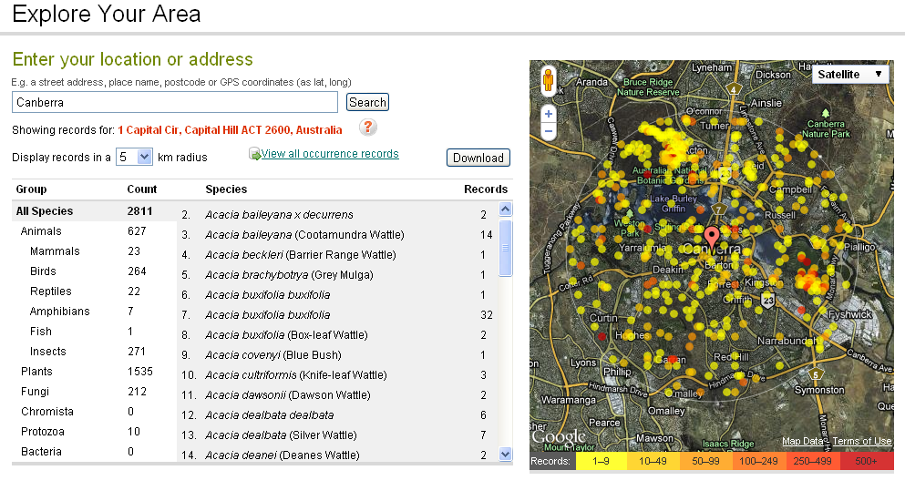
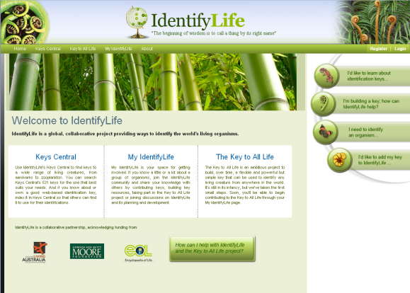
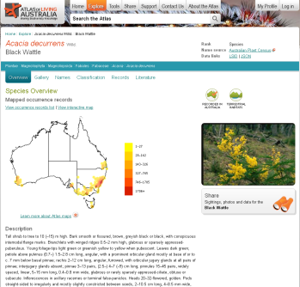
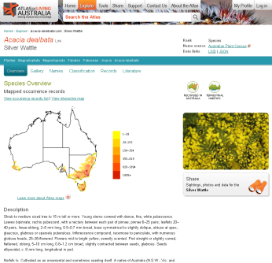
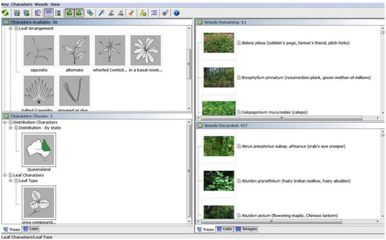
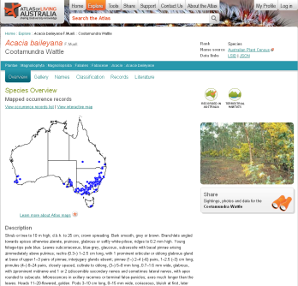
Example – contextual identification
List of Acacia species in area
Key to listed species
Links to aggregated species information

Slide 6
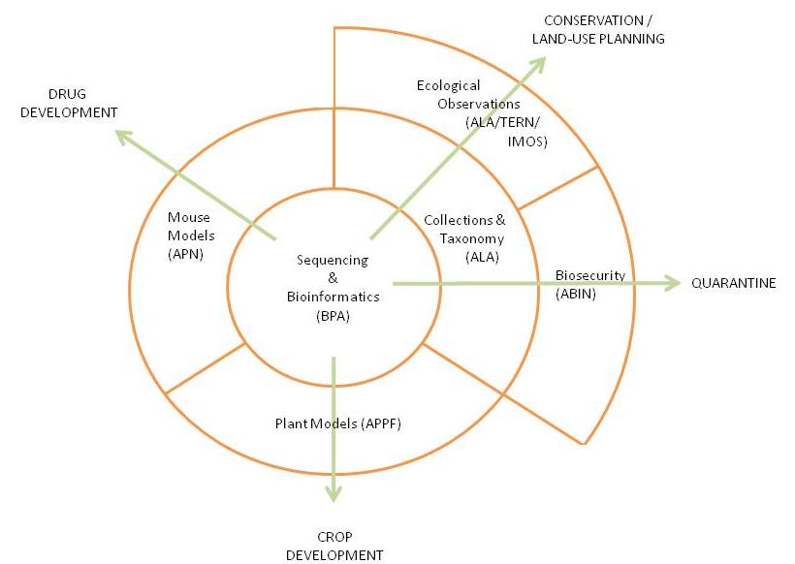
Broader NCRIS linkages

Slide 7
Environmentally Sustainable Australia
Aggregation of information on all Australian taxa
  Includes native and non-native, marine and terrestrial
Integrated data management
  Occurrence data from all sources
  Consistent management, quality control and presentation
  Faceted exploration of data (by species, data source, etc.)
  Integration with environmental data
  Data download
  Platform for integrating analytical software
Support for citizen science and community involvement
  Field observations
  Reports and tools for land managers and communities
Close linkages with TERN and IMOS
  Common data standards and software components
  Liaison in developing common architecture

Slide 8














