Slide 1
Digitisation of primary biodiversity data in natural history collections
John Tann
john.tann@austmus.gov.au
Kolkata, June 2011
The Atlas is funded by the Australian Government under the National Collaborative Research Infrastructure Strategy
and further supported by the Super Science Initiative of the Education Investment Fund

Slide 2
Australian collections
Collections (z = 63) | Specimens held | % databased
Agriculture Plant Genetic Resources | 197,000 | 95%
DNA Collections | 350,000 | 2%
Fauna Collections - Insect | 17,808,710 | 9%
Fauna Collections – State/Major | 35,653,401 | 15%
Herbaria – State/Major | 6,742,460 | 65%
Herbaria – University & Specialist | 501,310 | 49%
Microbial Collections | 53,507 | 65%
TOTALS | 61,306,388 | 20%
ABIF estimates February 2011

Slide 3
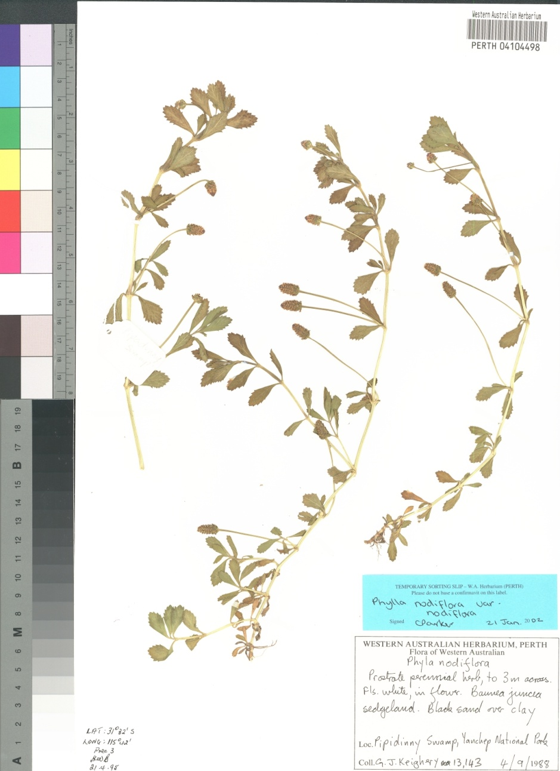
Herbarium sheets
Notes:
ALA will be setting up specialist imaging centres in selected cities, or providing specialist equipment to be used within institutions. The prime aim will be rapid throughput of imaging.
Of significant taxonomic importance will be images of primary types.
Our first pilot will be with WA herbarium to photograph at high resolution, their set of WA type specimens. ALA will sponsor photographic equipment and associated software to capture and manage the images, WA herbarium will supply the labour.

Slide 4
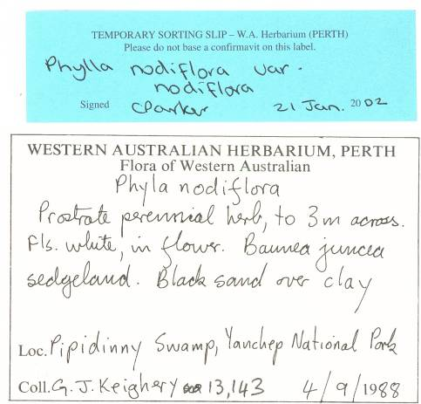
Herbarium sheets

Slide 5
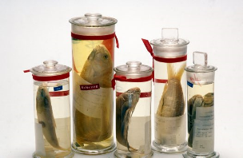
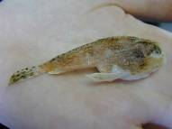
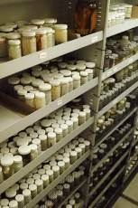
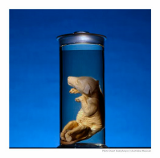
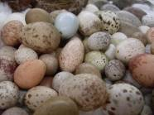
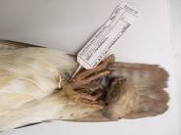
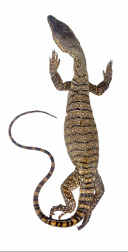
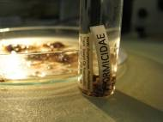
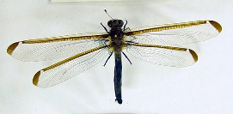
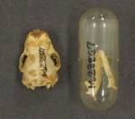
Museum specimens
Carl Bento, Australian Museum
Jason Armstrong, Australian Museum
Stuart Humphreys, Australian Museum
Brooke Carson-Ewart, Australian Museum
Australian Museum

Slide 6
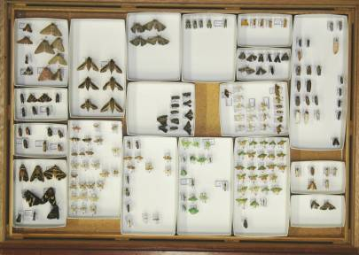
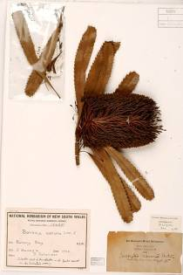
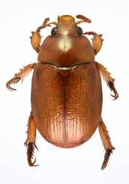
Imaging
Geoff Thompson, Queensland Museum
RBG Sydney
Imaging for diagnostics
Imaging for access
Imaging for preservation

Slide 7
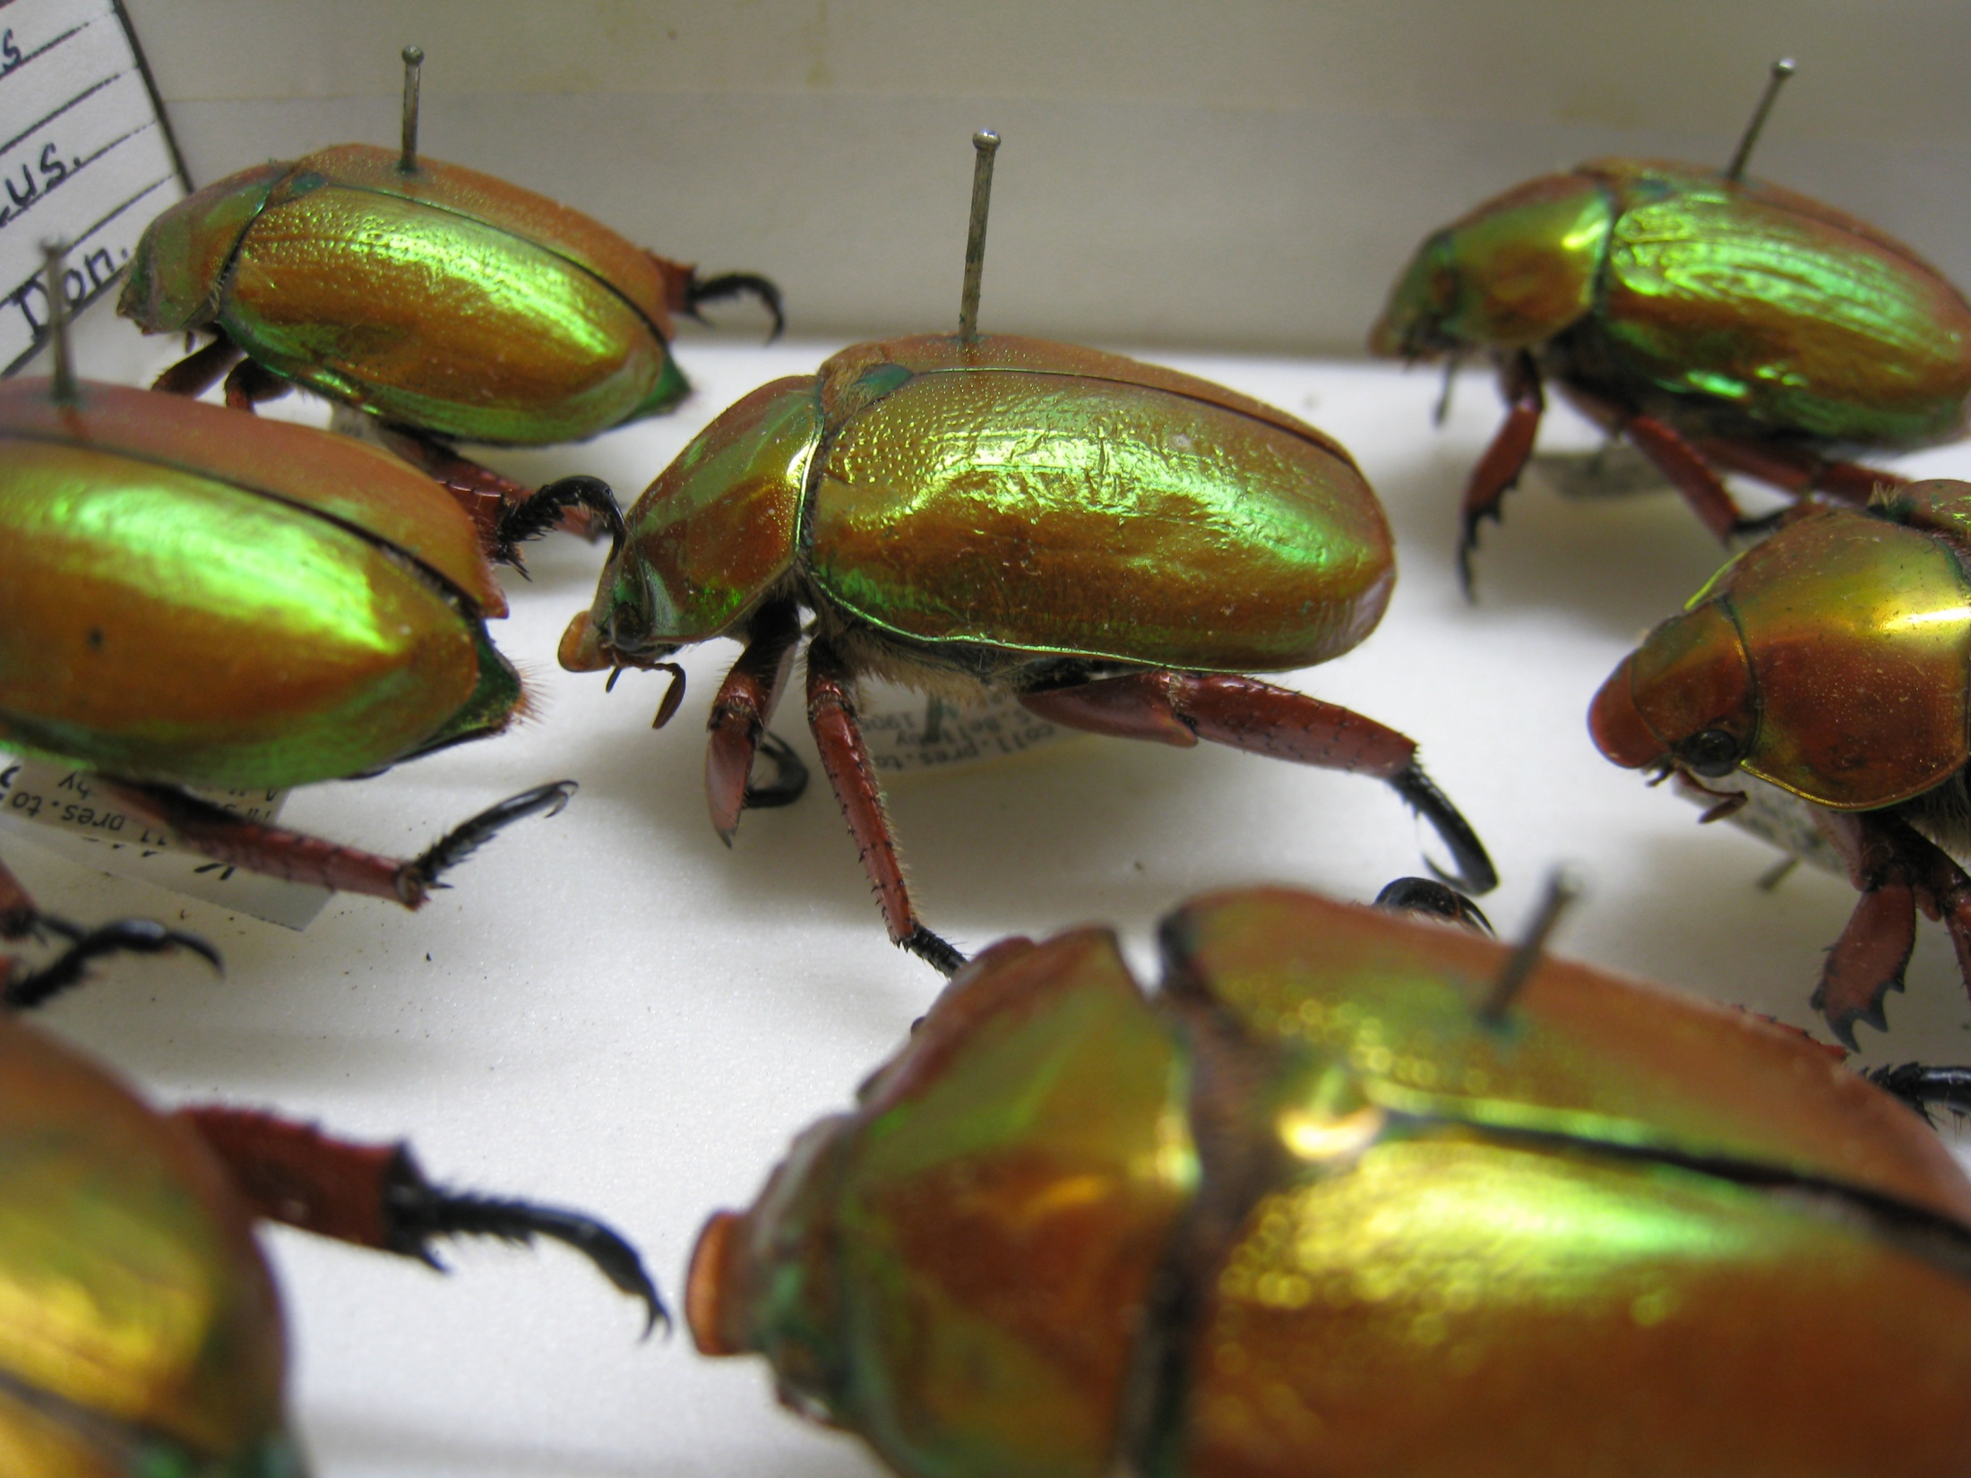
Notes:
Everything that we know about this beetle is on the label stuck to the pin.

Slide 8
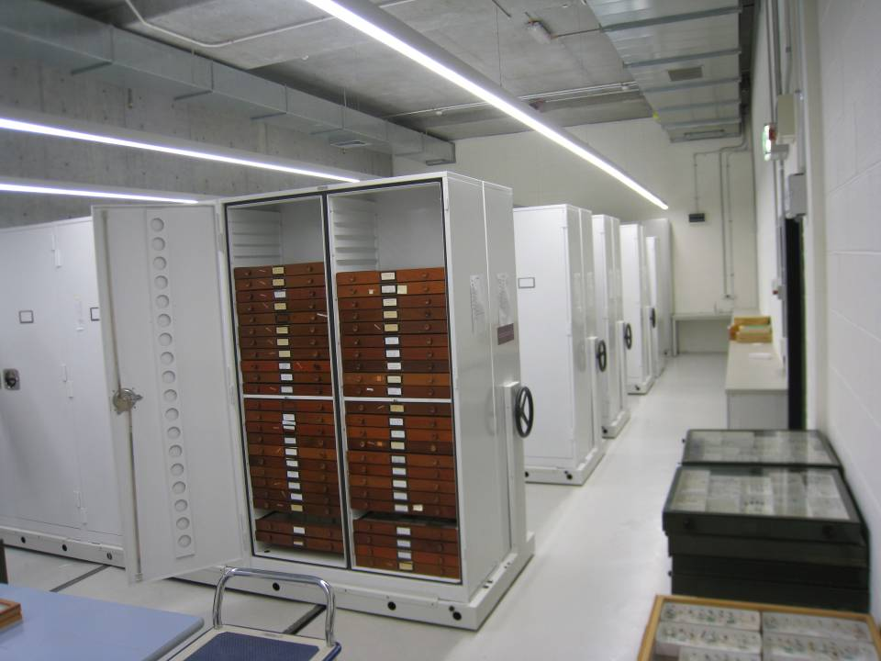
Notes:
That specimen
sits in a drawer
in a cabinet
in a room
in a museum
… that is locked up.

Slide 9
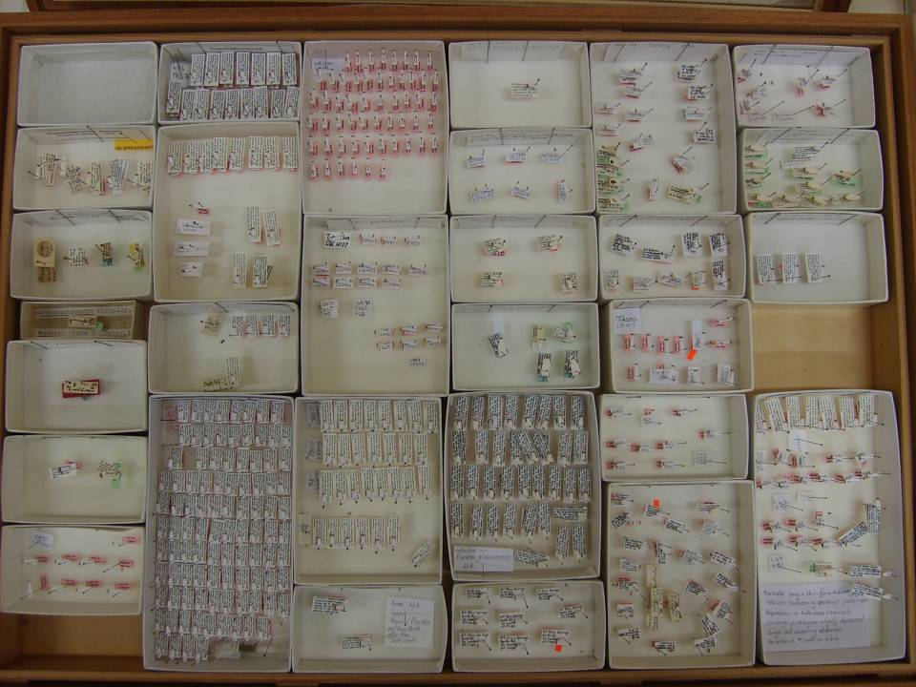
Notes:
Several hundred specimens in each drawer. Several rooms. And these are the insects …
I initially thought that I could take one high resolution photograph of a drawer, use some smart software to chop it up, OCR the text, feed into database. Job done.
Ha!

Slide 10
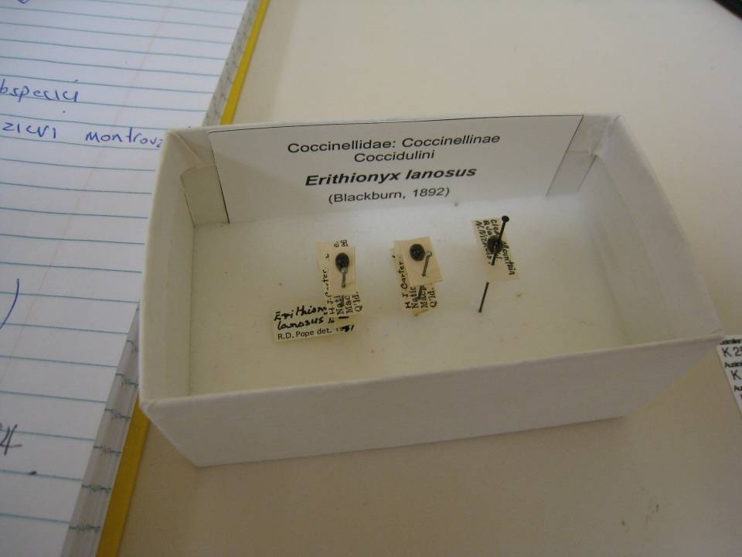
Notes:
First problem – labels sit under labels, under labels

Slide 11
Notes:
Second problem, coming back to the beetles, – labels are hidden

Slide 12
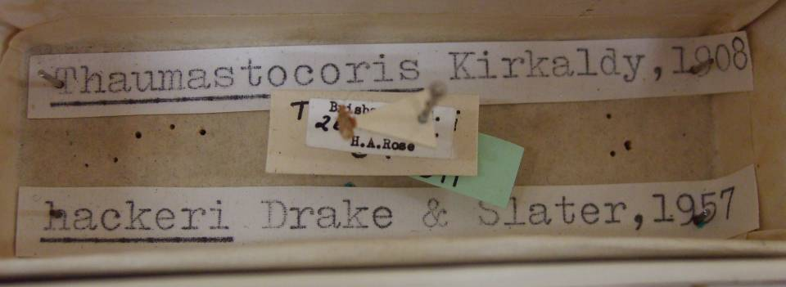
Notes:
Third, fourth problem – information appears in different places, the information is inconsistent, it needs some translation

Slide 13
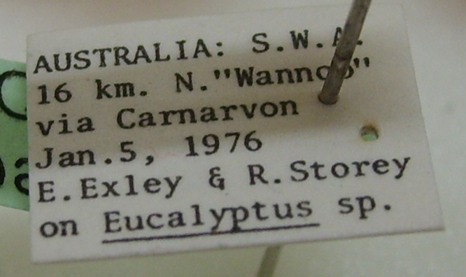
Notes:
Even if you get up close, the pin always gets in the way.
Labels, especially for insects, are very small, yet try to include a lot of information. Abbreviations are non-standard, information is not in a standard form, different labels hold different information.
Humans are good at this.

Slide 14
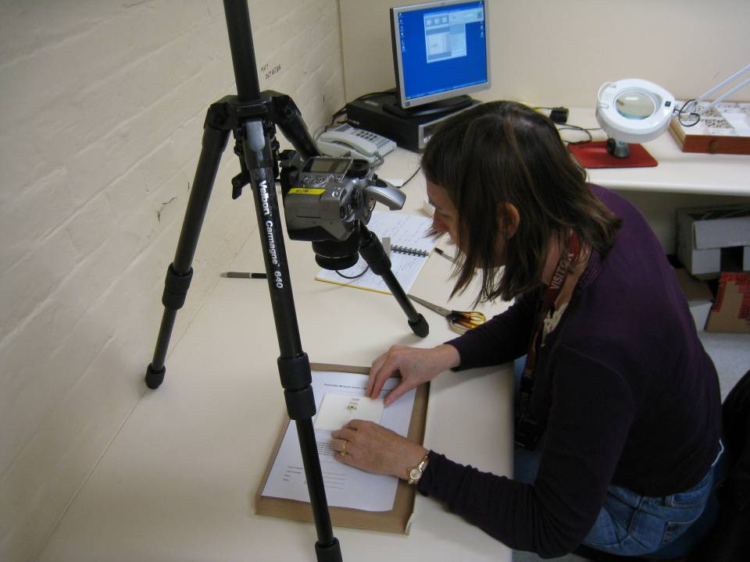
Notes:
Enter the volunteers.
Take each pin, pull off all the labels and take a photograph. Re-assemble.
Care and attention to detail is paramount. Speed is not important. (Of course, we measured speed, but it was important that there was no damage, and this was not rushed.)

Slide 15
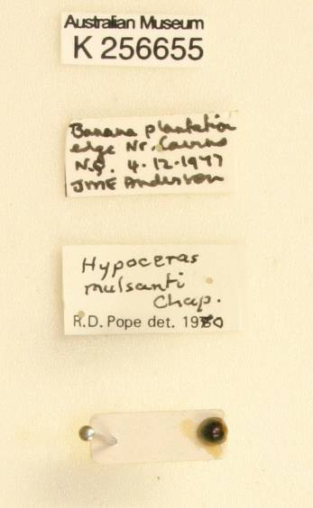
Notes:
A photograph of a label. Many are handwritten.
I wrote a script to OCR the text, grab the registration number, and add that registration number to the file name.
Result - a set of photographs that could be readily imported into EMu, the collections database.
This remains as a record of what is written on the label
This information in this photograph could then be sent to a computer – anywhere.

Slide 16
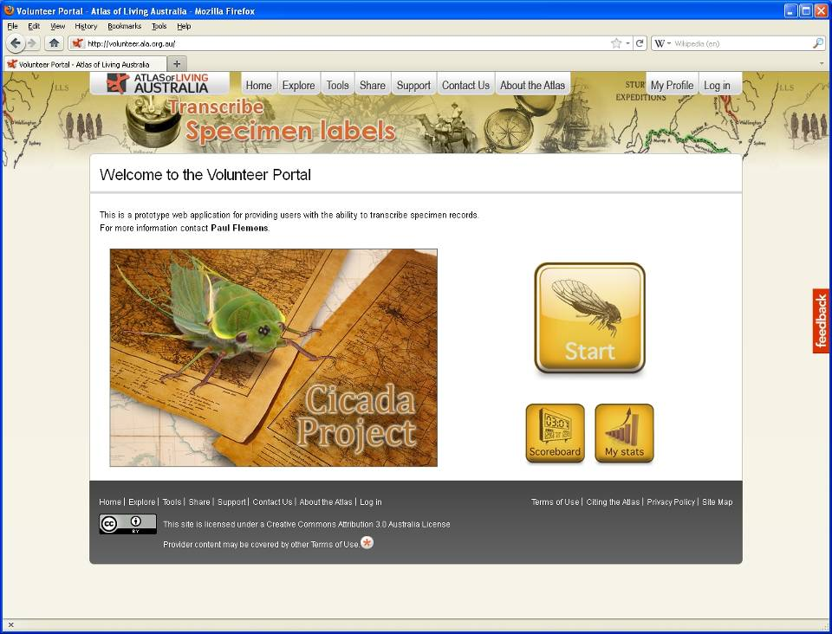
Notes:
Crowd sourcing
There are others:
* Herbarium @ home
* Galaxy zoo

Slide 17
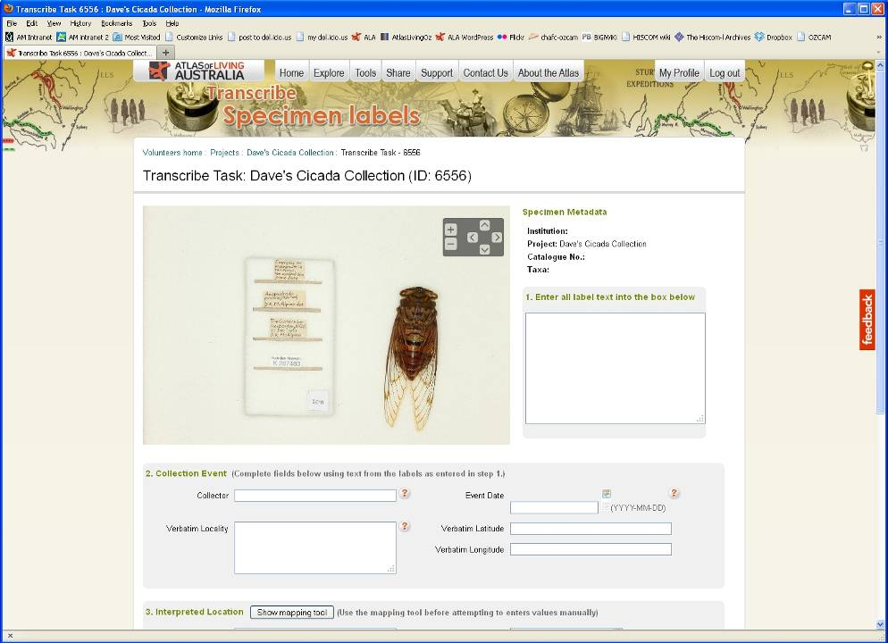
Notes:
Verbatim entry
Opportune image of specimen
Database entry is an interpretation
Creates access to specimen
A researcher needing this information can spend time completing details
… especially if this information can quickly be added to maps, etc

Slide 18
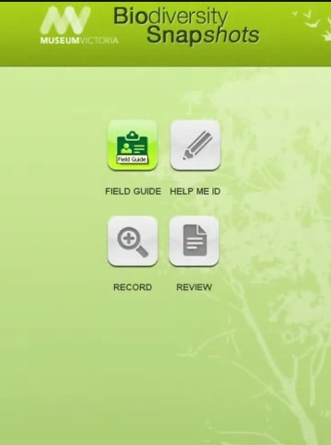
Field data capture
Initially targeted for Citizen Science and rebuilt for researchers
Web and mobile versions
Open Source
You define a project, including fields to collect.
Records captured can be viewed through website
Export records to your CMS
Administration through browser
Notes:
BDRS is software that you install on your computer
When you define a project – forms are created
The forms are downloaded to a mobile device
Record using the forms – mobile, web or app
View records on web

Slide 19
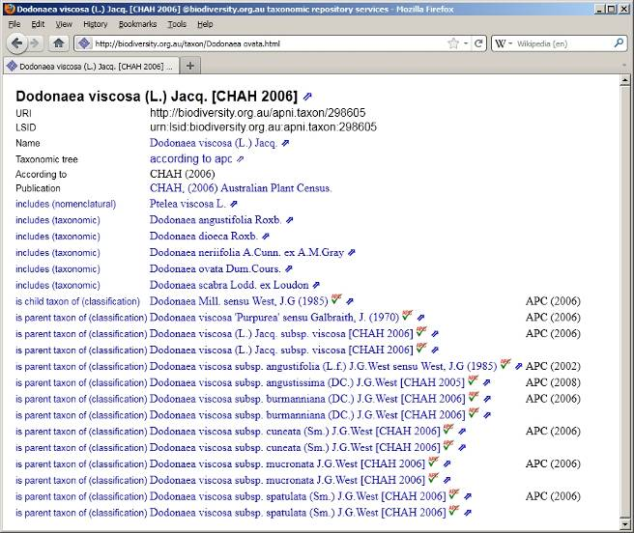
Names service
Notes:
Australian National Species Lists
Tow components:
Developing the web services
Filling out as much as possible
The Australian Plant Census (APC) and Australian Faunal Directory (AFD) represent the accepted classifications of species names for Australian plants and animals respectively.

Slide 20

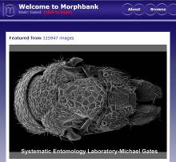

Supplementary projects
Specify 6
Open source Collection Management System
Morphbank
Image repository for biological science
GEOLocate
Georeferencing software and services
Notes:
ALA is promoting Specify 6 as software for management of collections
Morphbank is being re-worked with some support from ALA as an online image repository
GEOLocate can be used to translate text-based locality descriptions

Slide 21



















The Atlas of Living Australia Participants
Council of Heads of Australian Collections of Microorganisms
The Atlas is funded by the
Australian Government under the National Collaborative Research Infrastructure Strategy
and the Education Investment Fund
Notes:
ALA funding
One of several government supported projects – others are TERN, ARCS-ANDS
Funding from several sources, including in-kind from our partners to 2012
Primarily for research. With effects that flow on for policy making and natural resource management
17 partners – museums, herbaria in each state, national collections, some universities, government departments – DAFF, DSEWPaC

