Slide 1

User needs assessment and preparing a dissemination plan
John Tann
john.tann@austmus.gov.au
Kolkata, June 2011
The Atlas is funded by the Australian Government under the National Collaborative Research Infrastructure Strategy
and the Education Investment Fund
Notes:
The Atlas is a national initiative focused on making Australia’s biodiversity information more accessible and useable online, “an online encyclopedia of all living things in Australia”.
The website already holds 23 million distribution records for Australia’s fauna and flora, integrated with over 300 layers for mapping and analysis, as well as photos, maps, identification tools, reference species lists, literature and databases on biological collections.
The Atlas has now delivered its core infrastructure and some powerful new tools.
The Atlas can be used for biodiversity, biosecurity and ecological study, research and management.

Slide 2



















The Atlas of Living Australia Participants
Council of Heads of Australian Collections of Microorganisms
The Atlas is funded by the
Australian Government under the National Collaborative Research Infrastructure Strategy
and the Education Investment Fund
Notes:
ALA funding
One of several government supported projects – others are TERN, ARCS-ANDS
Funding from several sources, including in-kind from our partners to 2012
Primarily for research. With effects that flow on for policy making and natural resource management
17 partners – museums, herbaria in each state, national collections, some universities, government departments – DAFF, DSEWPaC

Slide 3
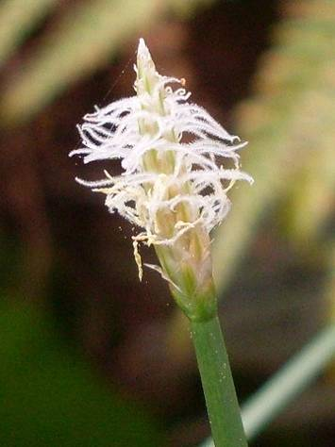
Principles
Open access to biodiversity information
Link users to original data providers
Support applied use of data
Adopt and promote international data standards
Develop open source software components
Notes:
Delivery

Slide 4
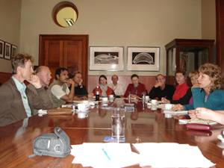
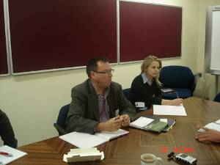
User Needs study
242 email survey responses
Workshops
20 in-depth interviews
Natural Resource Assessment longitudinal study
TDWG conference discussion sessions

Slide 5
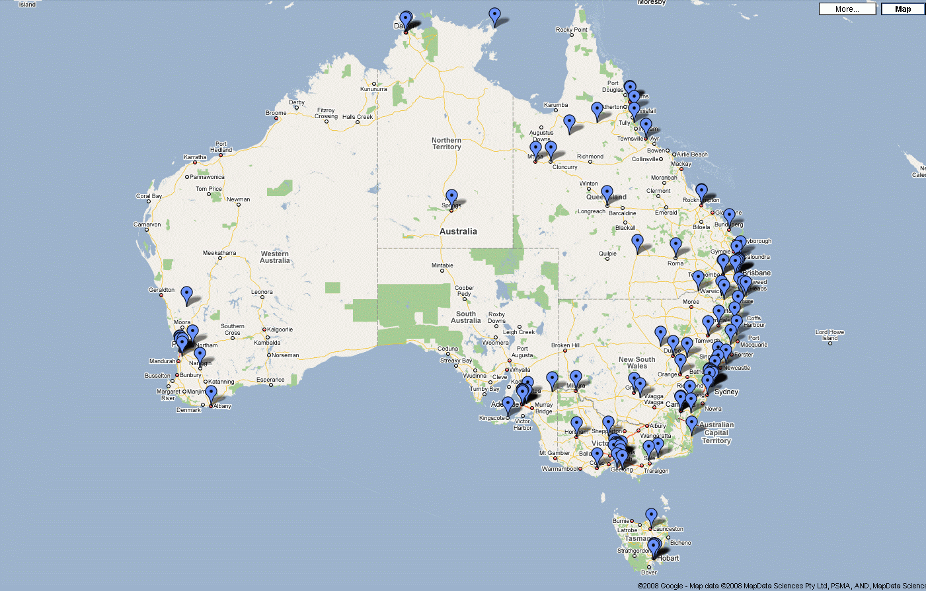
Email survey responses

Slide 6
Users of biodiversity data
Biologist
Botanist
Curator
DNA curator
Entomologist |  | Biosecurity officer
Ethnobotanist |  | Catchment officer
Ichthyologist |  | Community support
Invasives Researcher |  | Conservation officer
Mycologist |  | Ecologist
Ornithologist |  | Environmental consultant
Population modeller |  | Field naturalist
Spatial modeller |  | Fire consultant
Statistician |  | Horticulturalist
Taxonomic editor | Collection manager | Information curator
Taxonomist | Genetic Resource Manager | Media
Toxicologist | Land use planner | Military
Weeds researcher | Manager | Regeneration officer
Zoologist | Reserve manager | Restoration ecologist
Research | Policy and Management | Technical and Application

Slide 7
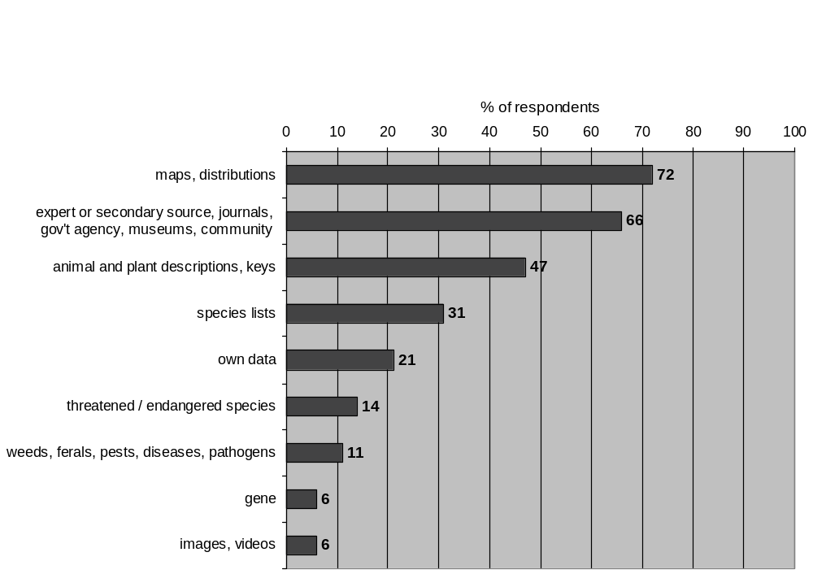
What biodiversity data do you use?

Slide 8
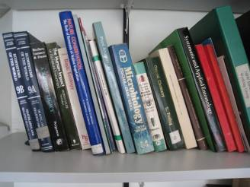


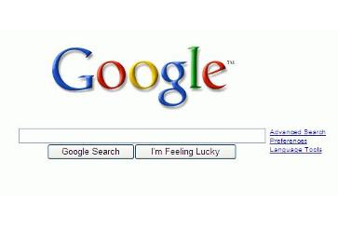
Data sources

Slide 9
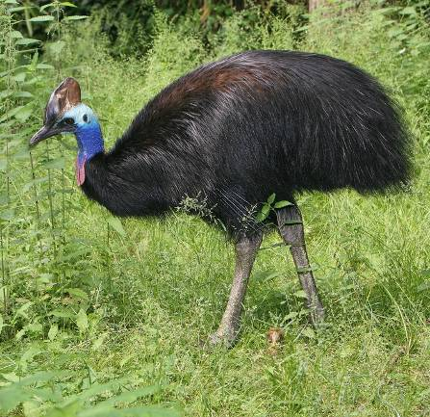
Example use case
Modelling cassowary habitat
Uses vegetation maps
Uses species presence data
Uses a local expert for species names
Sends DVD by mail
flickr.com/photos/ajhaverkamp

Slide 10
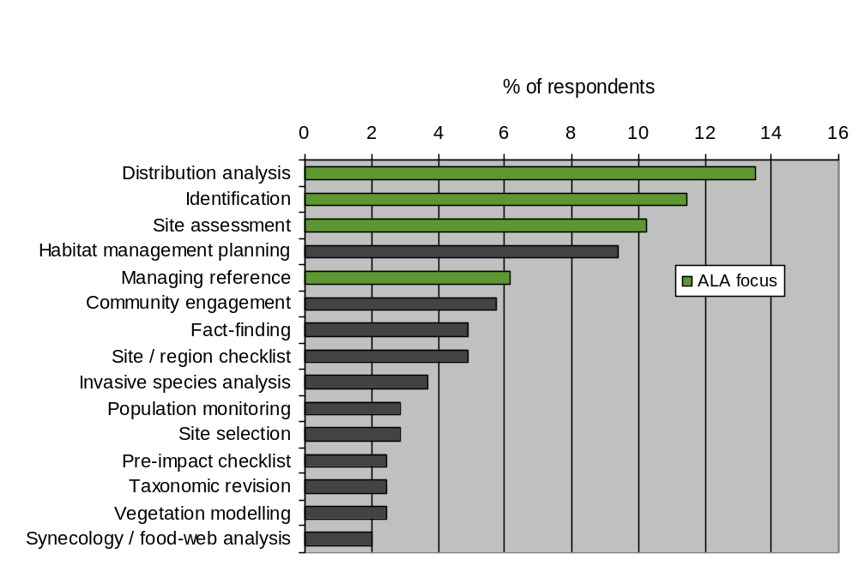
Major tasks

Slide 11
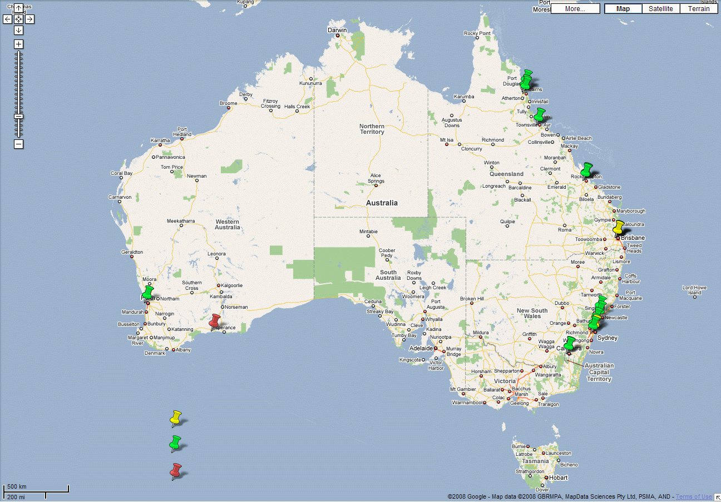
Workshops
Interviews
Longitudinal study

Slide 12
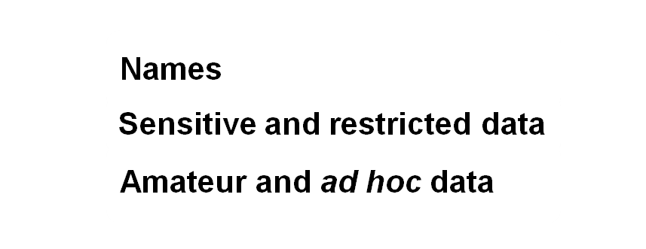
Workshops
Interviews
Longitudinal study

Slide 13
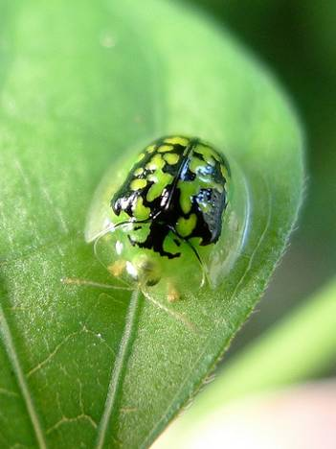

Names
What is the current name?
What is the name of this in other places?
I only know the common name...
Is an RSS feed available for name changes?

Slide 14
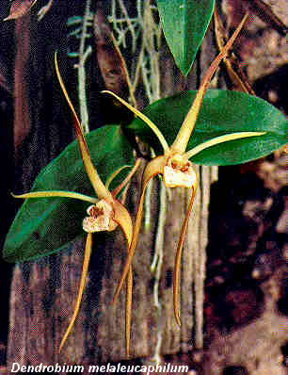
Sensitive data
Develop a rules-based Register of Sensitive Species
Develop a Sensitive Data Service
Develop a Sensitive Data Toolbox
© Greg Steenbeeke

Slide 15
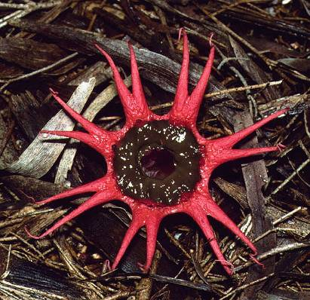
Amateur data
Variable quality
Often have good local knowledge
Lack professional support
Aseroe rubra Sydney Fungal Studies Group

Slide 16
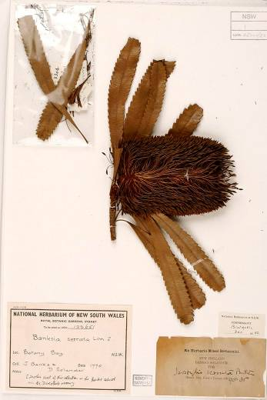
Desirable characteristics of data
Current
Accurate
Authoritative
Comprehensive
Well documented
National Herbarium of New South Wales
Notes:
Current – current accepted name
Accurate – locations, taxonomy
Authoritative – reliable source
Comprehensive
Well documented – metadata, validation processes

Slide 17
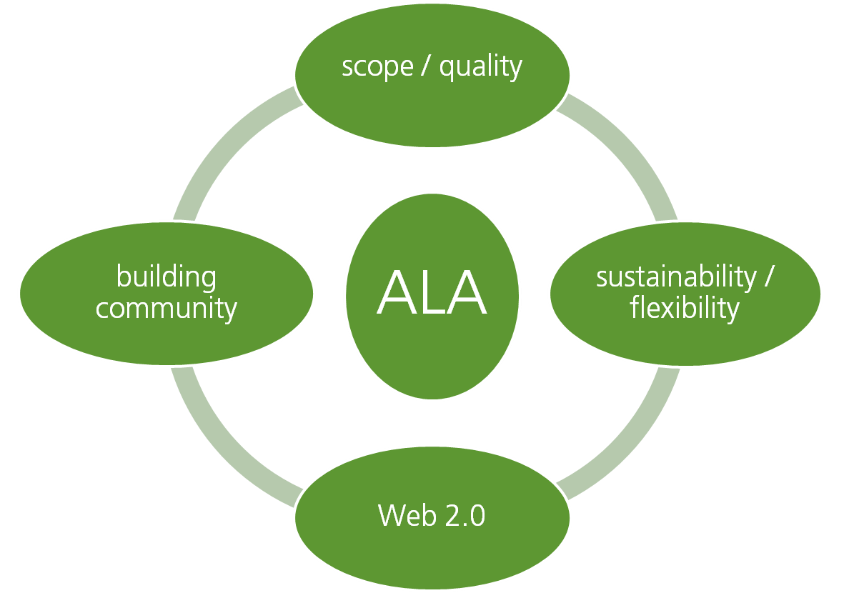
Bringing it all together
Notes:
Lynda, social scientist. Key to running the survey and the workshops. Very good at bringing people together and drawing ideas out.
Scope and quality – planning
Sustainability and flexibility – engineering
Building community – essential for the long-term success of a project
Web 2.0 – engaging using modern tools and methods

Slide 18






















Implementation
Uses (biosecurity, land-use, climate change, crop development, resource management, education, materials, forensics, taxonomy, etc.)
Regional Atlas
Biodiversity Information Explorer
Biosecurity Portal
Annotation Tools
Distribution
Metadata repository
Names and Classification
Links to international projects
Metadata (source, methods, ownership, access, etc.)
Data (collections, field observations, literature, molecular, images, expert knowledge, etc.)
Notes:
Bottom – many sources of information
Herbarium sheets, pinned specimens, microorganisms (fungi, bacteria, algae) field observations, published literature, molecular data, images, and people: experts, ecologists, researchers, taxonomists.
Top – potential users
Biosecurity, pests, land-use planning, climate change, agriculture, food production, health, education, forensics, taxonomy
In between – there has often been a significant gap. Difficulties with data being scattered, difficult to find.
ALA is building the in-between.

Slide 19
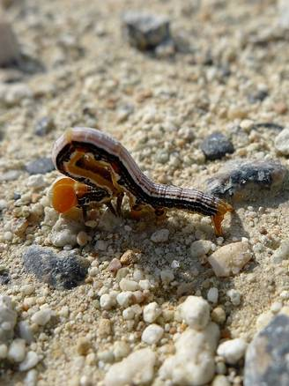
Key goals for ALA
Provide services to integrate information about Australia’s biodiversity:
Cataloguing biodiversity databases (including specimens, names, sequences, etc.), digital literature, images, and other online resources
Providing intelligent search interfaces for locating and retrieving these resources
Integrated handling of specimen and observational data for all taxonomic groups
GIS services based on the available specimen and observational data
Simplified models for institutions to share their data
Reusable web services for nomenclatural and taxonomic information
Tools for data validation and cleaning, and for handling user comments and feedback
Notes:
We expect to deliver tools and services in all of these areas. The issue underlying the priority setting process is that we need to reach the end of the funding period with some visible outputs (demonstration projects, if you like) which show the benefits that come from putting this kind of infrastructure in place.
If we can state that we have sophisticated mapping tools, but cannot point to any user groups who have benefitted materially from these tools, we will have failed.
If we develop fast, flexible interfaces for accessing taxonomic information and linking to a wide range of other data, but cannot show how this has benefitted officers engaged in biosecurity, land-use planning, conservation, or some other significant area, we will have failed.
If we trust simply to putting together whatever data and tools we can within the time frame and hope that we will have some grateful users, we are unlikely to have the impact we can foresee.
We therefore need, as a community, to agree that we will focus on a small number of additional high-interest, high-visibility showcase projects. This will not preclude us from integrating all other materials available to us, but this approach will help us to focus on critical users and on having some success stories to tell. If we do this well, it will be the best possible argument for additional funding for institutions to put more content online for all organismal groups.
As an indication, candidate projects could involve getting behind an existing taxon-oriented project such as Fishes of Australia Online to integrate ALA services with very rich content for a single group. Another option could be to work closely with a group such as the Murray-Darling Basin Authority to ensure that ALA-mediated data is integrated into their decision making. Another option might be to provide a well-integrated platform for digital images, organised taxonomically and morphologically (as with MorphBank) and incorporating services for user annotation. Another option might be a platform that simplifies the uploading and sharing of tabular data of various kinds (observations, checklists, ecological data sets), both from researchers and from the wider public. Others could address barcode data, biosecurity alerts, digital literature, etc.
We need to identify a small set of complementary showcase activities which highlight the power of our data in different areas and address real needs. At the same time,
we need to make the best possible use of the data and other resources which are already available in digital form, and
we need to capitalise on the many projects and other activities which are already under way and which can provide the context and rationale for what we do.

Slide 20
Prioritisation workshop
Questions for workshop participants
Are you already involved in any projects or partnerships which could form the basis for a powerful demonstration of what the ALA is trying to achieve (integrating data from multiple sources to address real questions)?
Can you suggest any other achievable projects or partnerships which would be worth considering?
Can you identify any taxonomic groups for which the network could provide rich and more or less comprehensive data, and for which there are clear user groups with high-profile interests?
Do you have any data sets or other information resources which could be integrated by the ALA (and of which we may still be unaware)?

Slide 21
ALA components
Australian National Checklists
Data Dissemination
Spatial Data Management
Web Services and User Interfaces
Biodiversity Information Explorer
Citizen Science Portal
Pest Information Portal
Conservation Portal
Spatial Portal
(Web GIS)
Completed National Checklists (AFD, APC, etc.)
Data Integration
Ontologies and Vocabularies
Metadata Repository
User Authentication and Identity Management
Annotation Services
Quality Control and
Sensitive Data Tools
Biological Data Cache
Legislative and Thematic Lists
Rich Data Stores
Descriptive Data (IdentifyLife)
Species Interactions
Images (MorphBank)
Sequences (BOLD)
Digital Literature (BHL)
Environmental Data Store
Directory of Taxonomic Expertise
Collection Data Management
Community Editing and Workflow Tools
Field Capture of Metadata
Accession Processing
Digitisation and Imaging Support
Database Integration Wrappers
Integrated Data Sets
Spatial Toolkit
AVH
APPD
OZCAM
AMRiN
OBIS
ALA Project Office
Notes:
ALA will deliver in six major component areas:
Australian National Species Checklists – shared infrastructure to manage and maintain biodiversity data sets on behalf of Australian institutions and projects.
Spatial Data Management – shared models, tools and services to ensure interoperability of all geospatial data accessed through ALA and compatibility with other NCRS projects.
Collection Data Management – tools and services to optimise the data supply chain through Australia’s natural history collections.
Rich Data Stores – shared infrastructure to manage and maintain biodiversity datasets on behalf of Australian institutions and projects.
Data Integration – core services to catalogue and index Australian biodiversity resources to maximise their accessibility and usefulness to researchers, policy-makers and the public.
Data Dissemination – web portals and applications to deliver biodiversity data to end-user communities.

