Slide 1

Data mobilisation
Components and Tools
Bryn Kingsford
brynk.ala@gmail.com
CSIRO Black Mountain, ALA Offices
March 2011
The Atlas is funded by the Australian Government under the National Collaborative Research Infrastructure Strategy
and further supported by the Super Science Initiative of the Education Investment Fund

Slide 2

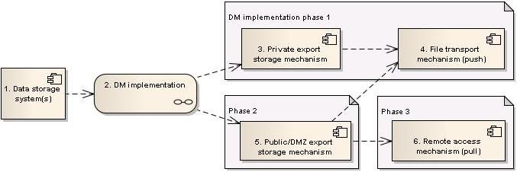
Data mobilisation components
(note: direction of arrows indicate flow of data)

Slide 3
1. Data storage system(s)
1. An organisation's Data storage system(s) are:
  the digital representation of their collection,
  a product of the data management process(es),
  potentially, the historical record of activity,
  potentially, a powerful ally in data cleansing and validation

Slide 4
1. Data storage system(s)
1. Some organisations Data storage system(s) :
  Collections management software:
  keEMU, Specify6, Morphbank, ...
  Bespoke systems:
  proprietary database back-end (ANWC, ANIC)
  Organic systems - the excel spreadsheet

Slide 5
2. DM Implementation
2. A Data Mobilisation implementation is:
  Preparation of data for sharing
  Mapping of data to a stable, well described form, ensuring full inclusion of concepts that support usability
  Mobilise data using methods most appropriate to the organisation - keeping future maintenance in mind

Slide 6
2.1 Implementation phase 1
2.1 Implementation phase 1 is:
  a functional prototype that meets the short-term goal to share data - the bare minimum,
  includes a private export-data storage mechanism (as distinct to the principle data storage system),
  as well as a push transport mechanism.

Slide 7
2.2 Implementation phase 2
2.2 Implementation phase 2 is:
  a migration of the private export storage data (component 3) to make it accessible to external parties and/or systems,
  pre-requisite for pull transport mechanism(s).

Slide 8
2.3 Implementation phase 3
2.3 Implementation phase 3 :
  requires firewall configuration to allow clients to access component 6 from outside the organisation's boundary,
  should involve IT security early on in the planning phase, as options may be excluded by organisational rules,
  may not be required.

Slide 9
3 Private export storage mechanism
3 Private export storage mechanism is:
  a method of accessing data in the storage system
  (tightly coupled to component 1),
  a method of manipulating and storing data accessed, to support a push of these data (component 4),
  built with a focus on maintenance by the data provider.

Slide 10
3 Private export storage mechanisms
3 Private export storage mechanisms :
  previous two full dumps, plus all partial updates in between and since (a "sliding window"),
  compressed text files, or a database snapshot,
  a HermesLite 'pitcher' instance.

Slide 11
4 File transport mechanism (push)
4 File transport mechanism is:
  one or more ways of sending the data stored in component 3 to one or more interested parties,
  chosen to suit an organisation's infrastructure.

Slide 12
4 File transport mechanisms (push)
4 File transport mechanisms :
  (s)FTP upload, (s)HTTP POST of file,
  Email, Dropbox,
  Post or courier of disc.

Slide 13
5 Public/DMZ storage mechanism
5 Public/DMZ export storage mechanism :
  consists of full or partial export of data in standard form,
  and a list of currently-valid record id's in standard form,
  includes logs of processes, copies of code, queries, schemata, etc. (necessary if an autopsy is required),
  exists with component 3, replaces, or enhances it.

Slide 14
5 Public/DMZ storage mechanism
5 Public/DMZ export storage mechanism :
  this storage is likely to be compressed text files,
  depending on the remote access mechanisms, these files may also populate a database,
  or a proprietary system generates this database, so text-files come from db-views instead (Vernon?).

Slide 15
6 Remote access mechanism (pull)
6 Remote access mechanism(s) :
  could offer a file-on-demand, a record-on-demand, or an interactive querying of the export store (component 5),
  may consist of one or more services for accessing data,
  are tightly coupled with component 5,
  present a higher-security concern for organisations.

Slide 16
6 Remote access mechanism (pull)
6 Remote access mechanism(s) :
  file-on-demand: GBIF-IPT, (s)HTTP or (s)FTP download
  record(s)-on-demand e.g. bespoke web-service for collection records, texxmlserver, WMS, ...
  interactive querying of the export store e.g.
  BioCASE, DiGIR, TAPIR

