Slide 1
What I Learned from Sneaking into the Video Game Industry
Greg Lane
Game Designer – Funtank LLC
October 8th, 2014

Slide 2
Is the Game Industry Right for Me?
Notes:
There can be a lot of crunch & overtime.
You can be laid off several times
You could be stuck in a ‘safe’ job that is unfulfilling.
Be prepared to have the magic spoiled (a bit)
You may get board of your passion.
Overall, ask if this is what you will fight for. Not everyone is a professional baseball player, but you can always join a rec league. Heck, you can join a rec league for kickball and that’s even better. You may find your happiness as a hobby.
Move in the direction of your most dominant thoughts.

Slide 3
Part I: Building Your CV
Is college important?
Should I just be focused on playing games?
Knowing your roles.
Years in the Industry vs. Game Titles
Game Jams
Expanding your genres.
Build It Yourself

Slide 4
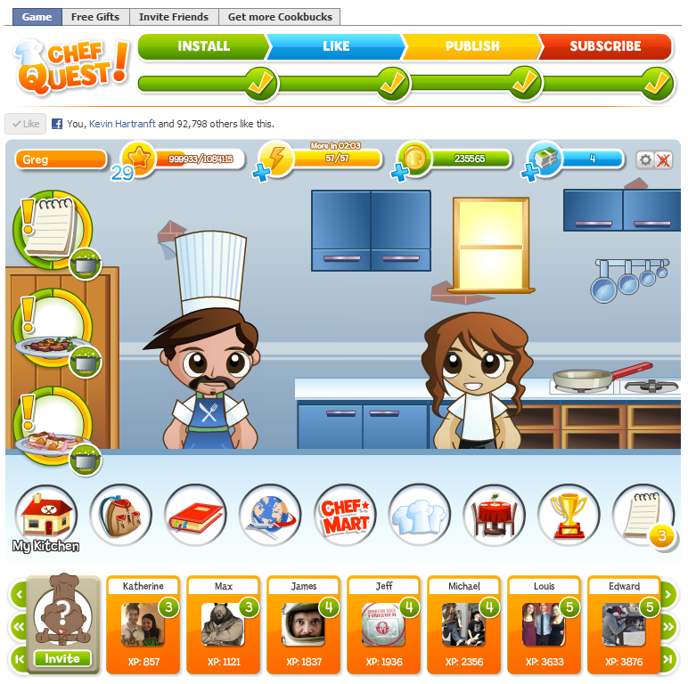
Is college important?
Notes:
Loaded question, and bold to be asking now. Here. At a university.
I did. I’m glad I went to college. I met my fiancée there.
It is difficult to pay for, even if you get a good job right away.
Study hard skills. I am a writer. I write and communicate well. If you study art, or study programming, you can always find a website to build or ad agency to design for. A degree in game design or other game-focused study may not be the best idea in the long run.

Slide 5
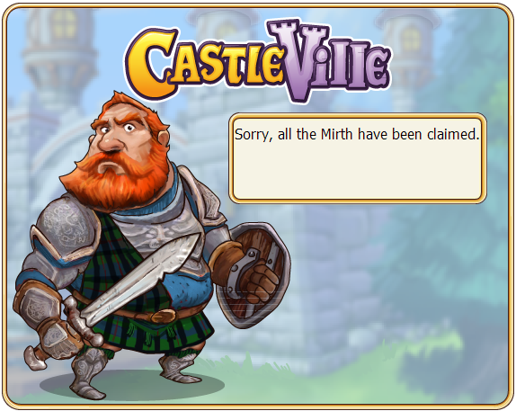
Should I just be focused on playing games?
Notes:
No! Think about how much content you create, vs. how much content you consume. Play games but don’t just play games.
Play Bad Games. They will teach you what to avoid! Plus, they’re usually cheaper!

Slide 6
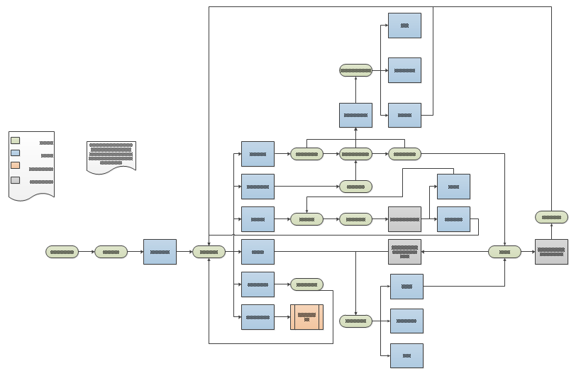
Knowing your roles.
Notes:
‘Designer’ and ‘Developer’ are thrown around a lot. Know if you want to program, do art, direct player experience, or build a team.
Be aware of the tools your desired profession uses. There is no such thing as an idea guy. Everyone is an idea guy. You wouldn’t be able to get out of bed, get dressed, or make an omelet if you didn’t have the idea to do so. Know how to communicate clearly (written and verbal), wireframe, use photoshop, and reason through psudo-code.

Slide 7
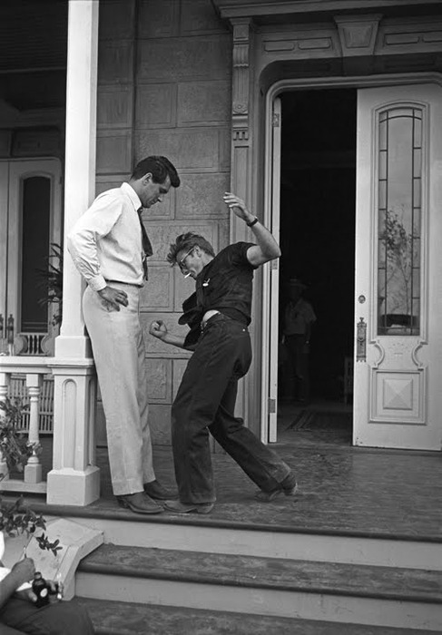
Years in the Industry vs. Game Titles
Notes:
The number of years you’ve done something is Rock Hudson in this photograph.
Your role, the number, and quality of game titles you’ve worked on is James Dean.
Now, Rock Hudson is a star for sure, but one of these things is going to win out.

Slide 8
Game Jams
Notes:
This is the clear winner. It ups your skillset, introduces you to other developers, and can even lead to game titles you can put on your CV!
This image is the emotional change as your do a game jam. I did the Indie Speed Run in January of 2013, and charted my emotional wellbeing throughout the event. I gave a talk about this experience earlier this summer at an event called Too Many Games. (celebrating its 10th year this year.)
I understand that Rutgers has a good jam scene, so keep your ears open and join in!

Slide 9
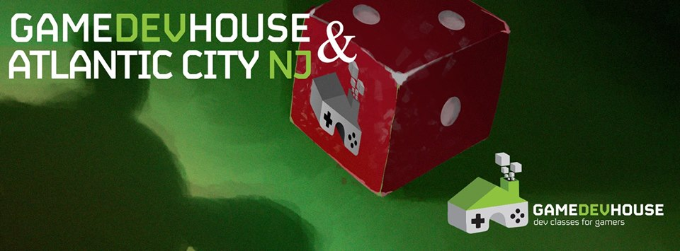
Expanding your genres.
Notes:
I started playtesting for Pen & Paper RPGs. I could volunteer for properties I liked (Firefly/Serenity) and add to my CV.
Teach. You show proficiency in your tools if you can teach. I mentored the “Spring Break Game Jam” this past spring. It was a great way to fight off the impostor syndrome. I also co-taught a 2 day course for teenagers about designing video games using Kodu.
Use Asset Stores, Like Unity & Construct 2. Sell art, music, and code. (I’’ve posted 2 sound FX packages to the Unity Asset store, and I get about 80 downloads a month.)
Write!
Share your experiences on Gamasutra, TIGsource, IndieDB, and /r/gaming.
You could also run a review blog or videos to deconstruct games. Egoraptor is a great example.

Slide 10
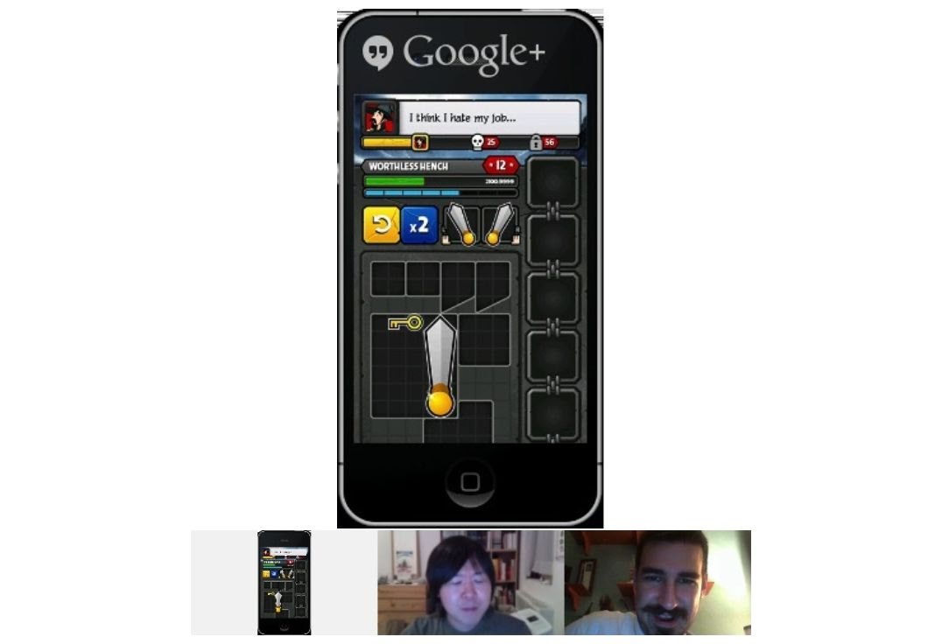
Build It Yourself
Notes:
Know your scope, and work small. It’s better to ship than to succumb to feature creep.
HOLY CRAP. YOU’RE AT A UNIVERSITY THAT HAS LICENSES TO ALL SORTS OF PROFESSIONAL TOOLS. THERE ARE ART GROUPS AND THEATER GROUPS AND WRITING GROUPS AND PROGRAMING GROUPS. Use this time. Work with all sorts of folks. Polish up one small great idea.

Slide 11
Part II: Understanding Your Regions
New York City
New Jersey
East Coast
Whole US
Global

Slide 12
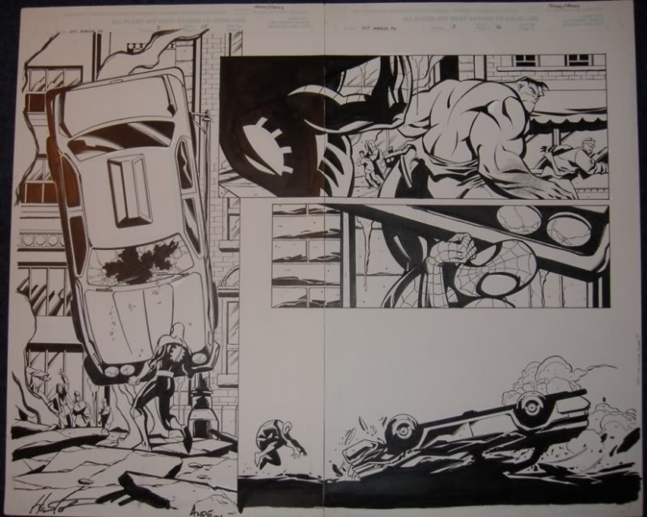
New York City
Notes:
If You Can Make it Here, You Can Make It….Very Few Other Places
History: ad agency -> digital ads -> interactive ads -> games(?)
Funtank LLC – run candystand.com worked on Facebook games. Got bought out, and now do…very little in the way of games. Honestly.
Avalanche (AAA - Mad Max)
Gameloft (Mobile Advergames)
Arkadium (Windows 8 Games)
NYU Game Center (Rides & Attractions)
…Babycastles (Hipster Games)

Slide 13
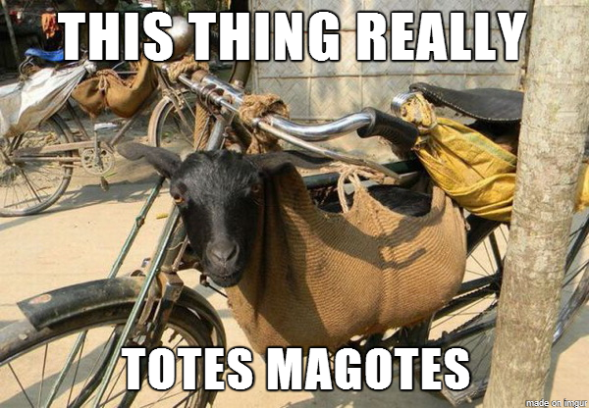
New Jersey
Notes:
Majesco (Cooking Mama, Dance Central)
Midnight City (Indie Publishing)
N-Fusion (Leisure Suit Larry [Remake])
GameDevHouse (Uh, sort of!)
Super Friendly IGDA meetups!
Small studios…
And Indie Devs, like me!

Slide 14
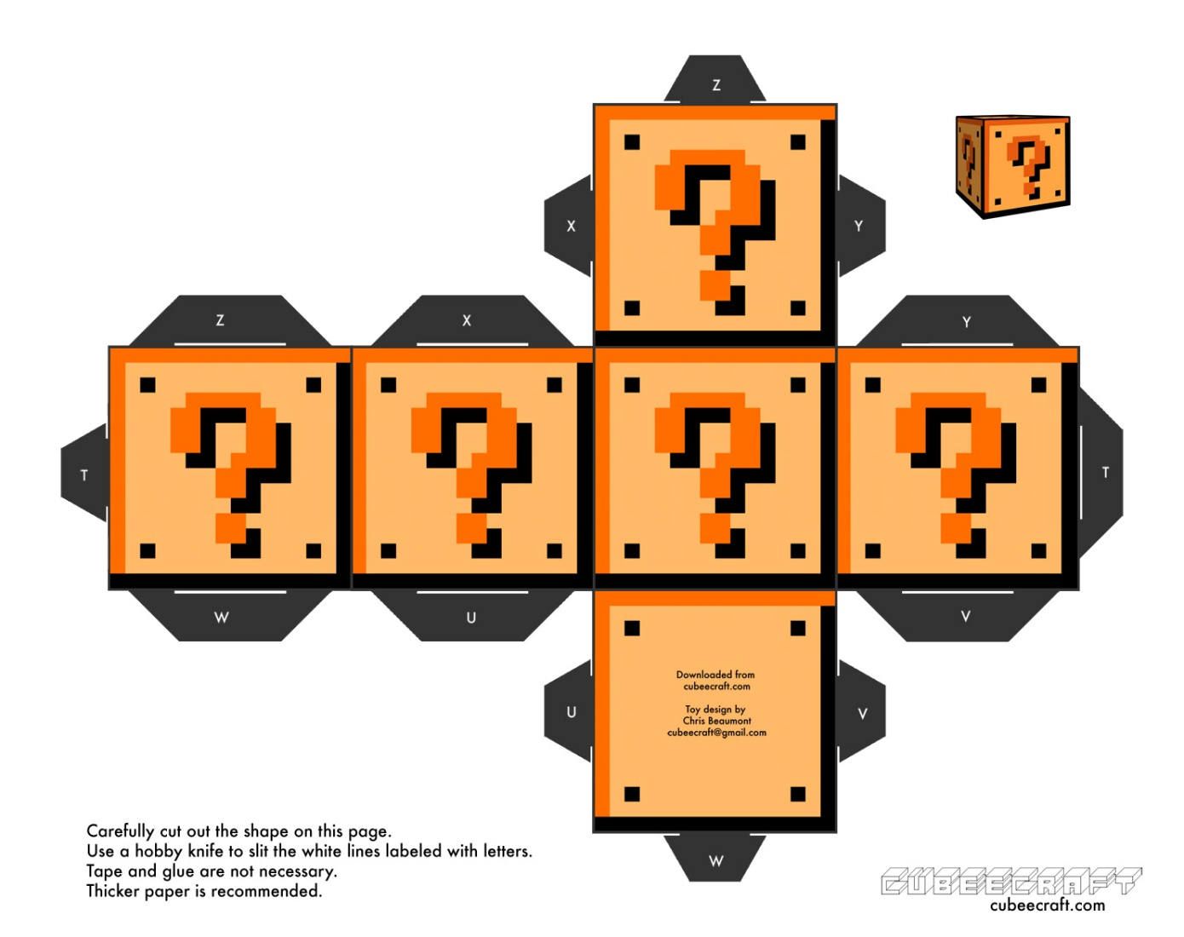
East Coast
Notes:
Massachusetts
Harmonix (Rock Band)
Hit Point (Hidden Object Games)
Otherside Entertainment (Ex-Looking Glass)
Maryland
Bethesda Softworks (Fallout, Elder Scrolls, etc…)
Zenimax Online Studio (ESO)
Firaxis (Sims)
Mohawk/Oxide/etc…
The Carolinas
Epic Games (Unreal Engine, Gears of War)
Boss Key Productions (Blue Steak)
Escapist Magazine (Game Journalism)
Pennsylvania
Philly is what New York wants to be. A handful of boutique studios.
Schell Games in Pittsburg (Children’s/Educational)

Slide 15
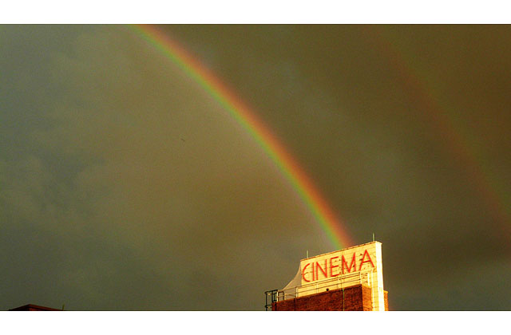
Whole US / Global
Notes:
Whole US:
California
Texas
Chicago / Wisconsin
Global:
Japan
England
Ireland
Germany
France
Brazil(?)

Slide 16
Part III: Knowing your Resources
Where to look for opportunity.
Friends & Colleagues
Online resource hubs

Slide 17
Where to look for opportunity.
Gamasutra Game Board
Linkedin
IndieDB, Craigslist, or other board – but buyer beware!

Slide 18
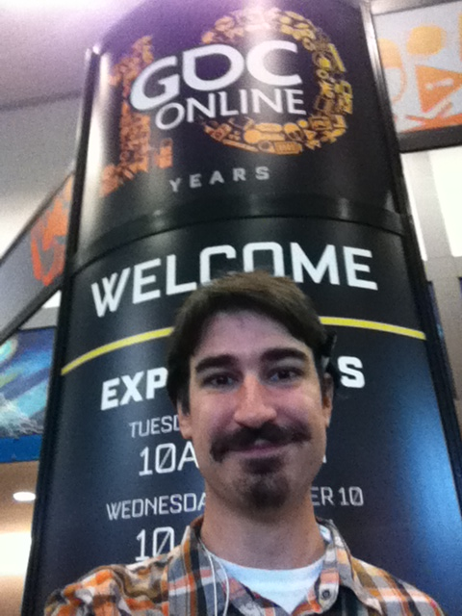
Friends & Colleagues
Notes:
…honestly, this is the answer. That’s why game jams & meetups are important!
I cold emailed every studio in New York City, New Jersey and Maryland. EVERY STUDIO. I went to some of these places in person. (Not a very successful tactic, but a good story.) From this, I was considered for an internship (which I didn’t get), met some producers, got to learn the overall shape of the industry, and got ONLY 1 interview.
Later on, at GDC Online (2012) I ran into someone who was impressed that I knew so much about the Maryland game industry. If I had the foresight at that point, I could have pushed harder to get into that scene.

Slide 19
Online resource hubs
GameDevMap (a bit outdated, but shows towns & studios)
CompoHub (Know what game jams are going on!
Linkedin (Establish your connections)
Krop (a free place for portfolios)
Gamasutra (Industry Articles, professional job board)
Facebook Groups: NJIGDA, NYC IGDA, NYC Indie Games, NYC Game Writers
Notes:
http://www.gamedevmap.com/
http://compohub.net/
http://www.linkedin.com/
http://www.krop.com/
http://www.gamasutra.com/

Slide 20
Questions/Comments?
Greg Lane
greg@funtank.com
fromdisaster@gmail.com
tinheart-interactive.tumblr.com

