Slide 1
Credit Card Fraud Analysis
Project Team Members: Kelly Carter, Sara Kleine-Kracht, Cory Lingerfelt, Greg Smith

Slide 2
Data Sources

Slide 3
Project Description and Research questions

Slide 4
Geography

Slide 5
Visualizations of geographic info

Slide 6
Victim Demographics

Slide 7
Visualizations of victim demographics

Slide 8
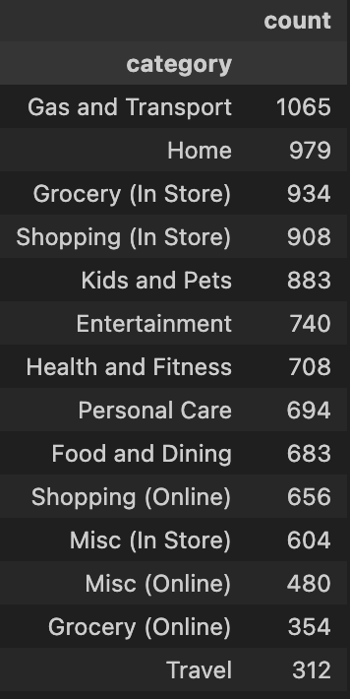
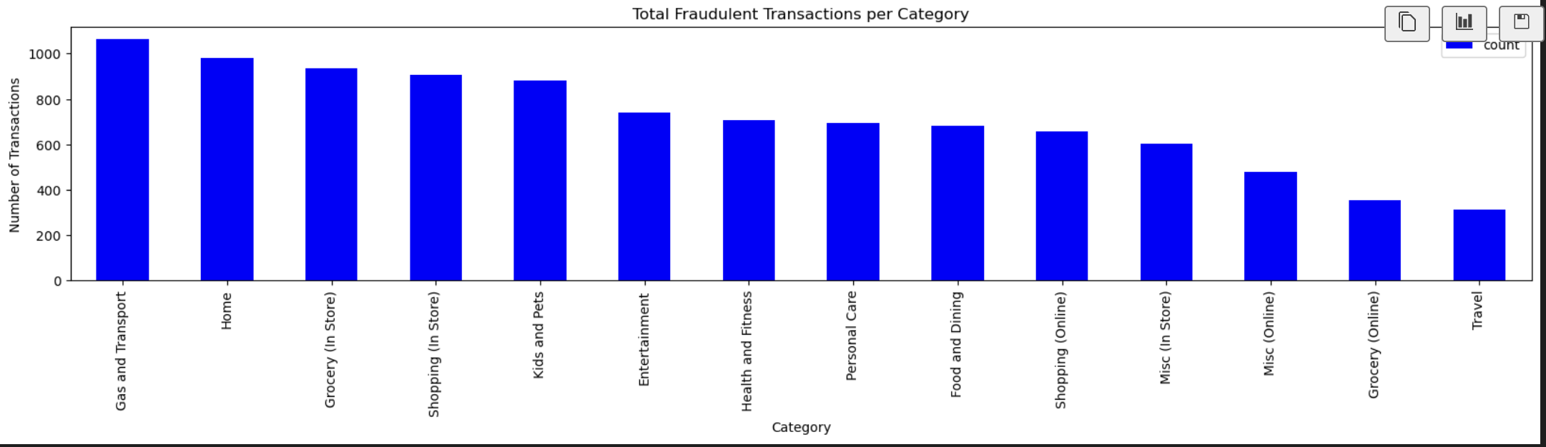
Fraudulent Merchant Categories
When analyzing the category types from the fraud dataset, we wanted to find the category that had the highest number of fraudulent transactions and which category accounted for the highest amount of loss
Gas and Transport was the merchant category with the highest frequency of fraudulent credit card transactions
Travel was the merchant category with the lowest frequency of fraudulent credit card transactions.

Slide 9
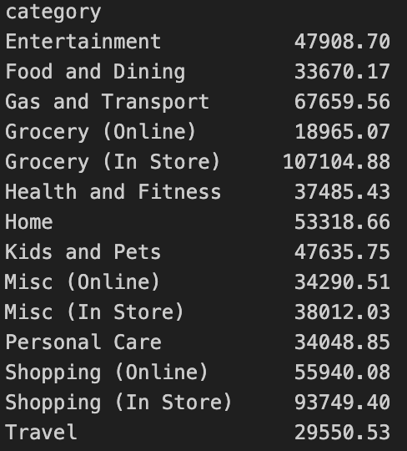
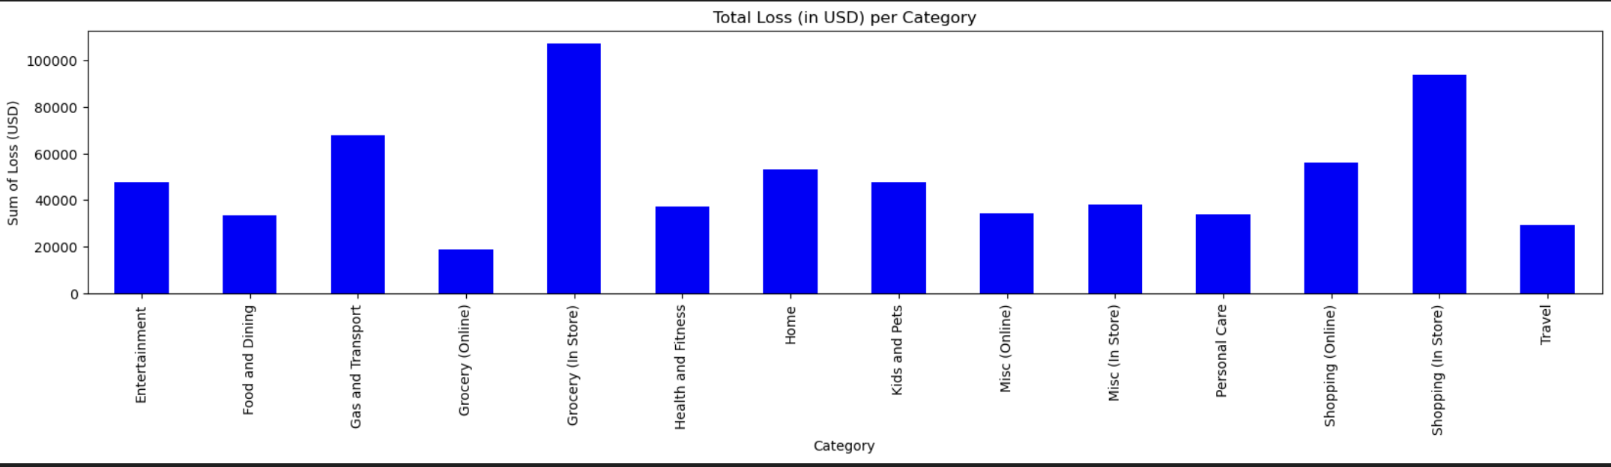
Fraudulent Merchant Categories
The Grocery (In Store) category accounted for the highest dollar amount lost through fraudulent transactions with $107,104.88
The Grocery (Online) category had the lowest total loss in dollars with $18,965.07.

Slide 10
Transaction Timing

Slide 11
Visualizations of transaction timing

Slide 12
Conclusion

