Slide 1

Smart City Waste Management [Text Data and Images]."
Team of members:
Sailesh
Atma Vidya Manoj
Rajesh

Slide 2
Abstract:
This project aims to develop a Smart Waste Management System that uses text data analysis and image classification using IoT-enabled smart bins to streamline waste collection, enhance recycling efforts, and reduce environmental harm.
By using Machine Learning (ML) and Deep Learning (DL), we’ll automate waste sorting and optimize collection routes. This will contribute to creating more sustainable urban environments while addressing the growing challenge of waste management.

Slide 3
Introduction:
Waste management in cities is becoming more challenging as populations grow and urban areas expand. Traditional methods are inefficient, often leading to pollution and overflowing landfills. As cities transition into Smart Cities, there’s an opportunity to use technology to improve waste management. By leveraging IoT (Internet of Things), AI (Artificial Intelligence), and Big Data, we can create more efficient systems to manage waste, reduce environmental impact, and improve public health.

Slide 4
Business Need
Waste management is becoming a serious challenge in growing cities, as the amount of waste continues to rise. This leads to inefficiencies, environmental harm, and even health risks. Traditional waste management methods are struggling to keep up with the increasing demand, and it's clear that smarter, more innovative solutions are needed. Our project aims to solve these problems by using AI and IoT technologies to automate waste sorting and optimize collection processes, making the entire system more efficient, sustainable, and better for everyone.
Sustainability: By reducing the amount of waste that ends up in landfills and encouraging recycling, we can make a positive impact on the environment.
Efficiency: Optimizing waste collection routes helps save time, reduce fuel costs, and improve overall operational efficiency.
Public Health: Proper waste management reduces health risks by minimizing the spread of disease and preventing environmental hazards caused by improperly handled waste.

Slide 5
Problem Statement
As cities adopt smart technologies, waste management still faces significant challenges. Overflowing bins, missed collections, and improper waste sorting continue to be common problems. Our project aims to solve these issues by creating an automated waste management system that uses real-time data from smart bins and citizen-reported problems. By integrating image recognition and text analysis, we want to make waste collection more efficient and reduce the pressure on existing systems. This will not only help streamline the process but also improve the overall cleanliness and sustainability of cities.

Slide 6
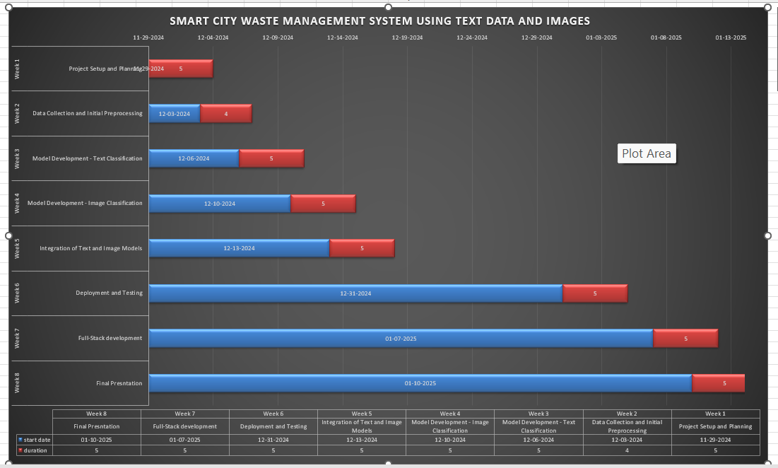
Gannt Chart

Slide 7
Model Descriptions
CNN: A custom convolutional neural network was designed with three convolutional layers for waste classification.
YOLOv5: A pre-trained real-time object detection model used for identifying multiple waste items in a single image
MobileNet50: A transfer learning model fine-tuned for waste classification tasks.

Slide 8
Classification Models
Model | Accuracy | Speed | Purpose
YOLO | 78-85% | Real-time | Detect and classify multiple objects
CNN | 75-80% | Fast | Task-specific Classification
Mobilenet | 70-75% | Moderate | Single-object classification

Slide 9
Model Performance
Model | Accuracy | Precision | AUC | MAE | MSE | RMSE | MAPE
CNN | 72% | 70% | 0.8 | 0.7 | 1.2 | 1.3 | 15%
YOLO | 100% | 100 | 1.0 | 0.3 | 0.3 | 0.5 | 3%
Mobilenet | 80% | 78% | 0.9 | 0.8 | 1.2 | 1.1 | 10%

Slide 10
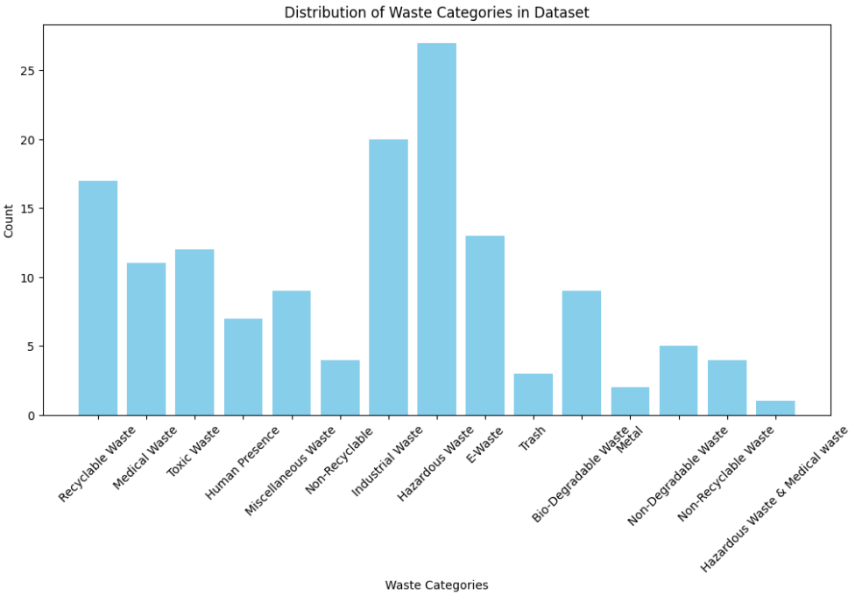
Categories

Slide 11
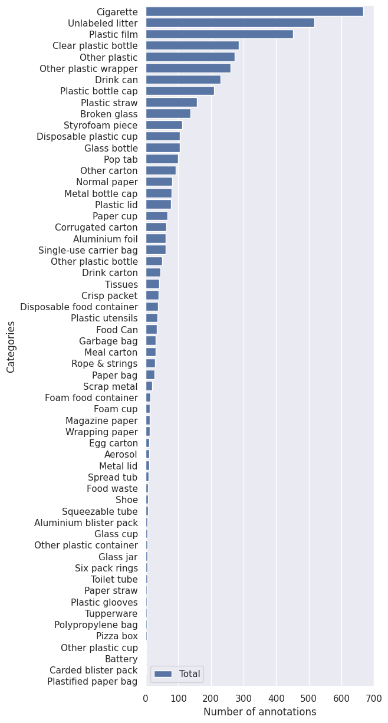

Slide 12
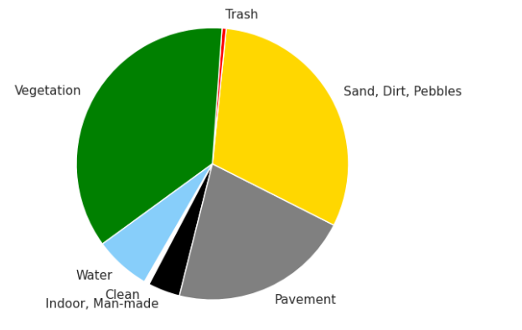
Pie Chart

Slide 13
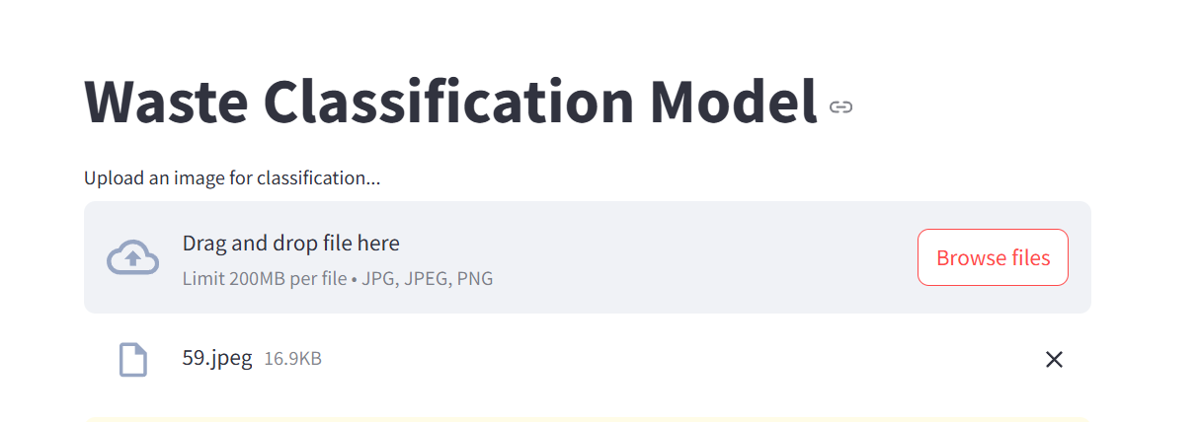
Output

Slide 14
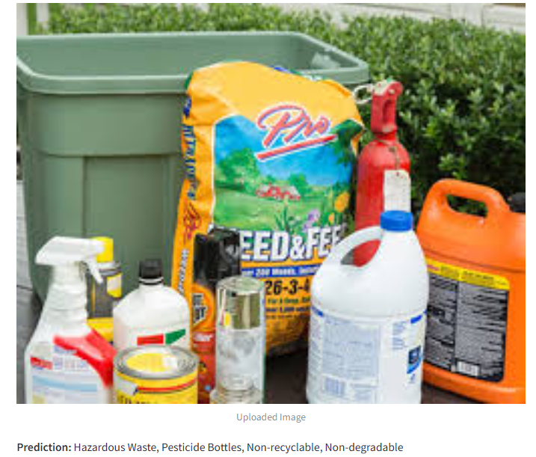

Slide 15
Future Work
Integrate the model with online server or upload in AWS cloud for future use.
Use this model to test in camera for real time detection.

Slide 16
References:
Rajakumaran, G., Usharani, S., Vincent, C., & Sujatha, M. (2023). Smart Waste Management and Classification Systems Using Cutting Edge Approach. Sustainability, 14(16), 10226. DOI.
Cheema, S. M., et al. (2020). A New Perspective on Waste Segregation Management with Smart Cities. ScienceDirect. Link.
Liu, J., et al. (2022). Internet of Things (IoT) and Waste Management Solutions for Sustainability. Springer. Link.
Rajesh, R., et al. (2022). Smart Waste Management: Waste Segregation using Machine Learning. Journal of Physics: Conference Series. Link.
Meena, M., & Kumar, K. (2021). Environmental and Economic Impact of IoT-Based Waste Management Systems. ScienceDirect. Link.

Slide 17
Thank You

