Slide 1

Smart City Waste Management [Text Data and Images]."
Team of members:
Sailesh
Atma Vidya Manoj
Rajesh

Slide 2
Introduction:
Waste management in cities is becoming more challenging as populations grow and urban areas expand. Traditional methods are inefficient, often leading to pollution and overflowing landfills. As cities transition into Smart Cities, there’s an opportunity to use technology to improve waste management. By leveraging IoT (Internet of Things), AI (Artificial Intelligence), and Big Data, we can create more efficient systems to manage waste, reduce environmental impact, and improve public health.

Slide 3
Abstract:
This project aims to develop a Smart Waste Management System that uses text data analysis and image classification using IoT-enabled smart bins to streamline waste collection, enhance recycling efforts, and reduce environmental harm.
By using Machine Learning (ML) and Deep Learning (DL), we’ll automate waste sorting and optimize collection routes. This will contribute to creating more sustainable urban environments while addressing the growing challenge of waste management.

Slide 4
Business Need
Waste management is becoming a serious challenge in growing cities, as the amount of waste continues to rise. This leads to inefficiencies, environmental harm, and even health risks. Traditional waste management methods are struggling to keep up with the increasing demand, and it's clear that smarter, more innovative solutions are needed. Our project aims to solve these problems by using AI and IoT technologies to automate waste sorting and optimize collection processes, making the entire system more efficient, sustainable, and better for everyone.
Sustainability: By reducing the amount of waste that ends up in landfills and encouraging recycling, we can make a positive impact on the environment.
Efficiency: Optimizing waste collection routes helps save time, reduce fuel costs, and improve overall operational efficiency.
Public Health: Proper waste management reduces health risks by minimizing the spread of disease and preventing environmental hazards caused by improperly handled waste.

Slide 5
Problem Statement
As cities adopt smart technologies, waste management still faces significant challenges. Overflowing bins, missed collections, and improper waste sorting continue to be common problems. Our project aims to solve these issues by creating an automated waste management system that uses real-time data from smart bins and citizen-reported problems. By integrating image recognition and text analysis, we want to make waste collection more efficient and reduce the pressure on existing systems. This will not only help streamline the process but also improve the overall cleanliness and sustainability of cities.

Slide 6
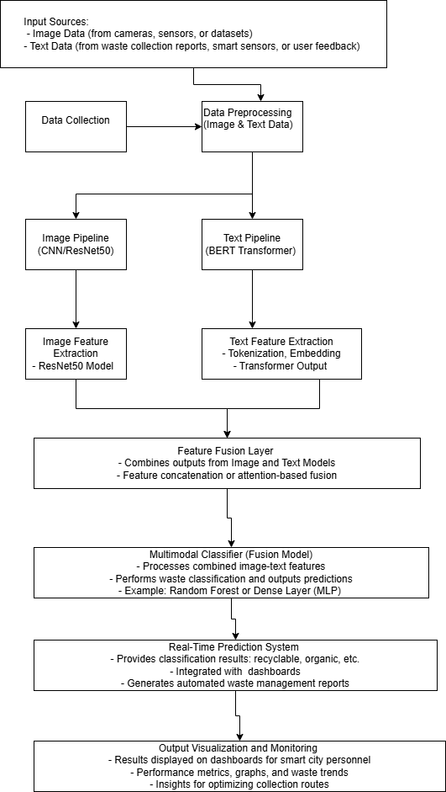
High-Level Architecture

Slide 7
Minimum Viable Product (MVP)
Image Classification Module: Using CNN,YOLO ,RANDOM FOREST,ResNet50 models to classify waste into categories like plastic, paper, and metal.
Text Data Analysis Module: Analyzing citizen feedback using Natural Language Processing (NLP) to identify common waste-related issues.
Basic Dashboard: A simple interface for authorities to monitor real-time data and optimize waste collection routes.
Machine Learning (ML) will help automate waste sorting, improve route optimization, and analyze trends from citizen feedback, making the system more efficient and scalable.

Slide 8
Gantt Chart
Week 1-2: Literature review and understanding the problem.
Week 3-4: Data collection (citizen reports, smart bin data) and preprocessing.
Week 5-6: Model development for text analysis and image classification.
Week 7: Integrating and testing the system.
Week 8: Optimizing the models and finalizing the presentation.

Slide 9
Literature review
Smart Waste Management Using IoT and AI: Modern waste management systems leverage IoT sensors and AI to monitor waste levels and automatically sort materials. These systems use machine learning (ML) and deep learning (DL) to enhance recycling processes and reduce waste in landfills. Research shows that CNNs (Convolutional Neural Networks) have achieved high accuracy in waste classification, improving efficiency while optimizing collection routes. Despite these advances, human involvement is still needed in some systems, indicating a need for fully automated solutions (Bridgera, MDPI).
Machine Learning for Waste Classification: A variety of AI techniques, especially SVM and CNNs, have been used to sort waste into categories such as plastic, paper, and metal. These systems are designed to improve accuracy, reduce human error, and enhance recycling rates. While current solutions are promising, challenges remain in achieving higher classification accuracy and fully automating the sorting process, which could lead to more effective waste management (Bridgera).

Slide 10
Literature review
3. IoT and Smart Bins for Waste Management Efficiency: IoT-based smart bins are transforming waste management by offering real-time monitoring of waste levels. These bins send alerts when full, reducing unnecessary pickups and optimizing collection routes. This not only saves time and energy but also helps in reducing operational costs. Additionally, predictive modeling helps forecast waste generation trends, allowing for better planning and resource allocation (Springer, Bridgera).
4. Drone-Based Waste Management: Drones equipped with image-processing technologies and CNNs are being used for waste detection and classification. These UAV systems help identify waste locations, particularly in remote or hard-to-reach areas. The use of drones for real-time monitoring provides a cost-effective and efficient solution, as they reduce the need for manual checks and improve overall waste management by sending immediate alerts to authorities (Bridgera, MDPI).

Slide 11
Literature review
5. Sustainable Waste-to-Energy Solutions: Technologies like bio-refineries, plasma gasification, and microbial fuel cells are increasingly used to convert waste into energy. Bio-refineries convert organic waste into biofuels such as biodiesel, while microbial fuel cells (MFCs) generate electricity from organic waste. Additionally, plasma gasification converts harmful waste into syngas, a form of fuel. These technologies not only improve waste disposal but also help generate renewable energy, contributing to environmental sustainability. Countries like Sweden have become models for waste recycling, showing how advanced technologies combined with public participation can create highly effective waste management systems (Bridgera, MDPI).

Slide 12
References:
Rajakumaran, G., Usharani, S., Vincent, C., & Sujatha, M. (2023). Smart Waste Management and Classification Systems Using Cutting Edge Approach. Sustainability, 14(16), 10226. DOI.
Cheema, S. M., et al. (2020). A New Perspective on Waste Segregation Management with Smart Cities. ScienceDirect. Link.
Liu, J., et al. (2022). Internet of Things (IoT) and Waste Management Solutions for Sustainability. Springer. Link.
Rajesh, R., et al. (2022). Smart Waste Management: Waste Segregation using Machine Learning. Journal of Physics: Conference Series. Link.
Meena, M., & Kumar, K. (2021). Environmental and Economic Impact of IoT-Based Waste Management Systems. ScienceDirect. Link.

