Slide 1
Joins
.

Slide 2
What is Join
Join is SQL query we use it for combining 2 or more Tables based on a common column.
These are the different Types of Joins.
1-Inner Join
2-Left Join
3-Right Join
4-Full Outer Join
5-Self Join

Slide 3
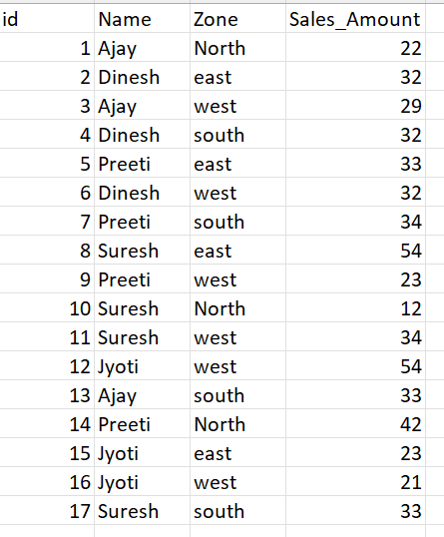
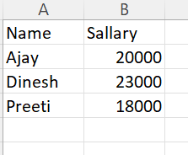
Example
Data1
Data2

Slide 4
Inner Join
.
Table-b Name
Table –a Name

Slide 5
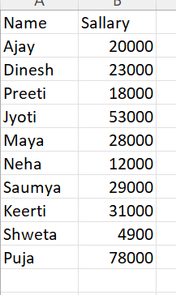
Example
Data1
Data2

Slide 6
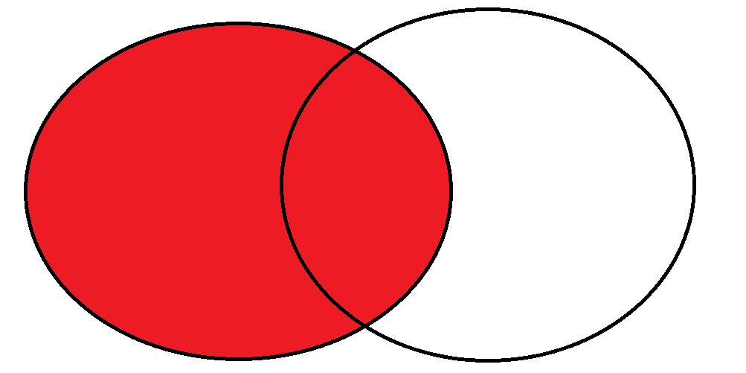
Left Join
.
Table-b Name
Table –a Name

Slide 7
Example
Data1
Data2

Slide 8
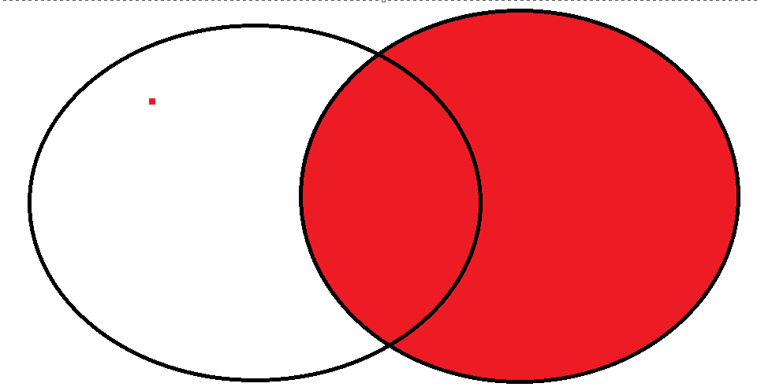
Right Join
.
Table –a Name
Table-b Name

Slide 9
Example
Data1
Data2

Slide 10
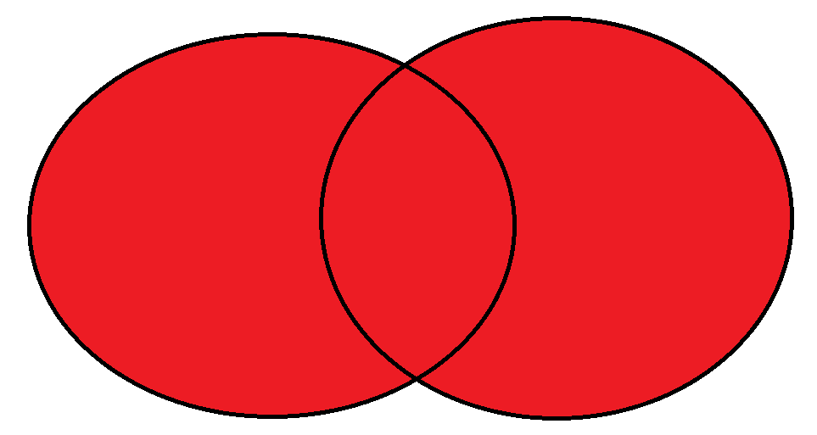
Outer Join
.
Table –a Name
Table-b Name

