Slide 1
Donut or Not
Landing page image

Slide 2
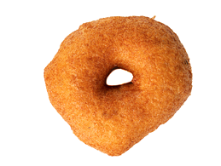
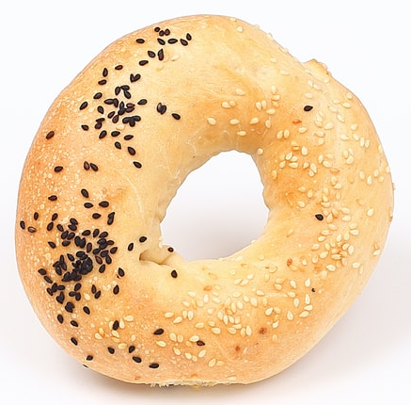
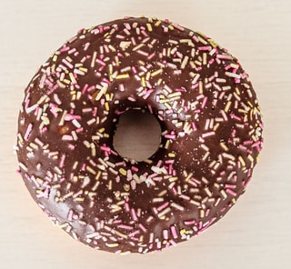
Donut or Not?
Vada
Donut
Bagel
Notes:
donut: https://unsplash.com/photos/Yc5sL-ejk6U
bagel: https://unsplash.com/photos/Zt7QakoA8E8
vada: https://www.istockphoto.com/photo/idli-vada-south-indian-food-gm1170077038-323661203?utm_source=unsplash&utm_medium=affiliate&utm_campaign=srp_photos_top&utm_content=https%3A%2F%2Funsplash.com%2Fs%2Fphotos%2Fmedhu-vada&utm_term=medhu%20vada%3A%3Asearch-aggressive-affiliates-v1%3Aa

Slide 3






Donut or Not? – tech stack
User
AWS API gateway
Docker Container
Mangum encapsulation
FastAPI server
Donut Or Not service
/ → index.html
/classifyImg → response.html
/listImgFiles → json
/getTimestamp → str
/hello → json
Resource files
export.pkl → PyTorch model
favicon.ico
landing_graphics.jpg
AWS Lambda service

