Slide 1
Mikroprocessor (SXT8C204)
Gustav Palmqvist
Ibrahim Salloum
David Luong
Magnus Eng

Slide 2
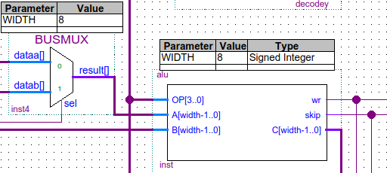
ALU

Slide 3
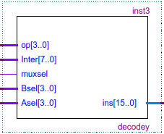
Avkodaren

Slide 4
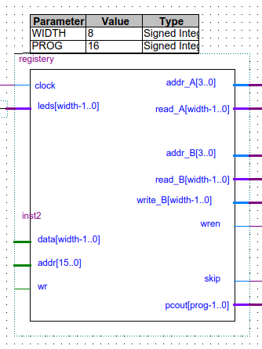
Register

Slide 5
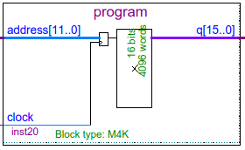
Programminne

Slide 6
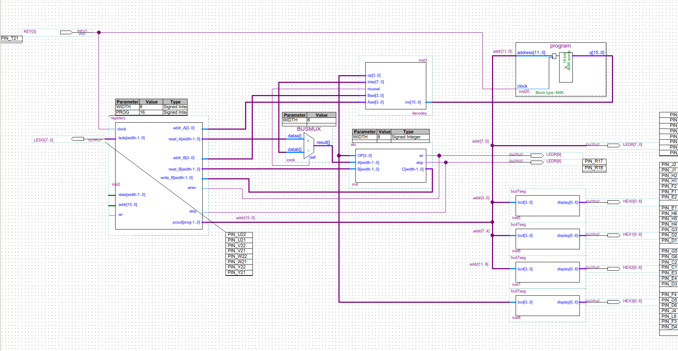
Kopplingsschemat

