Slide 1
Mikroprocessor
Gustav Palmqvist
Ibrahim Salloum
David Luong
Magnus Eng

Slide 2
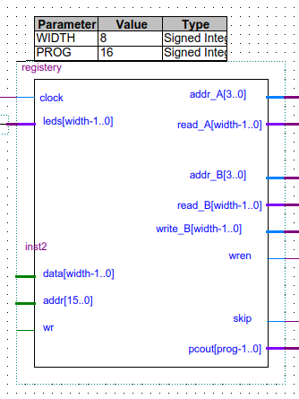
Register

Slide 3
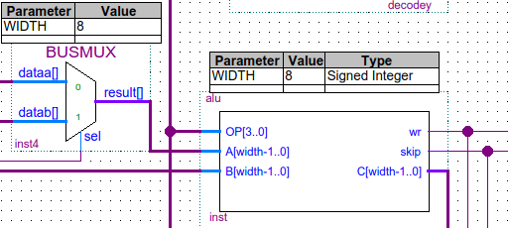
ALU

Slide 4
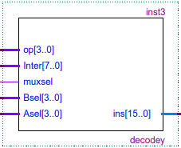
Decoder

Slide 5
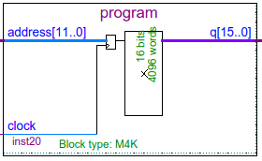
Programminne

Slide 6
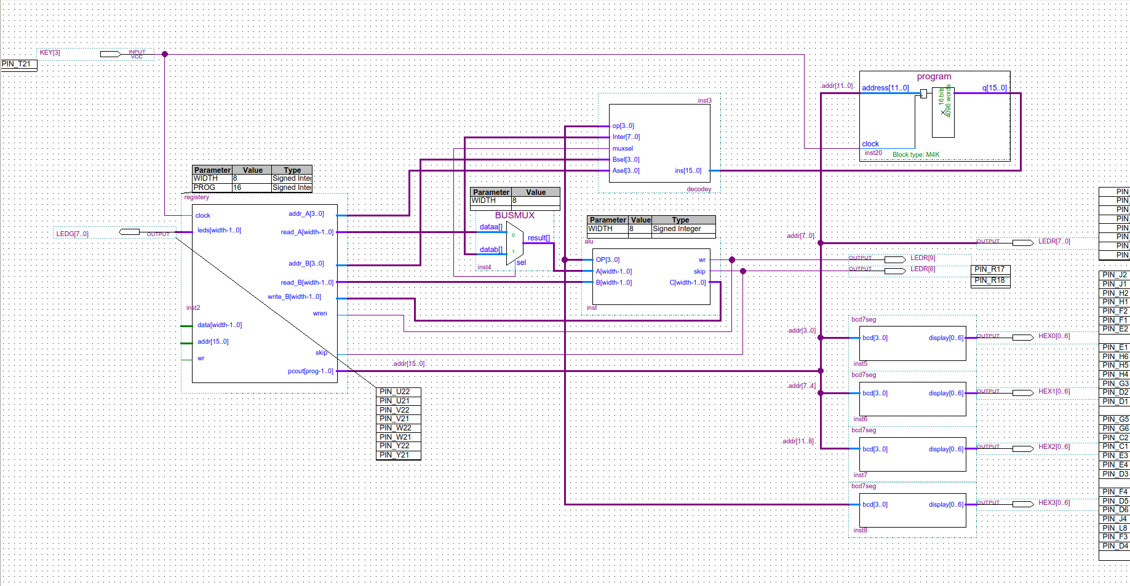
Kopplingsschemat

