Slide 1
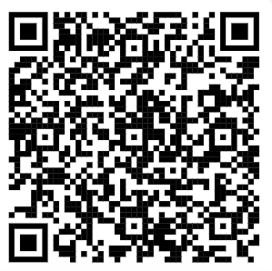
E-AI WG Data Curation’s primary intention is to lower barriers in E-AI activities data usage by analysing available and missing data holdings, obstacles in using them, and creating examples of using and converting the data into a suitable form for Machine Learning. The considered applications cover weather forecasting (from nowcasting to seasonal), climate applications, and downstream products and services
Key activities
Gap analysis of used and missing data in AI/ML applications relevant to E-AI content
Zarr usage best practices
Considered / future ideas
Catalogue of datasets used for E-AI applications, with link to use cases and associated tools
Usage and conversion examples
Your contribution is needed!
Tell us about your (or your colleagues’) use case and datasets
Contribute to the activities
Participate meetings
https://github.com/eumetnet-e-ai/wg1_data_curation

