Slide 1

The Financial Control Layer for Enterprise AI Agents
Tutelum lets enterprises deploy AI agents that spend money without losing control.
Pre-Seed · 2026
john@tutelum.ai · tutelum.ai

Slide 2
Agents Spend Real Money. With No Control.
As AI agents gain purchasing power, enterprises have no financial control layer.
Invisible Spending
Uncontrolled Spending
VP Engineering can't see what their agent fleet is spending: when, why, or to whom.
Any agent can call any API, drain company funds in a single request: no limits, no rules.
Prompt Injection Risk
No Cryptographic Record
Agents can be manipulated by malicious content in web pages or APIs, redirecting payments without any human knowing.
Finance and Compliance have nothing for auditors; no signed record of any agent transaction.
2 / 13

Slide 3
Three Converging Forces Create an Urgent Window
119%
€35M
10,780%
$40M
Agent Explosion
Regulatory Pressure
New Payment Rails
EU's binding AI risk law; mandatory compliance for high-risk AI systems
Surge in agent creation, H1 2025
x402 surge in one month (May 2025)
€35M EU AI Act maximum penalty
Market: $7.92B today
Coinbase launched x402: May 2025
August 2026 Deadline
→ $236B by 2034 at 45.8% CAGR
~500K payments in one week, Oct 2025
→ 4 months away
Source: Salesforce Agentic Enterprise Index, Sept 2025
Source: EU AI Act, Official Journal 2024
Source: Dune Analytics / Coinbase, Oct 2025
3 / 13

Slide 4
Real Incidents. Real Losses. No Controls.
These are public incidents. The unreported ones are worse.
ON-CHAIN AGENT · 2026
ON-CHAIN AGENT · NOV 2024
RESEARCH · JAN 2025
$250K
$47K
Critical
paper value, irreversible
via prompt injection
weaknesses in AP2
Lobstar Wilde
Freysa AI
Google AP2 Flaws
A trading agent misread a sarcastic post and transferred 5% of its token supply (~$250K paper value) to a user requesting $4. The transaction was irreversible.
Freysa's only rule: never transfer funds. After 481 failed attempts, a user's fake "admin terminal" override drained 13.19 ETH ($47K) from the prize pool.
Adversarial prompts reliably subvert Google's Agent Payments Protocol, manipulating purchases and extracting user data from Gemini agents.
Source: Reported 2026
Source: @jarrodwatts · Nov 2024
Source: arXiv:2601.22569 · Jan 2026
4 / 13

Slide 5
One Layer. Every Stakeholder. Zero Bypass.
DEVELOPERS
VP ENG / CTO
CISO
FINANCE / LEGAL
SDK + MCP · Zero rewrites required
Policy Engine · Spend limits
Anomaly Detection · TEE
Immutable Audit Log · SOC 2
AI Agent
Policy Engine
TEE Layer
Payment Router
Paid + Logged
initiates pay()
rules enforced
server-side
hardware limits
crypto-verified
x402 · USDC
card · ACH
signed receipt
immutable record
CISO: Can an agent spend outside policy if Tutelum's servers are breached? No. Spend limits are enforced in hardware by Turnkey's secure enclave; cryptographically verifiable, independent of our application layer.
5 / 13

Slide 6
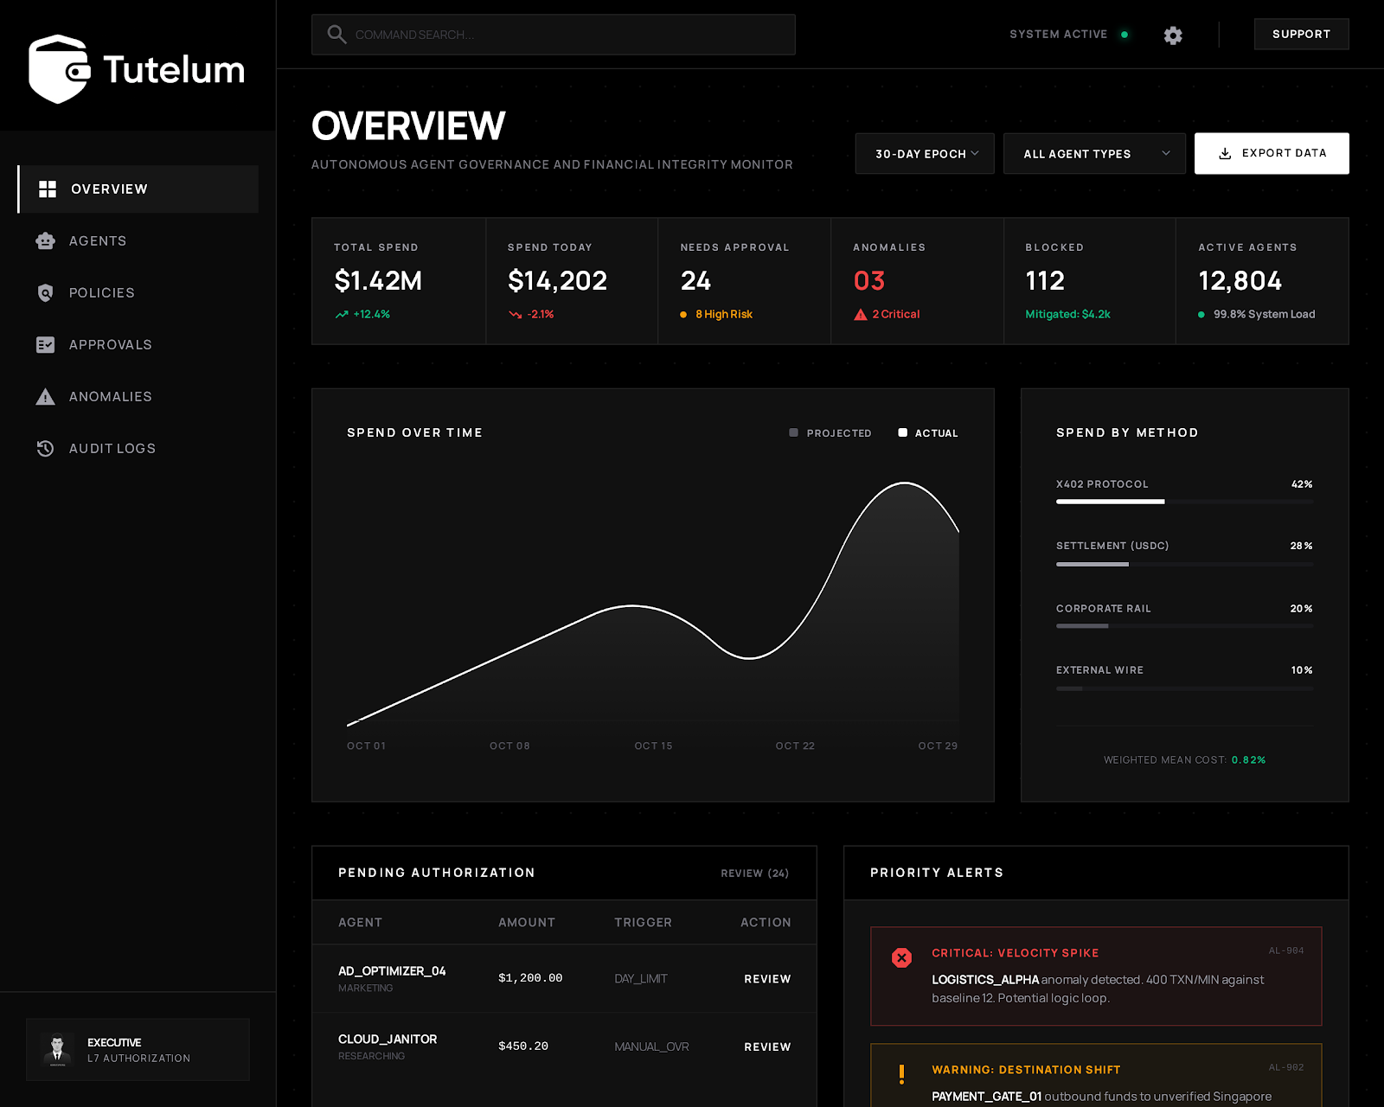
PRODUCT IN ACTION - UI MOCKUP
6 / 13

Slide 7
A $236B Market With No Governance Layer
TAM
SAM
SOM
$236B
$18B
$850M
Global AI Agents market by 2034
Enterprise agentic AI with financial capability
Reachable via dev-led enterprise sales (3 yrs)
45.82% CAGR · Precedence Research
88% enterprises × 200 agents × $20K/yr = ~$17.6B
0.3% SAM · 5 accts Y1
Bottom-Up Validation
~400K AI agents with purchasing power today · avg 200 agents/fleet · governance $20K–$80K/yr per fleet
Near-term SAM: $6B–$20B · 5 enterprise pilot accounts in Year 1 at avg $40K ACV = ~$200K ARR
400K+
140M
88%
€35M
AI agents with
purchasing power today
agent payments in
9 months (2025)
of enterprises using
AI in ≥1 function
EU AI Act max penalty
Aug 2026 enforce
7 / 13
Source: Coinbase / x402, Q1 2026
Source: Dune Analytics / x402, 2025
Source: McKinsey, 2025
Source: EU Official Journal

Slide 8
Every Alternative Enables Spending. None Enforce Governance.
Tutelum
Skyfire
Payman AI
AnChain.AI
MC Agent Pay
Ramp / Brex
TEE / Hardware-Attested
Enforcement
✅
❌
❌
⚠️
❌
❌
Prompt Injection Defense
at Payment Layer
✅
❌
❌
❌
❌
❌
Complex Conditional
Policy Engine
✅
⚠️
⚠️
❌
⚠️
⚠️
x402 + Traditional
Payment Rails
⚠️
⚠️
⚠️
❌
✅
✅
Enterprise Agent
Governance
✅
⚠️
⚠️
⚠️
❌
❌
Real-Time Transaction
Blocking
✅
❌
⚠️
❌
⚠️
❌
✅ Full support · ⚠️ Partial / in development · ❌ Not supported
8 / 13

Slide 9
Momentum Before Revenue
Pre-revenue ≠ pre-progress. The product is live and integrated with the top agent frameworks.
3
100%
0 → Live
5
Integrations Shipped
Policy Enforcement Rate
Production-Ready
(1 month)
Pilot Leads
LangChain · AutoGen · MCP
Drop-in for popular agent frameworks
Zero policy bypasses recorded
in production testing to date
Built by a 3-person team
Demonstrates execution speed
Active conversations with CISOs
and VP Engs in fintech and logistics
Goal: 5 signed LOIs before seed round · EU AI Act enforcement window: August 2026
9 / 13

Slide 10
Usage-Based SaaS + Platform Fees
Starter
Growth
Enterprise
Free → $199/mo
$999/mo + 0.008% per tx
Custom
Up to 10 agents
Unlimited agents
Turnkey TEE hardware
10K tx/mo
Full policy + anomaly detection
SOC 2 / EU AI Act packages
Basic policy
Human approvals
SSO (Okta, Azure AD)
30-day audit log
12-month audit log
Dedicated support
Unit Economics
Growth $999/mo = $12K ACV · Enterprise ~$40K–$80K ACV · Model: 5 enterprise accounts Y1 × $40K avg = ~$200K ARR
NRR expansion: a $12K/yr Growth account becomes $30K/yr as the agent fleet grows 2–3× YoY. Zero new sales motion.
10 / 13

Slide 11
Three-Motion GTM Strategy
Dev-led adoption lands the account. Compliance pressure closes the enterprise deal. Usage expansion drives NRR.
①
②
③
SDK-Led (Bottom-Up)
Compliance Pull (Top-Down)
Usage Expansion (Built-In NRR)
Initial developer reach via LangChain, AutoGen, and MCP communities: 200K+ active users. Free tier drives adoption into team stacks, zero cold sales needed.
EU AI Act enforcement (Aug 2026) is a mandatory procurement trigger. CISOs are already asking about agent financial controls; Tutelum is the answer.
Revenue scales automatically with agent fleet size. Every new agent an existing customer deploys generates incremental per-transaction revenue.
Activation: SDK-led (Now) → Compliance pull (Q3 2026, EU AI Act enforcement) → Usage expansion (YR2+)
11 / 13

Slide 12


Built by Engineers Who've Lived the Problem
S
John Chambard
Sri Harsha Potta
Amar Nangia
CEO · Co-Founder
CTO · Co-Founder
CRO · Co-Founder
Built infrastructure and enterprise compliance tooling at NETSYNC; Saw how emerging regulations around agents creates a need for AI auditing.
Built developer tooling at NETSYNC for platform tools; Knows exactly where governance gaps open up when developers get API access.
Worked on agent fleet deployments at NETSYNC; Saw the control gap firsthand: agents with access and nothing governing them.
Comp Sci @ Purdue
Comp Sci @ UT Austin
Comp Sci @ Georgia Tech
Enterprise IT @ Phillips66
Cloud Infrastructure @ HPE
SWE @ LinkedIn
linkedin.com/in/john-chambard
linkedin.com/in/sri-harsha-potta
linkedin.com/in/amar-nangia
We have built together for six years: hackathons, UIL competitive programming, a school app used by thousands, and internships at NETSYNC. Tutelum started when we saw firsthand how easy it was to give agents powerful API access with almost no financial safeguards.
12 / 13

Slide 13
$150K
Pre-Seed · Accelerator Round · SAFE
12 months runway · 5 enterprise pilot LOIs · EU AI Act compliance launch
Capital
Mentors & Network
Accelerator Value
Pre-seed SAFE to fund 12 months of engineering, 5 pilot LOIs, and SOC 2 certification
Intros to enterprise prospects · EU regulatory advisors · dev community
Portfolio companies as early customers · enterprise sales credibility · co-investor intros
THIS RAISE
MILESTONE 1
SEED ROUND
SEED DEPLOYS
$0
$200K
$1.5M
$3.5M
5 pilot LOIs
Product live
5 paying pilots
enterprise ARR
Target seed raise
EU market launch
200+ accounts
per-tx revenue
Capital Allocation
Engineering 45%
TEE hardening · EU AI Act modules · SSO
Sales & GTM 30%
Enterprise sales · developer community
Operations 25%
SOC 2 · EU AI Act prep · infra

