Slide 1
Dialogue Security Anti-Tampering Mechanism
網路與多媒體實驗 第四組
吳名洋 B09901045
林潁軒 B11508006
陳嘉謙 B11504045

Slide 2
Motivation
Background
As generative AI has grown popular in recent years, online conversation with AI chatbot has played an important role in our daily lives.
Concerns
Integrity: Occasional instances malicious tampering with AI or human responses may occur. Yet, there is no method to ensure the integrity of conversation. This could make clarifying liability difficult.
Vulnerability: AI and user data are usually stored in central web server. This model makes it prone to cyber attack, resulting in leak of sensitive info.

Slide 3
Introduction
We create a tamper-proof mechanism for human-AI dialogue using serialized encryption and signature, which we drew inspiration from blockchain technology.
This system can prevent others from tampering past conversation records: If one prompt is altered, then it would be inconsistent with the signatures of the following prompts. And we can locate the source of tampering easily.
Secrecy is also ensured through hashing so that third-party wouldn’t know the content of the conversation.

Slide 4
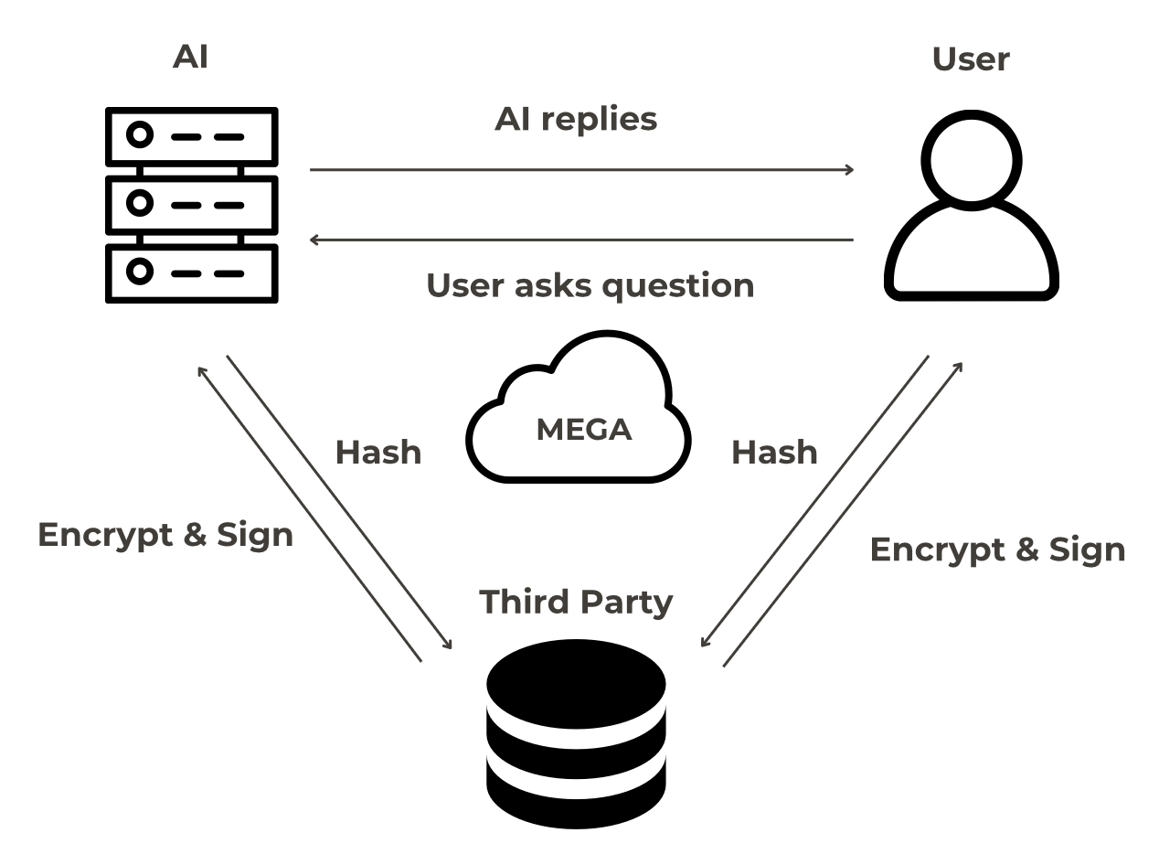
Structure
The conversation involves three entities: AI, human and the third-party (could be either human or machine)
AI and human have conversation, while the third-party have no idea of what they’re talking about. The third-party’s only job is to encrypt and sign.
Our entire system works via MEGA

Slide 5
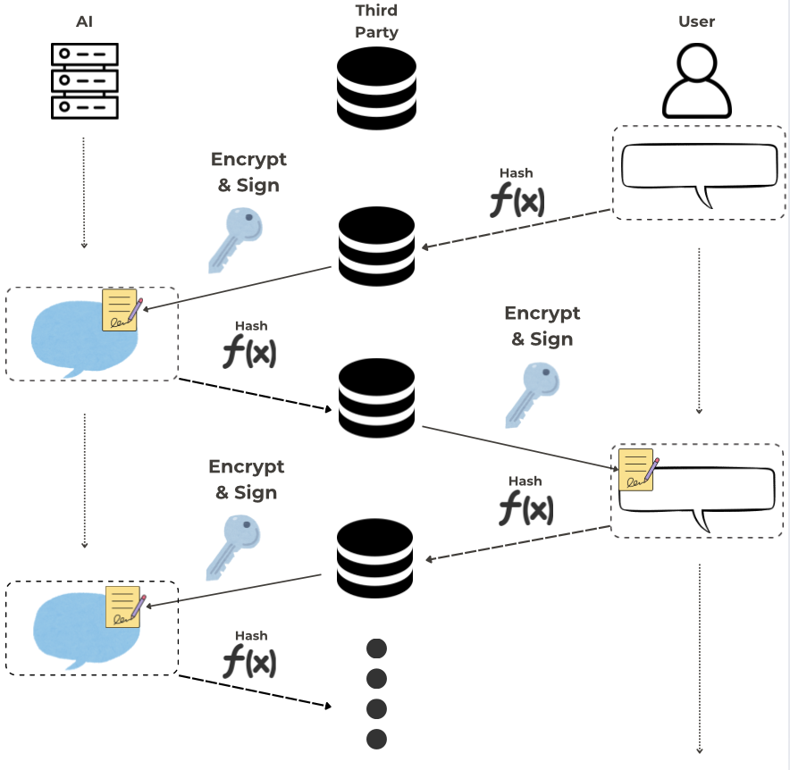
Mechanism
Both side’s block (prompt + signature) are hashed. Then encrypted by public key of third-party (kept secret to itself) and appended onto the other’s prompts as signature.

Slide 6
Advantages
This mechanism have 3 major advantages:
Integrity of dialogue records
Secrecy of conversation
Tampering source traceability

Slide 7
Technology
MEGA
We use MEGA (https://mega.io/zh-hant/) as a platform for data transfer
Llama3
We use ChatGPT API and integrate it into our application. The generative AI model is Llama3 .
RSA
We use RSA from python Crypto module to encrypt/decrypt our data.
PyQt5
Used as Human-AI interface

Slide 8
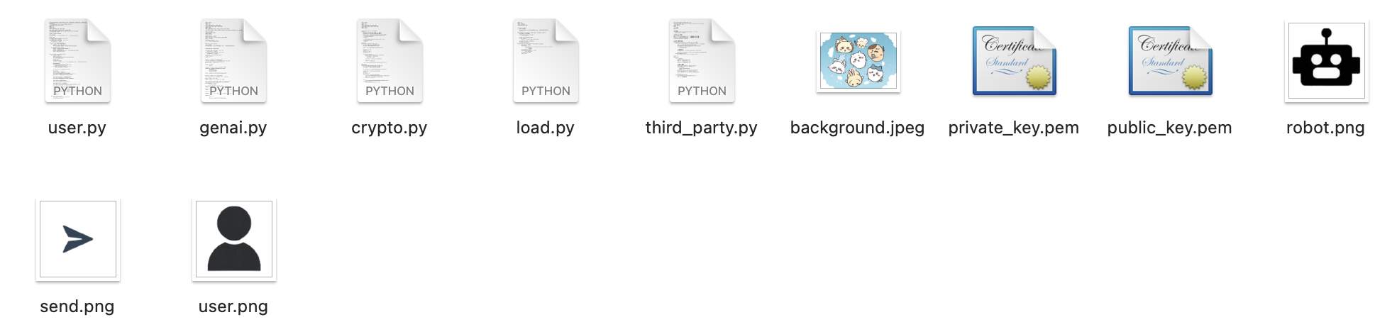
Code Structure
user.py: User run this file on terminal
genai.py: Someone run this file to act as Generative AI (implementation of ChatGPT API)
third_party.py: Third-party run this file (Encrypt and sign the hashed data)
# crypto.py includes encryption, decryption and key-generating function
# load.py includes mega-login, upload and download function

Slide 9
Code Structure
private_key.pem & public_key.pem: Public and private keys shared by user and AI, so that they can conduct encrypted conversation
Others: Human-AI user interface related elements

Slide 10
Code Structure
Terminology
For naming convenience, we name:
User Prompts: A1, A2, A3…
AI Prompts: B1, B2, B3…
Third-party Signature: K1, K2, K3
Module
Need to install the following python module: mega, PyQt5, Crypto and openai (need API base authorized)

Slide 11
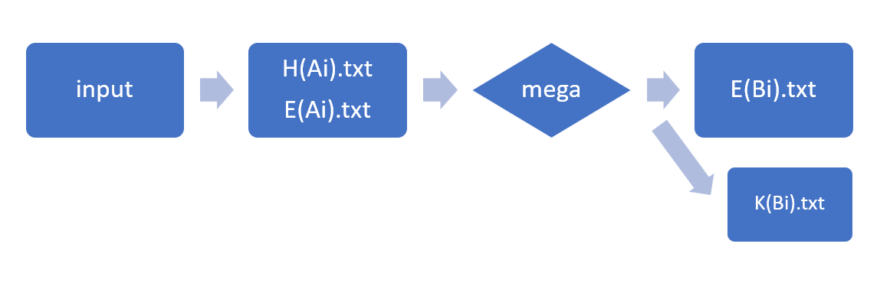
Code Structure - User
Here are some important function we import in AI:
decrypt_blob and encrypt_blob
hashlib
Hash
Upload
Download & Decrypt
Encrypt
Download

Slide 12
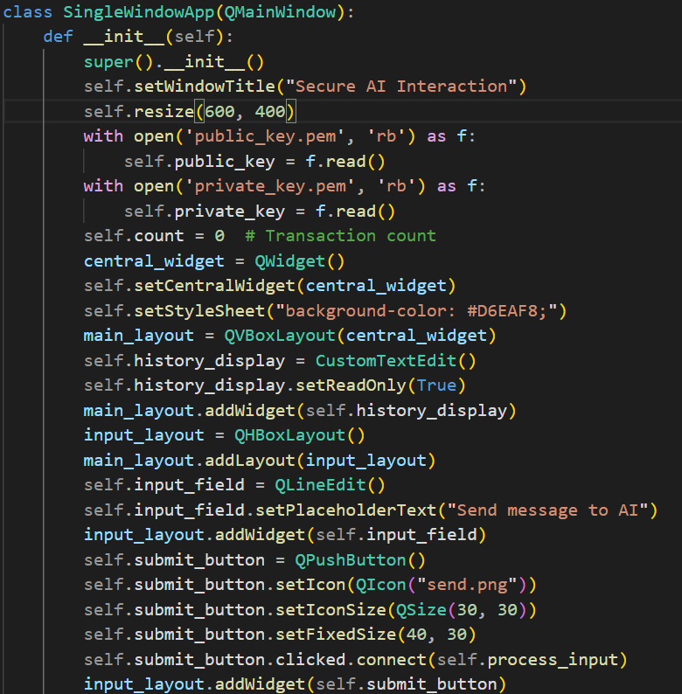
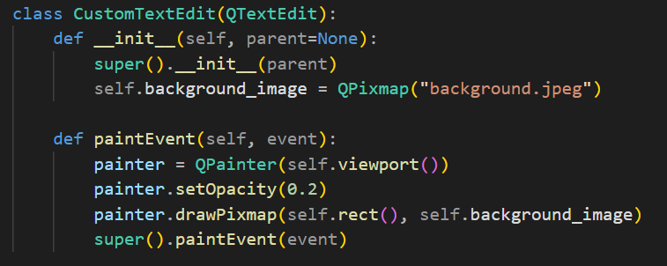
Code Structure - User
These two classes are defined for user interface (background, button, input…)

Slide 13
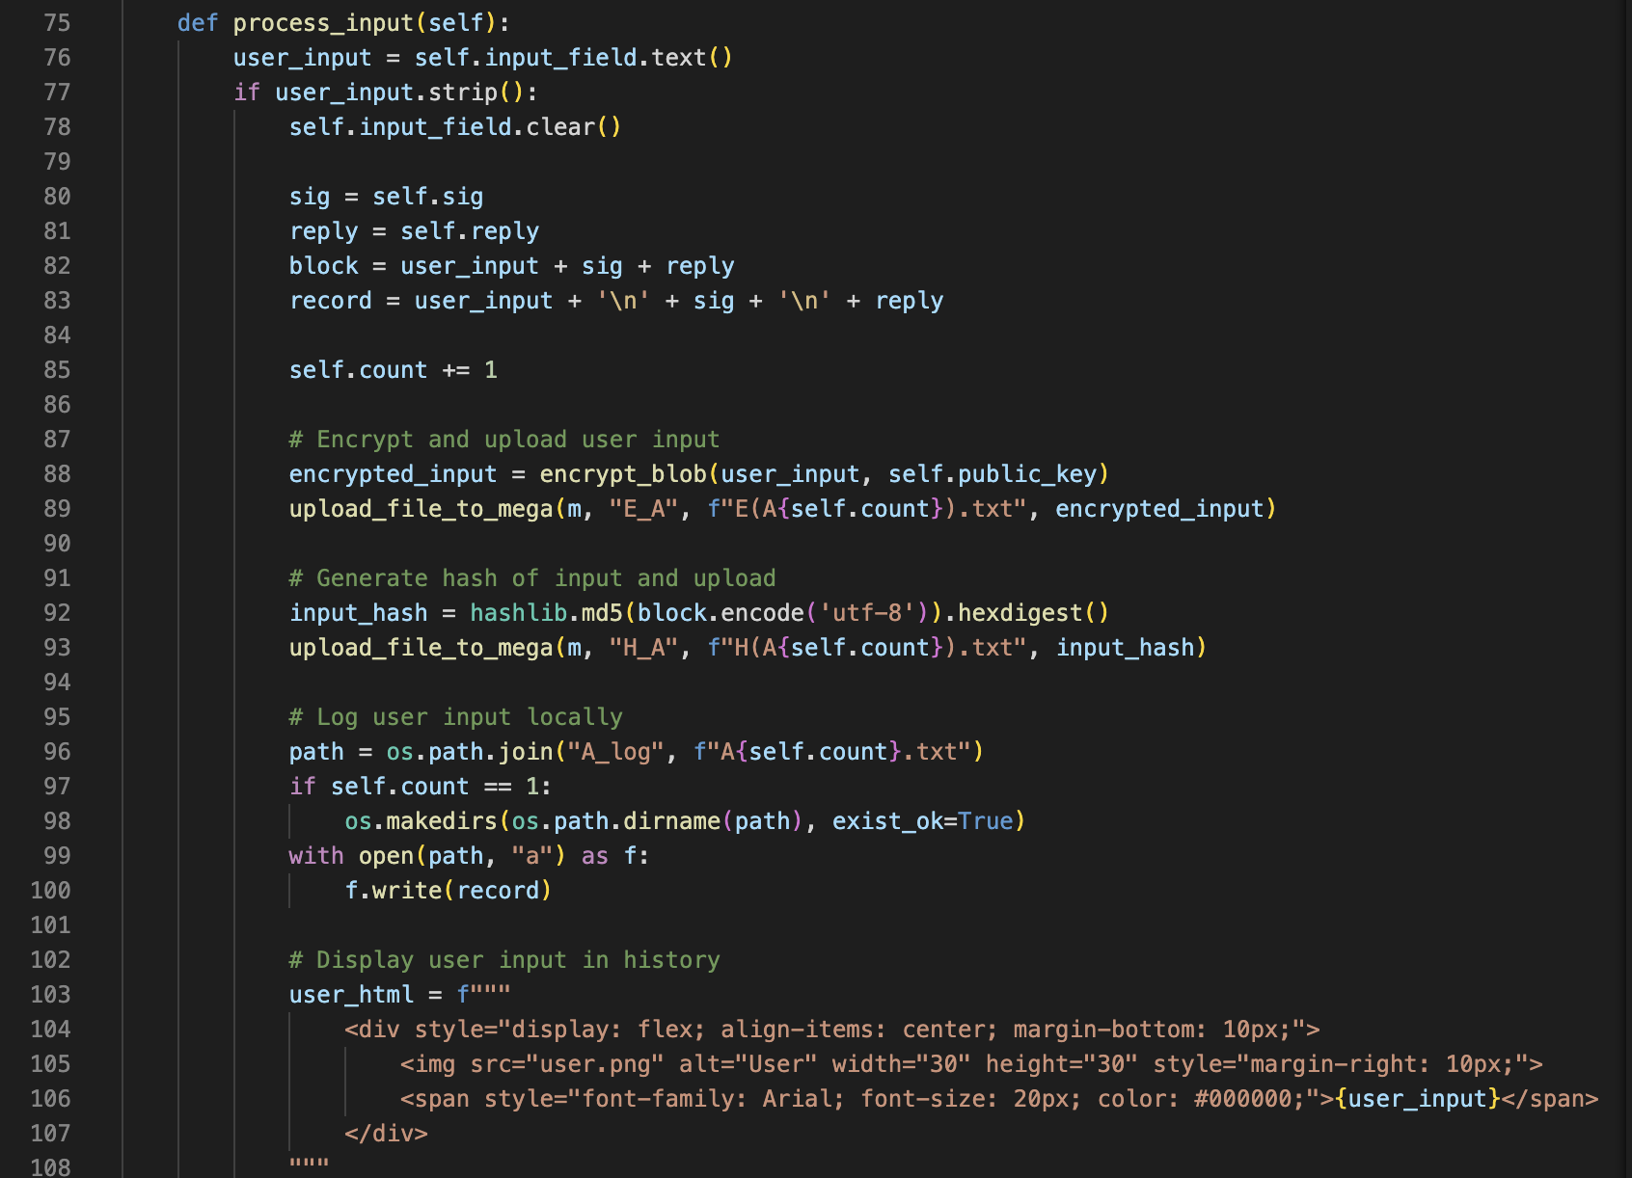
Code Structure - User
Each block is consists of user input, signature of prior block and AI’s reply
The conversation between user and AI is encrypted via traditional encryption protocol
The block is hashed and sent to the third-party for encryption and sign
And a copy of block is saved locally

Slide 14
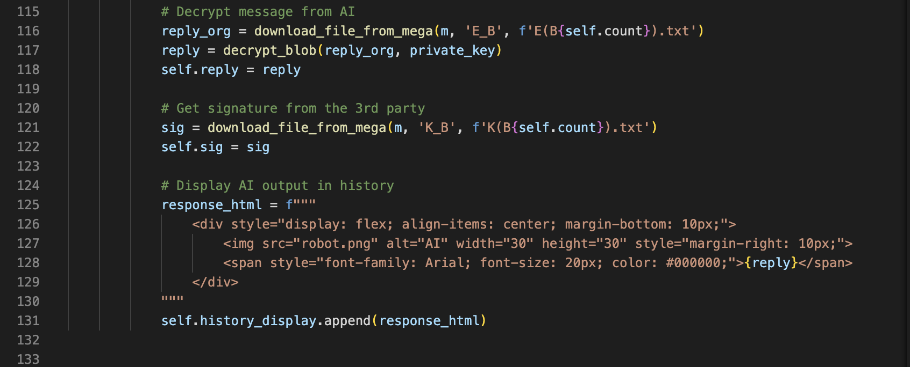
Code Structure - User
User decrypt reply from AI and get signature of prior blocks from the third-party

Slide 15
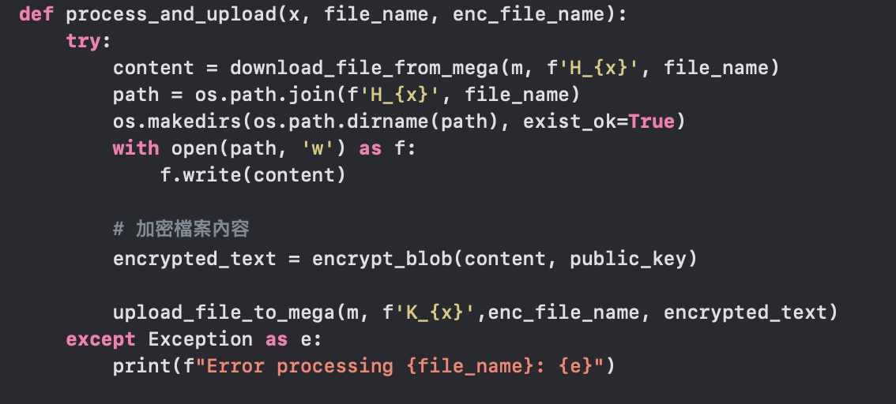
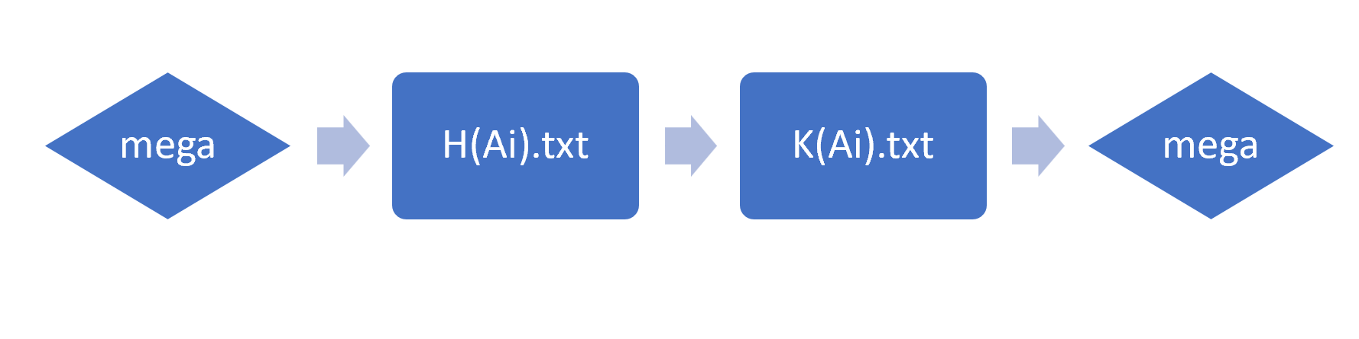
Code Structure - Third Party
Here are some important functions:
encrypt_blob
process_and_upload
Download
Encrypt
Upload

Slide 16
Code Structure - Third Party
This function downloads H(Xi).txt and encrypts the content. Then, save it as K(Xi).txt and upload it to mega .

Slide 17
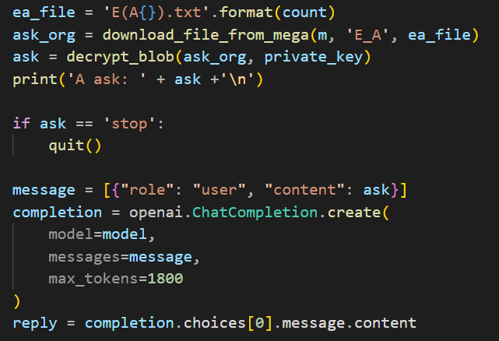
Code Structure - AI
The encrypted .txt files can be downloaded from MEGA. Then, this code can decrypt the message, send the message to OpenAI and get the reply.

Slide 18
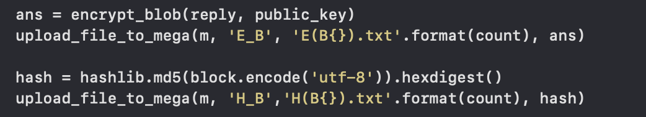
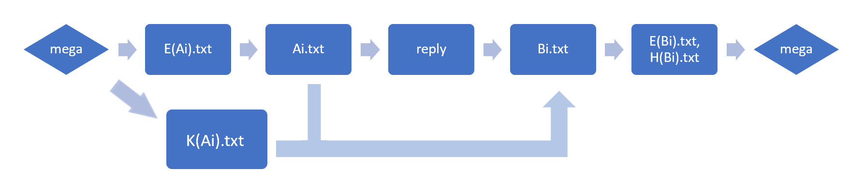
Code Structure - AI
After the reply is created, this part of code encrypts the reply and hash the block which contains the reply, signature and the question; then upload it to folders in MEGA.

Slide 19
Note
Since the files would be repeatedly uploaded/downloaded from mega, the time take for a single conversation can be very long ( > 1min )
third-party.py will show what stage has been processed
third-party.py will store the hashed data from both sides in H_A (from user) and H_B (from ai) folders. User and AI will store its “block” in A_log and B_log folders respectively.
User and ai have to share the same public-private key pairs, otherwise it won’t work
type “stop” in the user UI will kill three execution (user, genai and the third-party) all at once.

Slide 20
Contribution
Large language model: 吳名洋
Cryptography: 林潁軒、陳嘉謙
Interface (GUI): 吳名洋、林潁軒、陳嘉謙
Integration: 吳名洋

