Slide 1
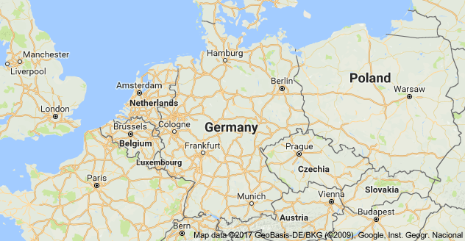
Germany
Andrew Noonan

Slide 2

Profile
Geography:
357,022 sq km sq mi; territory area.
Berlin acts as the capital.
Population:
80,594,017; July 2017 est.
Gov. Type:
Federal Parliamentary Republic.
Legal System:
Civil Law System.
German Confederation of March 19, 1848

Slide 3

Profile
Ethnic Groups:
German 91.5%
Turkish 2.4%
Other 6.1% (mostly Polish, Italian, Romanian, Syrian, and Greek)
Language:
German (Official)
Danish (Official Minority)
Frisian (Official Minority)
Sorbian (Official Minority)
Romani (Official Minority)
The coat of arms of the
German Empire, 1889–1918.

Slide 4
Historical Development
1871 – Otto von Bismarck unifies Germany.
1914-1918 – WW1 Germany loses and becomes a Republic.
1933 – Hitler becomes chancellor.
1939-45 -WW2 Germany loses and partitions into:
Pro-western Federal Republic
Soviet-controlled German Democratic Republic
1955 – W. German joins NATO; E. Germany joins Warsaw Pact
1957- W. Germany is a founding member of the European Economic Community.

Slide 5
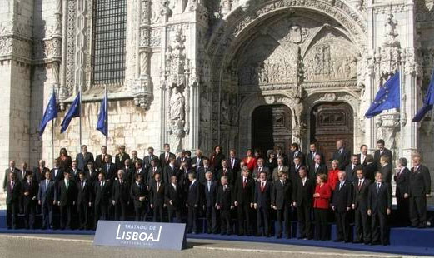
Historical Development
1961 – Berlin Wall is constructed.
1989 – Berlin Wall is torn down with the max exodus of E. Germans with relaxed travel restrictions.
1990 – Helmut Kohl leads a reunified Germany.
1993 - Co-Founder of European
Union.
2002 – Euro currency.
2007 – signed Lisbon Treaty.

Slide 6
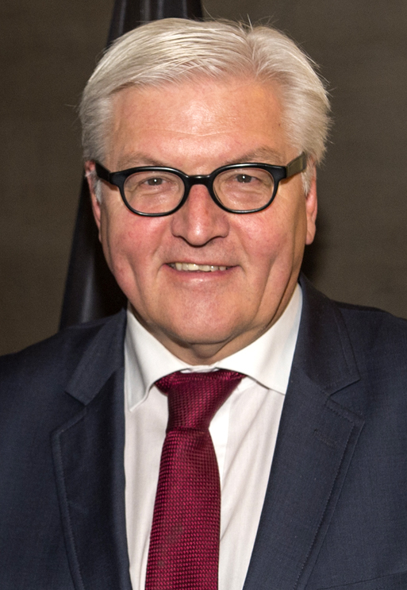
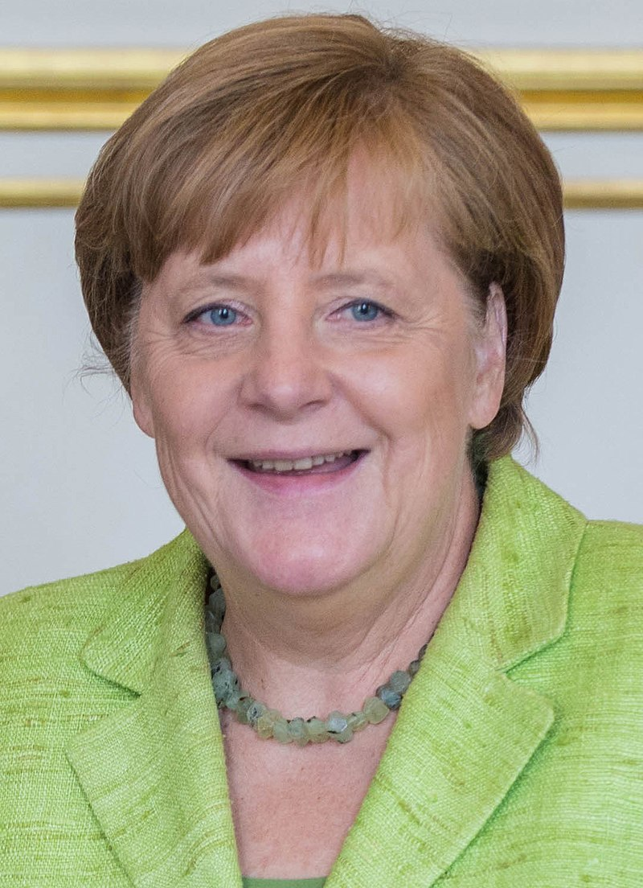
Current Political Institutions
Executive Branch:
President: Pres. Frank-Walter STEINMEIER; 19March2017
5-Year Term.
Head of Gov.: Chancellor Angela MERKEL; 22November2005
4-Year Term.
Cabinet: Federal Ministers
Recommended by the chancellor, appointed by the president.

Slide 7
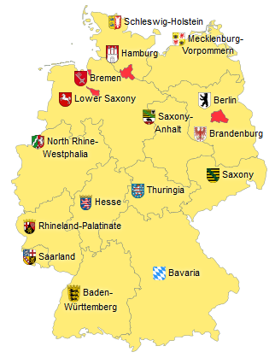
Current Political Institutions
Legislative Branch:
Bicameral Parliament
Federal Council (69 seats).
Federal Diet (631 seats).
Elections:
Federal Council appointed by the 16 state governments.
Federal Diet:
½ Multi-seat constituencies by majority vote.
½ Single-seat constituencies by majority vote.

Slide 8
Current Political Institutions
Judicial Branch:
Federal Court of Justice
127 Judges divided into 25 senates.
Election:
Selected by the Judges Election Committee.
32 Secretaries of Justice.
Serve until mandatory retirement at age 65.
Federal Constitutional Court Judges
Half House of Rep. / Half by Senate for 12-year terms.
Mandatory retirement at age 68.

Slide 9
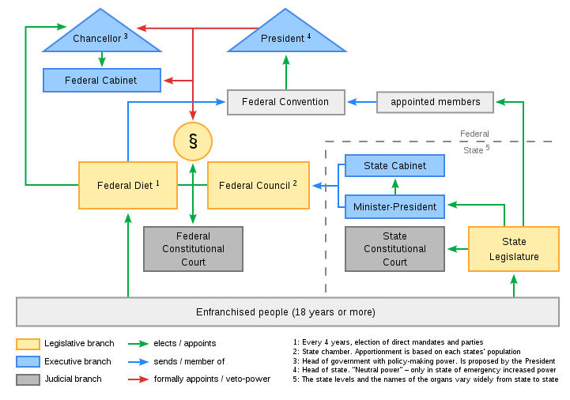
Current Political System

Slide 10
Political Economy
GDP: 3.467 trillion USD (2016).
Per Capita: 41,936.06 USD (2016).
Debt: 5.326 trillion USD 31MAR2016 est.
Exports:
1.322 trillion 2016 est. [8.9% US, 8.4% France, 7.1% UK]
Motor vehicles, machinery, chemicals, computer and electronic products etc.
Imports:
1.022 trillion 2016 est. [13.3% Netherlands, 7.3% China, 7.3% France]
machinery, data processing equipment, chemicals, oil and gas, metals, electric equipment, pharmaceuticals, foodstuffs, agricultural products.

