Slide 1
Amazon Agentcore Icons

Slide 2
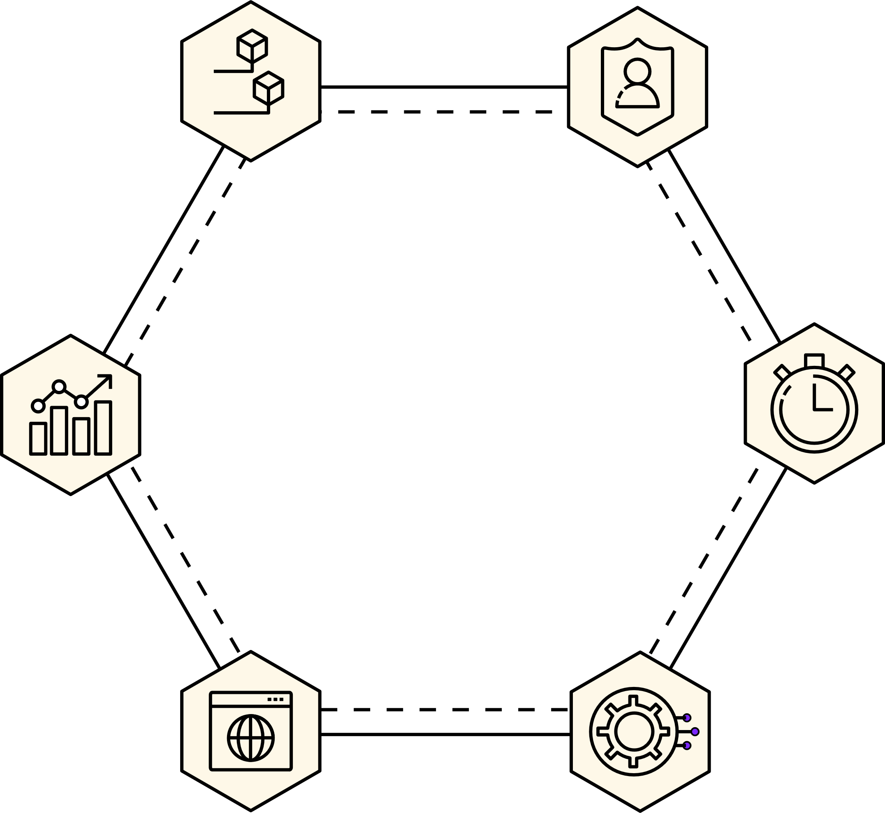


Slide 3












Agentcore ICONS
Agentcore
AI Agent
Runtime
Gateway
Identity
Code interpreter
Observability
Browser tool
Memory
Evaluations
Policy Engine / Agentic Guardrails
© 2023, Amazon Web Services, Inc. or its affiliates.

Slide 4











Agentcore ICONS
Agentcore
AI Agent
Runtime
Gateway
Identity
Code interpreter
Observability
Browser tool
Memory
Evaluations
Policy Engine / Agentic Guardrails
© 2023, Amazon Web Services, Inc. or its affiliates.

Slide 5











Agentcore ICONS
Agentcore
AI Agent
Runtime
Gateway
Identity
Code interpreter
Observability
Browser tool
Memory
Evaluations
Policy Engine / Agentic Guardrails
© 2023, Amazon Web Services, Inc. or its affiliates.

Slide 6











Agentcore ICONS
Agentcore
AI Agent
Runtime
Gateway
Identity
Code interpreter
Observability
Browser tool
Memory
Evaluations
Policy Engine / Agentic Guardrails
© 2023, Amazon Web Services, Inc. or its affiliates.

Slide 7











Agentcore
AI Agent
Runtime
Gateway
Identity
Code interpreter
Observability
Browser tool
Memory
Evaluations
Policy Engine / Agentic Guardrails
© 2023, Amazon Web Services, Inc. or its affiliates.

Slide 8











Agentcore ICONS
Agentcore
AI Agent
Runtime
Gateway
Identity
Code interpreter
Observability
Browser tool
Memory
Evaluations
Policy Engine / Agentic Guardrails
© 2023, Amazon Web Services, Inc. or its affiliates.

Slide 9











Agentcore
AI Agent
Runtime
Gateway
Identity
Code interpreter
Observability
Browser tool
Memory
Evaluations
Policy Engine / Agentic Guardrails
© 2023, Amazon Web Services, Inc. or its affiliates.

