Slide 1
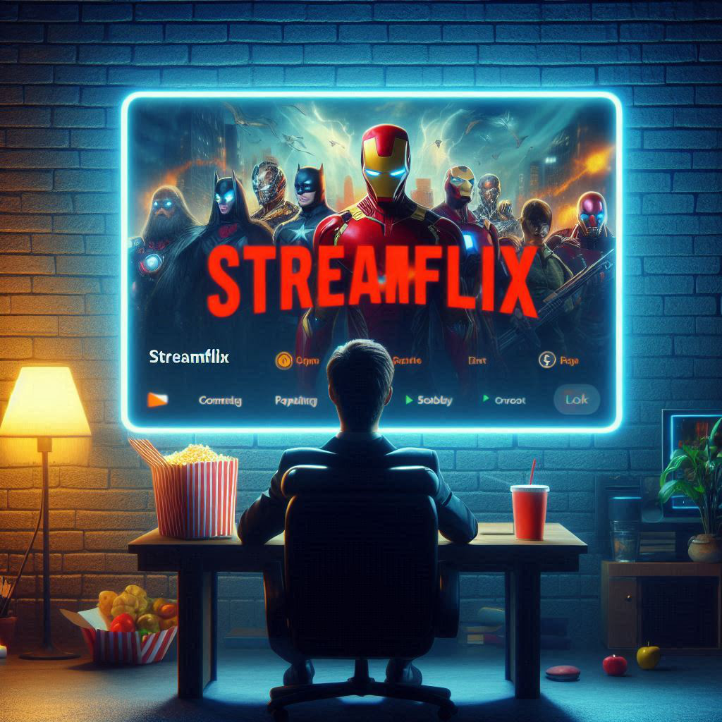
Streamflix Movie Recommender System
Created by:
Evaclaire Munyika
Simon Makumi

Slide 2
3
5
6
Table of Contents
1
Business Understanding
2
Data Understanding
Observations and Results
4
Conclusion
Recommendations
Next steps

Slide 3
Business Understanding
This can be the part of the presentation where you introduce yourself, write your email…

Slide 4
Business Understanding
Business Problem
Objective
Overview
Streamflix aims to enhance user experience with a movie recommendation system that will leverage collaborative and content-based methods for more personalized top 5 movie suggestions.
User retention and engagement issues are impacting company revenue, customer satisfaction and Streamflix’s competitive edge in the streaming industry.
To develop and deploy a hybrid recommendation system to improve prediction accuracy by capturing user-item interactions and movie attributes for a personalized experience.

Slide 5
Data Understanding
This can be the part of the presentation where you introduce yourself, write your email…

Slide 6
Data Understanding
Data Source
Our data is from the MovieLens dataset by the GroupLens research lab at the University of Minnesota.
Features of Importance
Movie_id - unique movie identifier.
Title - movie title.
Genres - movie genres.
User_id - unique identifier for users .
Rating - ratings given by the users.

Slide 7
Observations
This can be the part of the presentation where you introduce yourself, write your email…

Slide 8
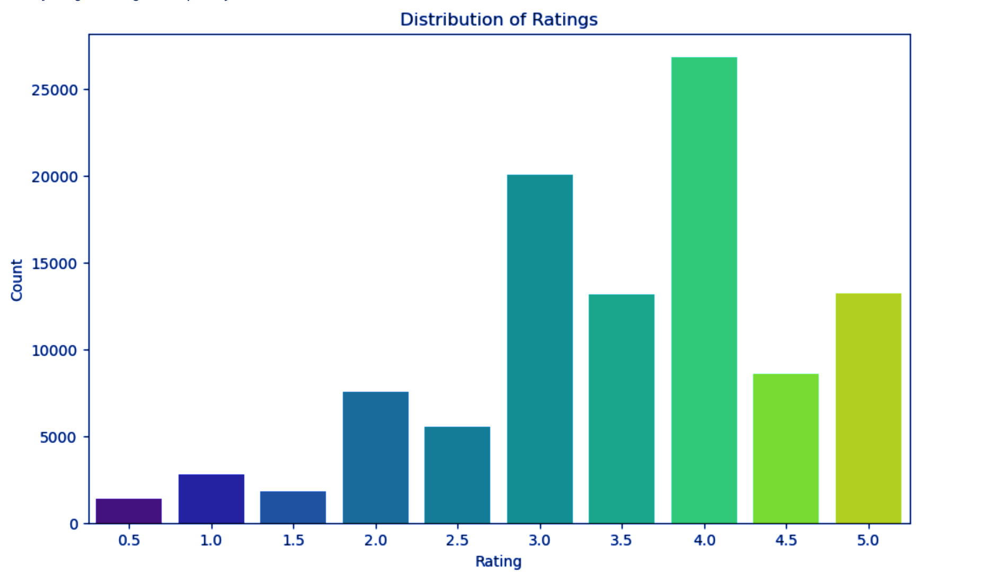
The most common rating is 4.0.
The distribution is positively skewed towards higher ratings.

Slide 9
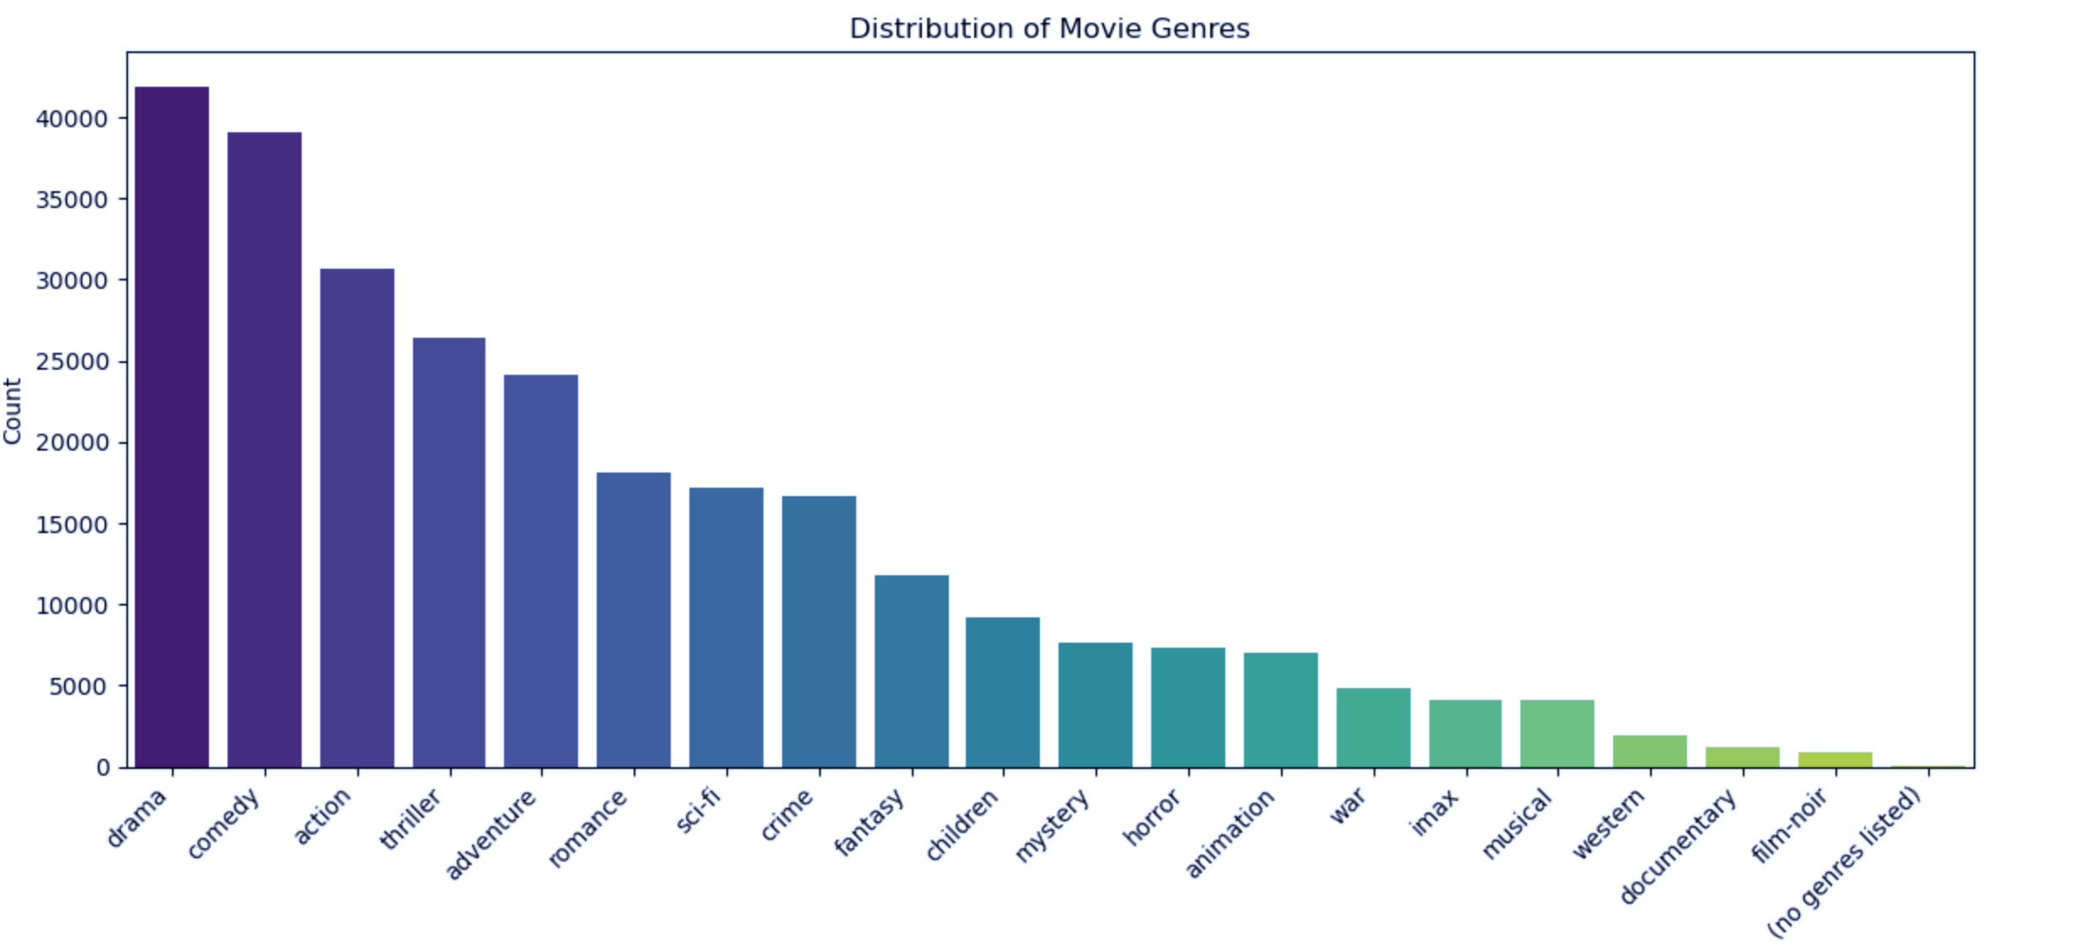
Drama is the most preferred genre followed closely by comedy.
Niche genres like animation, war, IMAX, musical and Western appear to have fewer than 10,000 movies each.

Slide 10
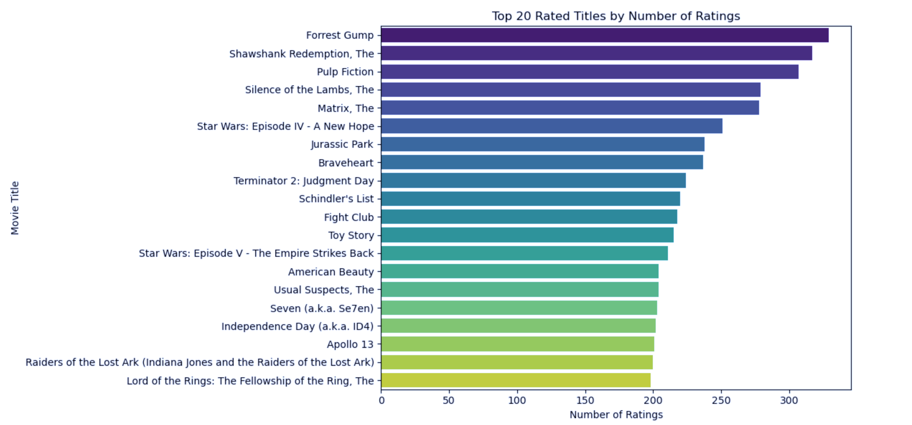
'Forrest Gump' has the highest number of ratings followed by 'The Shawshank Redemption' and 'Pulp Fiction’.

Slide 11
Modeling Results

Slide 12
Baseline dummy model yielded an RMSE of 1.43, SVD model outperformed KNN with an RMSE of 0.862 vs. 0.975.
Developed a CollabBasedModel for collaborative filtering and a ContentBasedModel for content-based filtering and combined both techniques creating a hybrid model.
The hybrid model tested various collaborative filtering weights, showing improved RMSE scores with higher weights reaching 1.1221 at a weight of 0.8 indicating better prediction accuracy with higher collaborative filtering emphasis.

Slide 13
Conclusions
This can be the part of the presentation where you introduce yourself, write your email…

Slide 14
Conclusions
The collaborative filtering model with an RMSE of 0.86 outperforms the hybrid model which shows higher RMSE of 1.24
This illustrates that collaborative filtering in a hybrid approach yields better accuracy and recommendation quality.

Slide 15
Recommendations
This can be the part of the presentation where you introduce yourself, write your email…

Slide 16
Recommendations
Experiment with smaller increments around the optimal collaborative filtering weight (0.6 > k < 0.8)
Use cross-validation to confirm that improvements in RMSE are consistent and not due to random variations or overfitting.
Integrate deep learning-based models and other advanced methods to enhance model capabilities..

Slide 17
Next Steps
This can be the part of the presentation where you introduce yourself, write your email…

Slide 18
Next steps
1. Set up an A/B test comparing the collaborative filtering and hybrid systems.
2. Set up a robust monitoring system to track performance of the deployed model over time.
3. Implement a mechanism for users to rate the quality of recommendations.

Slide 19
Thank You!
For follow-up questions
Reach out to us on:
evamunyika@gmail.com
simonmakumi5@gmail.com
Please keep this slide for attribution

