Slide 1
计算可复现性工作坊：研究汇报
Deardorff 等，PLOS ONE 2020。此稿是现稿修改路径对照，研究主张仍待科研审阅。
来源：Deardorff et al., PLOS ONE 2020；待科研审阅
Notes:
计算可复现性工作坊：研究汇报
来源：Deardorff et al., PLOS ONE 2020；本稿为待审候选。
Attribution supplied by the input; source accuracy and license rights have not been independently verified.

Slide 2
研究问题与汇报范围
研究关注编程工作坊与生物医学工作流程的计算可重复性；观察变化不等于因果证明。
来源：Deardorff et al., PLOS ONE 2020；待科研审阅
Notes:
研究问题与汇报范围
来源：Deardorff et al., PLOS ONE 2020；本稿为待审候选。
Attribution supplied by the input; source accuracy and license rights have not been independently verified.

Slide 3
研究方法与时间点
工作坊前访谈 14 人，三个月后有 12 人完成后访谈；两时点分母不同。
来源：Deardorff et al., PLOS ONE 2020；待科研审阅
[sample] https://doi.org/10.1371/journal.pone.0230697 ; https://doi.org/10.1371/journal.pone.0230697 · PDF 1 methods ; PDF 5 sample
Notes:
研究方法与时间点
来源：Deardorff et al., PLOS ONE 2020；本稿为待审候选。
[sample] https://doi.org/10.1371/journal.pone.0230697 ; https://doi.org/10.1371/journal.pone.0230697 · PDF 1 methods ; PDF 5 sample
工作坊前访谈 14 人，三个月后完成访谈 12 人；两时点分母不同。
Attribution supplied by the input; source accuracy and license rights have not been independently verified.

Slide 4
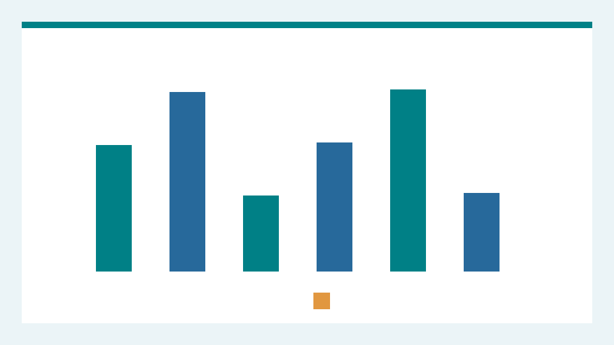

参与者与证据路径
两张自制示意图仅用于说明研究背景，尚未构成明确的可编辑三步证据路径。
来源：Deardorff et al., PLOS ONE 2020；待科研审阅
[illustration] local:asset-rights.json ; local:asset-rights.json · P0-13-IMG-07 ; P0-13-IMG-08
Notes:
参与者与证据路径
预设布局失败：现稿主要依赖两张抽象图片，未把三步证据路径明确标为可编辑的原生流程对象；布局审阅要求重做这一页。
[illustration] local:asset-rights.json ; local:asset-rights.json · P0-13-IMG-07 ; P0-13-IMG-08
第 4 页两张自制示意图不是论文测量数据，权利来自本包声明。
Image [participant-illustration]: WisWork 自制示意图 07; license: owned; alt text: 自制示意图 07；非研究测量数据
Image [second-illustration]: WisWork self-authored schematic 8; not research measurement data; license: owned; alt text: 自制示意图 08；非研究测量数据
Attribution supplied by the input; source accuracy and license rights have not been independently verified.

Slide 5
六项清单均值
六项清单平均分从 1.6/6 到 2.2/6；论文报告 p=0.318，未达统计显著。
来源：Deardorff et al., PLOS ONE 2020；待科研审阅
[score] https://doi.org/10.1371/journal.pone.0230697 · PDF 5 checklist
Notes:
六项清单均值
来源：Deardorff et al., PLOS ONE 2020；本稿为待审候选。
[score] https://doi.org/10.1371/journal.pone.0230697 · PDF 5 checklist
六项清单均值从 1.6/6 到 2.2/6，p=0.318，未达统计显著。
Attribution supplied by the input; source accuracy and license rights have not been independently verified.

Slide 6
开源软件使用：不同分母
Table 1：开源软件使用计数前测 7/14，后测 10/12，不能将计数差视作同一人的逐个变化。
来源：Deardorff et al., PLOS ONE 2020；待科研审阅
[open-source] https://doi.org/10.1371/journal.pone.0230697 ; https://doi.org/10.1371/journal.pone.0230697 · PDF 5 Table 1 ; PDF 5 sample
Notes:
开源软件使用：不同分母
来源：Deardorff et al., PLOS ONE 2020；本稿为待审候选。
[open-source] https://doi.org/10.1371/journal.pone.0230697 ; https://doi.org/10.1371/journal.pone.0230697 · PDF 5 Table 1 ; PDF 5 sample
开源软件使用人数前测 7/14、后测 10/12；分母不同。
Attribution supplied by the input; source accuracy and license rights have not been independently verified.

Slide 7
解释边界与局限
小样本、招募或应答偏差、单人编码及统计功效不足限制了推断。
来源：Deardorff et al., PLOS ONE 2020；待科研审阅
[limitations] https://doi.org/10.1371/journal.pone.0230697 · PDF 9 limitations
Notes:
解释边界与局限
来源：Deardorff et al., PLOS ONE 2020；本稿为待审候选。
[limitations] https://doi.org/10.1371/journal.pone.0230697 · PDF 9 limitations
小样本、招募与应答偏差、单人编码和统计功效不足限制推断。
Attribution supplied by the input; source accuracy and license rights have not been independently verified.

Slide 8
结论与后续审阅
结论和局限并列；科研审阅与真实 PowerPoint 验收尚未完成。
来源：Deardorff et al., PLOS ONE 2020；待科研审阅
[limitations] https://doi.org/10.1371/journal.pone.0230697 · PDF 9 limitations
Notes:
结论与后续审阅
来源：Deardorff et al., PLOS ONE 2020；本稿为待审候选。
[limitations] https://doi.org/10.1371/journal.pone.0230697 · PDF 9 limitations
小样本、招募与应答偏差、单人编码和统计功效不足限制推断。
Attribution supplied by the input; source accuracy and license rights have not been independently verified.

