Slide 1
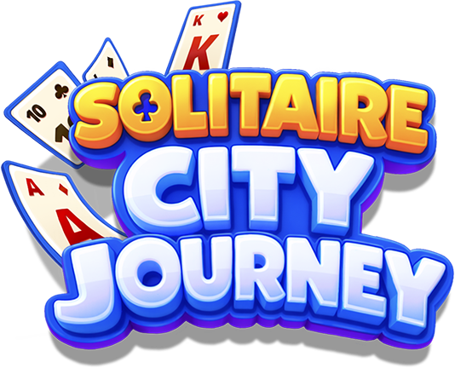
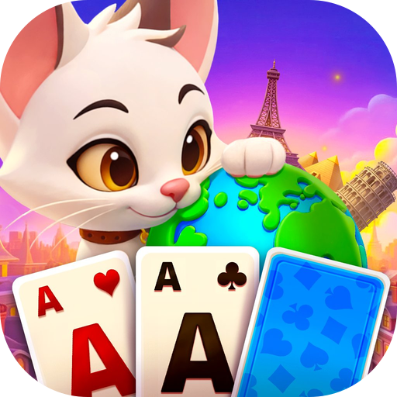
"Clear cards. Build your city. Live the journey."
Genre: Solitaire Tripeaks + City Decoration Meta
Platform: Facebook Instant Games
Audience: Global 35–60; North American adults (F6:M4)
Positioning: Travel the world with your cat companion.
Decorate landmark cities and collect them all.
Solitaire
City Journey
Explore world-famous landmarks with a charming cat companion
Native-app-level event system benchmarked from top solitaire titles
IAP-ready economy with proven solitaire monetization patterns
Facebook Instant Games

Slide 2
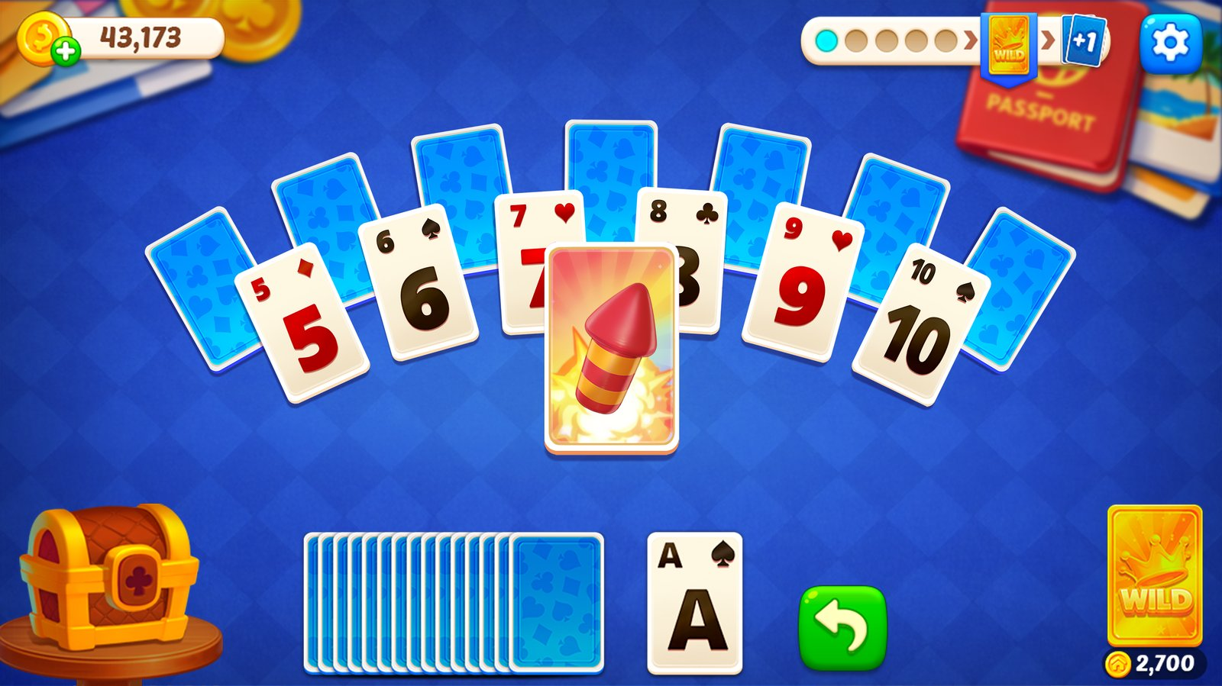



Core Gameplay
"Tap a card, clear the board, decorate your city."
Solitaire Tripeaks
Tap cards one rank higher or lower. Simple to learn, deeply satisfying. 2,800+ handcrafted levels with adaptive difficulty.
World Travel Meta
Travel to famous cities with your cat companion. Decorate iconic landmarks—from New York to Tokyo—and collect them all.
Live Events Engine
Multiple event types rotate weekly—benchmarked from Candy Crush Solitaire and Disney Solitaire’s proven structures.
Simple mechanics → Deep progression → Endless reasons to return

Slide 3



Core Game Loop
"Every session feeds the next. Every reward decorates something real."
01
02
03
04
PLAY
REWARD
DECORATE
LIVE OPS
Tripeaks Puzzle
→
Earn Resources
→
Build Your City
→
Fresh Events
Clear cards with
tap-based mechanics.
2,800+ levels.
Collect coins, stars,
and decoration items
as stage rewards.
Place landmarks,
customize streets,
collect world cities.
Rotating events
add new goals and
exclusive rewards.
↻ The loop is self-reinforcing: more play → more rewards → more decorating → more reasons to play

Slide 4





Key Differentiators
"What makes Solitaire City Journey stand out on Instant Games."
World Travel Meta
2,800+ Levels
Native-Level Events
Travel to iconic cities with a cat companion. Decorate landmarks from New York to Egypt. Collection and ownership drive long-term engagement.
Handcrafted maps with difficulty curves tuned per stage. Content pipeline supports continuous weekly updates.
Event structure benchmarked from Candy Crush Solitaire and Disney Solitaire—multiple concurrent event types.
Broad Demographics
Social Hooks
IAP-Ready Economy
Solitaire’s female-leaning audience + travel/decoration’s universal appeal = 35–60 full demographic reach.
Messenger challenges, feed sharing, and friend-overtake notifications drive organic UA.
Landmark decoration creates natural spend motivations. Premium items, boosters, and event passes designed for solitaire’s proven ARPU patterns.

Slide 5




Monetization
"Landmark decoration creates spend motivations that pure card games can’t."
In-App Purchases (Primary Revenue)
Why IAP Works Here
Premium Decor
Exclusive landmark decorations and city themes that accelerate collection progress
Decoration = Emotional Investment
Boosters
Undo, wild cards, fireworks — proven solitaire IAP items with high repeat purchase rate
Players who decorate landmarks feel ownership. Ownership converts to spend—same pattern as Monopoly GO! and Township.
Event Pass
Time-limited premium track with exclusive rewards — drives recurring spend tied to live events
Events Create Urgency
Time-limited event passes and exclusive decorations drive impulse purchases. Benchmarked from Candy Crush Solitaire’s event structure.
Coin Packs
Soft currency bundles for city decoration — natural sink from meta progression
Boosters Are Proven
Solitaire Tripeaks has one of the highest booster purchase rates in casual gaming. Undo and wild cards are high-margin, high-repeat items.
Advertising (Supplemental)
Native Volume = Native ARPU
Rewarded ads (revive, bonus coins) + interstitials with frequency caps. Non-intrusive layer that scales with DAU without cannibalizing IAP.
Our event density matches top native solitaire apps. Same engagement depth, same monetization opportunity.

Slide 6



Social & Virality
"Your city isn’t just for you. Show it off, challenge friends."
Messenger Challenges
Challenge friends to beat your level score via Messenger links. Compare results in real-time. Sparks instant rematches and brings lapsed players back.
Automatic Feed Sharing
City milestones and high scores generate shareable cards. One tap posts to Facebook feed, creating a natural viral loop with zero effort.
Friend Overtake Alerts
Notifications fire when a friend surpasses your city level or beats your score. Friendly competition drives re-engagement without feeling aggressive.
Sharing is organic and optional—built into moments of achievement, not interruption.

Slide 7



Operational Strategy
"From first tap to loyal player—a clear path at every stage."
Acquisition
Early Retention
(D1–D7)
Mid/Long-Term
(D14+)
Zero-friction start — one tap to play on FB IG
Messenger sharing → organic installs
Feed posts on milestones → social discovery
7-day login reward calendar
Daily tasks → habit formation
City decoration milestones every few levels
Weekly event rotation → fresh reasons to return
City collection deepens ownership investment
Continuous level pipeline sustains content
Content pipeline supports continuous updates. Event structure scales without additional core development.

Slide 8
Proven card mechanics. World travel progression.
Native-level live events. Built for Facebook Instant Games.
2,800+
35–60
IAP + Ad
Handcrafted Levels
Target Demographics
Dual Revenue Model
Solitaire
City Journey
Supergene Games
Facebook Instant Games

