Slide 1
The OSINT pivot
@Gateway
@AtomicNicos
Notes:
[15s - 00:00-00:15]

Slide 2






atomicnicos@1337m4ch1n3~$ whoami
atomicnicos.me
@AtomicNicos
AtomicNicos
nicolas-boeckh
gitlab.unige.ch/ Nicolas.Boeckh
Nicolas Boeckh
Notes:
[15s - 00:15-00:30]

Slide 3
Open Source INTelligence / Recon
Relies on publicly available data:
Social media accounts
Phonebooks
Documents
…
Usually less reliant on:
Interaction (HUMINT)
Communications technologies (SIGINT)
Equipment Analysis (TECHINT)
…

Slide 4
OSINT Steps
Define Requirements
Retrieve Data
Analyze
Pivot
Report

Slide 5
Summary
Pivoting ?
Effective pivoting
Logging
Tips

Slide 6
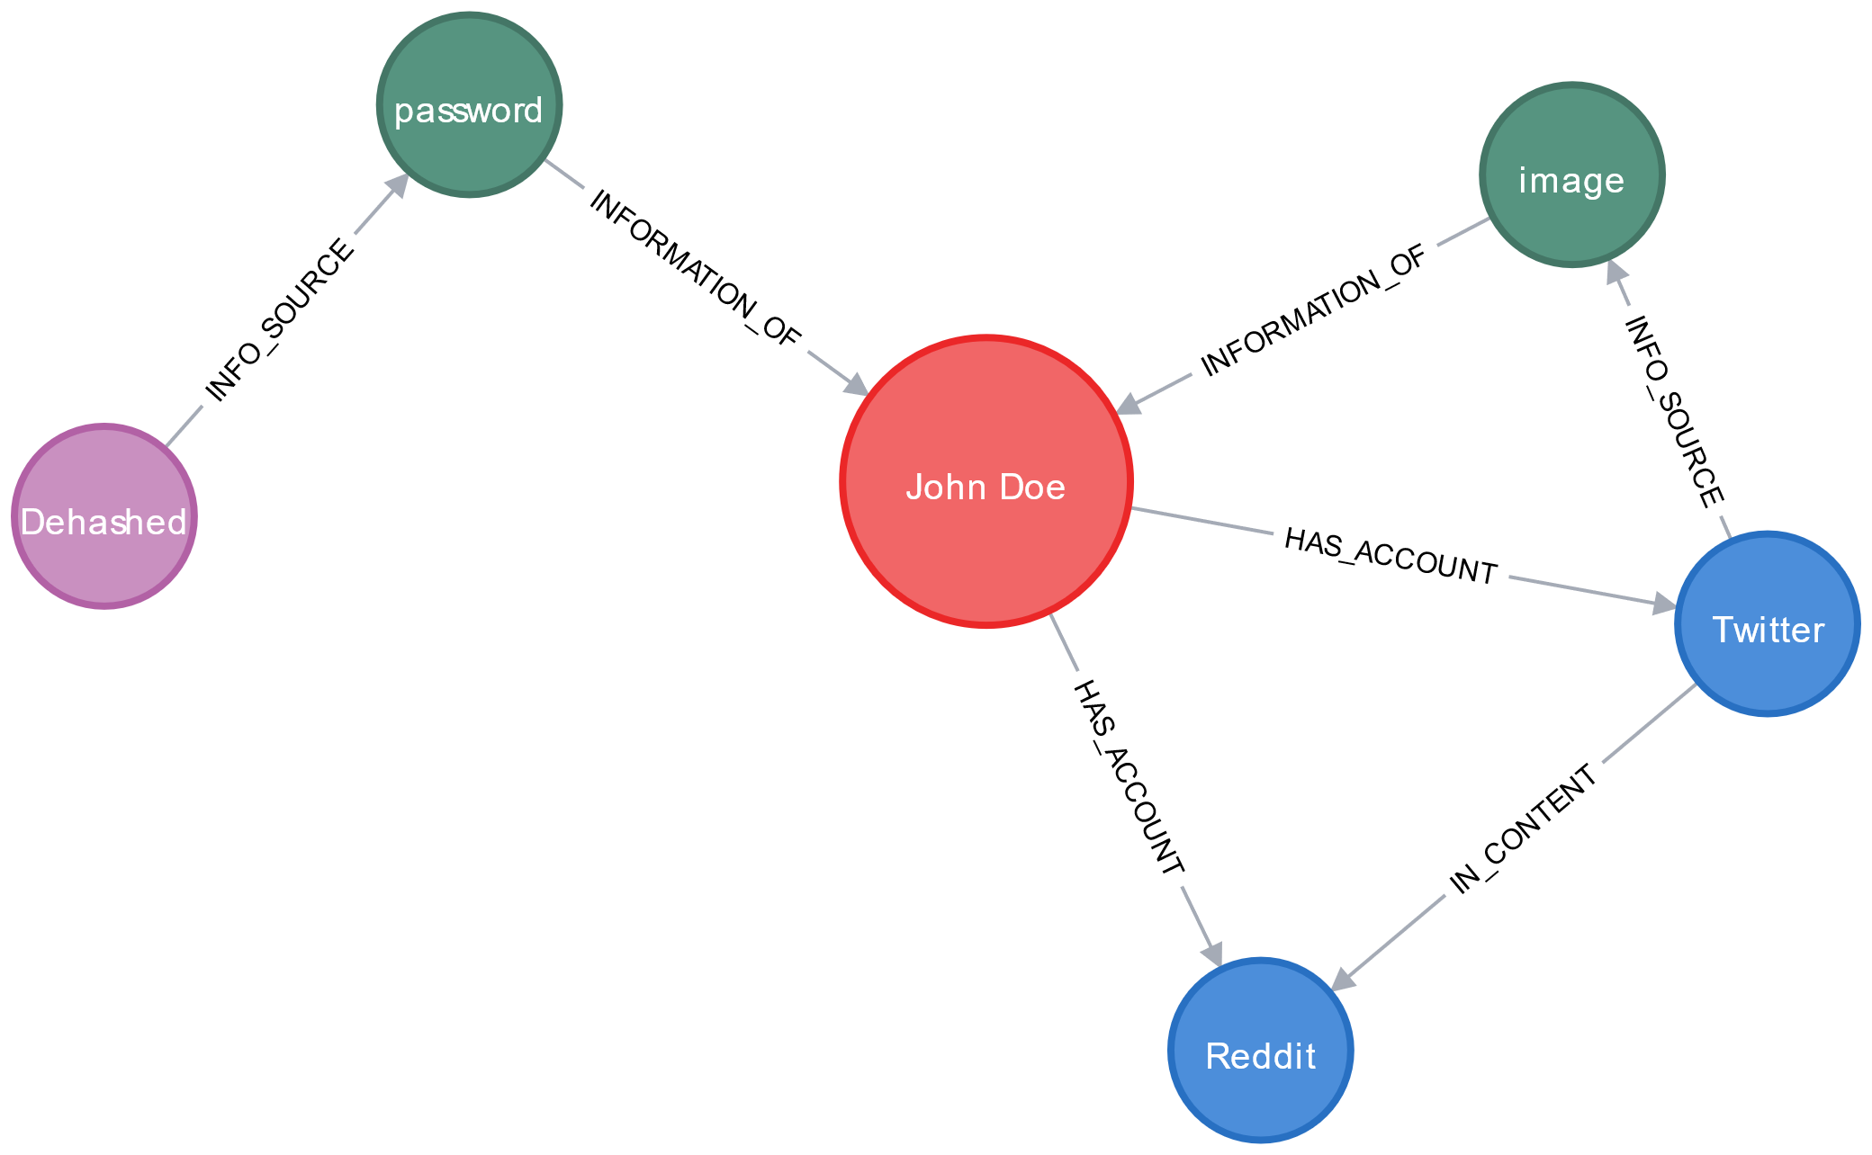
Pivoting ?
Get datapoints from a previously collected datapoint
Use it to grow the dataset

Slide 7


Slide 8
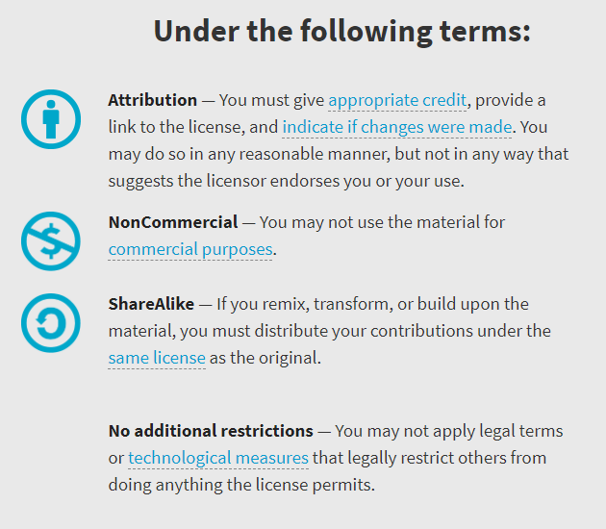

Availability
Work licensed under Creative Commons : CC-BY-SA (legalcode)
Open License
@AtomicNicos
Notes:
[30s – 31:40-32:10]

Slide 9

Thanks
Special Shoutouts
@coffee_fueled
@ClaireTills
@RoseSecOps
@safesecs
@RayRedacted
@TheBeerFarmers
@SeanWrightSec
@AppSecBloke
@phat_hobbit
@ScottMcGready
@j_opdenakker
@InfosecHour
@5w0rdFish
@lennaert89
@BeeFauBee09
@rag_sec
@TheCyberViking
@juan_spinel
@yellowcap_ghost
@CyberSecV
@davewj
Research
Shoutouts
@LisaForteUK
@smealum
@tautology0
AMA
Discord : @AtomicNicos#1404
Twitter : @AtomicNicos
Notes:
[60s – 32:10-33:10]
+ Q&A

