Slide 1
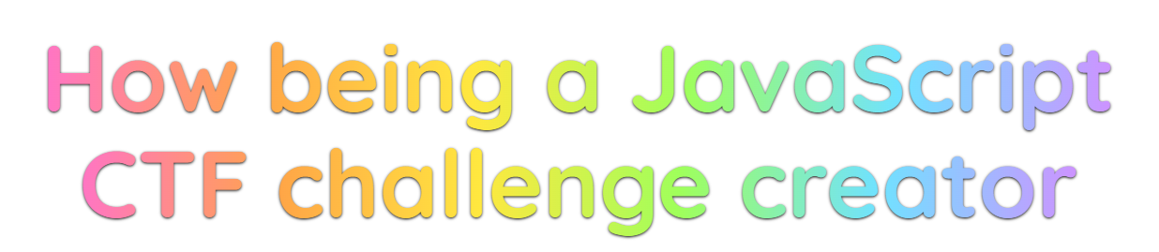

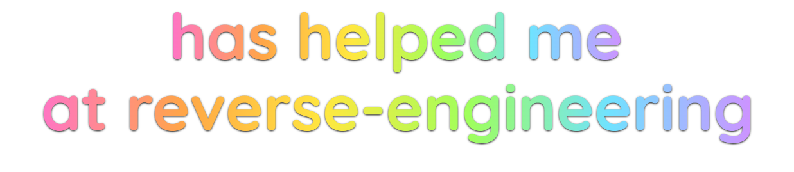

Slide 2

# whoami
Maya (aka. AtomicMaya)
they/she
(cyber/info)sec multi-practitioner of some intentionally vague description
On the side?
studies, communities, CTF’s, conferences
I do stupid (fun?) things

Slide 3
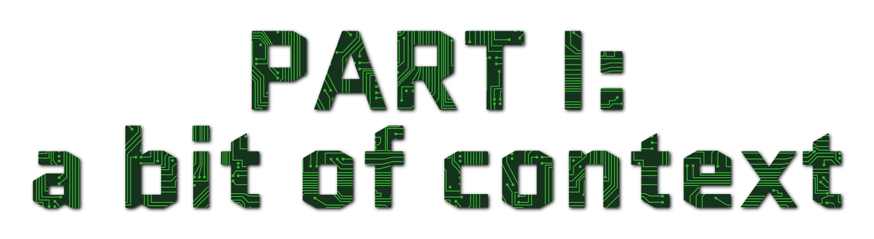

Slide 4
I really enjoy a good CTF – as a player
Notes:
- Player: TraceLabs,

Slide 5
I really enjoy a good CTF – as a contributor
I’ve built a few challenges
A lot of procedural steps:
Ideating
Feasibility
Reproducibility
Complexity
Engineering
Documenting
Notes:
- Player: TraceLabs,

Slide 6
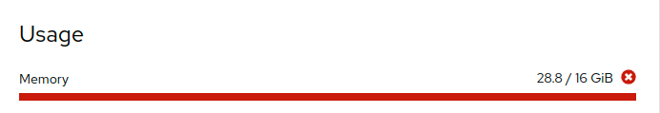
I really enjoy a good CTF – as an organizer
I really love the RACTF team for letting us stress test their platform with live events
Things catching fire halfway through is really fun
Notes:
- Player: TraceLabs,

Slide 7
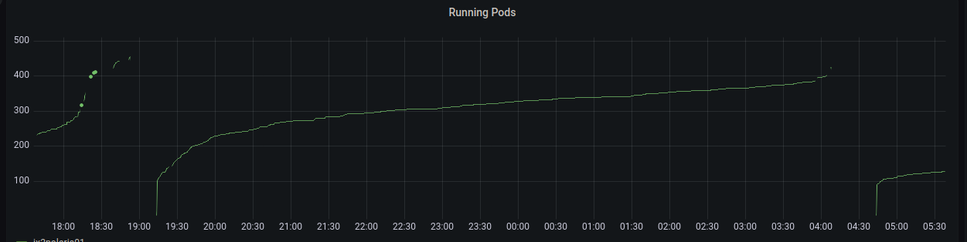
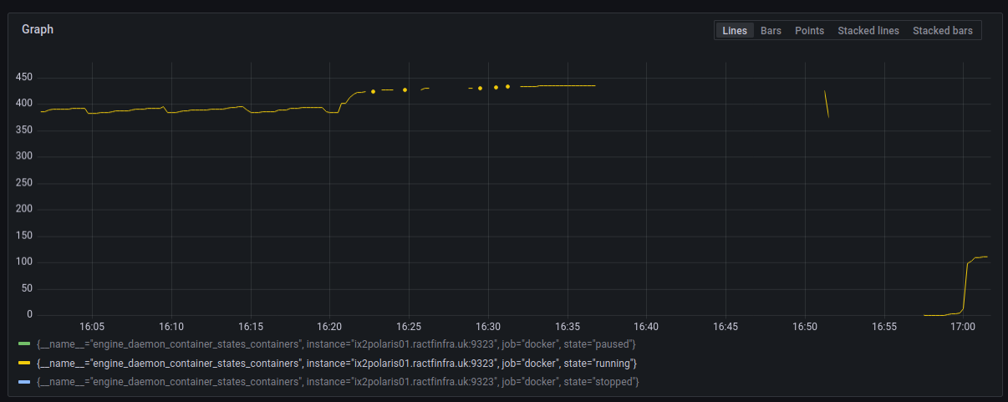

Slide 8


Slide 9
A brief introduction to JavaScript
A brief introduction to obfuscation
A brief introduction to JSFuck
How to get every single character
Builders

Slide 10

A brief introduction to JavaScript
Brendan Eich’s brilliant approach to a stupid idea in 1995
Our computers make use of it incalculably often
It is still very much maintained (ECMAScript is beautiful)
Notes:
“Let’s make some code on the web run on our client’s devices!”
Besides that, and various contributions at Mozilla, and founding Brave, the guy is pretty terrible.
Security wasn’t really considered back then

Slide 11
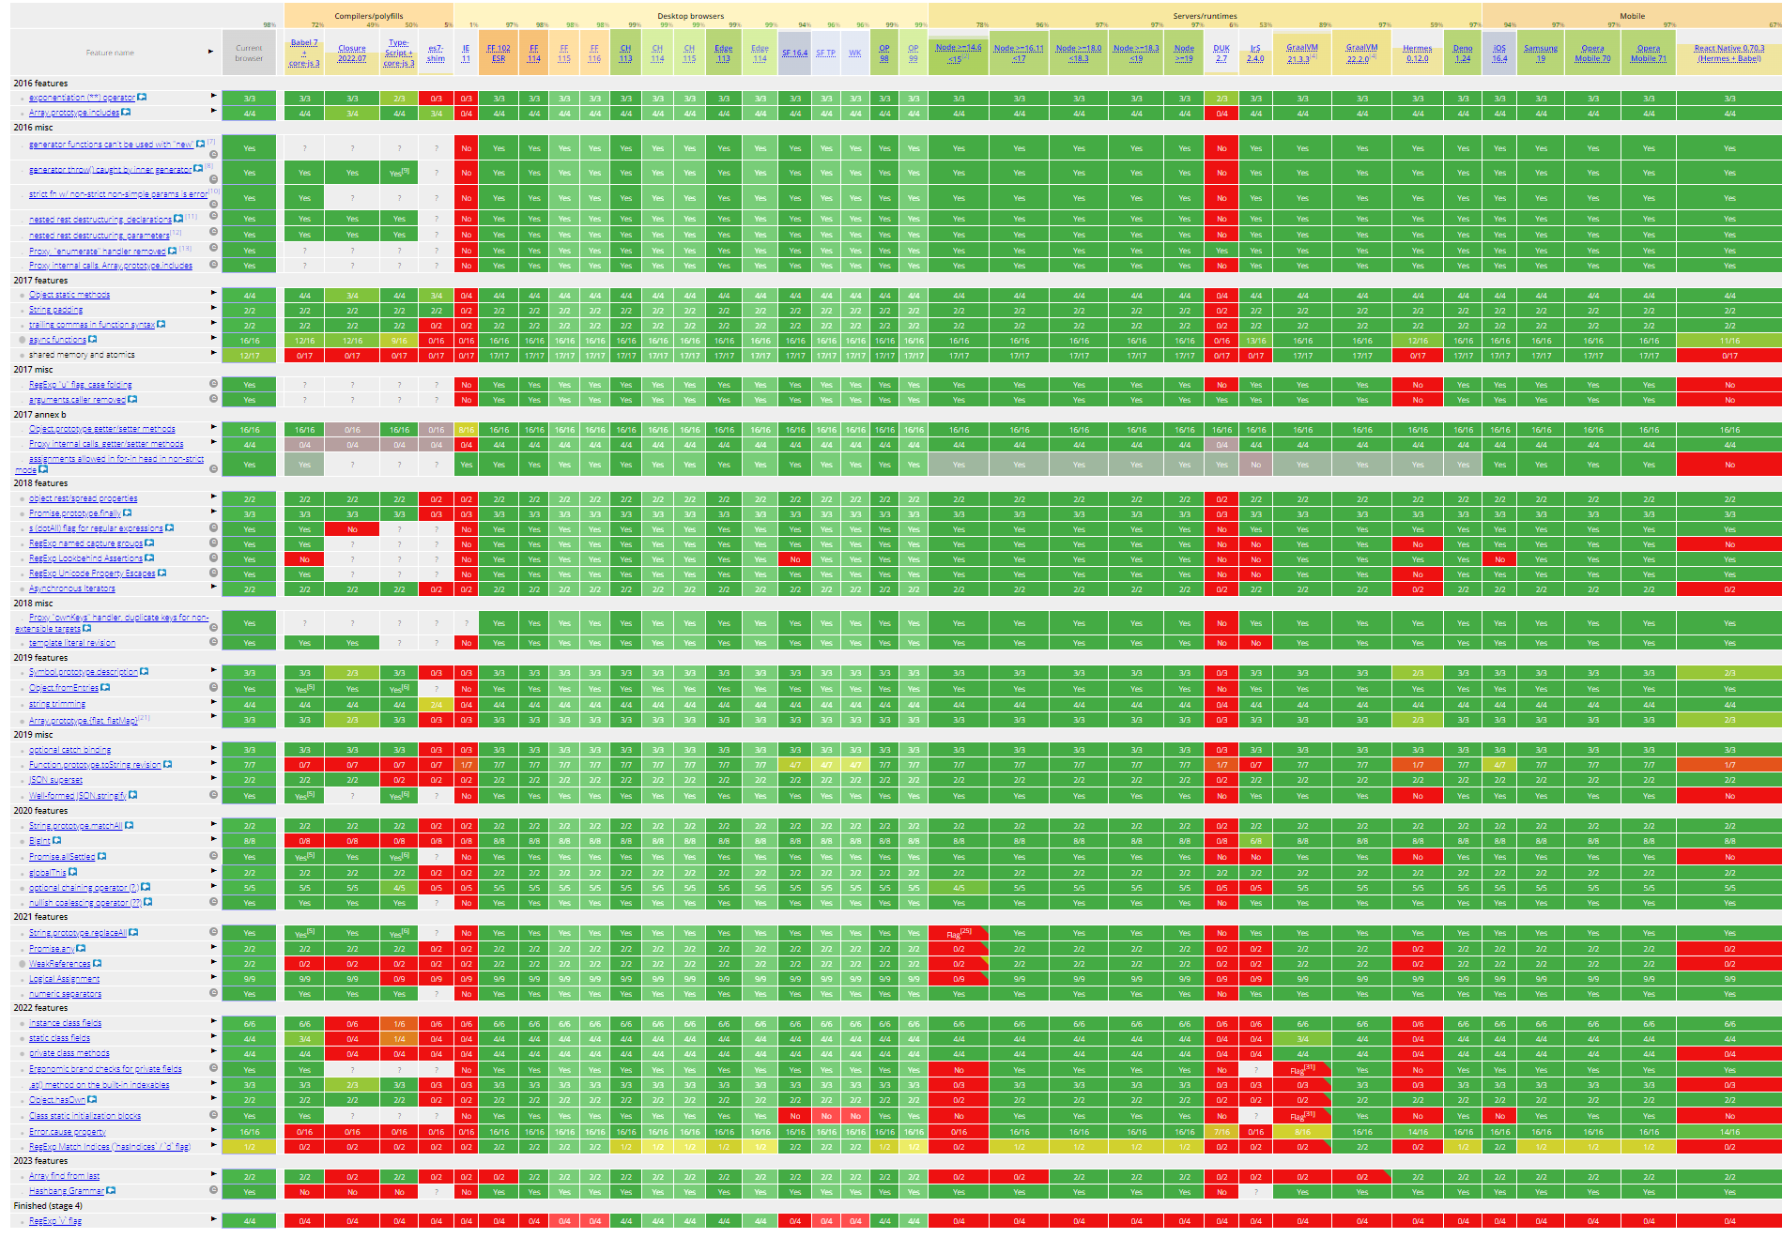
It do be a bit clunky tho

Slide 12
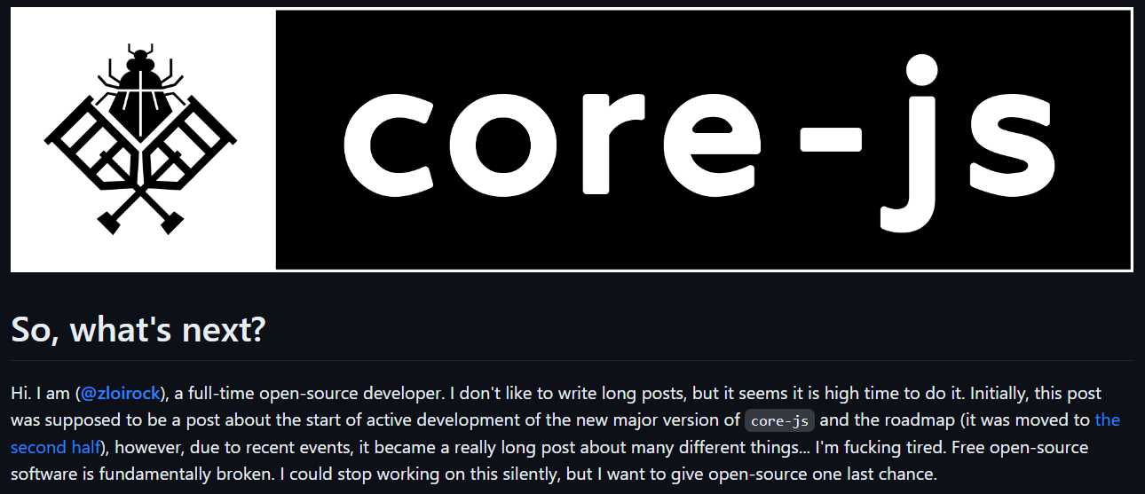
polyfills the unclunkinator
Well… maybe.
But the tale of the core-js polyfills project is “of concern”
github.com/zloirock/core-js/blob/master/docs/2023-02-14-so-whats-next.md
Notes:
- In a Dr. Doofenschmirtz voice

Slide 13
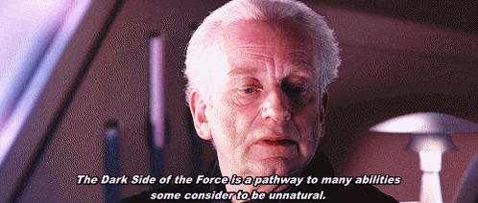
“I was promised something cursed”
Obfuscation:
It’s fun!
Hide things in other things!
What if I told you that you could in fact hide most of JS within an… esoteric… version of JS.
Notes:
Invisible ink that needs heat to show!

Slide 14
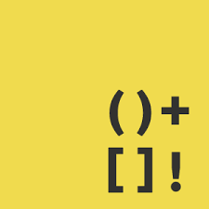
JSF*ck my beloved
These 6 characters let you write out anything!
And so long as you can actually spell out eval, well you can execute anything!
Unconvinced?
Ok, let’s have some fun!

Slide 15
WARNING Contrast Change

Slide 16
JSF*ck – Most numbers are very easy
+![] | 0
+!![] | 1
+!![]+!![] | 2
+!![]+!![]+!![]+!![]+!![] | 5
+!![]+!![]+!![]+!![]+!![]+!![]+!![]+!![]+!![]+!![] | 10

Slide 17
JSF*ck – Easy values
![] | false
!![] | true
[][+![]] | undefined
+[][[]] | NaN
+(+!![]+(![]+[])[+!![]+!![]+!![]+!![]]+(+!![]+!![]+!![])+(+![])+(+!![]+!![]+!![]+!![]+!![]+!![]+!![]+!![]+!![])) | +("1e309") aka. Infinity

Slide 18
“Excuse me, but quoi de le JSF*ck???”
+(
+!![] // 1
+(![]+[])[+!![]+!![]+!![]+!![]] // "false"[4] = ”e”
+(+!![]+!![]+!![]) // 3
+(+![]) // 0
+(+!![]+!![]+!![]+!![]+!![]+!![]+!![]+!![]+!![]) // 9
) // +("1e309")

Slide 19
WARNING Contrast Change

Slide 20
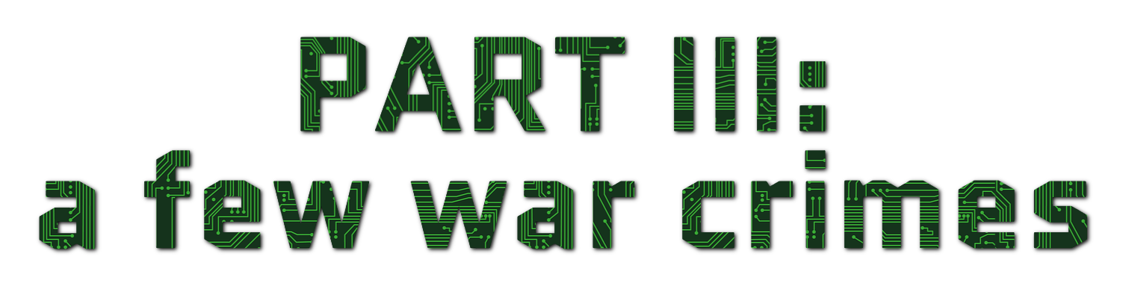

Slide 21
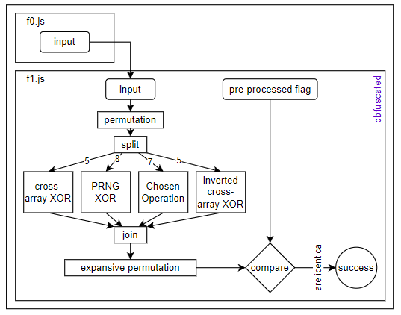
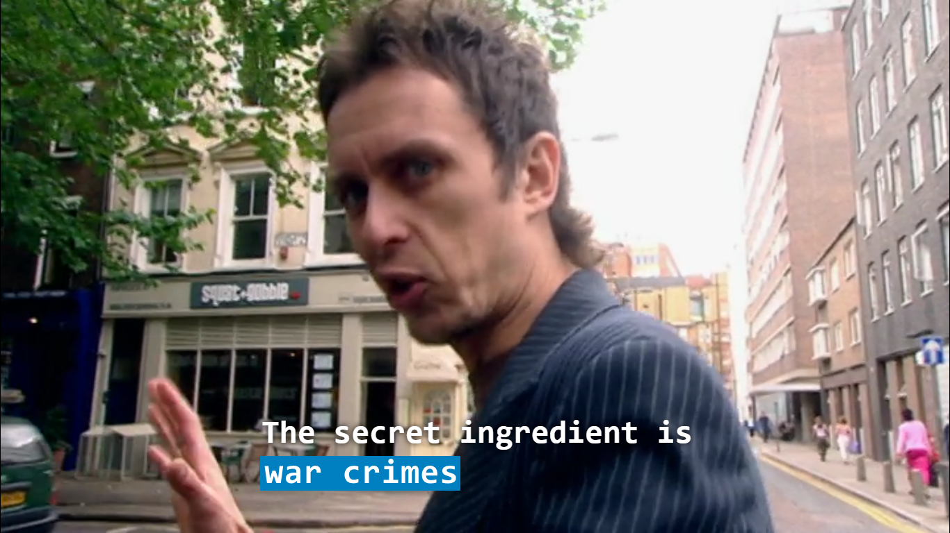
Evil CTF challenges

Slide 23
2 kinds of challenges
Creative things (e.g. base128 encoding)
Mind blasters (e.g. below)
Reverse Staticology
Random In’nit
The Geneva Suggestion
Creative resolution

Slide 24
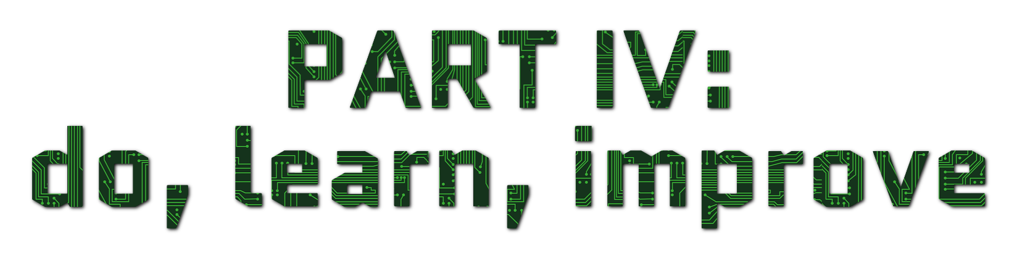

Slide 25
Fatal flaw with anything frontend
Fatal flaw with anything client incoming
“Client side certs” is a sequence of words I never want to hear in my life again

Slide 26
