Slide 1
From the living room to the boss’ office: IoT
(aka. The bane of Infosec)
@AtomicNicos
Notes:
[15s - 00:00-00:15]

Slide 2
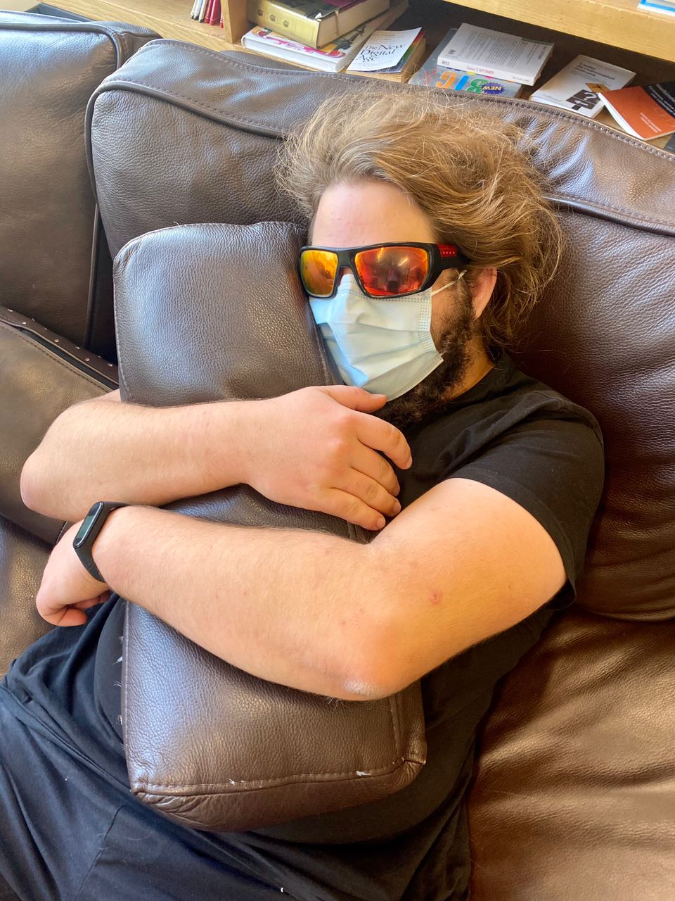


atomicnicos@1337m4ch1n3~$ whoami
@AtomicNicos
nicolas-boeckh
Nicolas Boeckh
Notes:
[15s - 00:15-00:30]

Slide 3
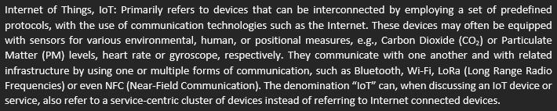
IoT
“Internet of Things”
A device that can “speak” to others
@AtomicNicos

Slide 4
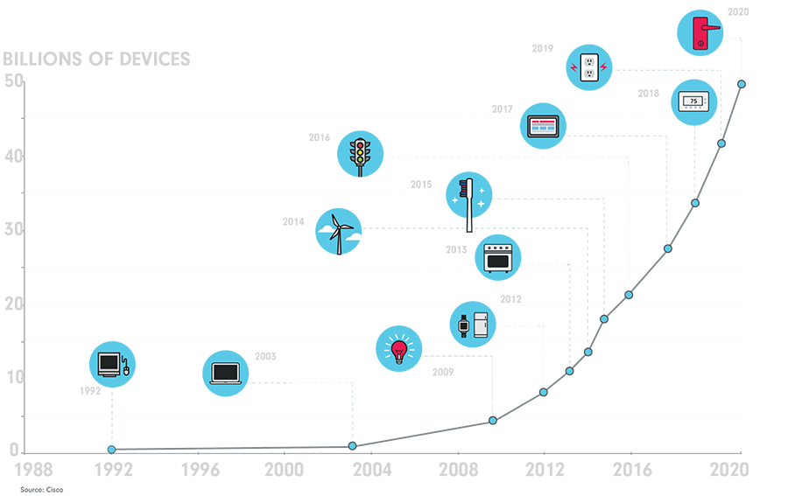
State of IoT
> 50 Billion IoT devices
IoT is everywhere Home automation, Logistics, Environment, Public Health
Technological breadth Cellular, ZigBee, BLE, LoRa, RFID
Credit: NCTA
@AtomicNicos

Slide 5
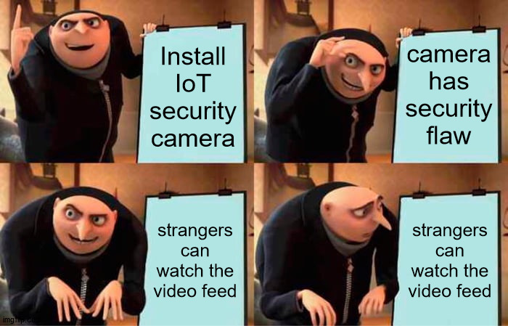
State of IoT security
Recent ISO/IEC standards e.g. : ISO/IEC 21823-2:2020
No “one size fits all” approach
Main aspect is interoperability Security is optional e.g.: Bluetooth Generic ATTribute (GATT) scheme
@AtomicNicos
Notes:
ISO/IEC 21823-2:2020
Internet of things (IoT) — Interoperability for IoT systems — Part 2: Transport interoperability

Slide 6
Summary
Breadth of (IoT IN) THE WILD
BEING A BADDIE,
IS IT HARD?
3LA RECOMMENDATIONS
@AtomicNicos

Slide 7

Breadth of (IoT in) the wild

Slide 8
Home automation

Slide 9
Environment control

Slide 10
Teledildonics

Slide 11
Industrial

Slide 12
Medical

Slide 13

ENISA
EU Cybersecurity Agency
Publishes recommendations
Hosts forums and conferences
@AtomicNicos
Notes:
ENISA active since 2005

Slide 14
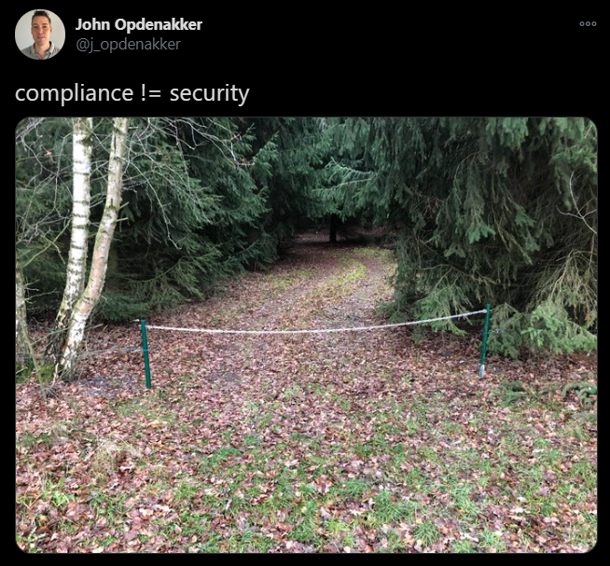
Compliance
Not the legalese version of compliance
Following / Adapting to recommendations
@AtomicNicos

Slide 15
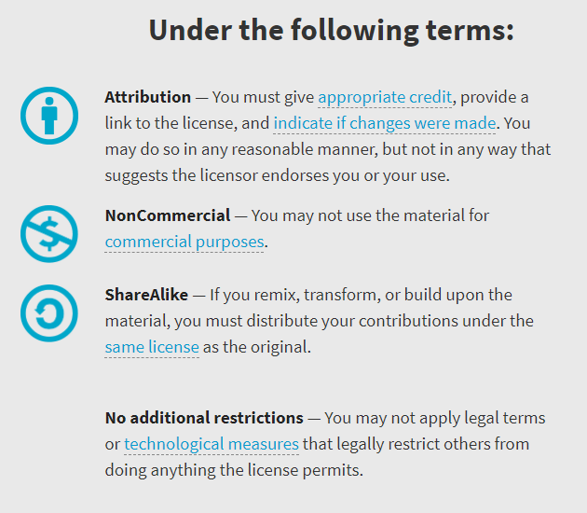

Availability
Work licensed under Creative Commons : CC-BY-SA (legalcode)
Open License
@AtomicNicos
Notes:
[30s – 31:40-32:10]

Slide 16

AMA
Discord : @AtomicNicos#1404
Twitter : @AtomicNicos
Notes:
[60s – 32:10-33:10]
+ Q&A

