Slide 1
Bring your own tooling
The hidden art of building shit that works for your specific use case

Slide 2

# whoami
Maya (aka. AtomicMaya)
they/she
(cyber/info)sec multi-practitioner
Someone made a mistake putting me “in charge” of security
On the side?
studies, communities, CTF’s, conferences
I do stupid (fun?) things
I am not that Swiss maia
Notes:
From Switzerland, sadly not the Nordic land of Blahaj (my beloved) or meatballs, but the country with about 50 different swiss german dialects (none of which are remotely close to german) and with 3 ways of saying 80 in French. Also cheese.

Slide 3

Maya (aka. AtomicMaya)
they/she

Slide 4
The Disclaimer
Opinions are mostly my own (my sharks had some say)
Any scenarios / individuals cited are purely fictional, regardless of the resemblance to any (living, dead, other) ● (person, entity, cat)
Please feel free to interrupt with questions ☺
@AtomicMaya

Slide 5
Bring your own tooling
The hidden art of building shit that works for your specific use case

Slide 6
“Don’t reinvent the wheel”
@AtomicMaya
Notes:
My issue with that sentiment is that most wheels out there feel like they've been engineered for a bloody spaceship when I just need the cart to go over the hill to the next village.

Slide 7


Mapping stuff?
nmap
masscan
portSpider
Service Map (Azure)
Leviathan Framework
sqlmap
tplmap
@AtomicMaya

Slide 8

Querying stuff and modifying data?
Postman
Hoppscotch (formerly Postwoman)
ZAProxy
Burpsuite
FoxyProxy
curl
@AtomicMaya

Slide 9

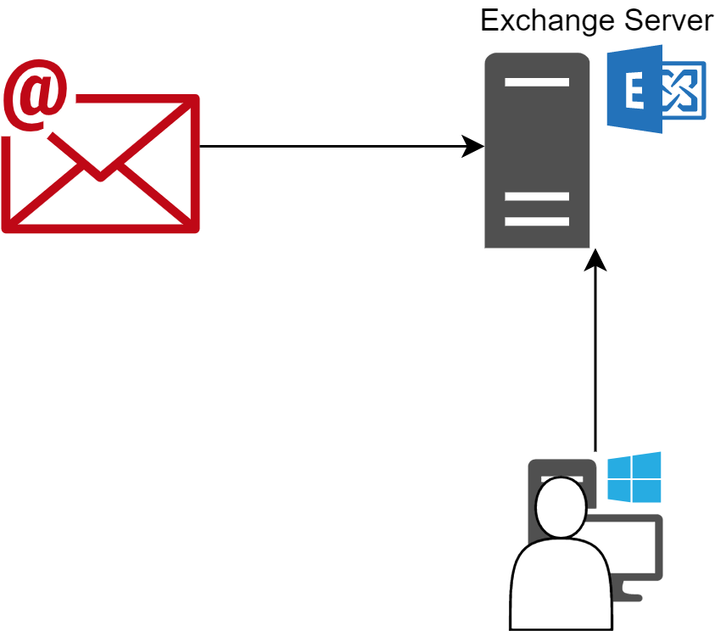
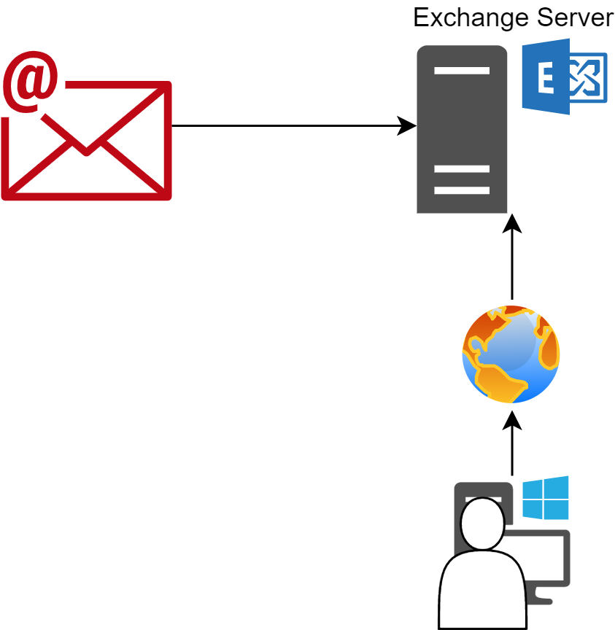
That’s very nice, but...
@AtomicMaya

Slide 10
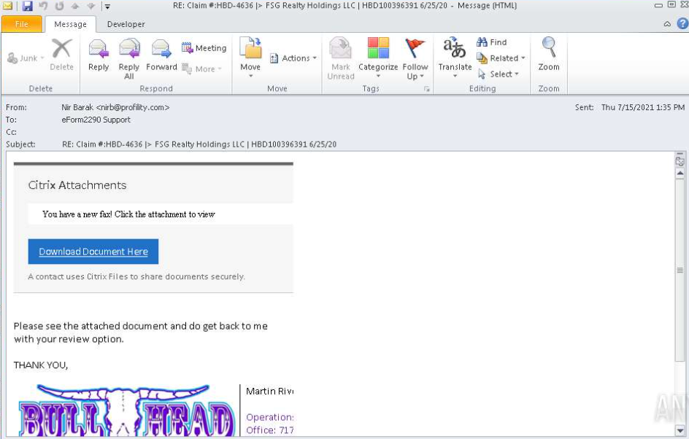
people at <workplace> get these!
@AtomicMaya

Slide 11
So I need to have a *thing* in a *place*
@AtomicMaya
Notes:
Arrow 1: User
Training
Arrow 2: Computer
AV + Endpoint protection
Arrow 3: Inbound mailserver
The fun bits

Slide 12
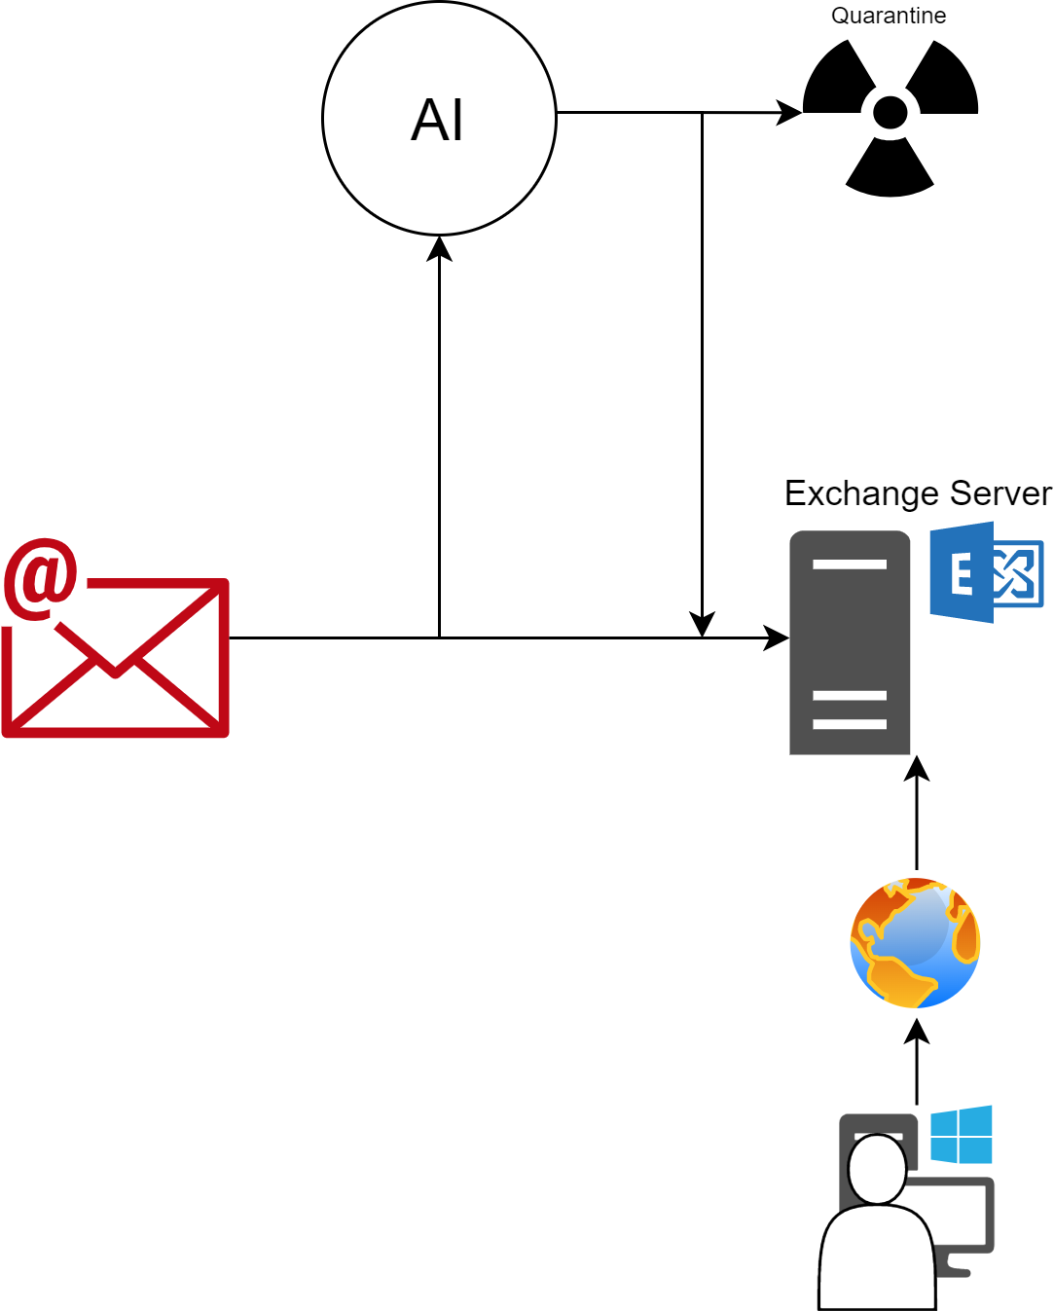
In this *purely hypothetical* scenario
@AtomicMaya
Notes:
You give it to some person called AL, and they decide what to do with it.
Parenthesis about AI

Slide 13
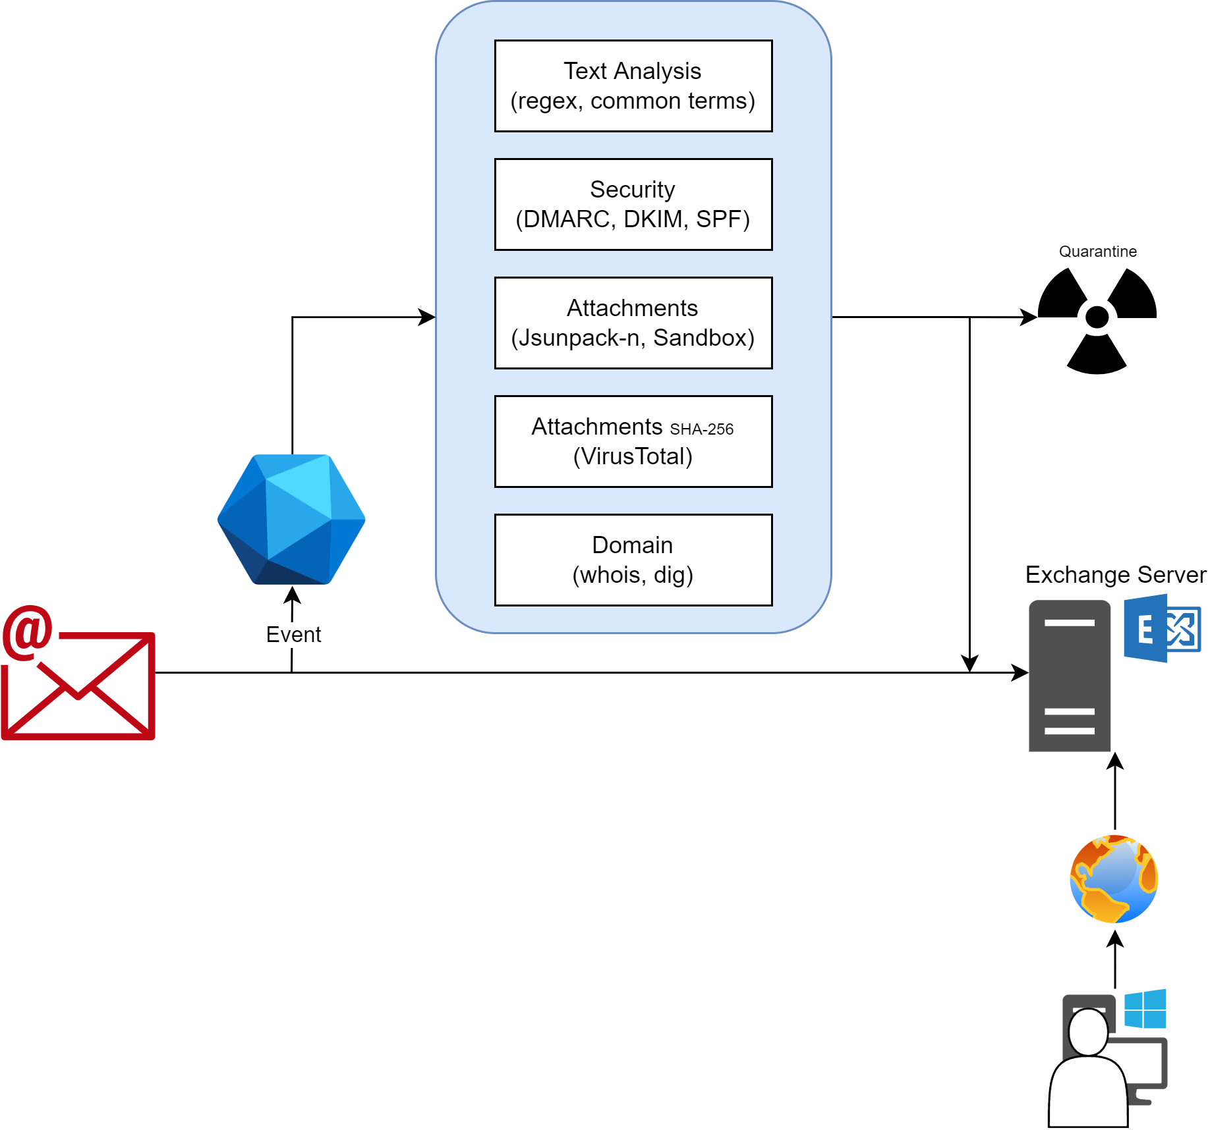
@AtomicMaya
Notes:
You give it to some person called AL, and they decide what to do with it.
Parenthesis about AI

Slide 14

Summary
The general idea (⬆️)
What is scripting?
What are the best languages to script in? (opinion)
No, really why would I script?
Back to basics
@AtomicMaya

Slide 15

“Sometimes you just need a very fancy hammer”
@AtomicMaya

Slide 16
“I’m no software engineer”
Software Engineering
≠
“throwing together some hacky piece of kit that does the job”
@AtomicMaya

Slide 17
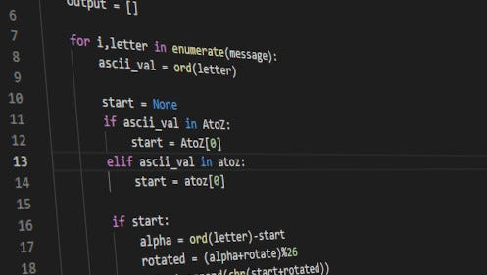
To script
Test out ideas
Automate a query
Automate an action
Do some fancy math
Play with spreadsheets
Play with API’s
@AtomicMaya

Slide 18
Life of a script
Do Thing 1
Do Thing 1 and then Thing 2
Do Thing 1 and then either (Thing 2 or Thing 3)
Oh now I need user input or an argument to differentiate
Oh I’m calling this from somewhere else so I needmore arguments
Oh I’ve Dockerized it
etc.
@AtomicMaya

Slide 19
Best languages to script in (imho)
Python
Golang
Interpreted language
Interpreters everywhere
Pre-loaded with modules
pypi.org has many more modules
Syntactically easy to understand
Updated regularly
Compiled language
Compiles to many platforms
Lightweight binaries
Many packages pre-loaded
pkg.go.dev has many more packages
Syntactically easy to understand
Updated regularly
More graceful error handling
@AtomicMaya

Slide 20
Feature: I/O
Python
Golang
Embedded
f = open(file, mode, encoding)
Package: ioutil
var content, err := ioutil.ReadFile("words.txt")
Can handle file modes (RO, WO, RW, A, etc.)
@AtomicMaya

Slide 21
Feature: System commands
Python
Golang
Module: os
o = os.popen("command").read()
Alternatively, use the subprocess module
Package: os/exec
var out, err := exec.Command("command").Output()
@AtomicMaya

Slide 22
Feature: Advanced formatting
Python
Golang
Embedded (f-strings)
f"Hello, {name}. You are {age}."
Has support for arbitrary content (arithmetic, etc.)
Embedded + Package: fmt
var s = fmt.Sprintf("Hello, %s. You are %s.", name, age)
Has a catch-all %v type.
@AtomicMaya

Slide 23
Feature: Lambda functions
Python
Golang
Embedded
f = lambda x: x**2
Also can be executed anonymously: (lambda x: x**2)(4)
Embedded
var f := func(x int) int { return x**2 }
Also can be executed anonymously: func(x int) int { return x**2; }(4)
@AtomicMaya

Slide 24
Feature: HTTP requests
Python
Golang
Module: requests
x = requests.get(url)
Package: net/http
x, err := http.Get(url)
Parse contents, status codes, headers, etc.
@AtomicMaya

Slide 25

Feature: Text User Interface
What’s a TUI?
A GUI but in your terminal
Why?
It’s cool
It’s low resources
It’s retro-compatible with shells
@AtomicMaya

Slide 26
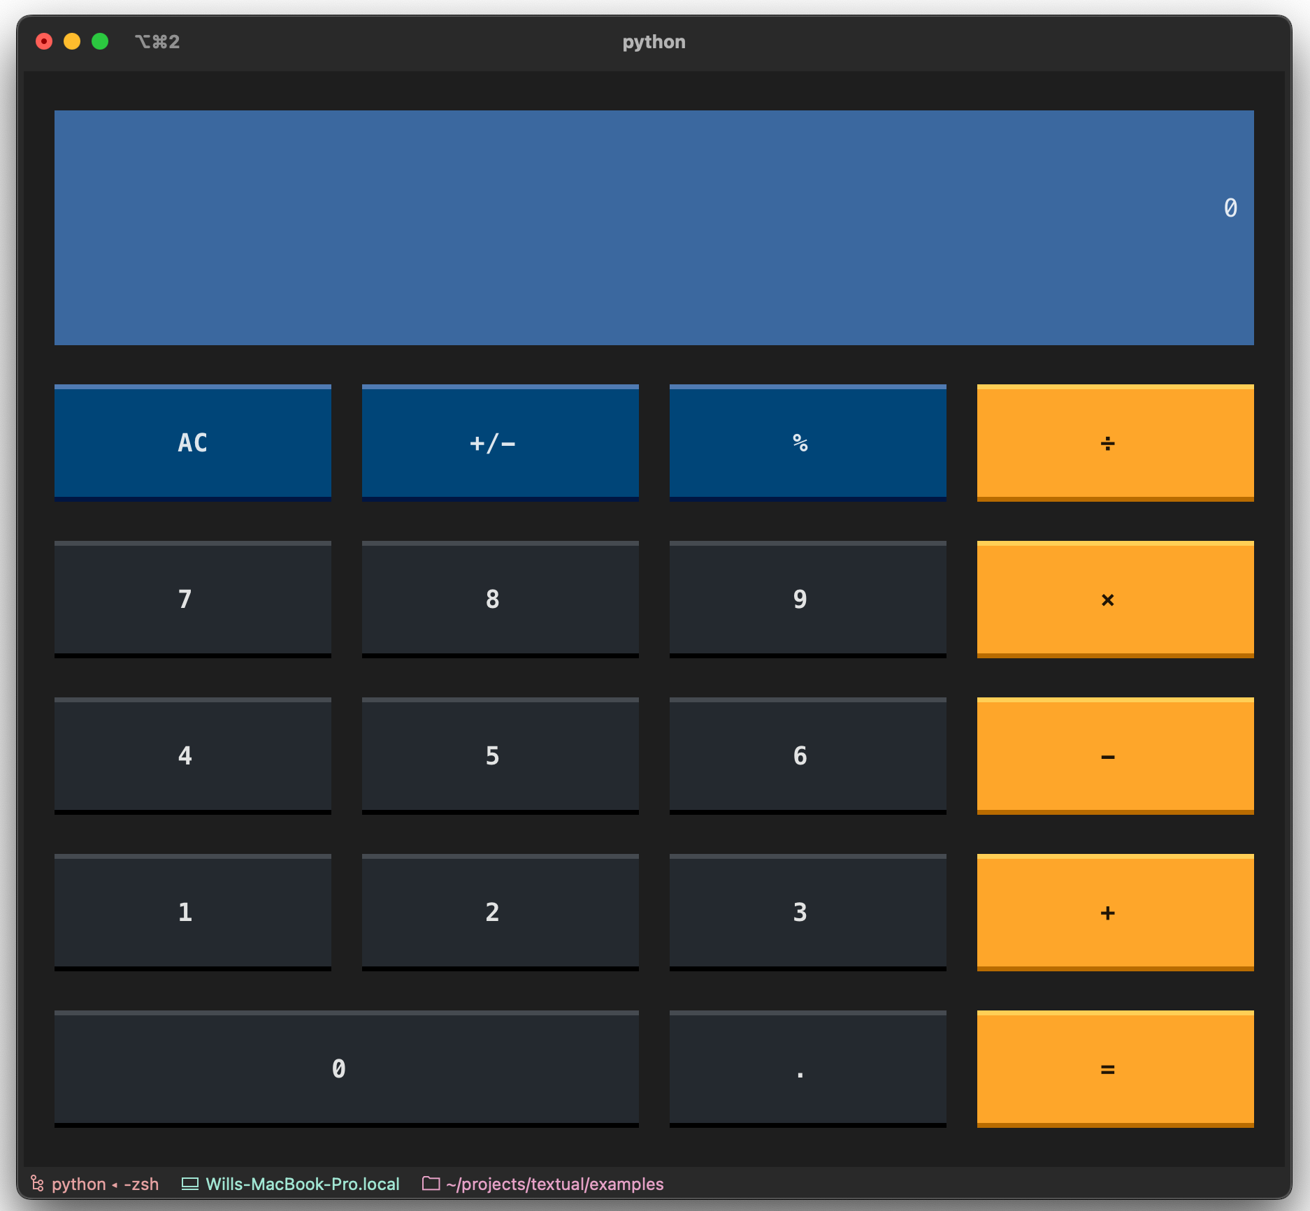
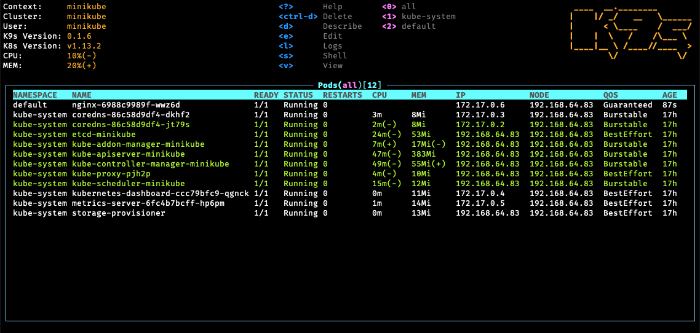
Feature: Text User Interface
Python
Golang
https://github.com/Textualize/textual
https://github.com/rivo/tview/
@AtomicMaya

Slide 27
Bonus points
Python
Go
God-tier list comprehension
API: fastapi
Data Analysis: pandas
HTTP Server: http.server
HTML Tokenizer: bs4
Easy multi-threading
API: gin
Data Analysis: gota + excelize
HTTP Server: net/http
@AtomicMaya

Slide 28

@AtomicMaya

Slide 29
Good reasons
(To get that warm fuzzy inside feeling)
@AtomicMaya

Slide 30

Understand the seedy underbelly of tech
“Oh hey, how does this dusty piece of tech defined in RFC 1149 from 1990 actually work?”
“How does this PoC for an exploit work?”
@AtomicMaya
Notes:
RFC 1149: IP over Avian Carriers

Slide 31
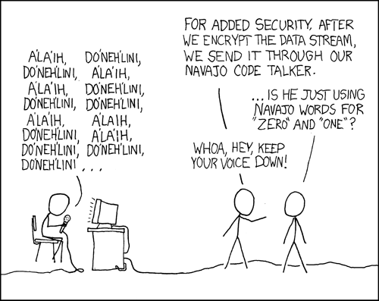
More insights into system deficiencies
“So that’s how the buffer overflow happened”
“Ooooh, this is where the person implementing their own cryptography messed up”
“So that’s where the permissions were misconfigured”
Source: XKCD #257 https://xkcd.com/257/
@AtomicMaya

Slide 32
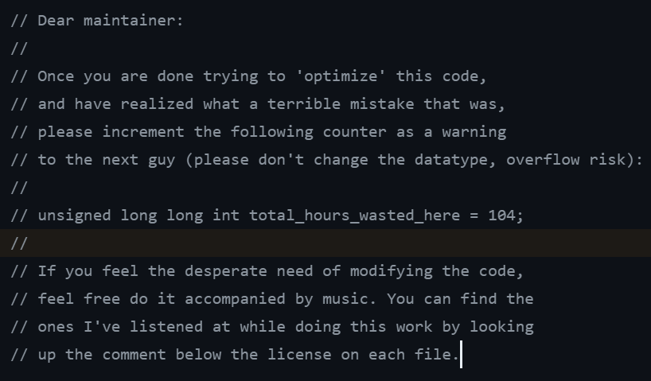
Ability to improve older systems
“Someone built this social security system in the 60’s in COBOL, but they’re dead now”
“The NHS system was using xls files to store COVID data”
@AtomicMaya

Slide 33

Debug 20 year old libraries
“Oh this library recommended by everyone on SO was for Python 2?”
“Have you heard of our lord of browser compatibility, polyfills?”
Source: XKCD #2347 https://xkcd.com/2347/
@AtomicMaya
Notes:
Fun fact, have you heard of polyfills? Or of core-js?
Cool, here’s the story of zloirock, aka Denis Pushkarev.

Slide 34

Mix offensive and defensive skills
Knowing how to do something can give you more insight
See patterns/approaches that others don’t
Transverse skills
@AtomicMaya
Notes:
Talk about Wavegame

Slide 35
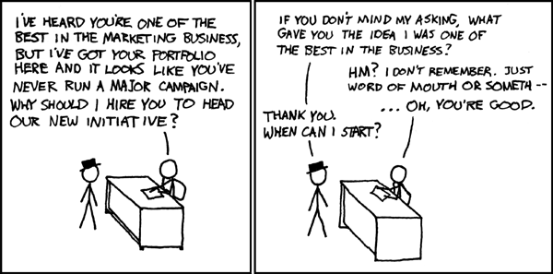
It doesn’t look half-bad on a CV
You’re probably not looking for a dev job and software engineers will look at you weird
Projects, etc. still means you can translate from security needs ↔ some code (anything’s a bonus in this hiring shitstorm)
Also AppSec is cool!
Source: XKCD #125 https://xkcd.com/125/
@AtomicMaya

Slide 36
Malicious reasons
(Because not all reasons have to be good and ethical)
OBVIOUSLY, DO NONE OF THIS.
@AtomicMaya

Slide 37
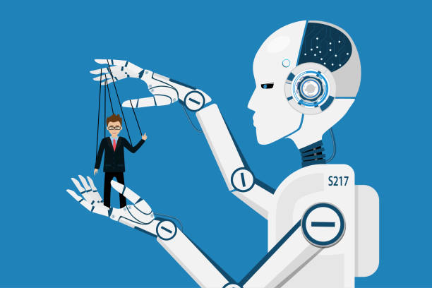
(Is good on a CV and your AI CTO told you to)
But: People notice quickly when you don’t have a clue what you’re doing
This will only work at generation 0 through 1 of LLM’s existing and aiding production
@AtomicMaya

Slide 38
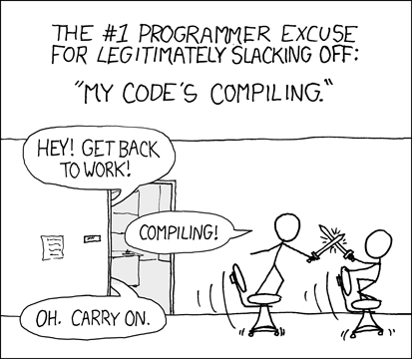
(You can always pretend you are coding)
This will work for a day or two, but lack of tangible progress can be felt
No one wins at the end, you’re still busy pretending
Source: XKCD #303 https://xkcd.com/303/
@AtomicMaya

Slide 39
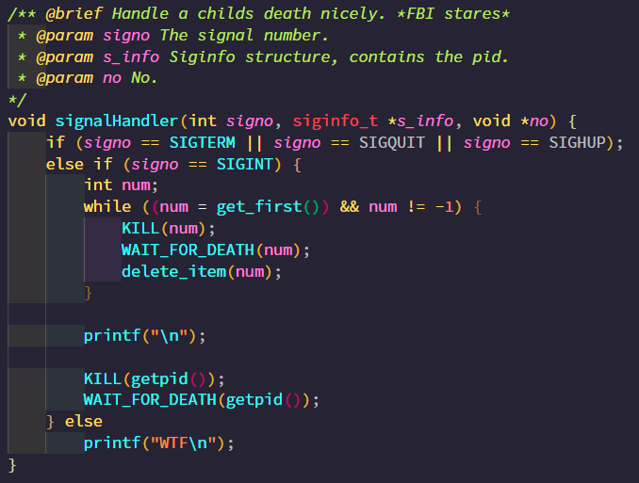
(Forget to write the docs & be unfireable)
Unless you’re the last person on Earth to know COBOL, that won’t work
Also I’m learning COBOL for fun
Documentation is also a very nice way to understand what you wrote (but the next day)
@AtomicMaya

Slide 40




# wanna know a bit more?
@AtomicMaya@tech.lgbt
@AtomicMaya_
m-boeckh
atomicmaya.me

Slide 41

Questions?

Slide 42
ARTIFICIAL
INTELLIGENCE
@AtomicMaya

Slide 43

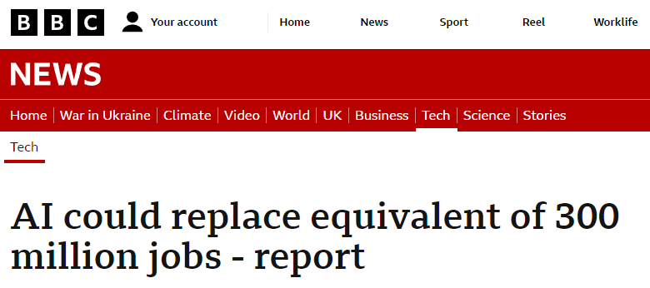

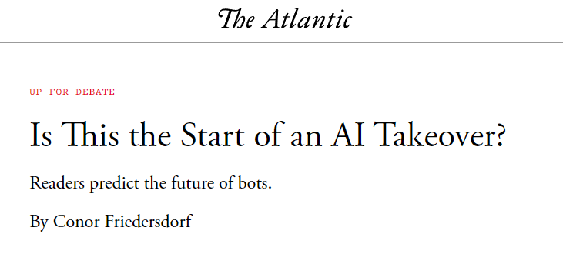

It’s been in the news
@AtomicMaya

Slide 44
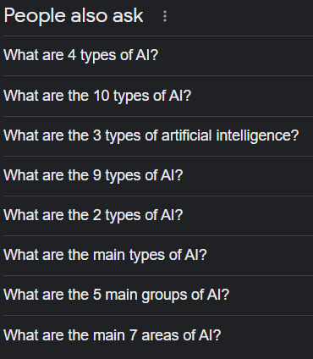
Types of AI?
Reactive Machines
Limited Memory
Theory of Mind
Self-Aware
AGI’s
Superintelligence
@AtomicMaya

Slide 45
Why don’t those terms resonate?
GAN
Deep Learning
NLP
Reinforcement Learning
Computer Vision
Expert Systems
Swarm Intelligence
Fuzzy Logic
KRR
Cognitive Computing
Bayesian Networks
Evolutionary Computation
@AtomicMaya
Notes:
Uses two neural networks (a generator and a discriminator) to generate new data that is similar to a training dataset.
Subset of machine learning that uses neural networks with multiple layers to learn complex patterns in data
Type of AI that focuses on enabling machines to understand and generate human language. See also LLMs
: Reinforcement learning is a type of machine learning that uses a reward-based system to train an AI agent to make decisions in an environment. Reinforcement learning has been used in robotics, game AI, and other applications.
Computer Vision: Computer vision is a type of AI that focuses on enabling machines to interpret and analyze visual data, such as images and videos. Computer vision has been used in self-driving cars, facial recognition, and other applications.
Expert Systems: Expert systems are AI programs that mimic the decision-making ability of a human expert in a specific field. Expert systems have been used in medical diagnosis, financial analysis, and other applications.
Swarm Intelligence: This is a type of AI that is inspired by the collective behavior of social animals such as ants, bees, and birds. Swarm intelligence algorithms are used in optimization, clustering, and other applications.
Fuzzy Logic: Fuzzy logic is a type of AI that deals with uncertainty and imprecision in data. Fuzzy logic systems are used in control systems, decision-making, and other applications.
Knowledge Representation and Reasoning (KRR): KRR is a type of AI that focuses on representing and reasoning about knowledge in a machine-readable form. KRR has been used in expert systems, natural language processing, and other applications.
Cognitive Computing: Cognitive computing is a type of AI that is designed to mimic the human brain's ability to learn, reason, and make decisions. Cognitive computing has been used in healthcare, finance, and other industries.
Bayesian Networks: Bayesian networks are a type of AI that use probabilistic models to represent relationships between variables. Bayesian networks have been used in decision-making, risk assessment, and other applications.
Evolutionary Computation: Evolutionary computation is a type of AI that is inspired by the process of natural selection. Evolutionary computation algorithms are used in optimization, machine learning, and other applications.

Slide 46

But at the end of the day:
It’s (mostly) all (extremely) spicy maths and probabilities
The rest is usually a bunch of if/else statements See rule-based AI’s
@AtomicMaya

Slide 47
❌
❌
❌
❌
❌
❌
❌
❌
✅
❌
❌
❌
❌
❌
ARTIFICIAL
❌
INTELLIGENCE
❌
❌
❌
❌
❌
@AtomicMaya

