Slide 1

it’s borked
programming was a mistake

Slide 2


# whoami
software / appsec engineering (-ish?)
infosec (not-so-ish)
on the side?
studies, communities, ctf’s, conferences
I do stupid (fun?) things
I am not that swiss maia (get bingled)
@AtomicMaya@tech.lgbt

Slide 3

# surely it’s not all borked

Slide 4
# surely it’s not all borked
if we can trace back a lot of programming design patterns across many languages to “Structured Programming”, the 1972 book written by Dahl, Dijkstra and Hoare
then yeah

Slide 5
# what’s with the title, Maya?
been programming for about 9 years now
python, c, js, ts, scala, java, swift, golang, dart, php
+ a bunch of frameworks/libs/dbms’
and yet, I am woefully underqualified to talk about anything
(but I can rant, and I will)

Slide 6
# python
fun interpreted language, very unquirky
except the lack of typing (like seriously, type hints were added in 3.9)
it’s slooooow
pip this, pip that (everything is a package)
multi-threading? sure
Notes:
Nothing, for loops easy, no semicolons, simple semantics, OOP, all that jazz
It’s very fun to hate on Python, but it’s where you can go when spreadsheets fail you
Type enforcement? Lol get the type_enforced package
sure your print(‘Hello World’) is quick, but uhhh$
It’s in a package (multiprocessing), also the package is flawed so there’s the same package fixed (multiprocess) and now in 3.10 we also have

Slide 7
#python
venv my beloved
(I’m cheating on you with Poetry)
list comprehension is really really fun to work with

Slide 8
#python
return [[reduce(lambda x, y: x ^ y, [gf_multiplication_7(a, b) for a, b in zip(fixed_matrix[i], transpose_square_matrix(matrix=matrix)[j])]) for j in range(size)] for i in range(size)]

Slide 9
#python
venv my beloved
(I’m cheating on you with Poetry)
list comprehension is really really fun to work with
testing! it exists
rated top language to build an API with (not really)

Slide 10

#php
the easiest language to hate
untyped by default
effectively three semantics in a trenchcoat
getenv
file_get_contents
Zend_Service_ReCaptcha
Notes:
It can be typed, but none of the tutorials show you that

Slide 11
#php
the dubious honor of being trashed by its creator
“PHP 8 is significantly better because it contains a lot less of my code”
if you really want “the full Monty” of a rant, check eevee’s blog:
https://eev.ee/blog/2012/04/09/php-a-fractal-of-bad-design/

Slide 12
#java
Now
runs on 3 billion devices (👀 Java card)
fully cross-OS environment
oh wait I have to ship a VM too?
garbage collection can be finicky
the dreaded existence of static
Notes:
Java Card is about X million, a lot of the rest is probably people playing Minecraft
Like, you can create self contained executables
How to break a context fr,fr
still requires you to manage what you’re storing where

Slide 13
#java (parenthesis)
EU Commission shenanigans for automated public transportation
a bit of context
“It has to be quick! I know, let’s dockerize 15 different Java components and hope for sub-1ms response times!”
I worked on something called the Risk Assessment Engine
Notes:
Null
Null
Null
Make of that what you will

Slide 14
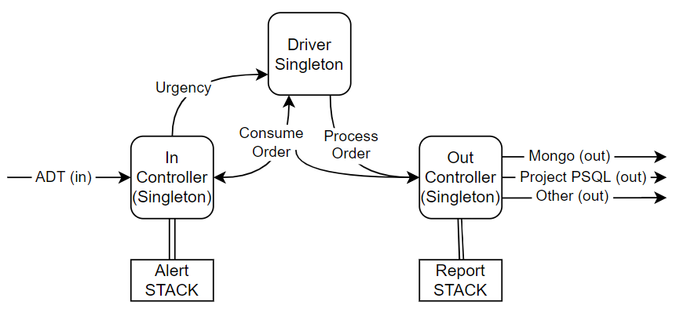
#java (parenthesis)
main issues
alert queueing
alert batch processing
fully asynchronous
(all of these are in their own threads btw)

Slide 15
#javascript
untyped
used everywhere a browser is
oh but wait node means running raw on servers too
super versatile (yay npm)
no one should have to deal with my javascript
(although if you want, uhhhh, DM me)
I have great user reviews

Slide 16
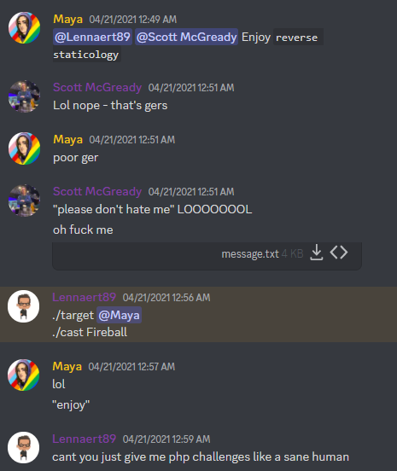
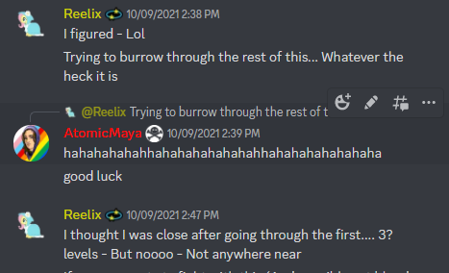
#javascript

Slide 17

#javascript

Slide 18
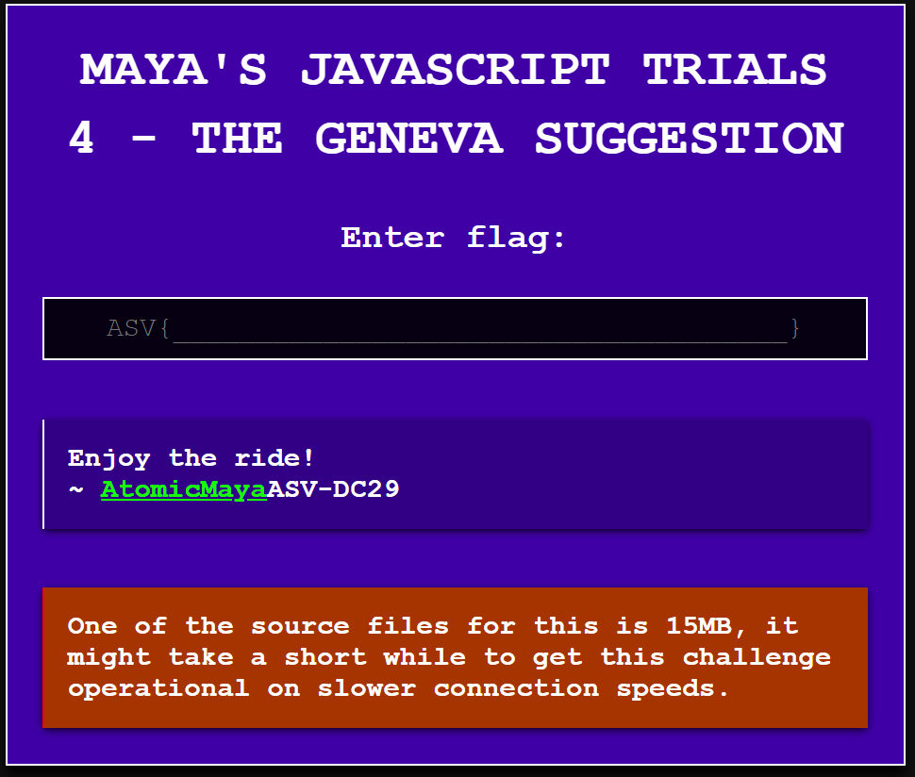
#javascript (or rather JSFUCK)

Slide 19
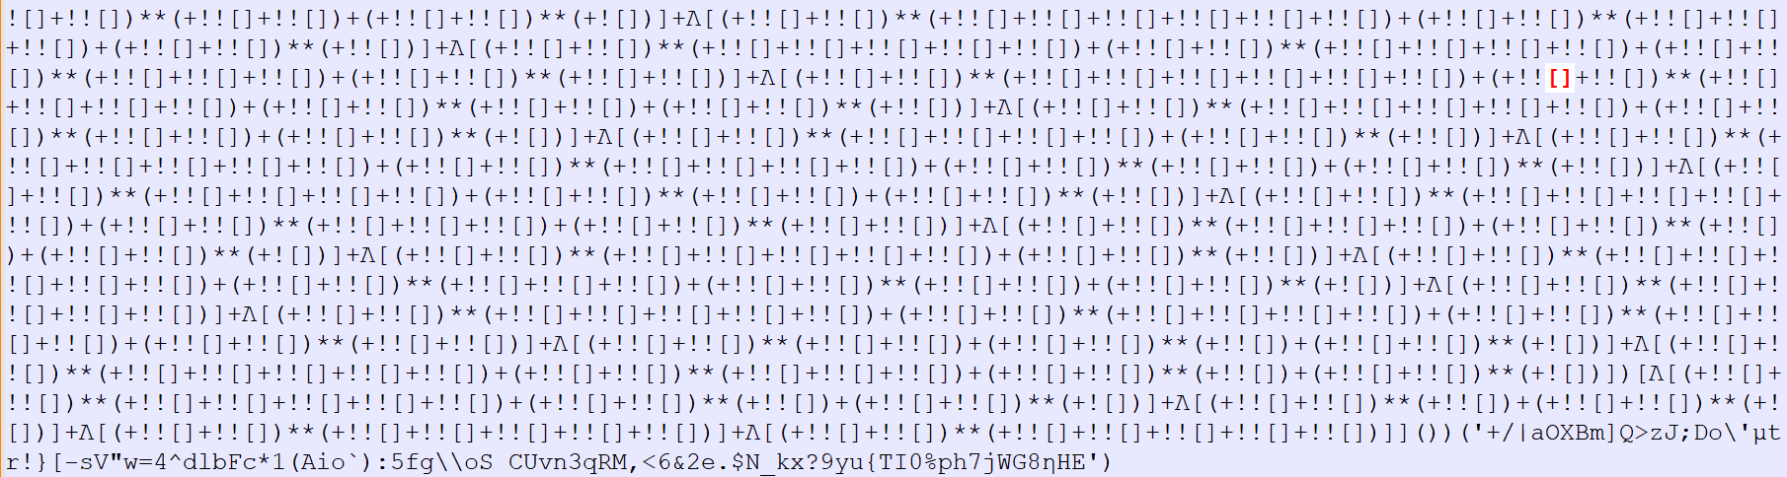
#javascript (or rather JSFUCK)

Slide 20
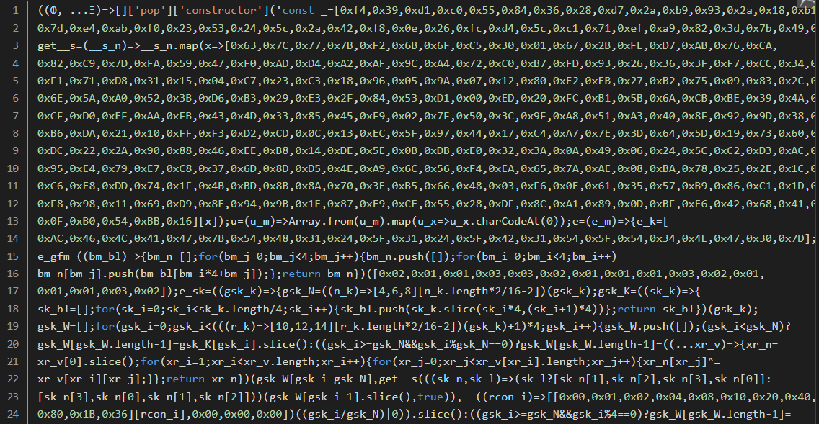
#javascript (or rather JSFUCK)

Slide 21
I could also talk about Golang
but it’s really cool though
it is garbage-collected but it can be wonky
dealing with panic’s is a really wild approach

Slide 22
I could also talk about Rust
but I don’t want to get stabbed
my only issue is how it handles JSON, but ¯\_(ツ)_/¯
(I know it’s not designed for it)
crabs are cool

