Slide 1
Python !
Usage for data retrieval and data analysis
@AtomicNicos
Notes:
[15s - 00:00-00:15]

Slide 2

Modules
requests
BeautifulSoup4
pandas
@AtomicNicos

Slide 3
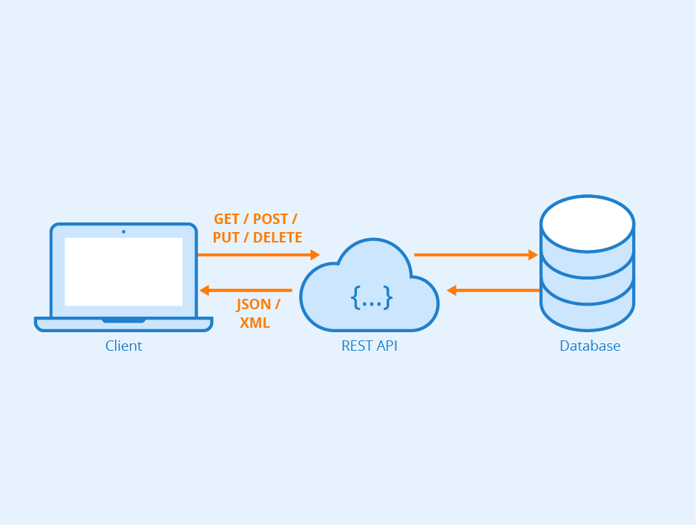
requests
RESTful interactions
Allows you to query “THE INTERNET”
Status Codes, Response Content, Headers, …
@AtomicNicos

Slide 4
requests
Demo
@AtomicNicos

Slide 5
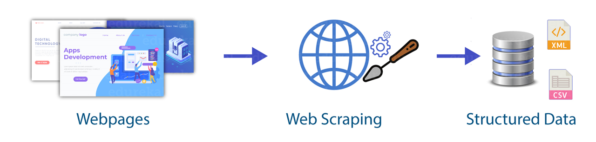
BeautifulSoup4
Why write a parser, when one already exists?
Useful for web scraping.
Copy tables, parse for email addresses, etc.
@AtomicNicos

Slide 6
BeautifulSoup4
Demo
@AtomicNicos

Slide 7
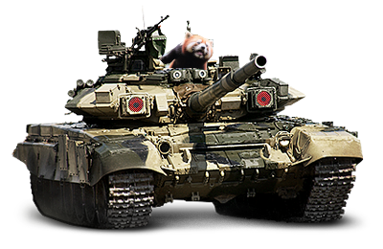
pandas
Used for working on data.
It is the tank of data representation and analysis
Works with most file formats.
@AtomicNicos

Slide 8
pandas
Demo
@AtomicNicos

