Slide 1
Implementing E2EE multi-client communication (for fun, work or profit)
what could go wrong?

Slide 2
Famous last words.

Slide 3
What is this?
We’re talking about crypto*
We’re in the ballpark of application development
Something something security
A shitpost?

Slide 4
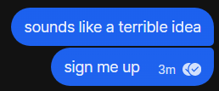

Slide 5
What is this not?
Anything you should do:
at home
at work
in production
A lesson on cryptography
Vendor/Snake oil/Academic shenanigans

Slide 6



$ whoami
Software / AppSec Role (-ish?)
On the side? OSINT, Communities, CTFs
I do stupid (fun?) things
@AtomicNicos
nicolas-boeckh

Slide 7
Disclaimer

Slide 8
But…

Slide 9
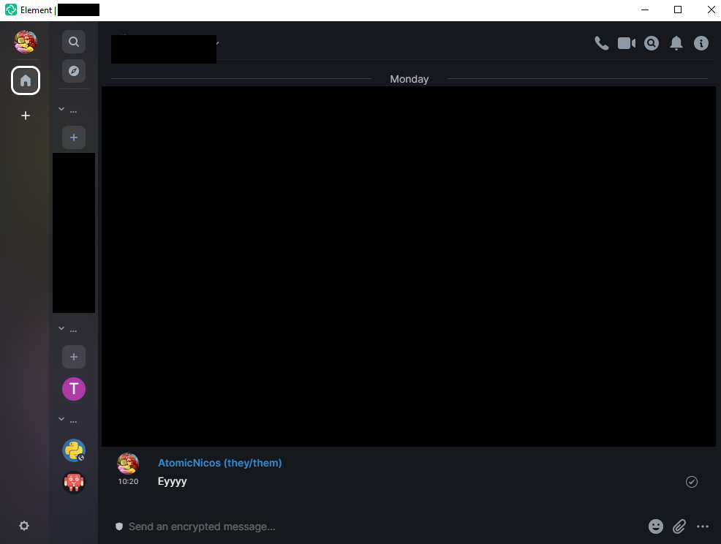
But… it already exists!
Signal
WhatsApp
Matrix
Keybase
Telegram (?)
Messenger (?)

Slide 10

But… what if I have nothing to hide?
Individual right to privacy
Speech isn’t protected everywhere
Patterns are important

Slide 11
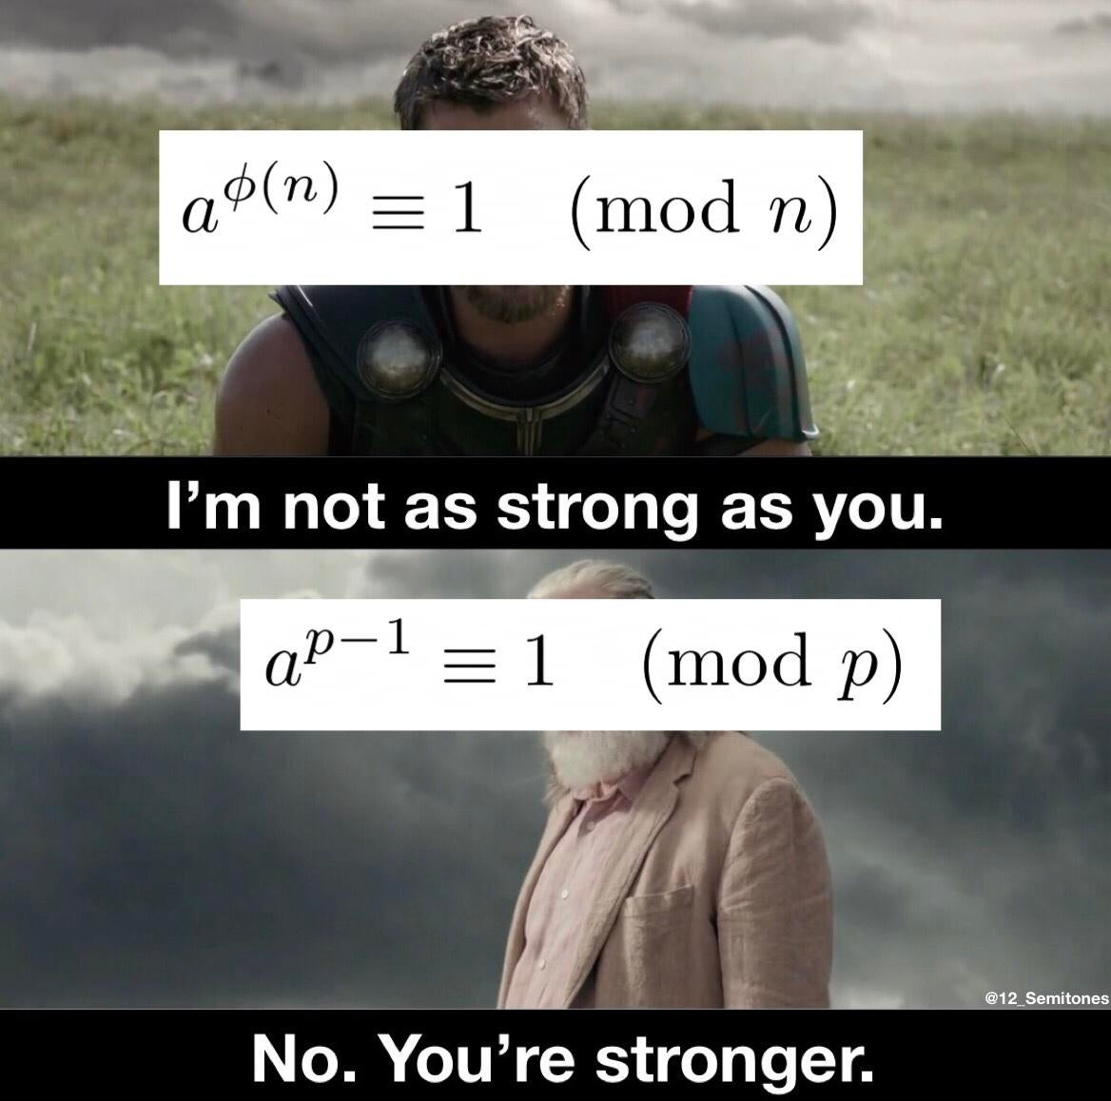
But… crypto is so easy to f*ck up!
Yes
Entirely accurate
Super easy

Slide 12
What do we need?

Slide 13
Encryption
No publicly shared keys
Reliance on cryptographically hard paradigms
Enc
Dec

Slide 14
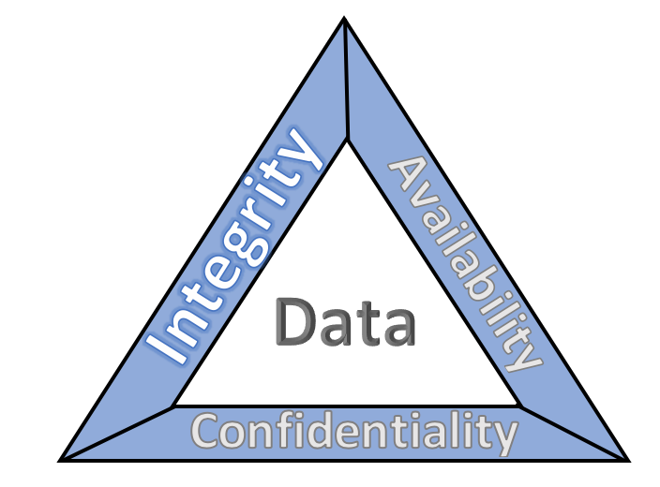
CIA Triad
Confidentiality
No decrypting en route
No content logging
Integrity
Messages can’t be modified
Modification = ABORT
Availability
Decentralized
Easily spawnable
Image credit: NIST

Slide 15
Infrastructure
Server
Anything running anything
Clients
Anything running the same kind of anything

Slide 16
What are our problems?

Slide 17
Problem 1: User flow
Enc
Dec

Slide 18
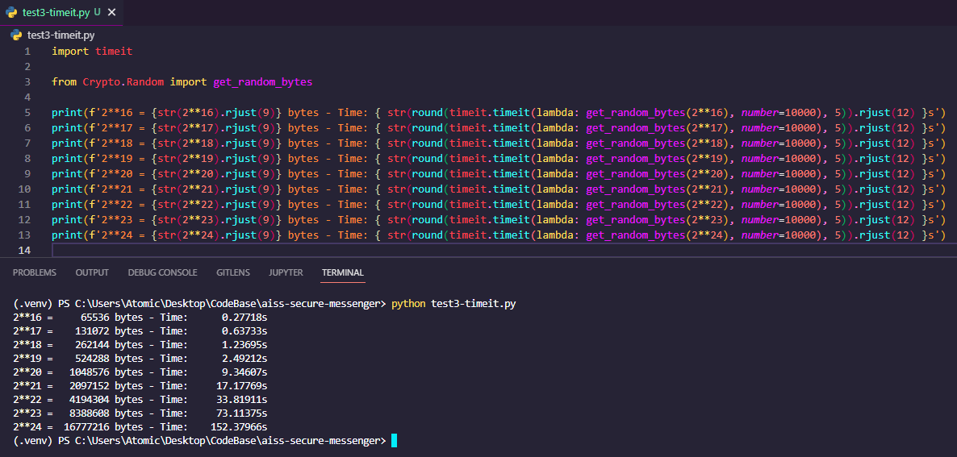
Problem 2: Asymmetric efficiency

Slide 19
Problem 3: n-clients

Slide 20
Problem 4: Synchronicity
No message delivery

Slide 21
Problem 5: Sockets

Slide 22
How does Signal do it?

Slide 23
How do I want to do it?

Slide 24
Demonstration?

Slide 25
