Slide 1
RULES & RECOMMENDATIONS
ARE WE PUSHING OUR NEW DEVICE OUT CORRECTLY?
@AtomicNicos
Notes:
30s – 00:00 | 00:30

Slide 2
4 teams
DEV
Developers
SEC
Security
MGR
Managers
THR
Threats

Slide 3
Base game statistics (entire team)
CHR
Charisma
DEV
Development capability
SEC
Security capability
NET
Network capability
SOC
Social Media capability

Slide 4
Dice
PHYSICAL DICE
VIRTUAL DICE
Googling “Roll a d20”
OR
https://www.aidedd.org/dnd-dice/index.php?l=1
Two types of dice will be used:
A d20 Twenty-sided die (for most occasions)
A d4 Four-sided die (rarely)

Slide 5
Pre-game (10 minutes)
Explanations
Build teams
Roll for team stats (Roll 5 d20’s, with 2 rerolls possible)
Strategize with the card deck

Slide 6
Game (45 minutes)
The Session Master goes from one team to another (a cycle is expected to last 4 minutes)
The cycle is: THR → MGR → DEV → SEC
Each time the SM shows up:
MGR & SEC & DEV If necessary, roll a ST (Saving Throw) against THR
THR & MGR Play 1 card and if necessary, roll a AC (Ability Check)
SEC & DEV Play a number of cards until out of Action Points for this turn.

Slide 7
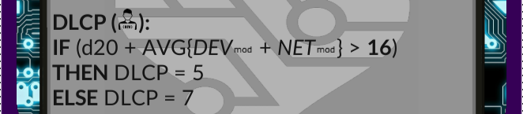
Action Points
DLCP: Development Lifecycle Points, the objective is to finish the deck of tasks before the end of the game. (9 per turn)
SAP: Security Action Points, the objective is to buff SEC, DEV and MGR against attacks by THR.
On selecting a card, roll a d20 and apply the appropriate modifiers to it.
If the calculated value is greater than the marked value, your task costs less, else, it costs more.

Slide 8
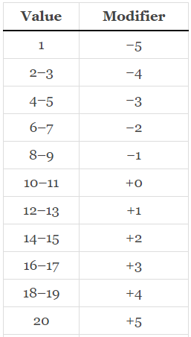
Modifiers

Slide 9






atomicnicos@1337m4ch1n3~$ whoami
atomicnicos.me
@AtomicNicos
AtomicNicos
nicolas-boeckh
gitlab.unige.ch/ Nicolas.Boeckh
Nicolas Boeckh
Notes:
45s – 00:30 | 01:15

