Slide 1
Intelligence
in the age of Digital Communities

Slide 2
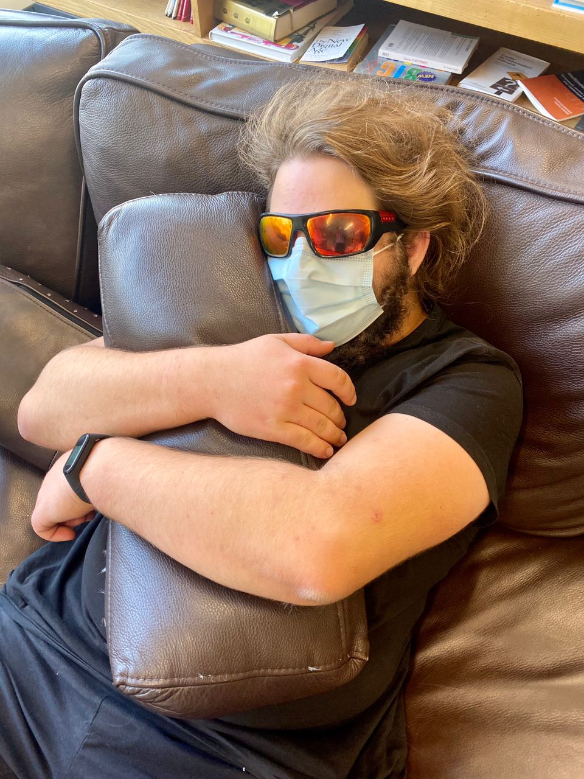


atomicnicos@atomicnicos.me~$ whoami
@AtomicNicos
nicolas-boeckh
Nicolas Boeckh
Notes:
Mention staff in communities
Mention Community Manager

Slide 3
Digital Communities
Interconnection of individuals
Discussion of topics of interest or just interpersonal discussions
Notes:
Building a community online, however, is much like sending a message to everyone in your town that you live at a specific address, and also inviting every one of them over for dinner at the same time: inevitably, less charitable or law-abiding people will show up, and some of them may try to take advantage of the situation.

Slide 4
Digital Communities
Back in the day (and sometimes still today): Internet Relay Chat
mIRC
Hexchat
Xchat

Slide 5
Digital Communities
Nowadays: Separate networks and infrastructure
Discord
Matrix
Element

Slide 6
How does Intelligence factor in?
In managing or volunteering in a digital community
To ensure the continued wellbeing of community members
To avoid various threats from gaining a hold (phishing, scams, …)
To limit raids
Notes:
Building a community online, however, is much like sending a message to everyone in your town that you live at a specific address, and also inviting every one of them over for dinner at the same time: inevitably, less charitable or law-abiding people will show up, and some of them may try to take advantage of the situation.

Slide 7
Summary
Threat Management
Skills & Knowledge in Incident Response
Cross-community intelligence exchange
Webs of trust vs. OPSEC
Staff guidelines & Enforcement

Slide 8

Threat Management

Slide 9
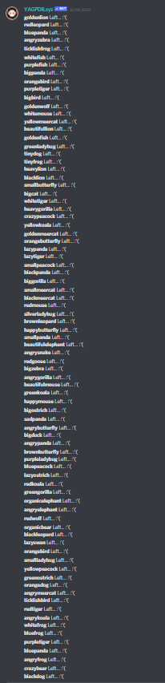
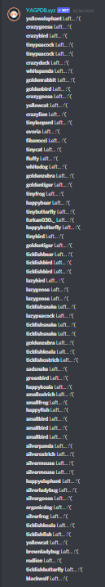
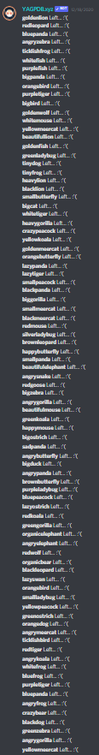
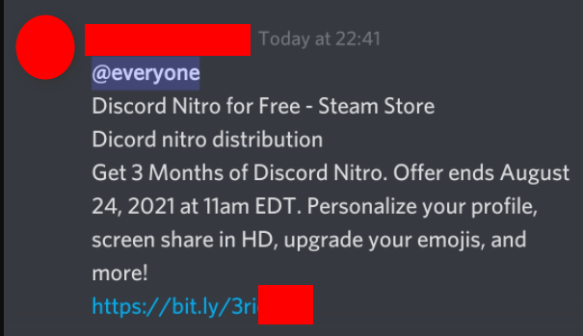
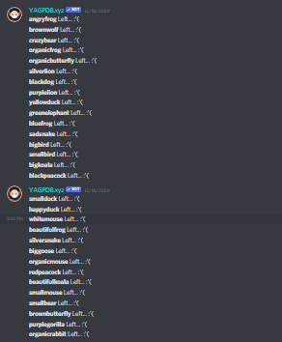
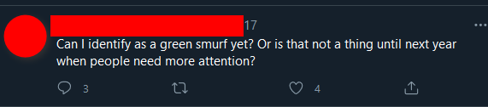
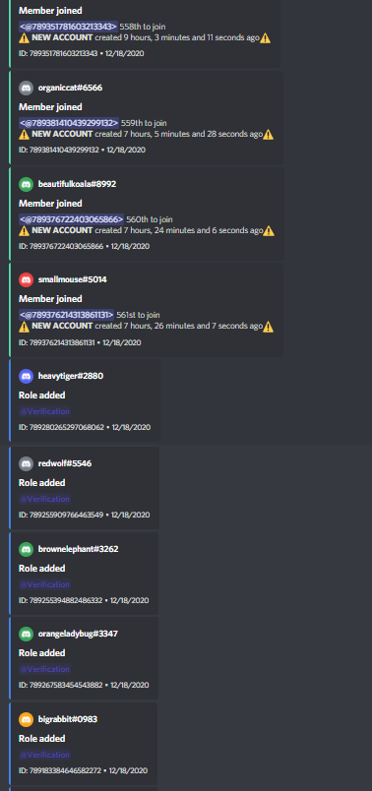
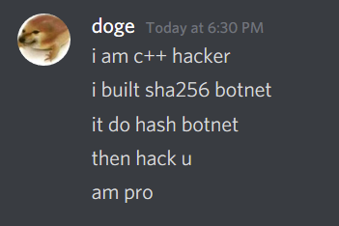
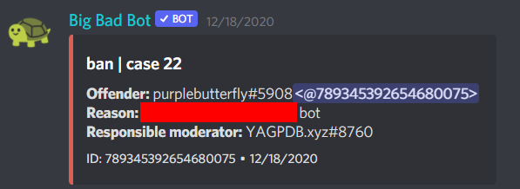


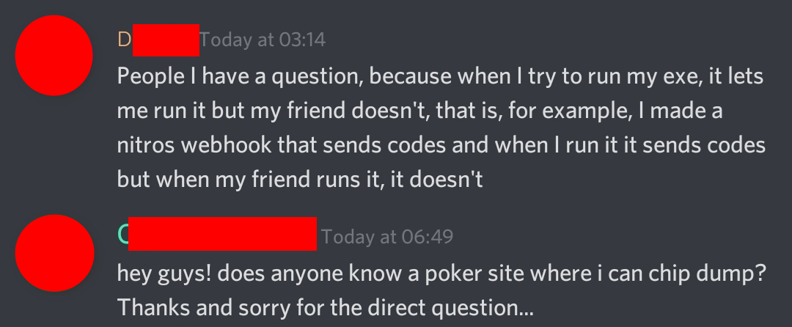
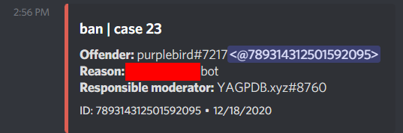
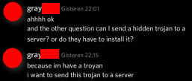
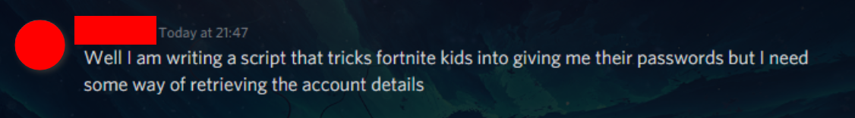

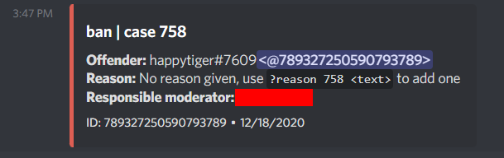
Identifying Threats

Slide 10
Categorizing Threats
Low Impact (“Can you hack <X>”)
Medium Impact (Scam)
High Impact (Raid)
Context dependent impact (Member doing/saying something against code of conduct)
-ist/-phobic comments
Sending pictures to a minor
Sharing malware

Slide 11
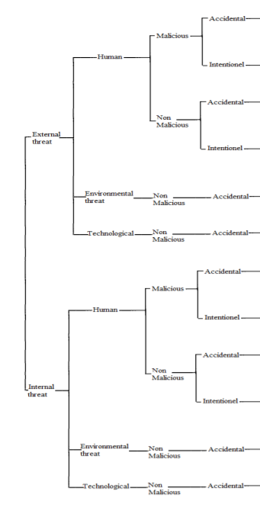
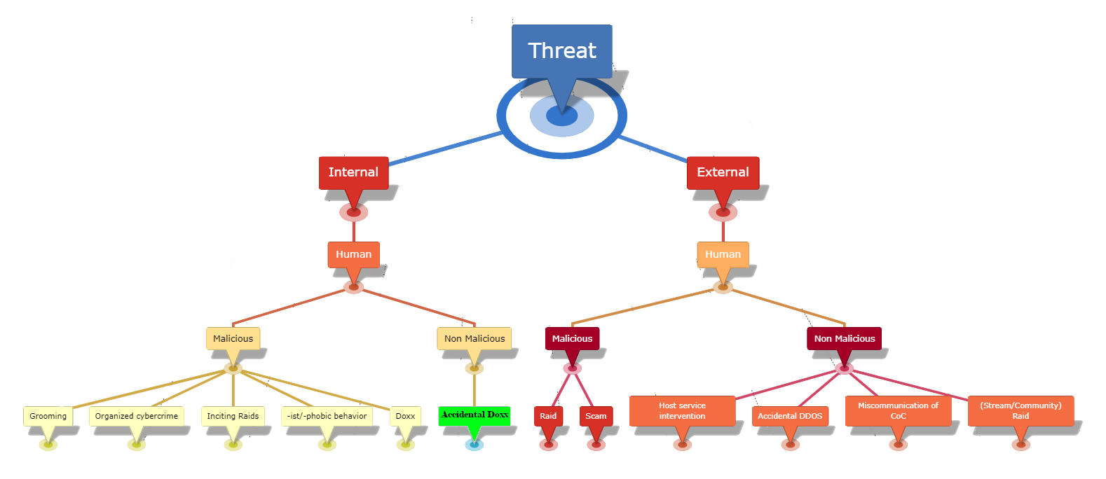
Categorizing Threats
https://doi.org/10.1016/j.procs.2014.05.452

Slide 12

Mitigating threats
Warn
Bans

Slide 13
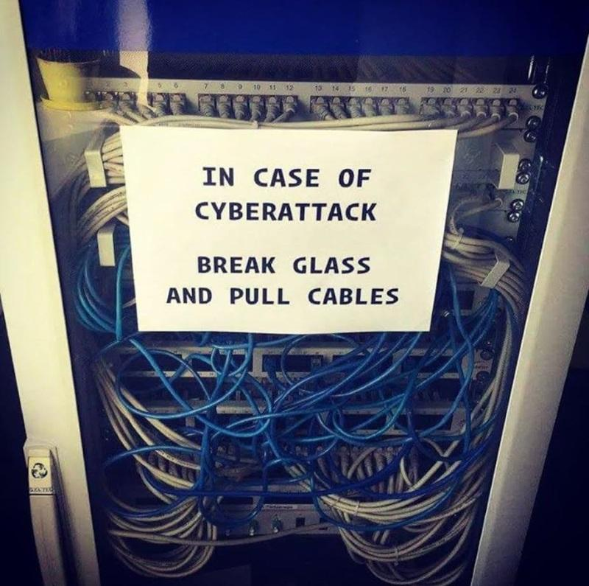
Skills & Knowledge in Incident Response

Slide 14
Responding to threats

Slide 15
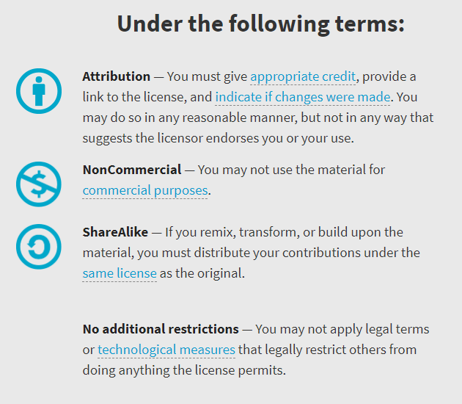

Availability
Work licensed under Creative Commons : CC-BY-SA (legalcode)
Open License
@AtomicNicos
Notes:
[30s – 24:30-25:00]

Slide 16

Discord : @AtomicNicos#1404 Twitter : @AtomicNicos
LinkedIn : /in/nicolas-boeckh
AMA
Notes:
[60s – 32:10-33:10]
+ Q&A

