Slide 1
GEOINT Tracking down locations in digital investigations
@AtomicNicos
Notes:
[15s - 00:00-00:15]

Slide 2
Open Source INTelligence / Recon
Relies on publicly available data:
Social media accounts
Phonebooks
Documents
…
Usually less reliant on:
Interaction (HUMINT)
Communications technologies (SIGINT)
Equipment Analysis (TECHINT)
…
@AtomicNicos

Slide 3
OSINT Steps
Define Requirements
Retrieve Data
Analyze
Pivot
Report
@AtomicNicos

Slide 4
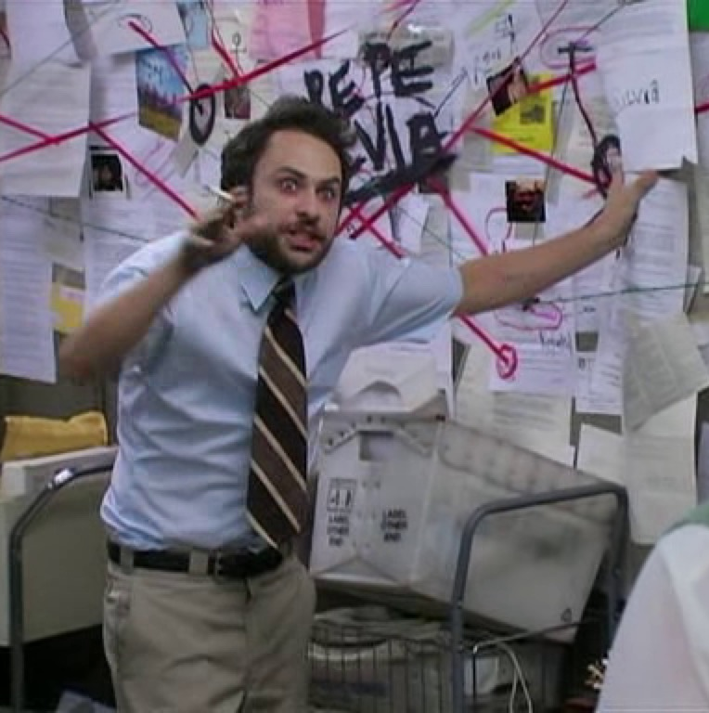
Pivoting
Looking less like this
@AtomicNicos

Slide 5
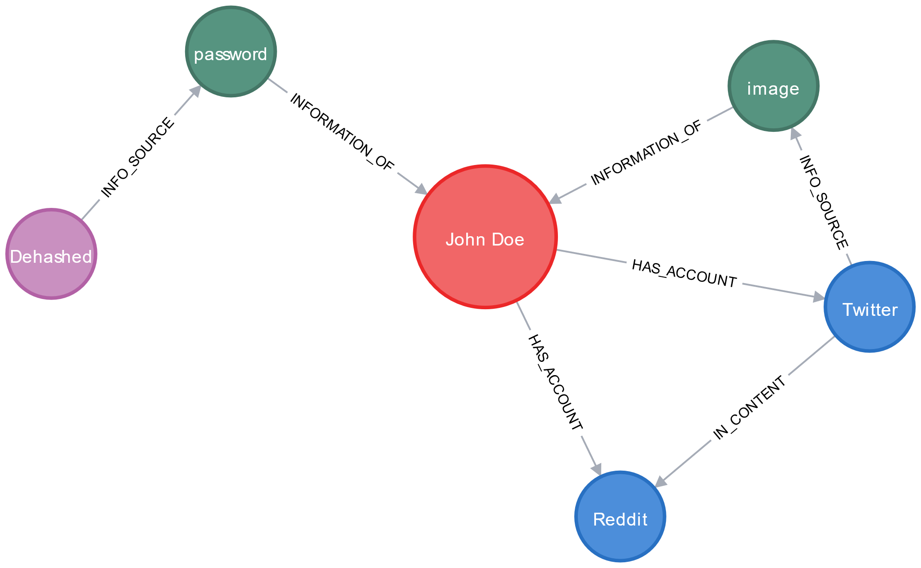
Pivoting ?
Get datapoints from a previously collected datapoint
Use it to grow the dataset
@AtomicNicos

Slide 6

First pivots
Find social media ! (Google dorking, …)
Result: Relations profile (family, friends, …)
Find pictures
Physical profile (body modifications, tattoos, haircut, …)
Locations
@AtomicNicos

Slide 7
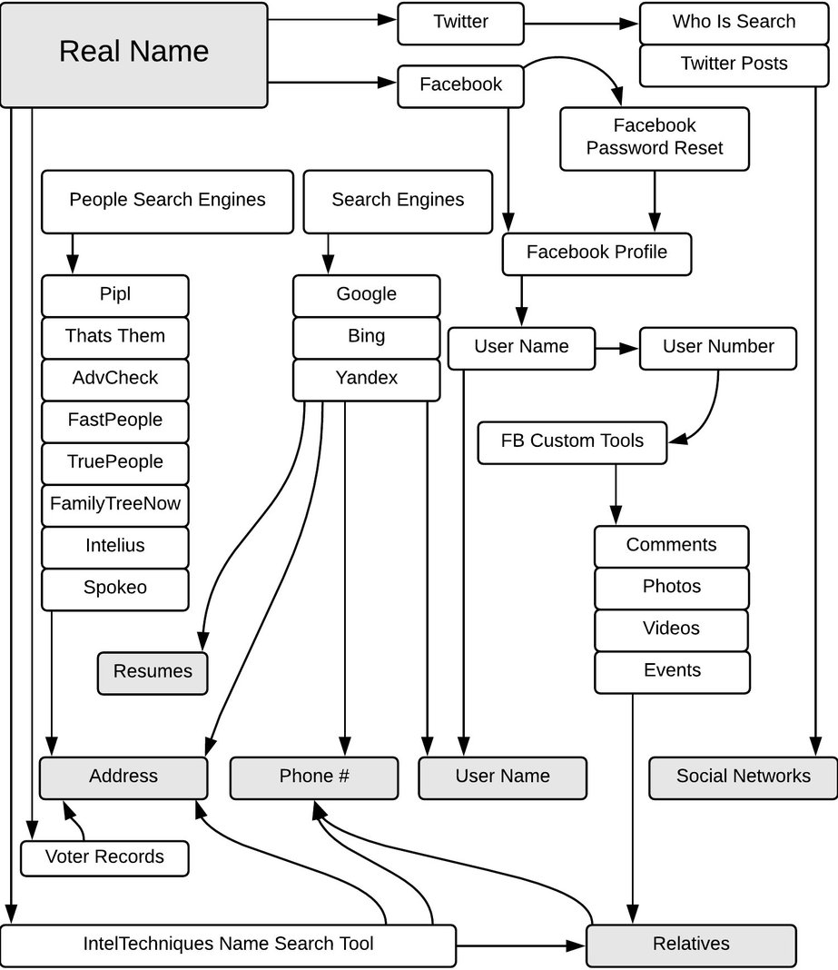
Advanced pivots
Name changes (→ Aliases, Records, …)
Yellow / White pages (→ Addresses, Assets, …)
Dehashed, RaidForums (→ Credential Leakage, …)
Criminal Records (→ Affiliations, …)
Credit: Petro Cherkasets
@AtomicNicos

Slide 8
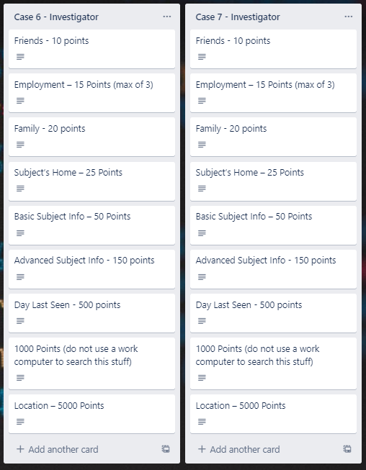
Tracking steps
Finding data once is cool, having to find it again is a waste of time.
Store information type, a short description, URL’s, snapshots.
⚠Also note how you got there !
@AtomicNicos

Slide 9

Demonstration
https://twitter.com/juan_spinel/status/1396151405677879296
@AtomicNicos

Slide 10
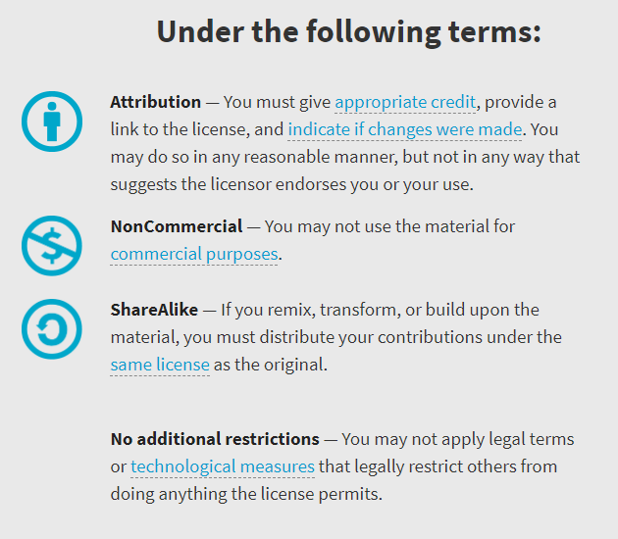

Availability
Work licensed under Creative Commons : CC-BY-SA (legalcode)
Open License
@AtomicNicos
Notes:
[30s – 31:40-32:10]

Slide 11

AMA
Discord : @AtomicNicos#1404
Twitter : @AtomicNicos
Notes:
[60s – 32:10-33:10]
+ Q&A

