Slide 1
Make AppSec Weird Again
Part 2 - Web
@AtomicNicos
Notes:
[15s - 00:00-00:15]

Slide 2
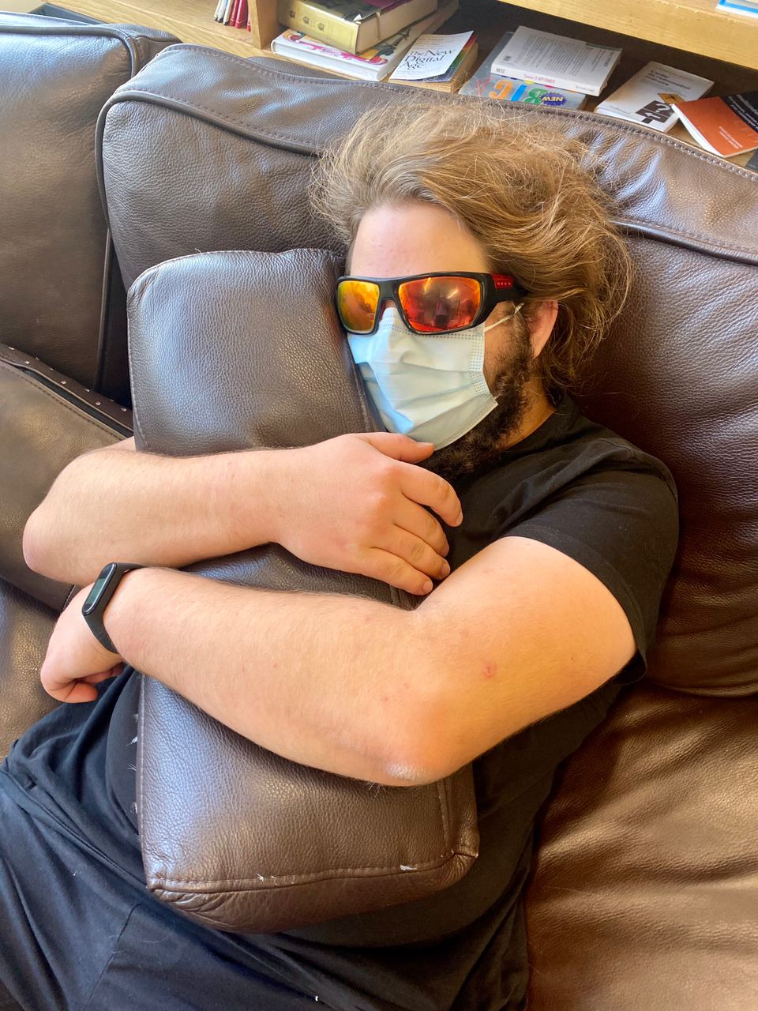


atomicnicos@1337m4ch1n3~$ whoami
@AtomicNicos
nicolas-boeckh
Nicolas Boeckh
Notes:
[15s - 00:15-00:30]

Slide 3
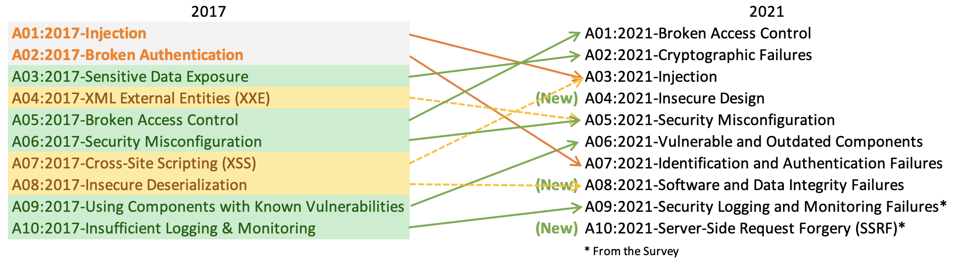
The new (as of Wednesday) OWASP Top 10
@AtomicNicos

Slide 4
A01:2021-Broken Access Control
Previously A05:2017
Unauthorized access to service resources
Remediation:
Deny by default
Enforcement of Access control by a trusted service, usually in the “backend”
@AtomicNicos

Slide 5
A02:2021-Cryptographic Failures
Previously A03:2017-Sensitive Data Exposure
Clear text information exchange and storage, use of weak cryptographic algorithms, missing security directives, non-verification of server certificates.
Remediation:
Classify all data
Encrypt sensitive data at rest
During transit, use TLS with PFS. Enforce encryption with HSTS directives
@AtomicNicos
Notes:
Perfect Forward Secrecy (PFS)
HTTP Strict Transport Security (HSTS)

Slide 6
A03:2021-Injection
Previously A01:2017 and merged with A07:2017-Cross-Site Scripting (XSS)
Missing validation, filtration and sanitization of user-supplied data. Dynamic queries
Remediation:
Keep data separate from queries, escape all special characters
Enforce query limitations to hinder mass disclosures
Avoid relying on user reference of database structures
@AtomicNicos

Slide 7
A04:2021-Insecure Design
New in OWASP Top 10 2021
Missing controls and logic validation
Remediation:
Secure SDLC establishment
Use Threat Modelling
Write Unit/Integration Tests
@AtomicNicos

Slide 8
A05:2021-Security Misconfiguration
Previously A06:2017 and merged with A07:2017-XML External Entities (XXE)
Lack of hardening, extraneous features, default accounts/credentials, disabled security features, out of date software, etc.
Remediation:
Hardening over time
Segmented application architecture, with containerization, segmentation or cloud security groups
@AtomicNicos

Slide 9
A06:2021-Vulnerable and Outdated Components
Previously A09:2017-Using Components with Known Vulnerabilities
Lack of asset inventory, irregular or no vulnerability scans, missing upgrades, regular patch cycle.
Remediation:
Patch Management Process
Source Management
Monitor for maintenance issues
@AtomicNicos

Slide 10
A07:2021-Identification and Authentication Failures
Previously A02:2017-Broken Authentication
Credential Stuffing, Brute Forcing, Allowing weak passwords, Store passwords wrong, No MFA, No Session ID rotation.
Remediation:
Implement MFA
No Default Credentials
Weak Password checks
Harden against enumeration
Build a session manager
@AtomicNicos

Slide 11
A08:2021-Software and Data Integrity Failures
Previously A08:2017-Insecure Deserialization
Lack of protection against integrity violations, insecure pipelines, untrusted 3rd party content.
Remediation:
Implement integrity checks
Consume trusted repositories when using dependency management tools
Ensure that the supply chain is protected by a tool
Fix the pipelines.
@AtomicNicos

Slide 12
A09:2021-Security Logging and Monitoring Failures
Previously A10:2017-Insufficient Logging and Monitoring
No logging of auditable events (failures, warnings), no log monitoring, no centralization of logs, no escalation alerts and procedures
Remediation:
More logging
Ensure audit trail
Effective monitoring of suspicious activities
Implement and maintain an IR+Recovery plan
@AtomicNicos

Slide 13
A10:2021-Server-side Request Forgery
New in OWASP Top 10 2021
Web application retrieves content without validating a user-supplied URL.
Remediation:
Network: Deny by default
Application: Sanitize by default, Positive allow list, No raw responses, No Redirects
@AtomicNicos

Slide 14
Explaining XSS
Reflected XSS: User-content sent to the server is then displayed as-is on the page.
Stored XSS: Same as reflected but maintains persistency in the backend over time. Can affect other dependents.
Cookie stealing: Intercepting requests and modifying a cookie to pose as the correct user
@AtomicNicos

Slide 15
Explaining Validation
Making inputs respect certain rules
Looks like an email
Looks like a phone number (complicated)
Is a strong enough password
At some point relies on parsing or regex
@AtomicNicos

Slide 16

Validating “is it a number”
Check that all characters are numbers and maximum one separator
Candidates:
0.3113
42
1337
.1
420.69
@AtomicNicos

Slide 17
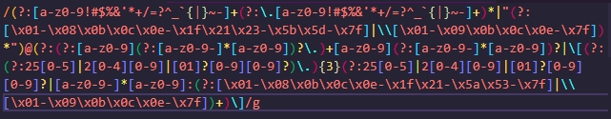
Validating “is it an email”
Alphanumerical sequence with dots, dashes, plus and tildes (“.”, “-”, “+”, “~”), followed by an at symbol (“@”) followed by at least one domain name (size > 0) and one TLD name (size ≥ 2)
Candidates:
a@b.cd
a-legit-human_truly+spam@test.somewhere.au

Slide 18
Playground
Damn Vulnerable Web App
Various challenges
@AtomicNicos

Slide 19
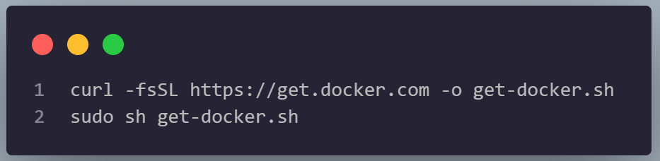
Installing Docker
Go to https://www.docker.com/get-started
MacOSX and Windows – Download and install Docker Desktop
Linux: Run the following commands
@AtomicNicos

Slide 20
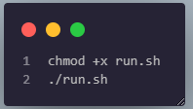
Downloading/running the workshop materials
Go to https://github.com/AtomicNicos/bsides-ncl-workshop
Either git clone it or click on the zip file and download/extract that.
Execute the run.sh (MacOSx and Linux) or run.bat (Windows) in your default shell environment.
When you are done, execute kill.sh / kill.bat
@AtomicNicos

Slide 21
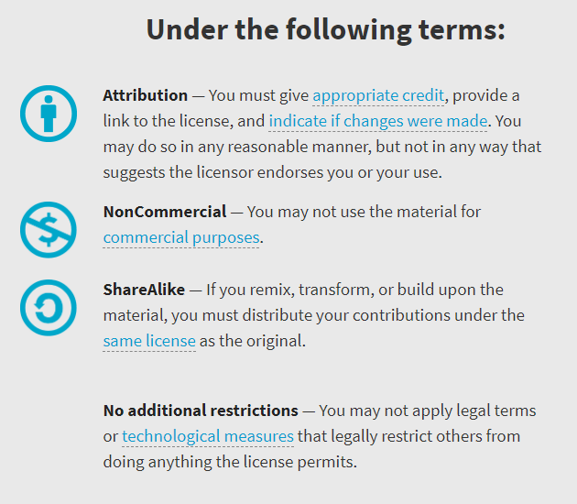

Availability
Work licensed under Creative Commons : CC-BY-SA (legalcode)
Open License
@AtomicNicos
Notes:
[30s – 31:40-32:10]

Slide 22

Discord : @AtomicNicos#1404
Slack : @AtomicNicos
Twitter : @AtomicNicos
LinkedIn : Nicolas-boeckh
AMA
Notes:
[60s – 32:10-33:10]
+ Q&A

