Slide 1
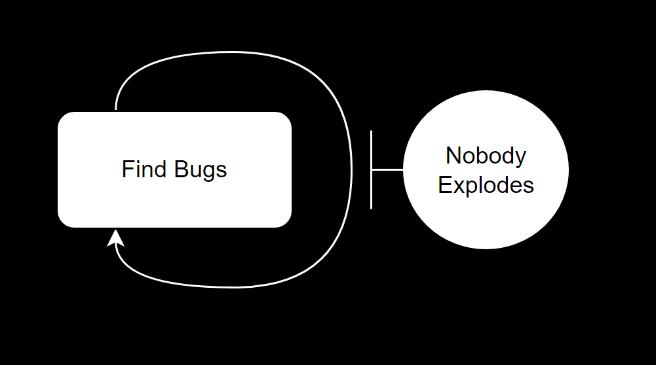
Notes:
People who develop software are the absolute worst: no consideration for security, crap APIs, no documentation to be found (internal or external)… When we call them into our 2 hour meetings they just say it’s in the backlog. Really inconsiderate of them 😡

Slide 2

whoami
I study & teach
I work do things
I try to help and challenge people
Nicolas Boeckh
aka.
AtomicNicos
Notes:
I’m a bit technical but that’s not the point of this session
I’m not the best person for this. However I have written a lot of buggy code. I’ve also fixed some of my code. I’ve also fixed the code of others. I’ve seen code in my alphabet soup. I’ve graded code as a TA.

Slide 3
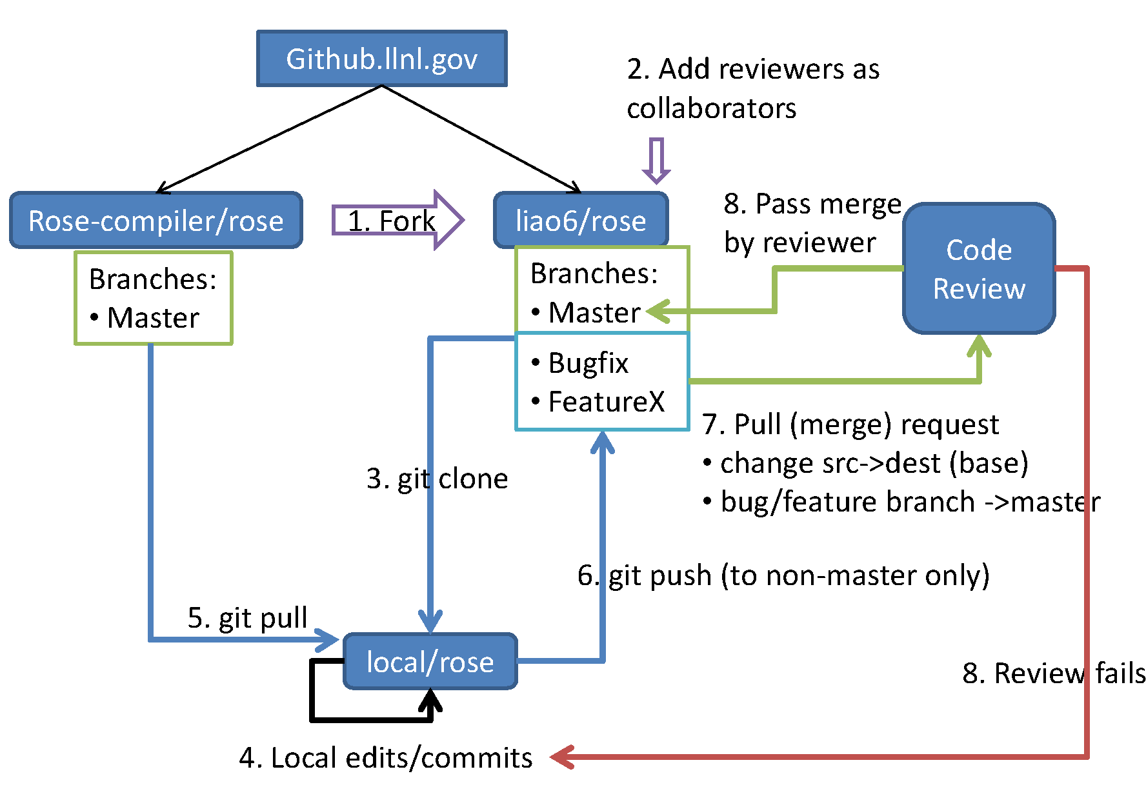
Code Review
By Chunhualiao - Own work, CC BY-SA 3.0, https://commons.wikimedia.org/w/index.php?curid=20065381
Notes:
Whoa. Big graphs! No! Just a support
What? Basically Its a QA thing.
Main tenets:
Better code quality
Finding defects
Learning/Knowledge transfer
Increase sense of mutual responsibility
Finding better solutions
Complying to QA guidelines, ISO/IEC standards
But simpler, answering 4 questions
Are there any obvious logic errors in the code?
Looking at the requirements, are all cases fully implemented?
Are the new automated tests sufficient for the new code? Do existing automated tests need to be rewritten to account for changes in the code?
Does the new code conform to existing style guidelines?
Why?
The best developers also make mistakes,
avoiding mistakes in production,
reduce the effect on customers.
How?
Usually unanchored,
much like other aspects of agile development: On a contribution, one or more senior contributors evaluate the code.

Slide 4

Context
Notes:
Currently somewhat top down (senior contributors), very asynchronous
Can be very aggressive when “rejecting” a contribution. (this is often discussed, and now there’s different types of issues, such as small nitpicks vs. Breaking bugs).
Not hard to set a baseline of styles, of guidelines, or of documentation. Harder to propagate them.
Hard to integrate outside opinions (a pentester, a QA person, a UX compliance person, etc.)

Slide 5
Solution?
Get people “together”
Level the playing field
Invite competent guest
Play game
Fix bugs
Notes:
So, why not game it out (also in a non-virtual way)
Gamification transforms the negative stress of pushing out secure code into positive stress!
In this case: Cooperative games strengthen bonds, help level the playing field, help people diversify the skill set.
Are people available? Not all need it,
Is this optimal?
Eh.
It’s not a replacement, it’s an addition.
And to bounce of peedar’s point earlier, you very much need to avoid making it an encompassing game

Slide 6
Game 1: Capture the bug
Find a bug
1
Analyze & Categorize it
2
Submit it
3
Get points
4
Notes:
Find the bug on the entire codebase (or what was changed during a sprint).
Find what kind of bug, do a cliffnotes report on exploitability and impact.
Pool the report somewhere
At the end, get points, (but based on everyone’s grading)
Players can be incentivized to win.

Slide 7
Game 2: Edgeroulette
Example:
Getting a number from a website input form!
-> parseInt('12341234')
<- 12341234
-> 1 * '12341234'
<- 12341234
-> eval('12341234')
<- 12341234
'-!![]+12341234'
Error
Error
-> eval('-!![]+12341234')
<- 12341233
Notes:
Edge cases are important.
Imagine you have a web portal for banking, and it asks for an account ID, easy right? Those account numbers are text
And they need to be numbers.
There’s ways to do this!
parseInt, 1*’12’, etc.
But also ‘eval’ and that lets me do weird stuff.

Slide 8
Game 2: Edgeroulette
Find edge cases
1
Analyze & Categorize them
2
Submit them
3
Get points
4
Notes:
Sound familiar to the first one?
Yes, but not exactly, here it’s easier to involve outside people such as pentesters. It’s also a different focus.

Slide 9
Game 3: Documentary
Read functional snippet of code
1
Read the available documentation
2
Describe what it does
3
Notes:
Documentation should:
Follow guidelines
Explain what the code does
Explain what is used by the code
Shows the limitations in the available documentation

Slide 10
Game 4: Pitch me a function
Read functional snippet of code
1
Describe what it does
2
Identify side-effects
3
Prime for refactoring
4
Notes:
Even with documentation, if the code does too much, it should not be as such.
Something that does the thing, opens a file, writes to a file, read from another file, perform analysis, etc.

Slide 11

Finishing up
Questions?

