Slide 1
F. U. D.
ear
ncertainty
oubt

Slide 2
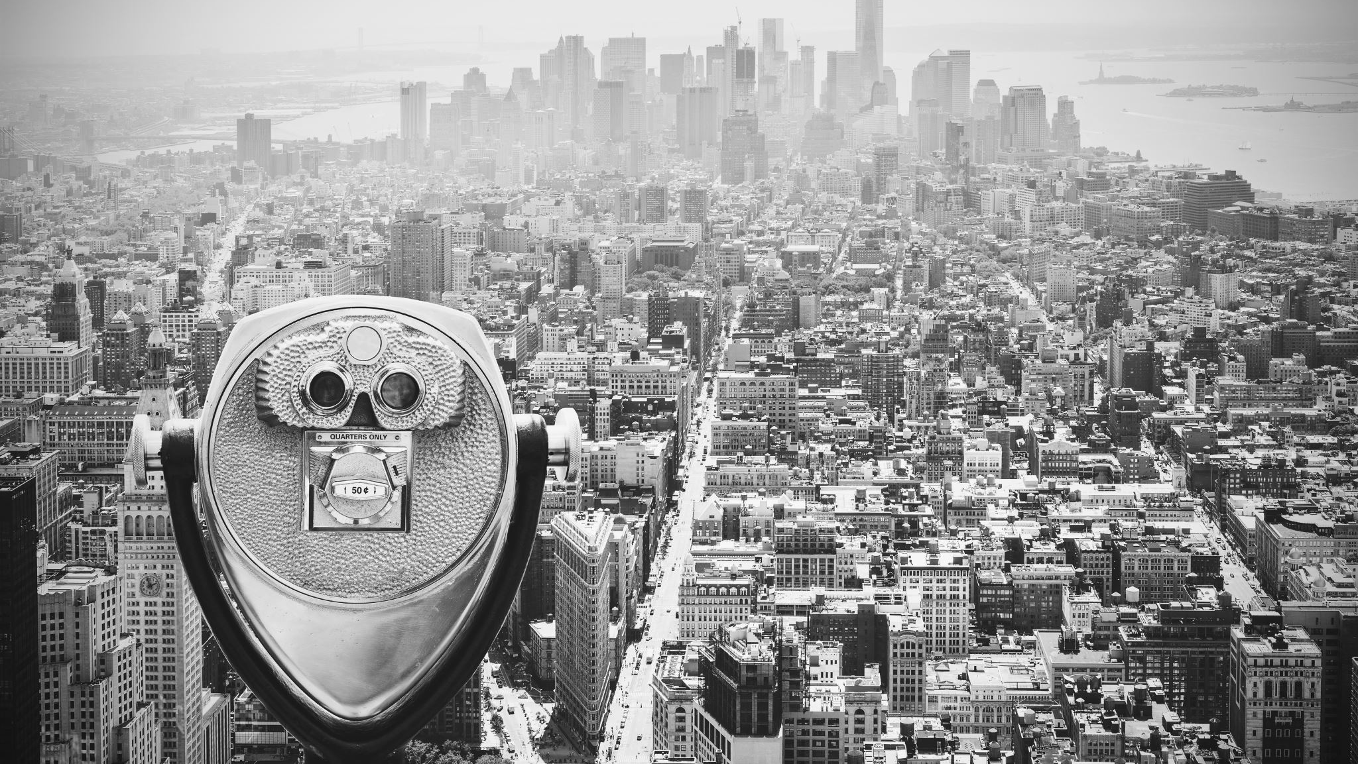
NOTHING NEW
Notes:
1693: “doubts, fears, and uncertainties” in William Payne’s “A practical discourse of repentance”
1920: “fear, uncertainty, and doubt” in Farrell’s letters: “suspicion [of Catholics]has no place in our exchanges; it is a shield for ignorance, a sign of FUD”
(Both come from a religious background)
Black Wall Street / The Tulsa Massacre (Oklahoma)
The Red Scare
UNSUBSTANTIATED: The war on Jimi Hendrix, Woodstock!
The war on drugs
Affect the stock market (political tensions and the rise of the Brent barrel cost)
(Loss of user base made Meta stock nosedive 25%)
Microsoft: MS-DOS better than DR-DOS. Software created by MS to run on both would show fake “Non-fatal error” to the user.
Also FOSS infringes on patents...
SCO vs. IBM: Microsoft funded the SCO Group lawsuit, which was meant to occupy and reduce trust in IBM.
Apple: “Jailbreaking phones can crash cell towers”

Slide 3
EMBRACE MODERNITY
Notes:
Tech Support Scams!
Enticement: “You need the Alpha Pro Premium S+ Enterprise License for that software” Clickbait: “Top 10 Home Appliances You Mistakenly Thought Were Safe”
Vaporware: “We will be releasing X (specs)” one week before competitor announces Y (stealing thunder)
Sense of Urgency: “13 other customers are looking at this *right now*”
“Why would you get X when it doesn’t do Y that our software does?”

Slide 4
F. U. D.
ear
ncertainty
oubt
& CYBERSECURITY
Notes:
« X Nation State is attacking »
« Log4j is the worst vuln we’ve ever seen »

Slide 5
ECHO CHAMBERS
SENSATIONALISM
Notes:
Sensationalisation of what we work in.
Having an incident hit the media (ie. FB’s BGP outage) is often a source for speculation. Reporters should of course practice due diligence but it’s often hard when the topic is so far removed from the people they are writing to. (Not everyone is technical).
TrustedSec:

Slide 6
LIMITING INADVERTENT FUEL
SAFEGUARDS

