Slide 1
A conference talk...
About running and staffing (infosec) conferences...
@AtomicNicos

Slide 2
What is this?
Talking about infosec conferences
A bunch of personal stories / perspectives
A 4th wall break?
A shitpost?
@AtomicNicos

Slide 3
What is this not?
NOT an infosec talk per se
A self-congratulatory bunch of roses thrown my way.
Vendor/Snake oil/Academic shenanigans
@AtomicNicos

Slide 4
Disclaimers
Not going to name and shame.
Limited visibility.
You will see some of my stupid, inane, wacky shit.
@AtomicNicos
Notes:
I will mention things that have failed. Won’t mention who did it though.
I haven’t done all the conferences, so I am basing it off of my own experience.

Slide 5
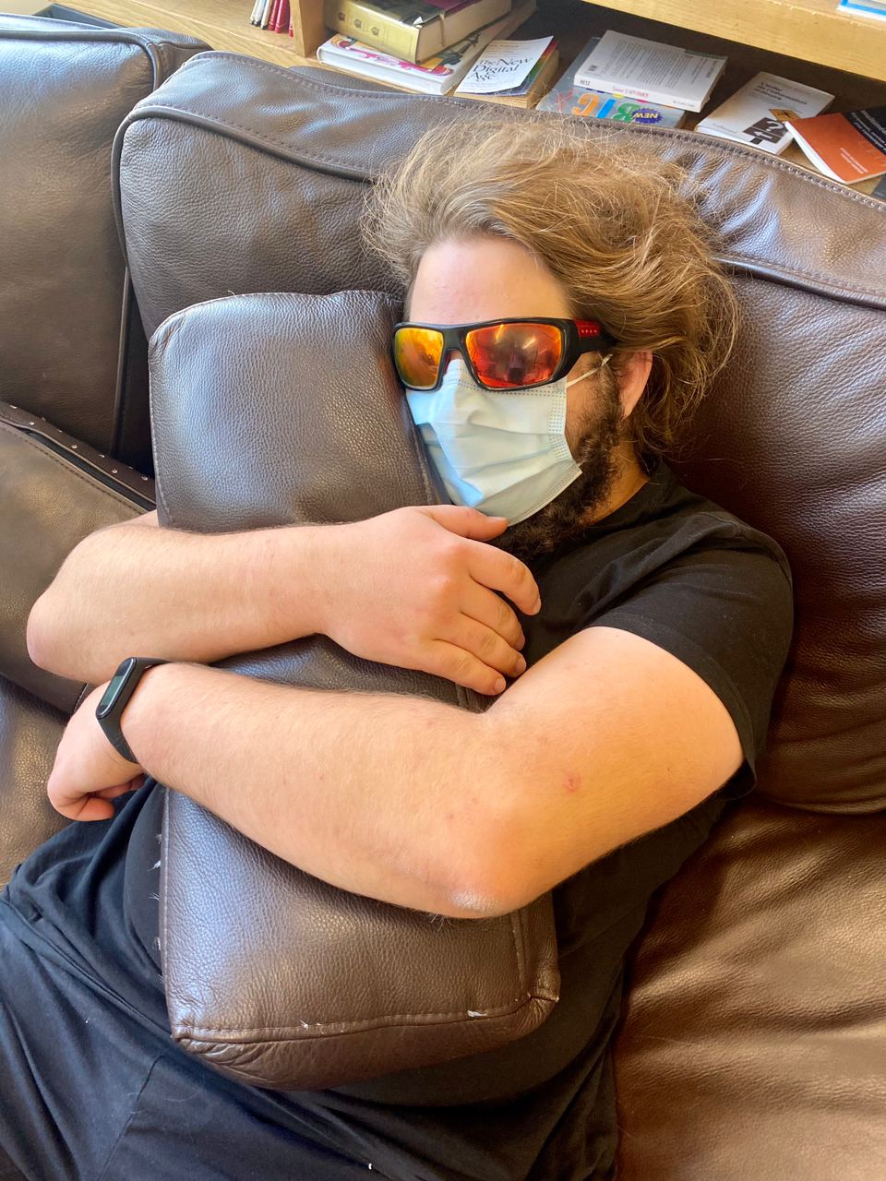


$ whoami
Software / AppSec Engineering (-ish?)
On the side?
Studies, OSINT, Communities, CTFs
I do stupid (fun?) things
@AtomicNicos
nicolas-boeckh

Slide 6
I’ve been... around...
CTFs | Conferences
AppSecVillage CTF @RSA2022, @DEFCON2022, @DEFCON2021 BSides NCL CTF 2021 TransTechTent’s PhoenixCTF 2022 Digital Overdose CTF 1, 2, 3, 4... | BeerCon 3, BeerCon 4 Bsides NCL 2021 PlaySecure Conference 2021, 2022 MayContainHackers 2022 Digital Overdose Conference 2021, 2022 The Diana Initiative 2021 CircleCityCon 2021, 2022
@AtomicNicos

Slide 7
Taking a peek behind the curtain!
@AtomicNicos

Slide 8
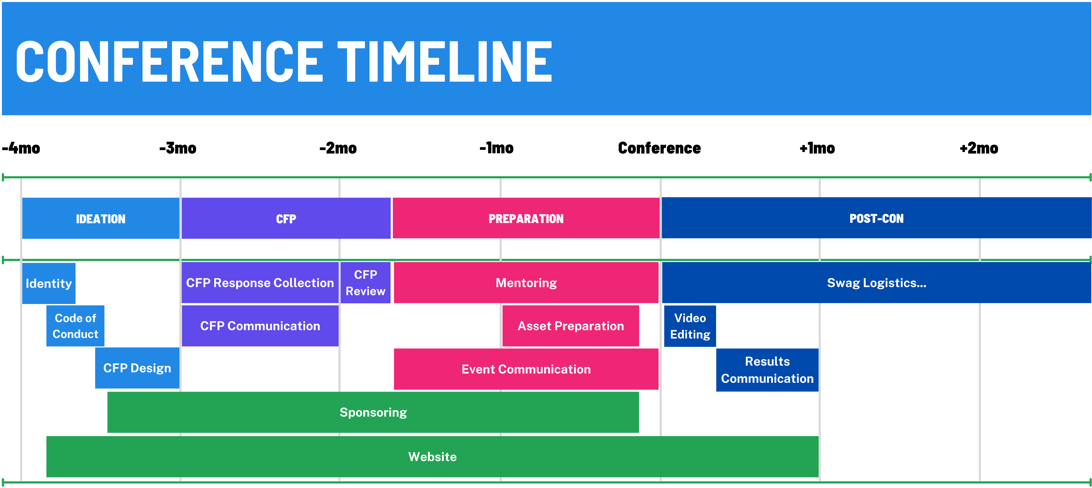
@AtomicNicos

Slide 9
#TheRules

Slide 10
The CFP

Slide 11
The Preparation

Slide 12
The Post-Con

Slide 13
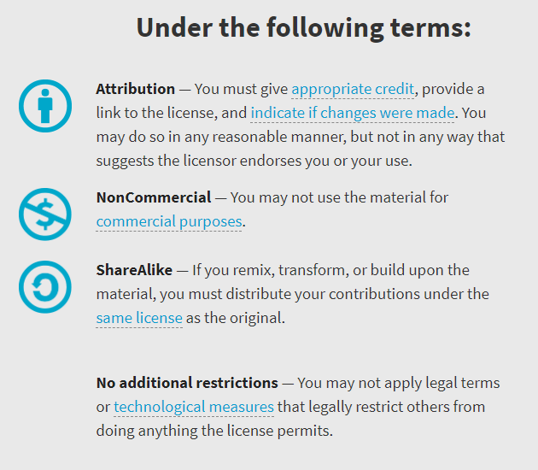

Availability
Work licensed under Creative Commons : CC-BY-SA (legalcode)
Open License
@AtomicNicos
Notes:
[30s – 24:30-25:00]

Slide 14

AMA
Discord : @AtomicNicos#1404
Twitter : @AtomicNicos
Notes:
[30s – 26:00+]

