Slide 1
OSINT & the Art of Pivoting
@Digital Overdose
@AtomicNicos
Notes:
[15s - 00:00-00:15]

Slide 2
Open Source INTelligence / Recon
Relies on publicly available data:
Social media accounts
Phonebooks
Documents
…
Usually less reliant on:
Interaction (HUMINT)
Communications technologies (SIGINT)
Equipment Analysis (TECHINT)
…
@AtomicNicos

Slide 3
OSINT Steps
Define Requirements
Retrieve Data
Analyze
Pivot
Report
@AtomicNicos

Slide 4
Summary
Pivoting ?
Effective pivoting
Tracking Steps
Tips
Tools
@AtomicNicos

Slide 5
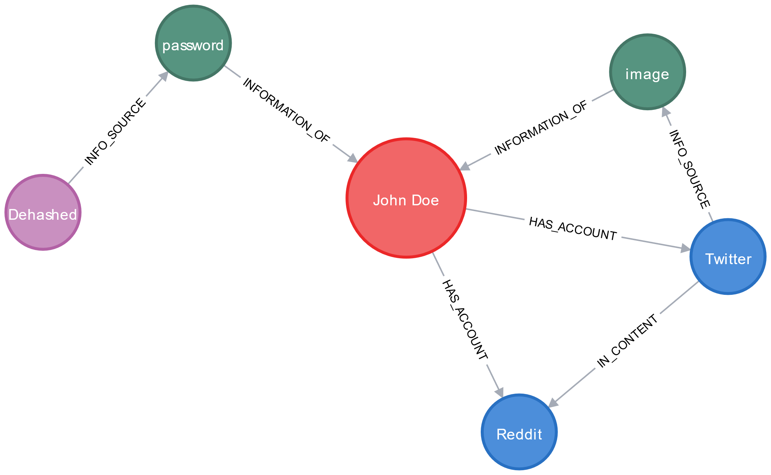
Pivoting ?
Get datapoints from a previously collected datapoint
Use it to grow the dataset
@AtomicNicos

Slide 6
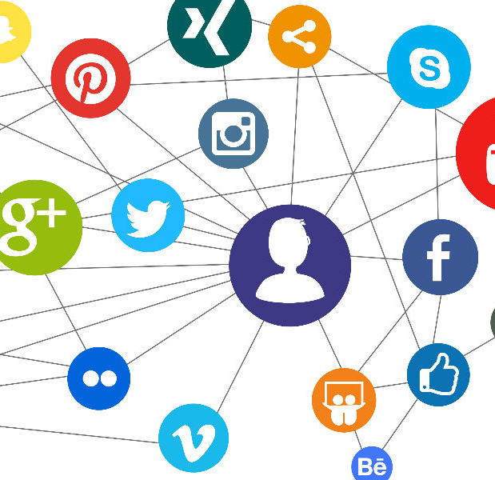
First pivots
Find social media ! (Google dorking, …)
Result: Relations profile (family, friends, …)
Find same username on other platforms
Result: Future pivots, Aliases
Find pictures
Result: Physical profile (body modifications, tattoos, haircut, …)
@AtomicNicos

Slide 7
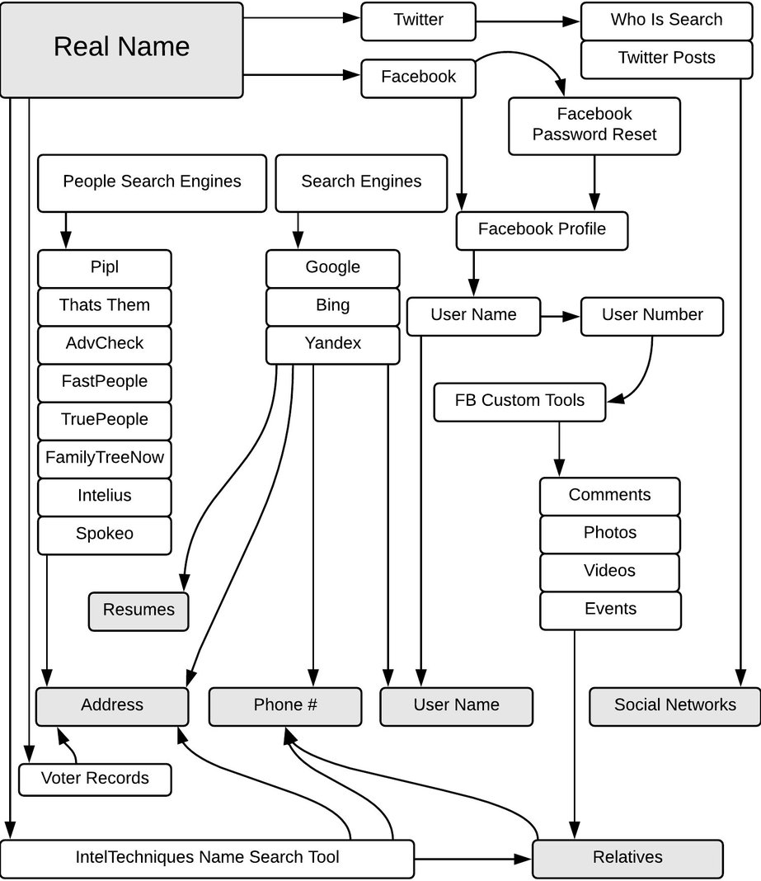
Advanced pivots
Name changes (→ Aliases, Records, …)
Yellow / White pages (→ Addresses, Assets, …)
Dehashed, RaidForums (→ Credential Leakage, …)
Criminal Records (→ Affiliations, …)
Credit: Petro Cherkasets
@AtomicNicos

Slide 8

Effective Pivoting
Looking less like this
@AtomicNicos

Slide 9
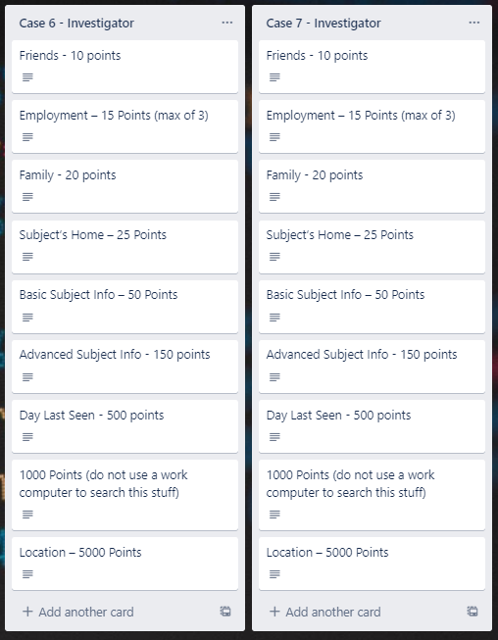
Tracking steps
Finding data once is cool, having to find it again is a waste of time.
Store information type, a short description, URL’s, snapshots.
⚠Also store what node got you there !
@AtomicNicos

Slide 10

Drilling
Interesting images
Linked services
Families & Friends
POI
Potential offenders
@AtomicNicos

Slide 11

Analyzing
Find distinguishing marks
Build a timeline
Make an asset inventory
Build addiction profiles
@AtomicNicos

Slide 12
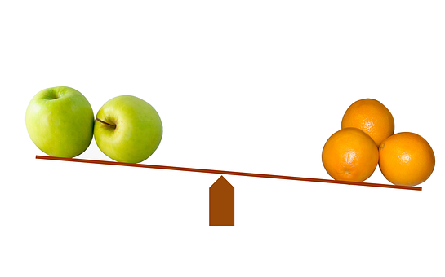
Comparing
Find sock accounts
See changes in features
Mark evolution of relationships
@AtomicNicos

Slide 13
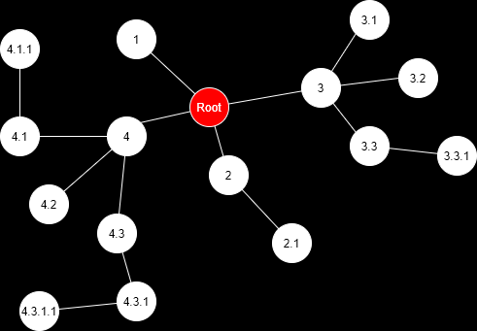
Moving on
Pivot in place
Add to the backlog
Remain in familiar waters
Backtrack when you feel like it
@AtomicNicos

Slide 14
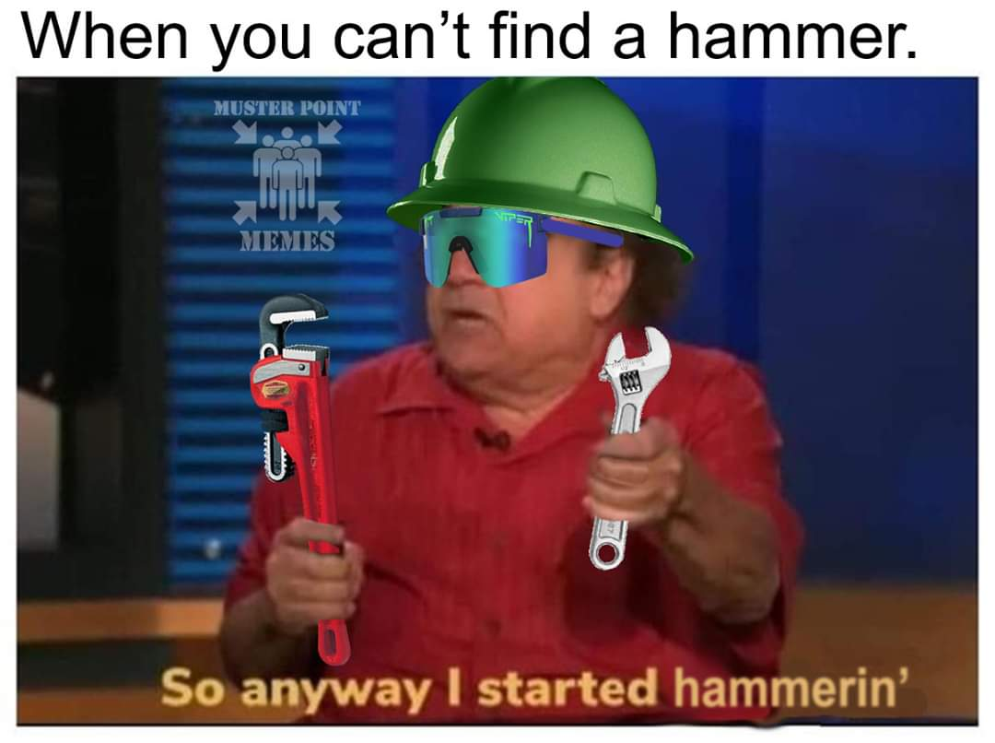
Tools of the trade
The wrong tool brings the right headache
@AtomicNicos

Slide 15
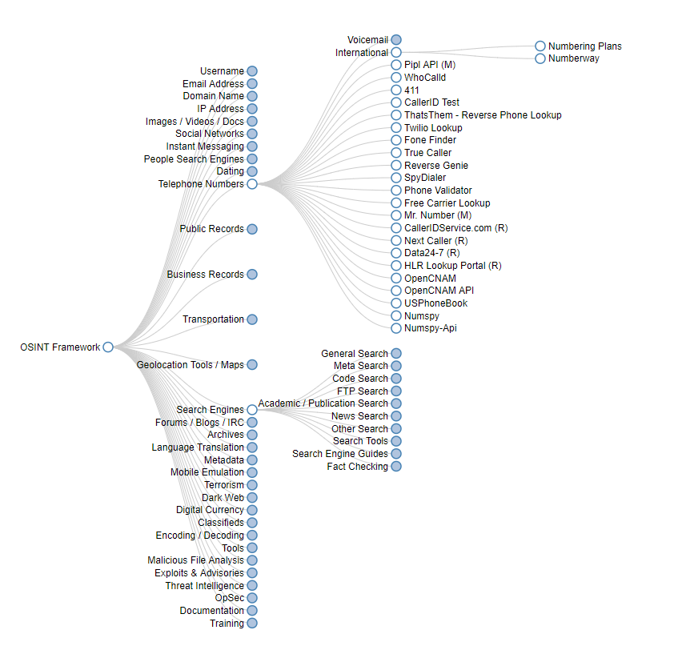
OSINT Framework
Not a tool, but a curated list of tools
Easy mind-map-esque access
@AtomicNicos

Slide 16
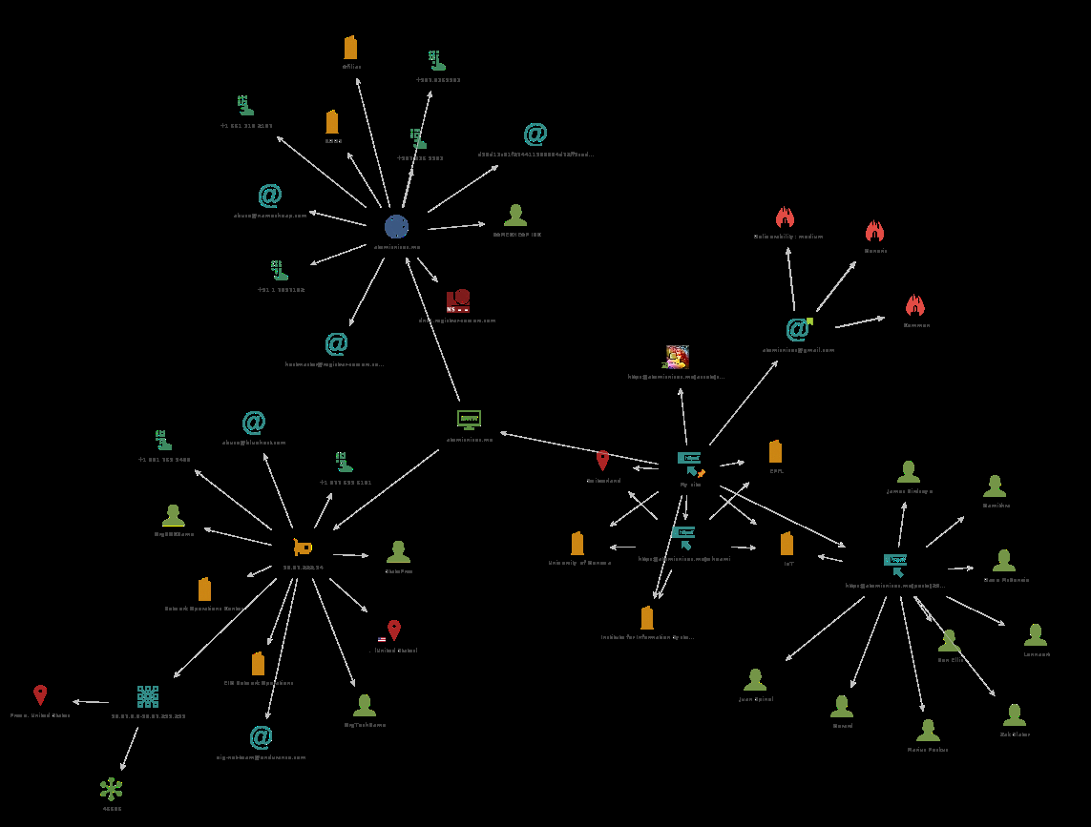
Maltego
Powerful tool leveraging transforms to dig for data
Versatile use cases
Overall reporting capability
@AtomicNicos

Slide 17

Google Dorking
Make use of the robots !
Powerful tool
Investigative shortcuts
@AtomicNicos

Slide 18
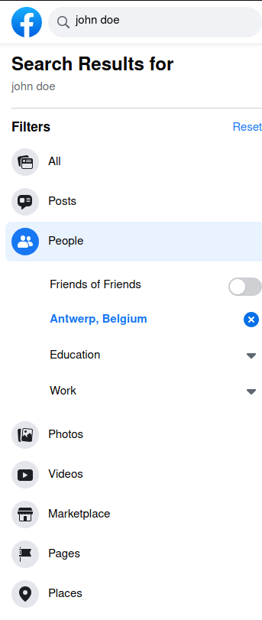
Social Media Advanced Search
Facebook Explore / Twitter Advanced Search
Use locations to filter accounts
Sort mentions
@AtomicNicos

Slide 19
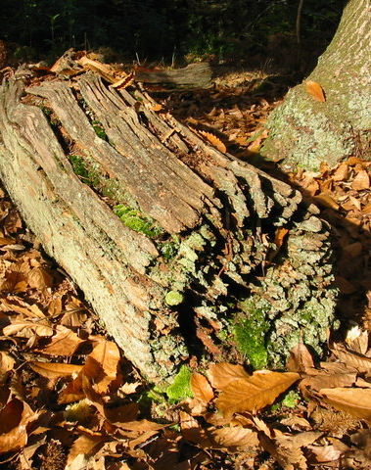
How to log ?
CTF Style. Not like a lumberjack
@AtomicNicos

Slide 20
Trello boards
Small investigations (ie. Tracelabs)
Organized around point structures
@AtomicNicos

Slide 21

“MS Word” Files
DON’T
Small investigations
Use tables, I guess
Hot link to images
Credit: Seán G., BeerCon2
@AtomicNicos

Slide 22
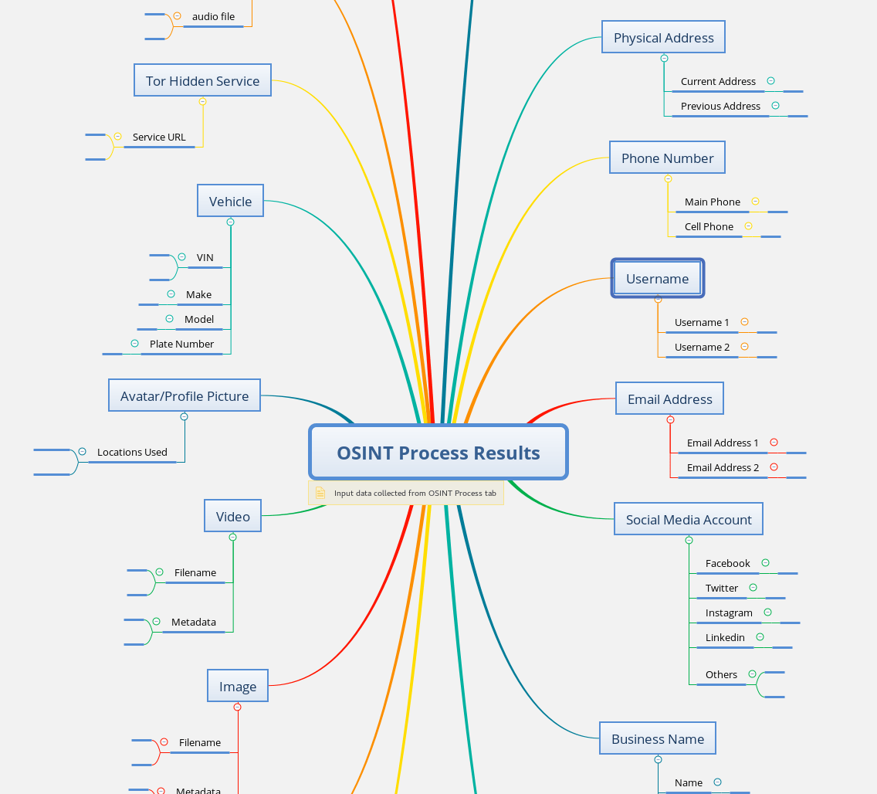
Mindmap
Graphical representation
Use on a per-case basis
Works well with big cases
Hard to place drill results
@AtomicNicos

Slide 23
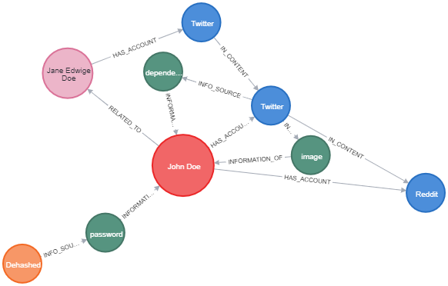
Other solutions
Databases
Editable chats (ie. Discord, …)
Jazzy Homebrew
@AtomicNicos

Slide 24
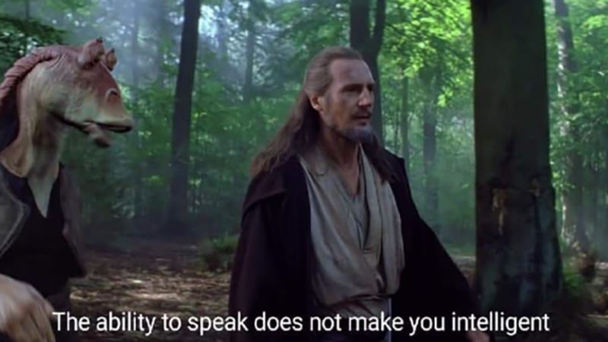
Some tips from an amateur
Jumping to conclusions is a sure flight to defeat
@AtomicNicos

Slide 25

Overextending is painful
Use a backlog
Alternate reconnaissance and analysis
Too much at once → Loss of focus
@AtomicNicos

Slide 26

Mental Health is important
Take breaks
Discuss what you’ve seen with teammates
Ground yourself in the now
@AtomicNicos

Slide 27
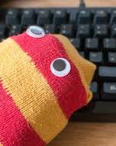
Sock accounts
Have nurtured socks
No LinkedIn
Don’t forget your passwords
@AtomicNicos

Slide 28

No-touch investigating
Avoid spooking your target
Don’t attempt to reset their emails (or log in)
Don’t send anyone messages
@AtomicNicos

Slide 29

Work with peers
Peer check your work
Discuss during all phases
Work on strengths and weaknesses
@AtomicNicos

Slide 30
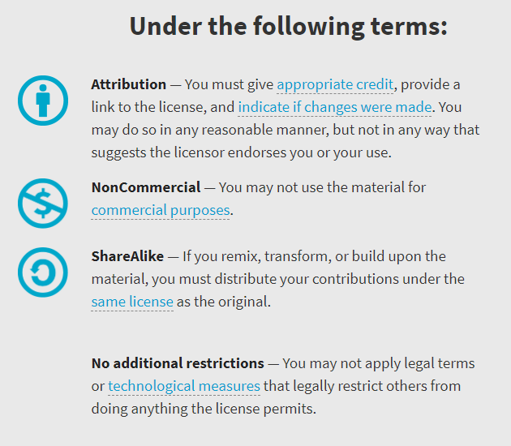

Availability
Work licensed under Creative Commons : CC-BY-SA (legalcode)
Open License
@AtomicNicos
Notes:
[30s – 31:40-32:10]

Slide 31

Thanks
Shoutouts
@Vent
@Mrs_Skelli
AMA
Discord : @AtomicNicos#1404
Twitter : @AtomicNicos
Notes:
[60s – 32:10-33:10]
+ Q&A

