Slide 1
Containers
What? Why? How? Well… ?
@AtomicNicos
Notes:
[15s - 00:00-00:15]

Slide 2
Disclaimer
I only know so much about containers and am in no way a point of reference.
If you want a point of reference, check out @alicegoldfuss’s talk and whatever @IanColdwater does.
@AtomicNicos

Slide 3
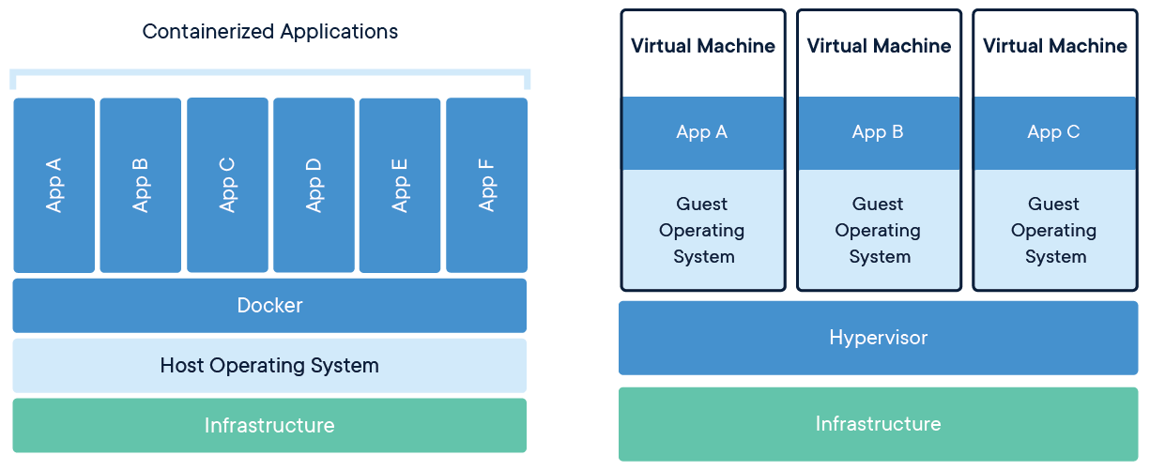
What is a container?
It’s a (semi-)segregated environment that has its own runtime and is independent from host software infrastructure.
@AtomicNicos

Slide 4
Why do we use containers?
To run standalone services (spiderfoot, sonarqube, etc.)
To stop people saying “it works on my machine”
To have an “easy” approach to service maintenance
@AtomicNicos

Slide 5
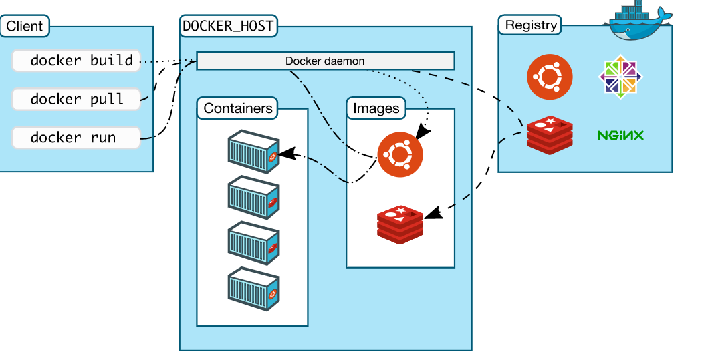
How do we use containers?
Docker
Docker (container)
@AtomicNicos

Slide 6
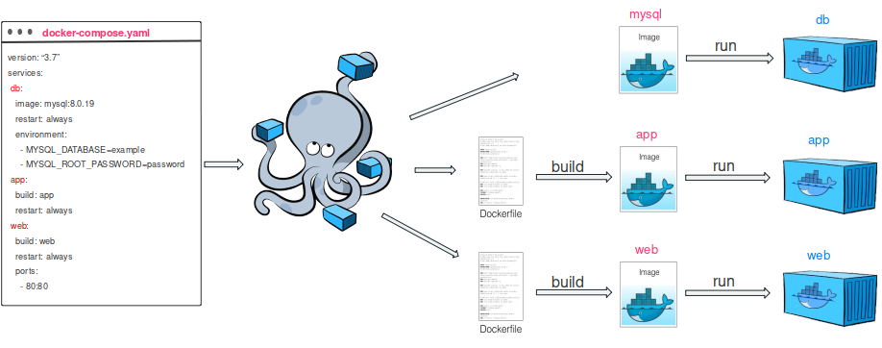
How do we use containers?
Docker
Docker (container)
Docker-Compose (service group of containers)
@AtomicNicos

Slide 7
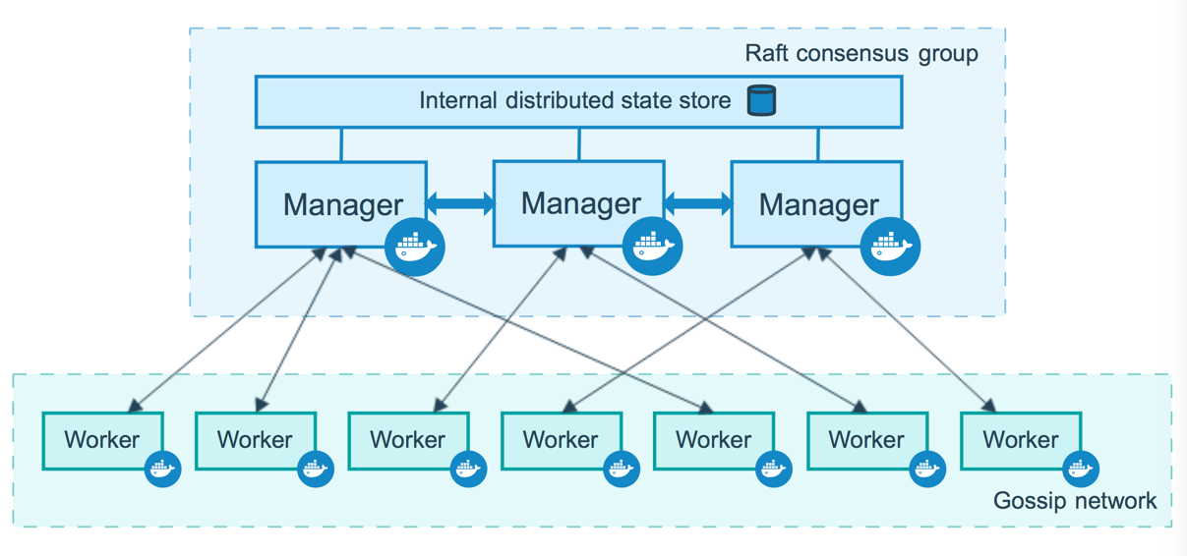
How do we use containers?
Docker
Docker (container)
Docker-Compose (service group of containers)
Docker Swarm (a “container orchestration tool”)
@AtomicNicos

Slide 8
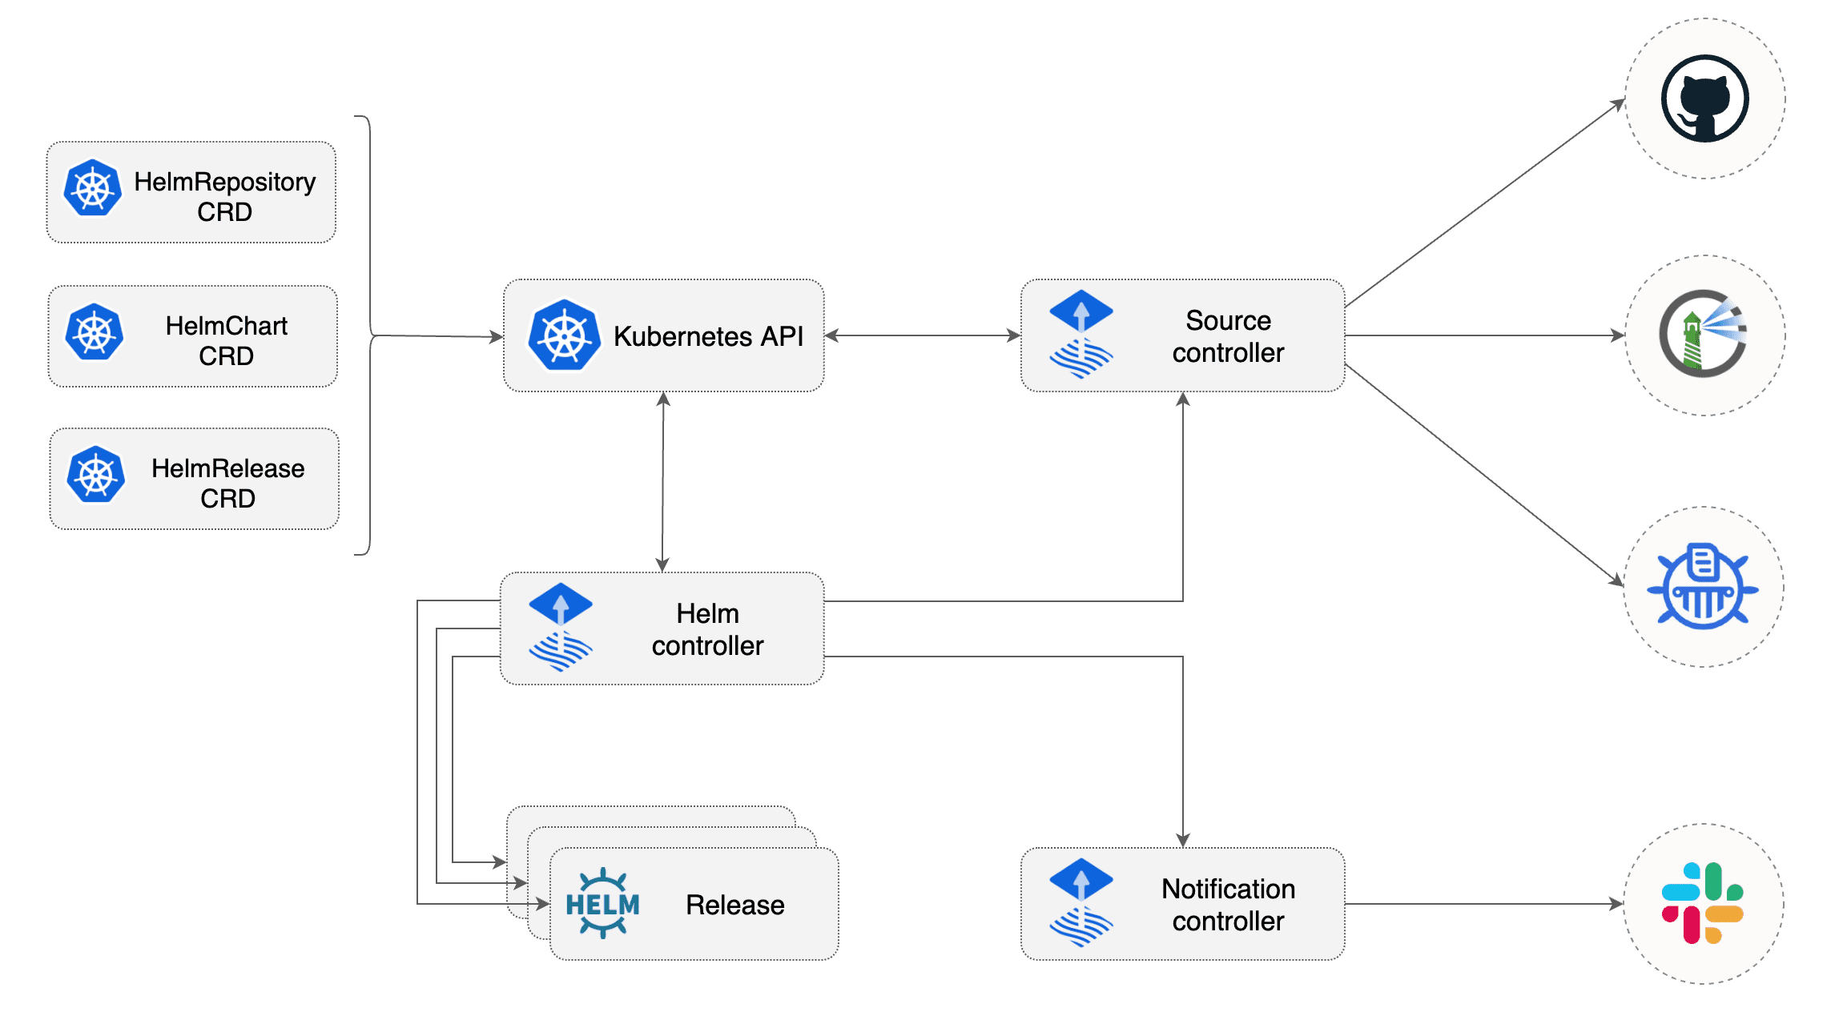
How do we use containers?
Kubernetes
Docker containers
Helm charts
@AtomicNicos

Slide 9
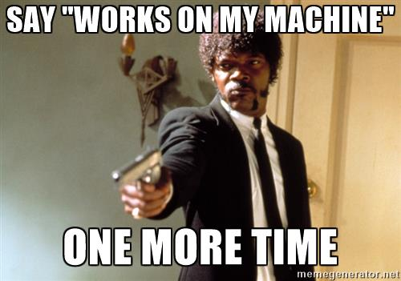
Well… does it make development easier?
Yes
No
It’s complicated
@AtomicNicos

Slide 10
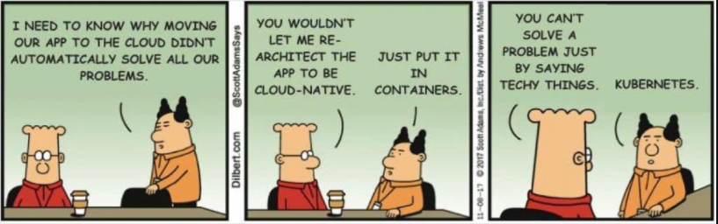
Well… does it make resources more accessible?
Yes
No
It’s complicated
@AtomicNicos

Slide 11
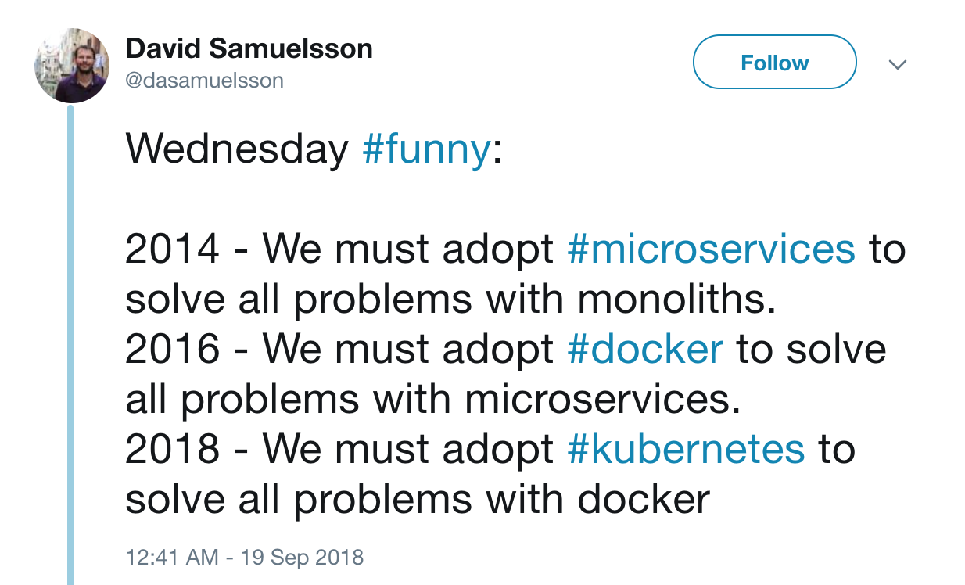
Well… should we default to always using containers?
Yes
No
It’s complicated
@AtomicNicos

