Slide 1
Pitfalls in IoT security
@AtomicNicos
Notes:
[15s - 00:15-00:30]
Whoami ? (*)
I am Nicolas Boeckh, I usually go by AtomicNicos on the Internet and I am a student from Switzerland.
I am a rookie speaker and a rookie in infosec, and this talk will be based on my own experiences and opinions.

Slide 2
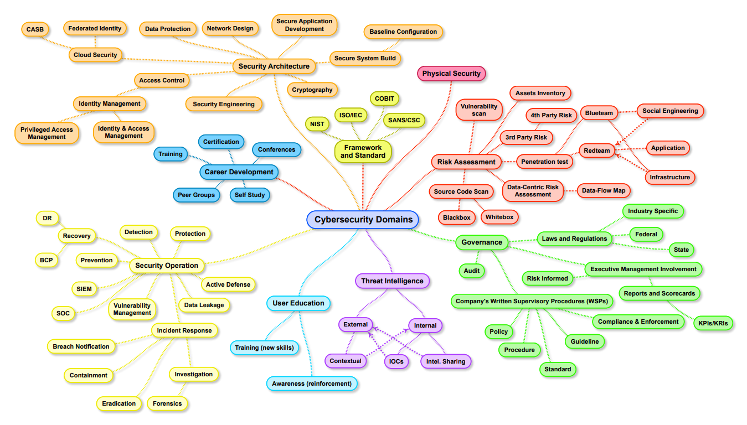
Trying to describe the universe
Credit: Henri Jiang, 2017 (link)
@AtomicNicos
Notes:
[30s – 00:30-01:00]
Trying to talk about cybersecurity is like trying to talk about the universe: There’s a lot to talk about and a lot left to discover. (*)
You may have seen this map on Twitter, LinkedIn or some other website. It was created by a CISO by the name of Henri Jiang back in 2017 and is called the “Map of Cybersecurity Domains (version 2.0)”. There’s room for growth, and we might see another version some time soon. We’ll just be using it to introduce our subject. (*)

Slide 3
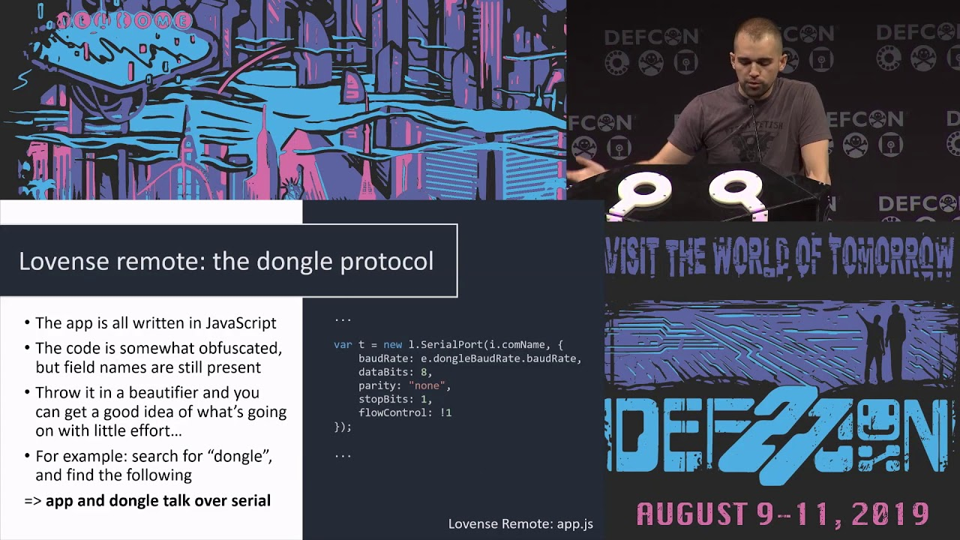
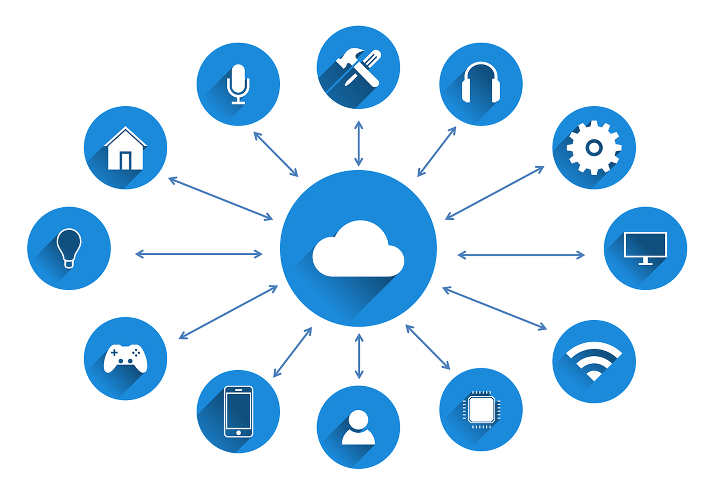


IoT
@smealum
We’re talking about IoT clusters, usually.
Clusters are generally service-centric.
@AtomicNicos
Notes:
[45s – 06:25-07:10]
Now, on to the Internet of Things – or IoT as it is known.
What does it include ? Smart-everythings.
Fridges, watches, coffee-machines, homes, etc., even going so far as (*) teledildonics, which @smea covered in his DEFCON 27 talk “Adventures In Smart Buttplug Penetration testing”. (*)
All the links mentioned in this segment will be provided with the slides later.
Is *that* what we’re talking about ?
Not really. (*)
We usually talk about clusters of IoT devices, which are (*) usually service-centric, for example an IoT sensor grid to measure Carbon Monoxyde levels in the city streets.

Slide 4
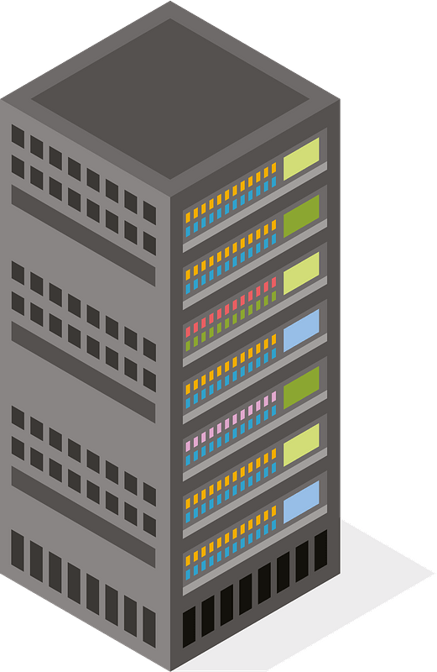

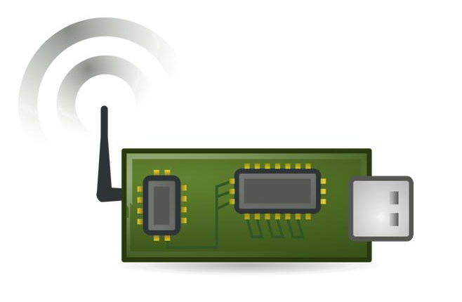
IoT Clusters and the IoT triad
GSM Network / Wi-Fi
Mobile device
(phone, tablet, …)
Servers
LoRa
Bluetooth Low Energy
GSM Network / Wi-Fi
NFC
IoT Device
@AtomicNicos
Notes:
[20s – 07:10-07:30]
IoT devices within such clusters (*) alongside mobile devices and servers (*) form the IoT triad.
All of these devices can potentially communicate (*) with each other, using Long Range – LoRa – RF networks, GSM networks or Bluetooth Low Energy wireless connectivity to cite but a few examples, not all of them being on your screens.

Slide 5

Why would one want to do this ?
@AtomicNicos
Notes:
[20s – 07:30-07:50]
But why…. would we want to do that ? (*)
Let’s talk about the people involved (*), the technology at the core (*), the risks that they pose (*) and the fallout at hand in case of an incident. (*)

Slide 6
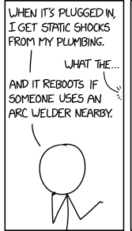
Users
Best friend
Users
Worst enemy
Credit: XKCD
Morality : Love them for the income, hate them for the problems they bring
@AtomicNicos
Notes:
[15s – 07:50-08:05]
Users are at the core of your service ! (*)
They’re your best friend (*) and your worst enemy (*), so you should basically love them for the income, and hate them for the problems they bring. (I’ll give you a moment to read the comic, <wait 3-5 seconds>)

Slide 7

Developers & Managers
@AtomicNicos
Notes:
[10s – 08:05-08:15]
You also need to be aware of your developers, managers and the hierarchy they are a subject to, because they will let everything burn down to save face.

Slide 8
Technology
Database
IoT
Data Dump
Information storage
Physical Media
Servers
Logfile
API
@AtomicNicos
Notes:
[20s – 08:15-08:35]
Let’s talk about the technology at hand. (*)
Storage in the context of IoT (*), databases (*), data dumps (*), servers (*), logfiles (*), API’s (*) is always stored on some form of physical media.
Depending on where the storage is located, it can be exposed to physical access.

Slide 9
Technology
Information transmission
Medium
Protocols
Availability
Conclusion : Huge attack surface
Security
Wires
Authenticity
Integrity
Bluetooth
Wi-Fi
Authentication
@AtomicNicos
Notes:
[30s – 08:35-09:05]
The transmission of information uses (*) a medium, which can be (*) wires, (*) proximity wireless and (*) wireless, all of which can be observed by a potential attacker.
This transmission is (*) usually the subject of multiple protocols – some more efficient or secure than others – that can account for (*) Authenticity, (*) Authentication, (*) Integrity and (*) Security.
All in all (*) this shows us that there is a huge attack surface.

Slide 10
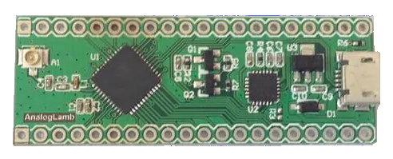

Risks – Storage
SD Card
Physical access
Easy I/O
Contains files
Micro-processors
Retrieve assembly code
If it’s addressable to a computer, it’s addressable to you ~ @BlindHacker
@AtomicNicos
Notes:
[30s – 09:05-09:35]
So what risks and threats is IoT the subject of ?
Well, in the context of information storage (*), you’ll probably have an SD card reader baked in or attached to your chip assortment, which can contain log files, configuration files, ssh files, and these kinds of juicy things that probably shouldn’t be in the clear like that.
This is not to say that the data should be (*) embedded in the source code of the micro-processor, as it is possible to retrieve the static values within the assembly code.

Slide 11
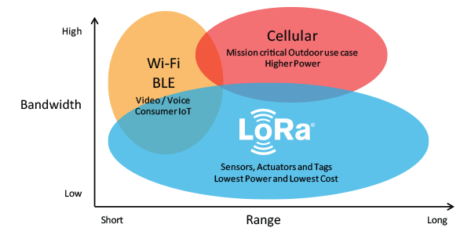
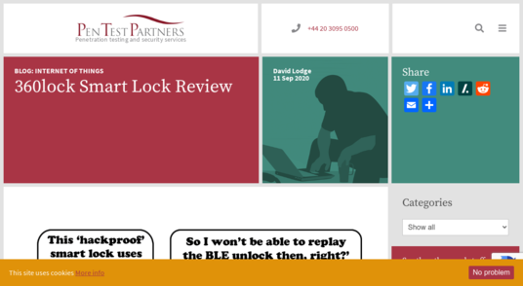

Risks – Transmission
Bluetooth Low Energy
Plain-text byte stream
OITM (Observer in the Middle)
GATT attack (Generic ATTribute)
LoRa (Long Range)
Plaintext byte stream over RF
Wi-Fi
Packet capture and other standard risks.
@tautology0
@AtomicNicos
Notes:
[40s – 09:35-10:15]
There are a few ways that IoT devices (*) can transmit data, for example via (*) Bluetooth Low Energy which is a plaintext byte stream that can passively be observed or actively attacked.
As an example (*), tautology0 – fellow infosec happy hour joiner and buckfast enthusiast – has published a tweet thread about breaking a Bluetooth Low Energy smart lock, which can be found on the PenTestPartner’s website linked here.
The same can go for (*) LoRa transmissions, which are plaintext bytes that can feasibly be received on any compatible RF receiver.
Finally, packet capture (*) and other methods have been extensively documented for compromising local networks.

Slide 12
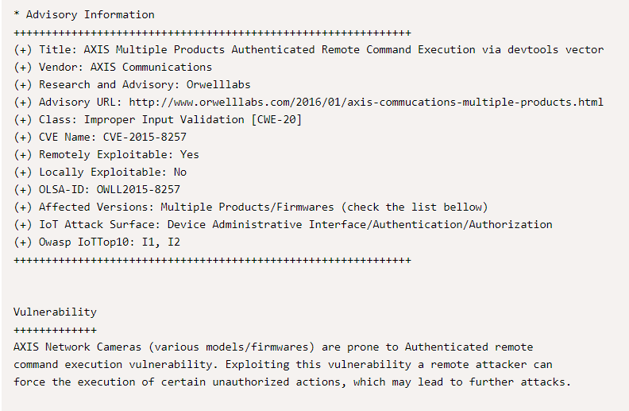

Risks – Pivot
Axis M3004-V
@AtomicNicos
Notes:
[40s – 09:35-10:15]
There are a few ways that IoT devices (*) can transmit data, for example via (*) Bluetooth Low Energy which is a plaintext byte stream that can passively be observed or actively attacked.
As an example (*), tautology0 – fellow infosec happy hour joiner and buckfast enthusiast – has published a tweet thread about breaking a Bluetooth Low Energy smart lock, which can be found on the PenTestPartner’s website linked here.
The same can go for (*) LoRa transmissions, which are plaintext bytes that can feasibly be received on any compatible RF receiver.
Finally, packet capture (*) and other methods have been extensively documented for compromising local networks.

Slide 13

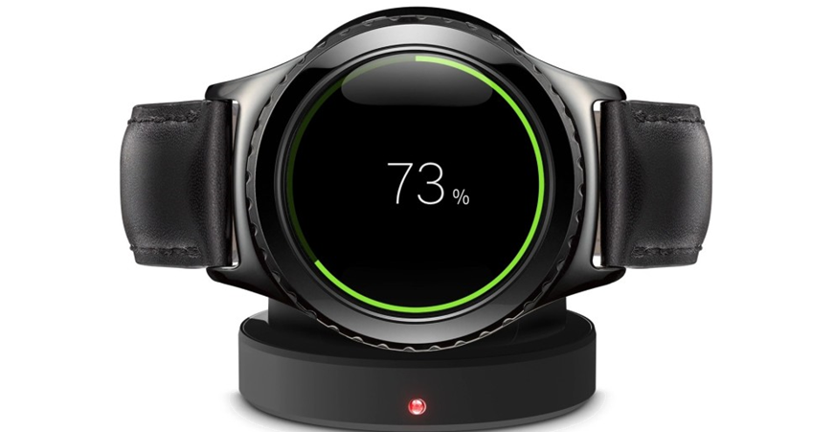


Story time
Story link
@AtomicNicos
Notes:
[50s – 12:10-13:00]
I can now tell you of a story that embodies these risks, that a Dutch security researcher shared with me, and (*).
They bought an IoT watch (*) that allowed to track children for their non-existing "child“, registered it and installed the accompanying app.
They then observed some communication by the application, and so inserted Burpsuite in the middle.
The application would query the server by using an id, which retrieved the location of the watch.
What did they do ? They changed the id. And the location data changed.
They then tried to replicate the retrieval, which didn’t exactly work out.
The service required a sufficient level of authentication but not of authorization on the data it requested, and thus enabled access to the locations of potentially hundreds of thousands of children.
This issue, which implicated a third party, has in the meantime been fixed.

Slide 14
How do I reduce the risks of getting punked ?
aka. Risk Mitigation
@AtomicNicos
Notes:
[20s – 15:00-15:20]
Let’s get into the heart of the subject.
Given what we just saw, I’m sad to report that with an attack surface that large, there is no way to stop all the risks that can affect our ecosystem.
What we can do (*) is mitigate the risks by making it more complicated to get punked.

Slide 15

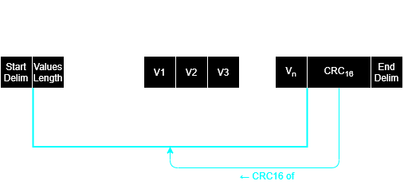

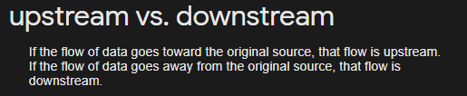
Storage
No upstream critical files
Operations logs and not data logs
Don’t produce anything that can’t receive firmware updates.
@AtomicNicos
Notes:
[40s – 15:20-16:00]
In keeping with our flow, let’s talk about IoT and (*) data storage.
The first and most important point is (*) to avoid adding upstream critical files. If an SSH key is required on the device for firmware updates, make sure it has as little access as possible, and not access to all of the company’s git repositories – something I’ve seen in the wild.
In trying to log activity (*), divide by usability: General logs should contain notable state changes, and not the entirety of the data collected. Error logs should contain the error and state descriptions as well as the data that produced the error. This limits the information an offensive actor can use.

Slide 16
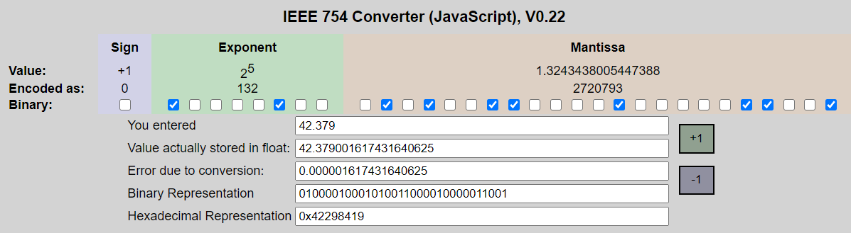
Transmission
Define/Use standards for PDU’s
IEEE 754 float, integers, chars, etc.
Advantages ?
Standards ⇿ Error/modification detection is possible
Compression
42.379 is 6 chars → 12 bytes
0x42298419 → 4 bytes
(tool)
@AtomicNicos
Notes:
[40s – 16:00-16:40]
In terms of (*) transmission, use (*) – or define and then use – a standard for Protocol Data Unit’s which represent a standardized unit of data – much like the Ethernet PDU we saw earlier.
Within these PDU’s (*), use a standardized representation for data types, such as for example the I triple E 754 representation of floating point numbers.
Why ? (*) Because standards (*) allow you to interpret data easily, and possibly even catch errors or modifications – if you also check for integrity.
An additional benefit (*) is that the use of standardized data type representation will at most be of equal size as the characters representing it, so the overall data size will be lighter.

Slide 17
Bonus points :
Extensible framework
Integrity validation
Add timestamp to “avoid” replay attacks
Custom cleartext transmission PDU
@AtomicNicos
Notes:
[40s – 16:40-17:20]
For bonus credit, (*) you can make your PDU future-proof by supporting additional data types.
You can also validate the integrity of your data – with a CRC for example.
If you want to be fancy, you can integrate a timestamp to avoid replay attacks. (*)
This example here is a PDU for cleartext information transmission that works well for BLE or LoRa.
It is defined by (*) delimiters, (*) integrates the size of the accompanying data, (*) provides the value existence notifier array – to be then compared with the protocol specification, and (*) then the concerned values. Finally it (*) provides a CRC_16 – an integrity value – on all the data.

Slide 18
Pivot
Segregate your networks
Harden your infrastructure
All the patches
@AtomicNicos
Notes:
[40s – 16:00-16:40]
In terms of (*) transmission, use (*) – or define and then use – a standard for Protocol Data Unit’s which represent a standardized unit of data – much like the Ethernet PDU we saw earlier.
Within these PDU’s (*), use a standardized representation for data types, such as for example the I triple E 754 representation of floating point numbers.
Why ? (*) Because standards (*) allow you to interpret data easily, and possibly even catch errors or modifications – if you also check for integrity.
An additional benefit (*) is that the use of standardized data type representation will at most be of equal size as the characters representing it, so the overall data size will be lighter.

Slide 19
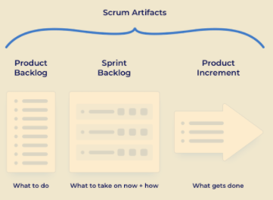
Development workflows
Waterfall / linear development :
Lack of tangible products during development
Lack of Quality Assurance
Agile development :
Lack of security counsel on development artefacts
@AtomicNicos
Notes:
[50s – 18:40-19:30]
When considering development workflows, some issues can affect the overall product, and it’s development timeline.
In more traditional workflows, such as (*) waterfall or linear development, the lack of tangible products – or development artefacts – can negatively affect the security considerations of the project, as well as the oversight of it’s overall quality.
In the hip and modern (*) ‘agile’ development workflow, each cycle usually provides a tangible, testable and usable artefact. The lack of oversight or counsel in this artefacts’ development can lead to issues that then snowball a project into vulnerability hell.
These notions are especially important to keep in mind when considering a development workflow, and this is why the permanent assignment of a proficient information security specialist to the team – even in rotations between teams, is something I personally want to see more of in the industry.

Slide 20
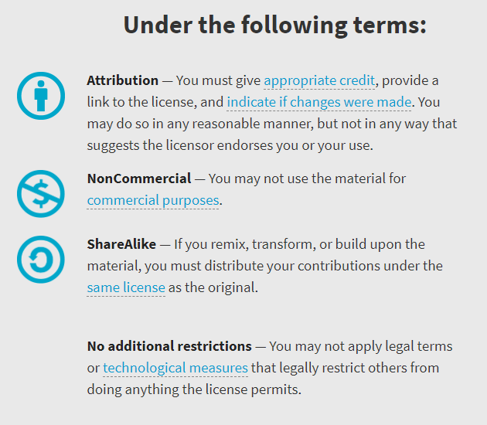

Availability
Work licensed under Creative Commons : CC-BY-SA (legalcode)
Open License
@AtomicNicos
Notes:
[30s – 24:30-25:00]

Slide 21

AMA
Discord : @AtomicNicos#1404
Twitter : @AtomicNicos
Notes:
[30s – 26:00+]

