Slide 1
Python !
Setup, dependency management, environments and fuuuun !
@AtomicNicos
Notes:
[15s - 00:00-00:15]

Slide 2
Python
High-level
Interpreted
Dynamically typed
Cross-OS
Programming language
@AtomicNicos
Notes:
Pythons are nonvenomous snakes found in Africa, Asia, and Australia. They are some of the largest snakes in the world.

Slide 3
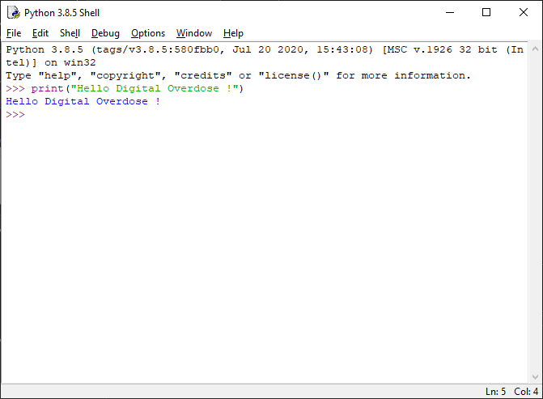
Python
Latest version: 3.9
Download: https://www.python.org/downloads/
Comes with a shitty IDE (IDLE)
@AtomicNicos

Slide 4
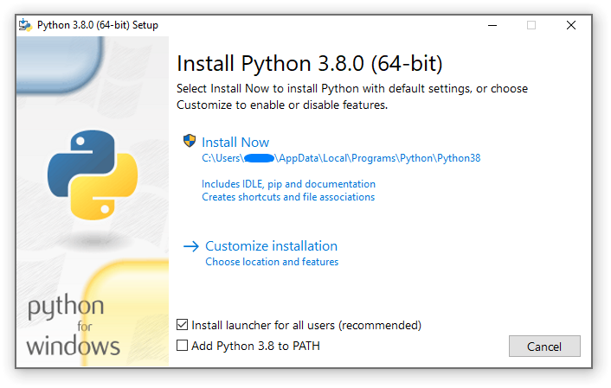
Setup
Download
Execute
Add to the PATH environment
Run !
@AtomicNicos

Slide 5

pip: Package Installer for Python
Installs base code extensions
Keeps the base download small
Packages for: databases, webservers, science, graphics, etc…
@AtomicNicos

Slide 6
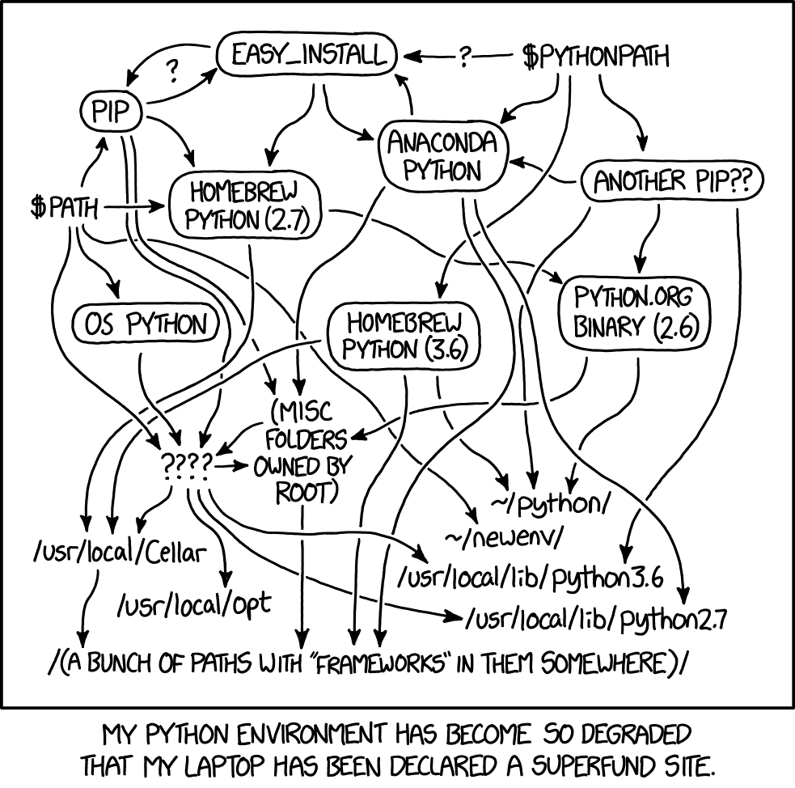
Environments
Making the primary installation redundant
Keeps requirements simple
Avoids cross-contamination
Source: XKCD
@AtomicNicos

Slide 7

venv
The OG environment manager
Complicated usage
Replaced by pipenv
@AtomicNicos

Slide 8

pipenv
Upgrade on venv
Makes functions more accessible
@AtomicNicos

Slide 9
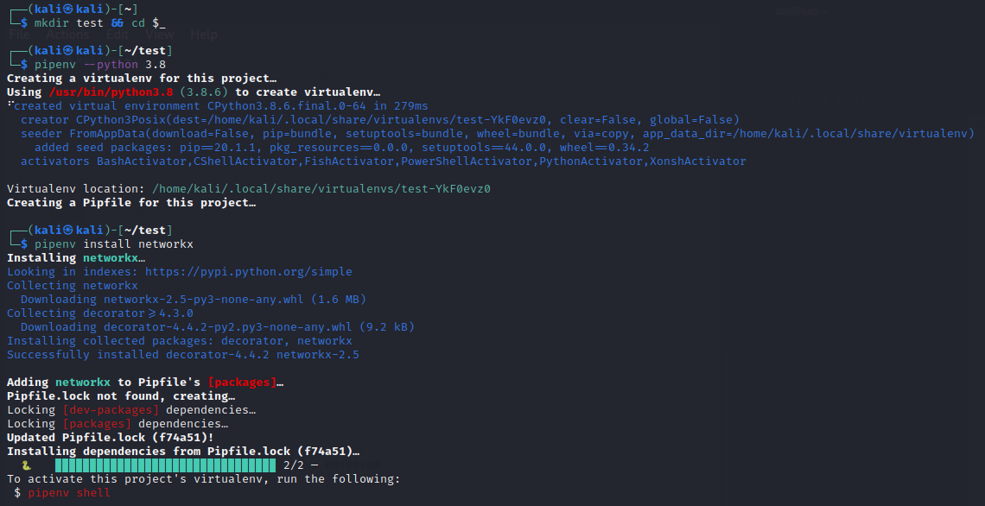
@AtomicNicos

Slide 10
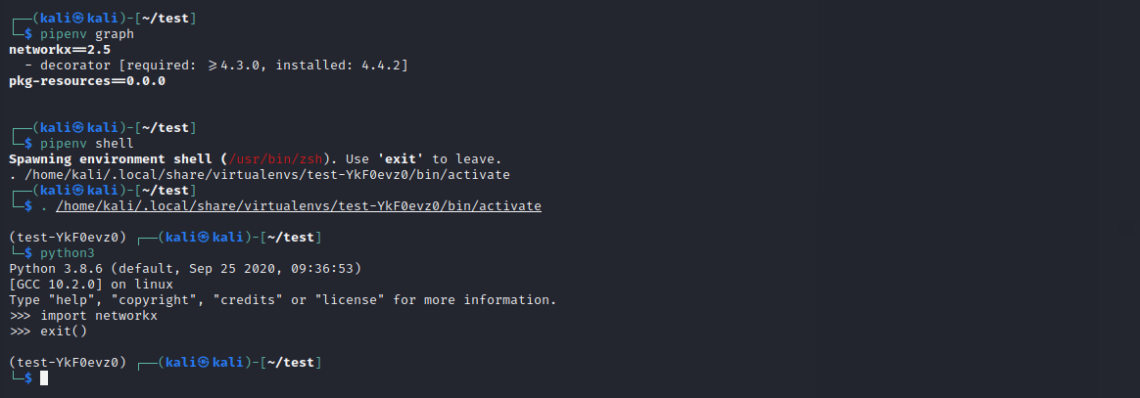
@AtomicNicos

Slide 11
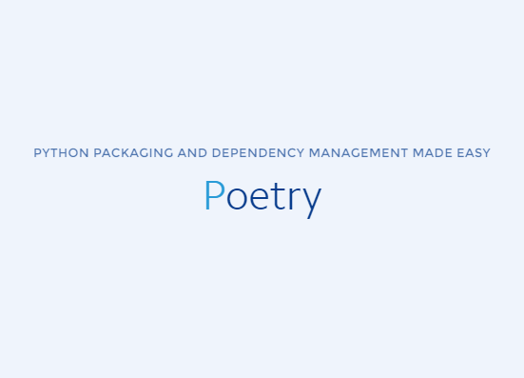
poetry
Clean and simple function
Integrates YAML
Available via pip or directly
@AtomicNicos

Slide 12
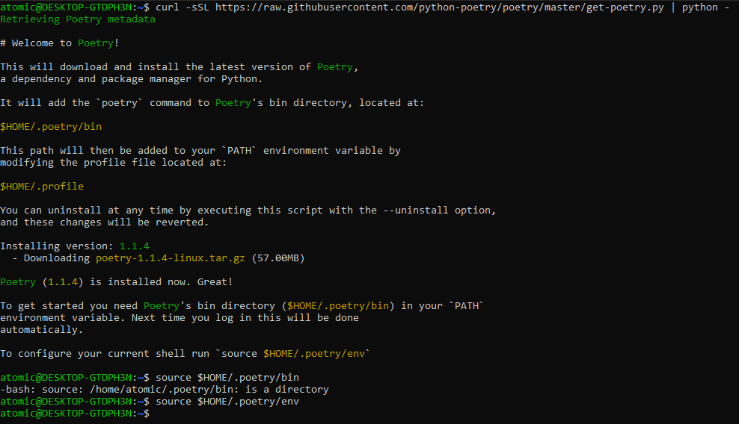
@AtomicNicos

Slide 13
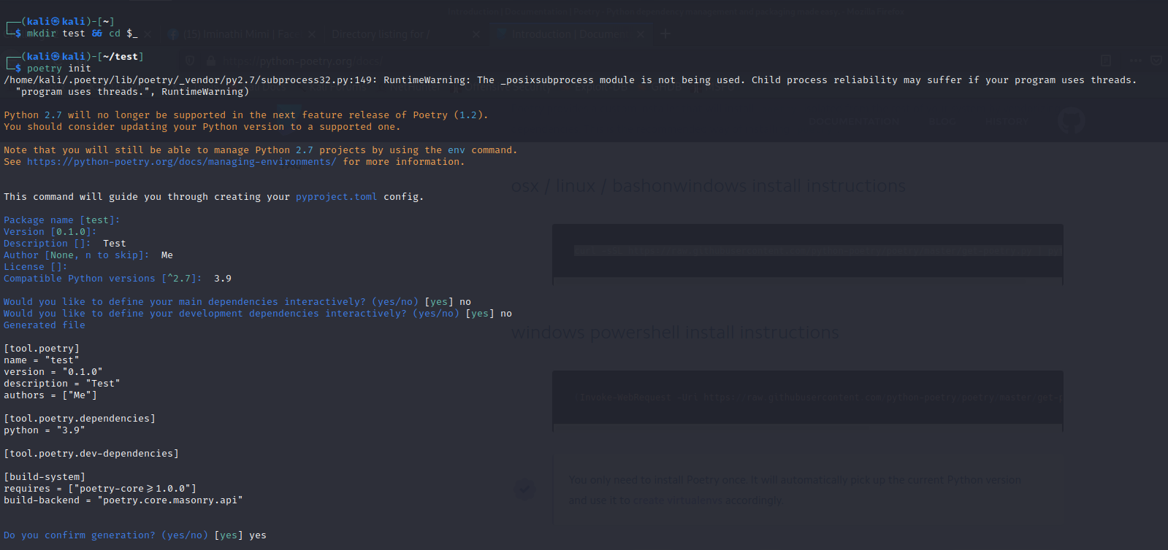
@AtomicNicos

Slide 14
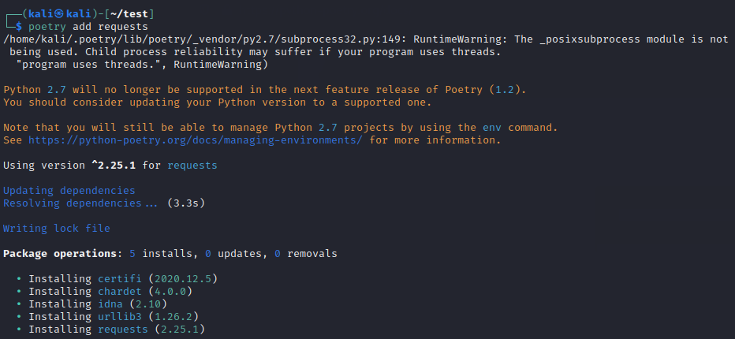
@AtomicNicos

Slide 15
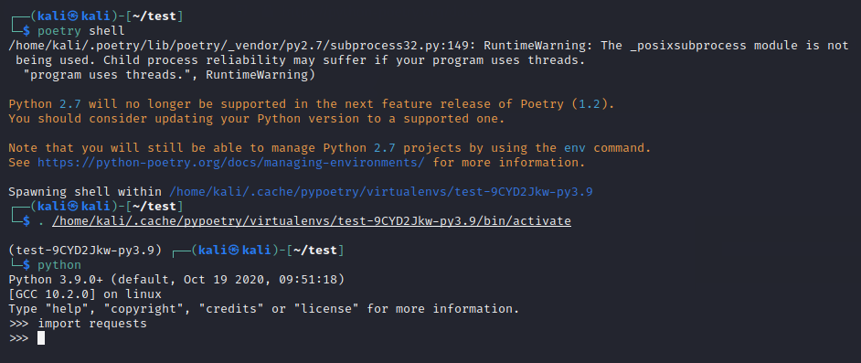
@AtomicNicos

Slide 16
Fun things !
Webserver
Request machine
Bot
Webpage
Graph
@AtomicNicos

Slide 17

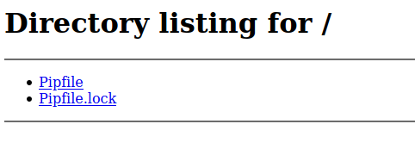
Webserver
@AtomicNicos
Notes:
python3 -m http.server

Slide 18
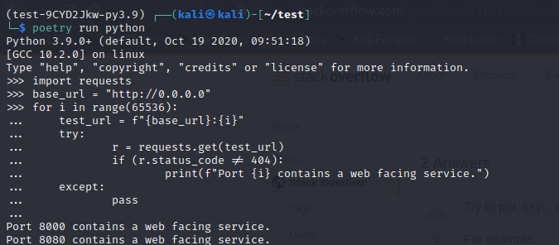
Request Machine
@AtomicNicos
Notes:
#main.py
import requests
base_url = "http://0.0.0.0"
for i in range(65536):
test_url = f'{base_url}:{i}'
try:
r = requests.get(test_url)
if (r.status_code != 404):
print("Port {i} contains a web facing service")
except:
pass

Slide 19
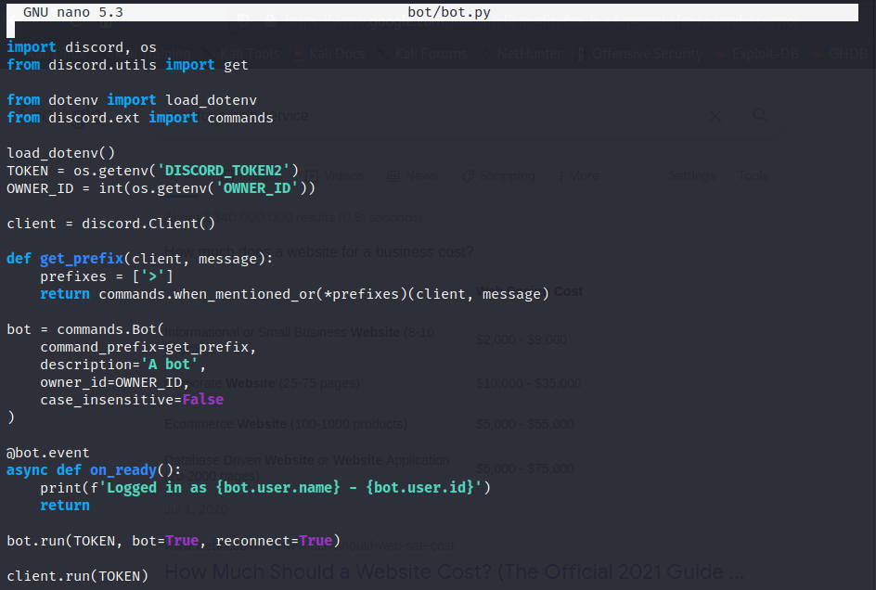
Discord Bot
@AtomicNicos
Notes:
#main.py
import discord, os
from discord.utils import get
from dotenv import load_dotenv
from discord.ext import commands
load_dotenv()
TOKEN = os.getenv('DISCORD_TOKEN2')
OWNER_ID = int(os.getenv('OWNER_ID'))
client = discord.Client()
def get_prefix(client, message):
prefixes = ['>']
return commands.when_mentioned_or(*prefixes)(client, message)
bot = commands.Bot(
command_prefix=get_prefix,
description='A bot',
owner_id=OWNER_ID,
case_insensitive=False
)
@bot.event
async def on_ready():
print(f'Logged in as {bot.user.name} - {bot.user.id}')
return
bot.run(TOKEN, bot=True, reconnect=True)
client.run(TOKEN)

Slide 20
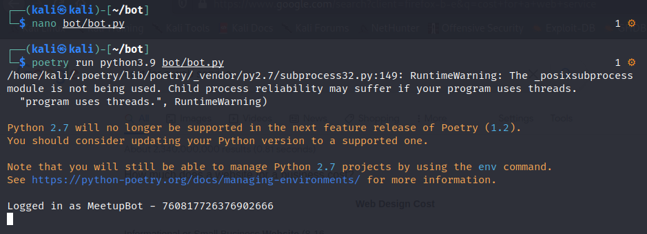
@AtomicNicos

Slide 21
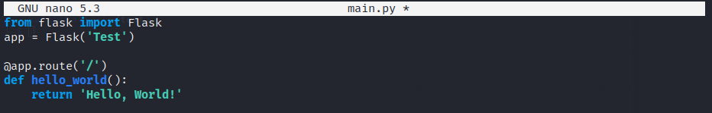
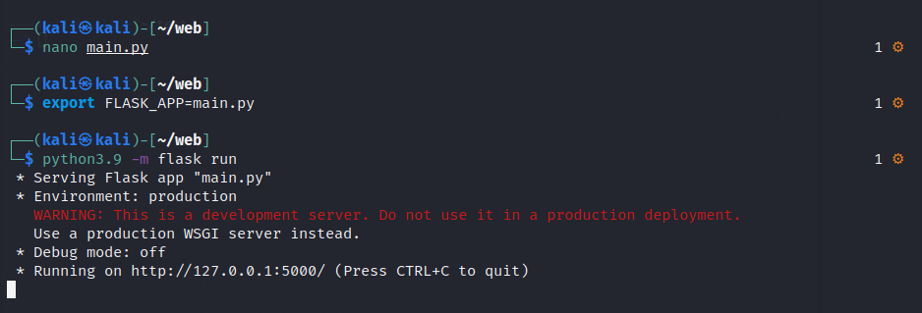
Website
@AtomicNicos
Notes:
#main.py
from flask import Flask
app = Flask('Test')
@app.route('/')
def hello_world():
return 'Hello, World!'

Slide 22
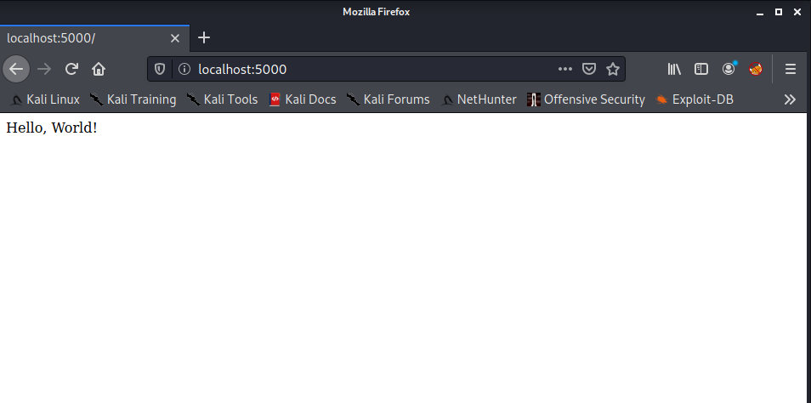
@AtomicNicos

Slide 23
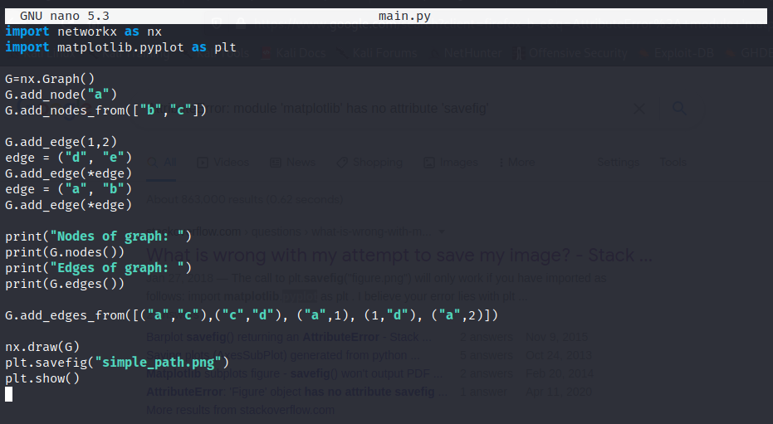
Graphs
@AtomicNicos
Notes:
#main.py
import networkx as nx
import matplotlib.pyplot as plt
G=nx.Graph()
G.add_node("a")
G.add_nodes_from(["b","c"])
G.add_edge(1,2)
edge = ("d", "e")
G.add_edge(*edge)
edge = ("a", "b")
G.add_edge(*edge)
print("Nodes of graph: ")
print(G.nodes())
print("Edges of graph: ")
print(G.edges())
G.add_edges_from([("a","c"),("c","d"), ("a",1), (1,"d"), ("a",2)])
nx.draw(G)
plt.savefig("simple_path.png")
plt.show()

Slide 24
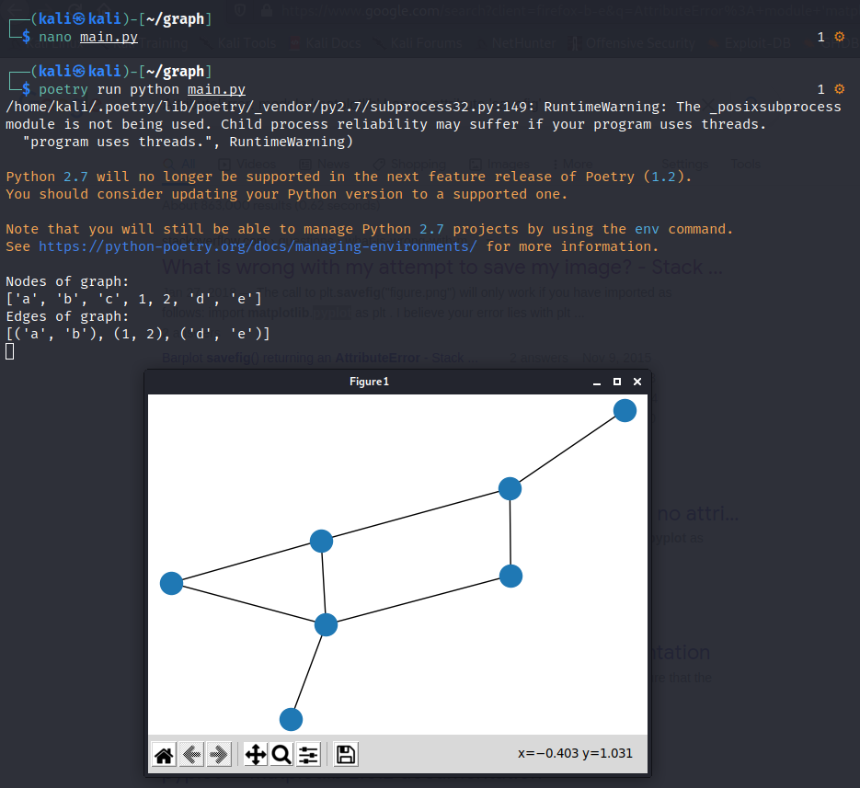
@AtomicNicos

