Slide 1

Lunch and Learn I: October 2012
Introduction to Functional Programming
Chris Dunphy, Core Communications Applications

Slide 2

Welcome!
This is the first of a series of lunch and learn sessions on Functional Programming (FP)
Functional programming is becoming mainstream.
I am new to FP. I am excited about what I am learning.
I hope to share knowledge and learn something from some of you.
I want to get you excited about Functional Programming!

Slide 3
Introduction to Functional Programming
How many in the audience today are familiar with functional programming?
My definition:
Functional programming is a method of software development that separates (and minimizes) the parts of the program that use side effects and mutable state (I/O for example) from pure functions which do not use mutable state at all. FP also emphasizes the use of higher order functions to solve complex problems by building complex functions out of much simpler ones.

Slide 4
Why FP matters
Concurrency
Conciseness.
Correctness
It’s Different
It’s Fun!

Slide 5





Some Functional Programming Languages
λ Scheme

Slide 6


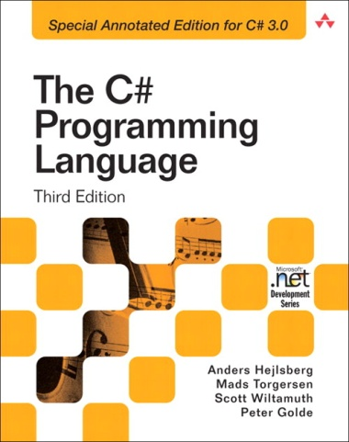


Influenced by FP

Slide 7
Quick Overview of FP Using Haskell
Immutable state
Recursion
Higher order functions
Currying
Pattern Matching
Working with immutable lists.

Slide 8
Interesting facts about Haskell
Haskell is statically typed, but because its type inference is so powerful you almost never have to type the types!
Haskell has lazy evaluation which is really neat (e.g. give me the first 10 elements of an infinite list)
Haskell is pretty fast. Close to Java, certainly faster than dynamic languages like Python or Ruby. It compiles to machine code like C or C++. The compiler is seeing a lot of improvements lately as interest grows.
Haskell also has a REPL that allows you to play with the language easily and try new things.

Slide 9
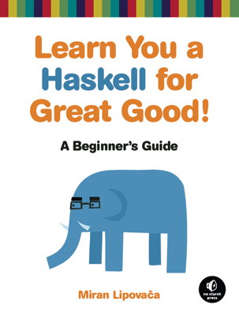

Want to try Haskell?
Free eBooks!
Learn you a Haskell for Great Good!
http://learnyouahaskell.com/chapters
Real World Haskell
http://book.realworldhaskell.org/read/
Cool video introduction (Google Tech Talk):
http://www.youtube.com/watch?v=b9FagOVqxmI

Slide 10

Want to try Haskell?
Get Haskell Platform easily for your machine
Linux (Fedora or Ubuntu):
$ sudo apt-get install haskell-platform
$ sudo yum install haskell-platform
Windows or Mac (or Linux):
Get the platform here: http://www.haskell.org/platform/
Yes, there is an Eclipse plug-in:
http://eclipsefp.github.com/

Slide 11
Topics for Future Sessions
How you can help by presenting your ideas and experiences with FP.
If you wish to present at a future session contact me:
<chris.dunphy@sjrb.ca>
Functional programming concepts and idioms
Higher order functions, currying, pattern matching, functional algorithms, monads, etc.
Actors and other functional approaches to concurrency.
Functional programming languages
Any functional language!
Also, how functional concepts can help us write better programs in imperative languages like C#, C++, or Java.
Demos, talks, or relevant videos on YouTube are all welcome!

Slide 12

Questions?
My example code (along with this slide deck) has been posted to Github at:
https://github.com/Nebulaeus/fnprogfun1
New distribution list for Outlook called Shaw Functional Programmers is coming. We will be able to post information relating to the sessions there.
Thanks for coming. We hope to see you again next month!

