Slide 1

Lunch and Learn I: October 2012
Introduction to Functional Programming
Chris Dunphy, Core Communications Applications

Slide 2
Welcome!
One of the most enjoyable aspects of working as a software developer is learning new things.
Functional programming, which has been popular in academia for a very long time, is becoming more popular in mainstream circles for a variety of reasons.
I am new to FP, but what I am learning is very exciting. It is just awesome to write programs in FP!
My hope for these lunch and learns is to share knowledge on this subject and perhaps learn something from one of you in the audience!
I want to get you excited about Functional Programming!

Slide 3

Lunch and Learn Series
Today’s Agenda
A brief overview of functional programming with some basic examples in the Haskell programming language.
Why FP is worth learning and how these lunch and learns are going to be a lot of fun!
But First!
How you can help by presenting your ideas and experiences with FP.
If you wish to present at a future session contact me:
<chris.dunphy@sjrb.ca>

Slide 4
Topics for Future Sessions
Functional programming concepts and idioms
Higher order functions, currying, pattern matching, functional algorithms, monads, etc.
Actors and other functional approaches to concurrency.
Functional programming languages
Any functional language!
Also, how functional concepts can help us write better programs in imperative languages like C#, C++, or Java.
Demos, talks, or relevant videos on YouTube are all welcome!

Slide 5
Introduction to Functional Programming
How many in the audience today are familiar with functional programming?
My definition:
Functional programming is a method of software development that separates (and minimizes) the parts of the program that use side effects and mutable state (I/O for example) from pure functions which do not use mutable state at all. FP also emphasizes the use of higher order functions to solve complex problems by building complex functions out of much simpler ones.

Slide 6
Why FP matters
Concurrency
It turns out that eliminating mutable state from most of your program makes writing concurrent software much easier!
Conciseness
Functional programming tends to be very concise and extremely expressive. Less code means less bugs and you often can often understand the programmer’s intent more easily.
Correctness
Pure functions never change from underneath you. They are easier to reason about and make your programs more predictable. Pure functions have no side effects whatsoever. FP separates the pure functions from the parts of the program which cannot be pure (I/O and stuff like that).
It’s Different
If you are like me, you’ll like the fact that programming with FP is very different. You have to approach things very differently. This stretches your mind and helps you to approach your craft from a fresh angle.
It’s Fun!
I haven’t had this much fun playing with code in a long time.

Slide 7





Some Functional Programming Languages
λ Scheme

Slide 8


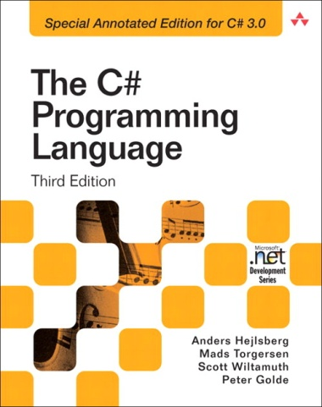


Influenced by FP

Slide 9
Quick Overview of FP Using Haskell
Immutable state
Recursion
Higher order functions
Currying
Pattern Matching
Working with immutable lists.

Slide 10
Interesting facts about Haskell
Haskell is statically typed, but because its type inference is so powerful you almost never have to type the types!
Haskell has lazy evaluation which is really neat (e.g. give me the first 10 elements of an infinite list)
Haskell is pretty fast. Close to Java, certainly faster than dynamic languages like Python or Ruby. It compiles to machine code like C or C++. The compiler is seeing a lot of improvements lately as interest grows.
Haskell also has a REPL that allows you to play with the language easily and try new things.

Slide 11
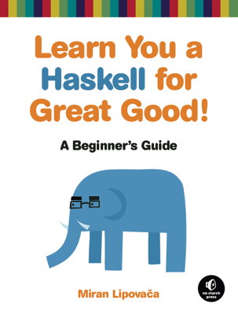
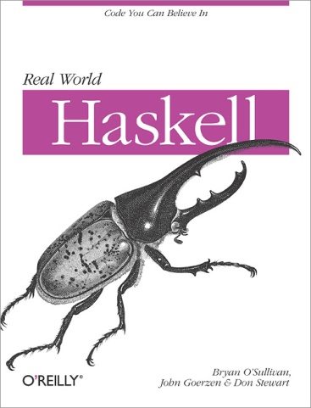
Want to try Haskell?
Free eBooks!
Learn you a Haskell for Great Good!
http://learnyouahaskell.com/chapters
Real World Haskell
http://book.realworldhaskell.org/read/
Cool video introduction (Google Tech Talk):
http://www.youtube.com/watch?v=b9FagOVqxmI

Slide 12

Want to try Haskell?
Get Haskell Platform easily for your machine
Linux (Fedora or Ubuntu):
$ sudo apt-get install haskell-platform
$ sudo yum install haskell-platform
Windows or Mac (or Linux):
Get the platform here: http://www.haskell.org/platform/
Yes, there is an Eclipse plug-in:
http://eclipsefp.github.com/

Slide 13

Questions?
My example code (along with this slide deck) has been posted to Github at:
https://github.com/Nebulaeus/fnprogfun1
New distribution list for Outlook called Shaw Functional Programmers is coming. We will be able to post information relating to the sessions there.
Thanks for coming. We hope to see you again next month!

