Slide 1

VaqPack Project
Team - 02
William DeWald ( Project Manager )
Fernando Bazan
Nathanael Carr
Erik Lopez
Raul Saavedra
Prepared for
Software Engineering
University of Texas Rio Grande Valley
Instructor: MK Quweider, Ph.D.
Fall 2015

Slide 2
Software Engineering Ethics
In producing the required software we have, where applicable and in accordance with commitment to health, safety and welfare of public, adhered to the Software Engineering code of ethics principles as outlined below:
PUBLIC - Software engineers shall act consistently with the public interest.
CLIENT AND EMPLOYER - Software engineers shall act in a manner that is in the best interests of their client and employer, consistent with the public interest.
PRODUCT - Software engineers shall ensure that their products and related modifications meet the highest professional standards possible.
JUDGMENT - Software engineers shall maintain integrity and independence in their professional judgment.
MANAGEMENT - Software engineering managers and leaders shall subscribe to and promote an ethical approach to the management of software development and maintenance.
PROFESSION - Software engineers shall advance the integrity and reputation of the profession consistent with the public interest.
COLLEAGUES - Software engineers shall be fair to and supportive of their colleagues.
SELF - Software engineers shall participate in lifelong learning regarding the practice of their profession and shall promote an ethical approach to the practice of the profession.

Slide 3
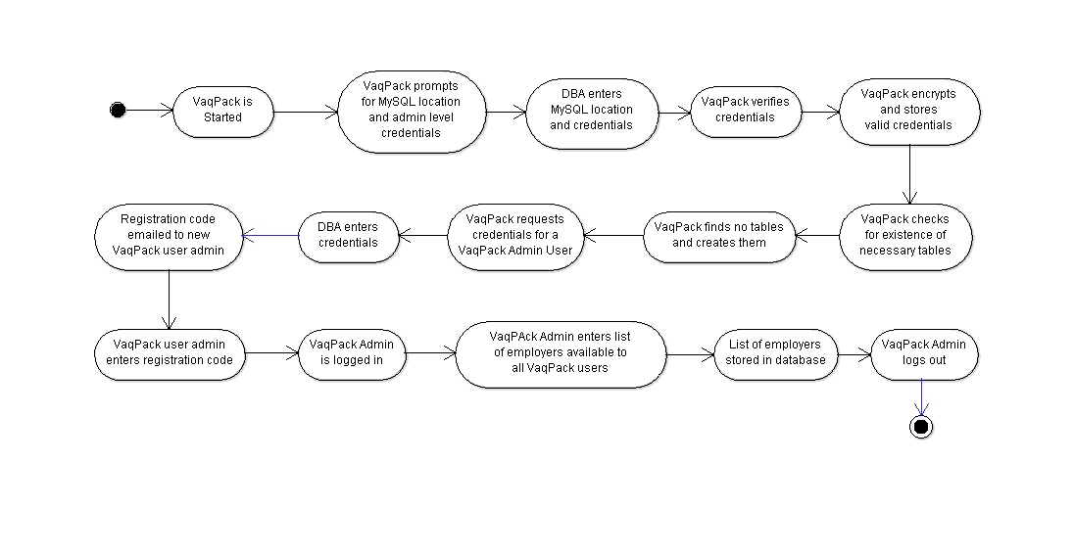
VaqPack First Run -- Program Flow

Slide 4
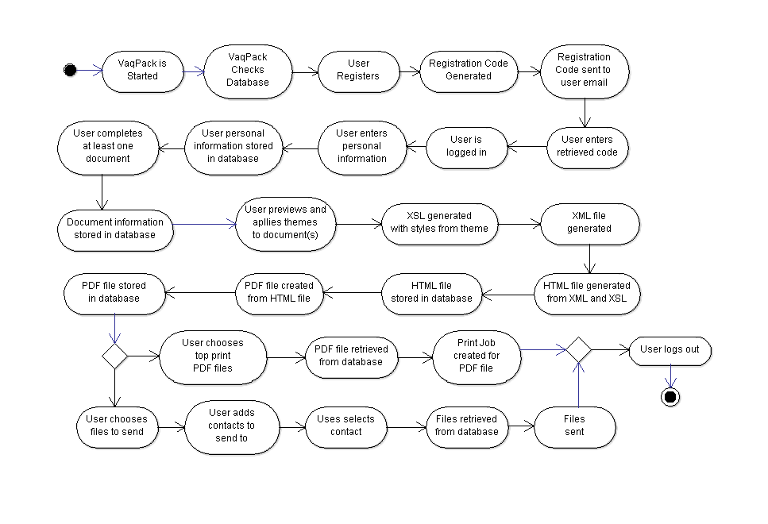
VaqPack First Time User -- Program Flow

Slide 5
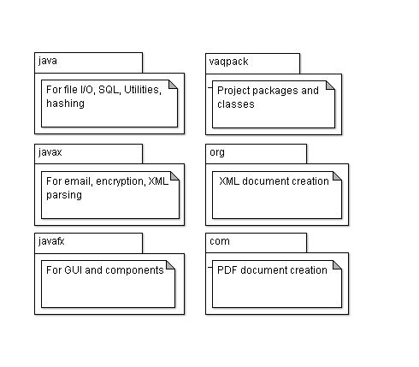
Main Packages

Slide 6
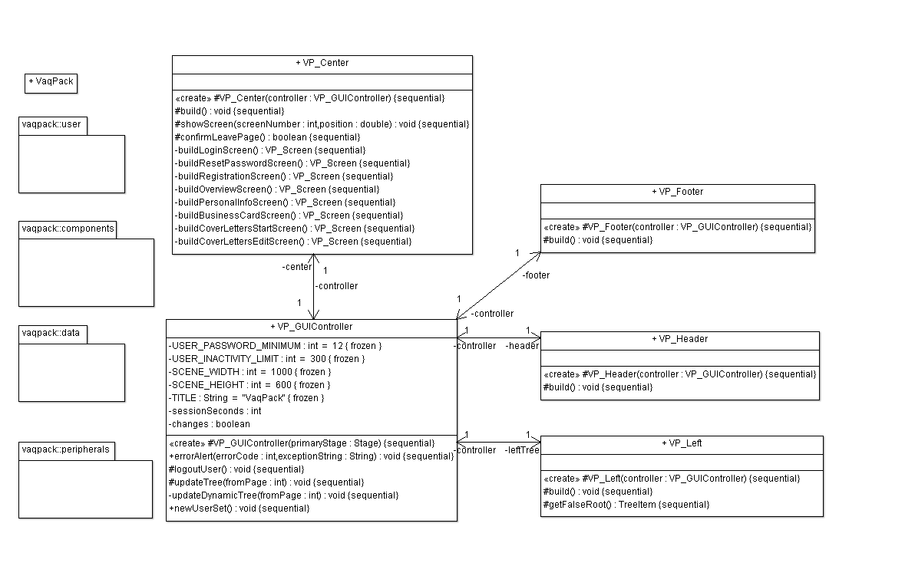
Inside the vaqpack Package

Slide 7
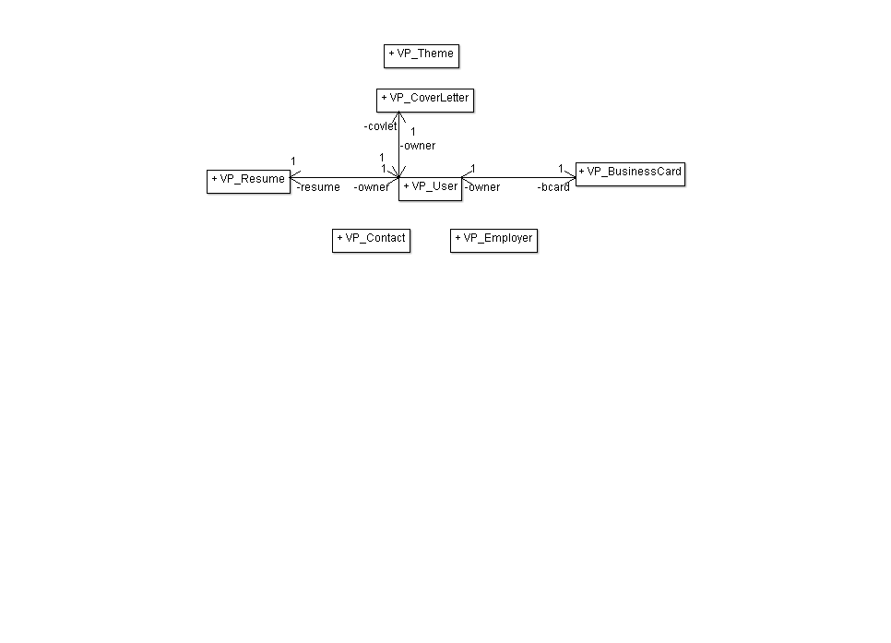
Inside the vaqpack::user Package

Slide 8
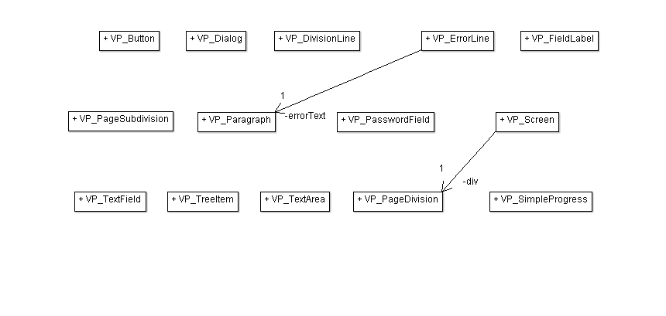
Inside the vaqpack::components Package

Slide 9
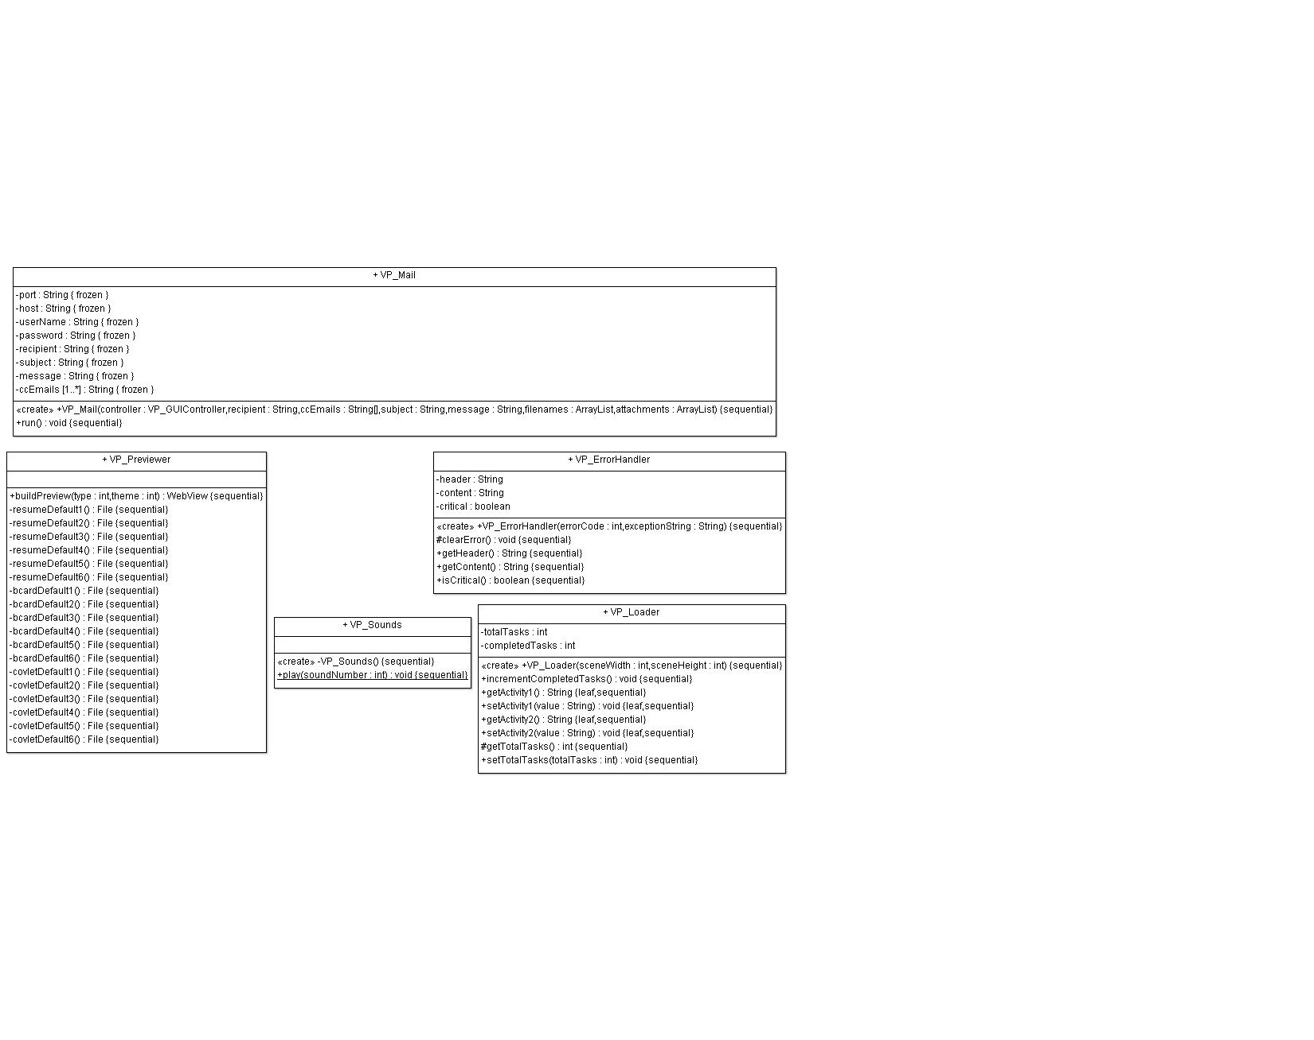
Inside the vaqpack::peripherals Package

Slide 10
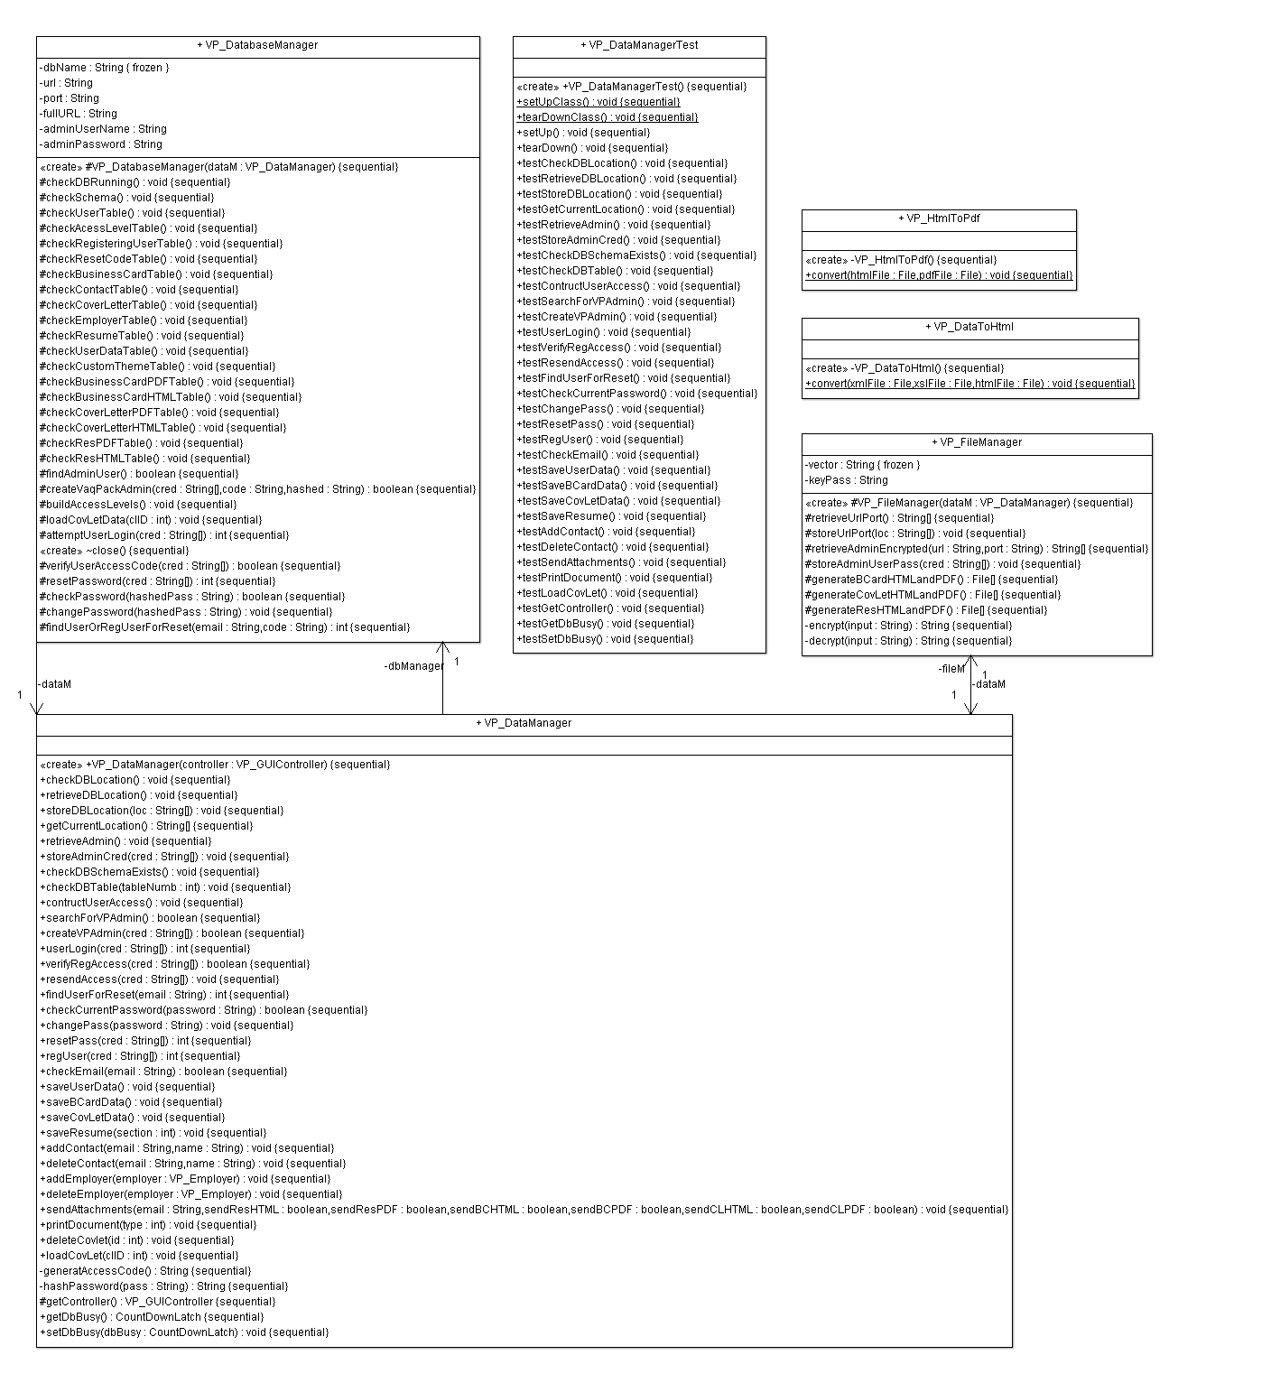
Inside the vaqpack::data Package

Slide 11
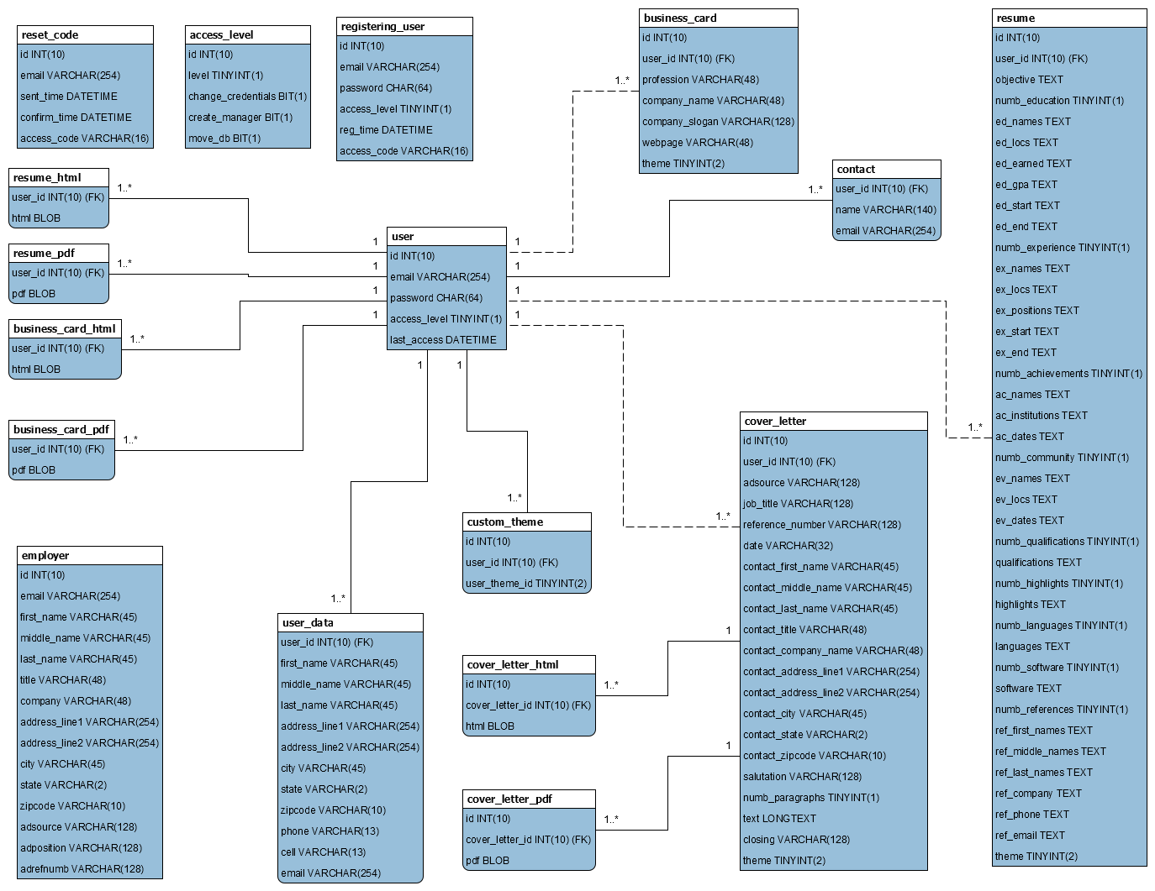
VaqPack Database Structure

Slide 12
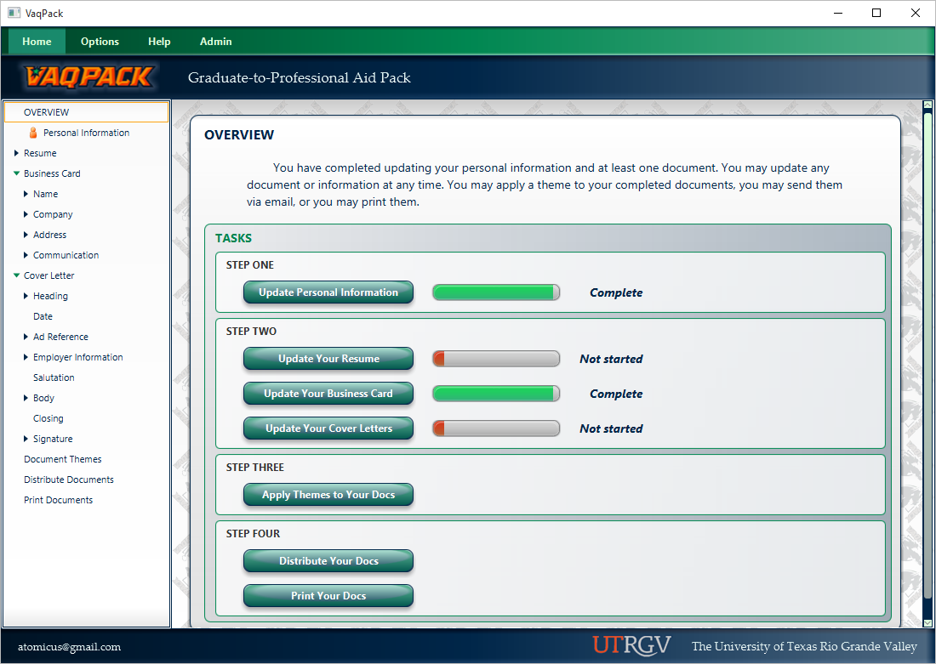
VaqPack GUI Introduction

Slide 13
Additional Gathered Requirements Implemented
VaqPack provides a means to generate the necessary database tables.
VaqPack Admin User has ability to change the MySQL location before or after data migration.
Password encryption. ETHICS!!!
Allow users to reset passwords when forgotten.
Allow for storage of multiple cover letters.
Users can go back through wizard and make changes.

Slide 14
Extra Features Implemented
Users may change passwords after being logged in, but
Requires reentering credentials (ETHICS!)
For security, VaqPack logs out users after 5 minutes of
Inactivity. (MORE ETHICS!!!)
Functionality to update the date shown on a stored covered letter.
Employer list is global, but user can enter in own private contacts.
Our virtual marketing team received virtual legal permission from UTRGV to use the official logo and colors.
VaqPack has sounds.
Minimum required password strength. (Yep, more ethics.)
6 themes can be applies to all document types.
HTML stored for all document types.
Left-side tree view unlocks as user progresses through wizard, allowing an alternative method of quick navigation.
Documents samples of the themes can be previewed before printing/sending.
“About” and help screens available.
VaqPack detects when changes have been made to a document, prompting a user to choose to remain on current page and save or continue.

Slide 15
DEMO!

