Slide 1
Predicting Medical Insurance Costs with Machine Learning
Atoosa Ebrahimabadi
University of genova

Slide 2

INTRODUCTION
Random forest regression is a machine learning technique that uses multiple decision trees to perform regression tasks. It is based on the idea of combining the predictions of many weak learners (trees) to produce a more accurate and robust estimate.
Notes:
Random Forest Regression is a Machine Learning technique that uses multiple decision trees to make predictions. Instead of relying on a single tree, it combines multiple weak models to get a more accurate and reliable prediction. This method helps improve accuracy and prevents overfitting, which is when a model memorizes data instead of learning patterns.

Slide 3

ADVANTAGES
It can handle high-dimensional and nonlinear data
It can reduce overfitting and variance by averaging the results of different trees
It can provide measures of variable importance and feature selection
It can deal with missing values and outliers
Notes:
There are several advantages of using Random Forest Regression like:

Slide 4

DISADVANTAGES
It can be computationally expensive and slow to train and test
It can be difficult to interpret and explain the model
It can be sensitive to the choice of parameters and random seed
Notes:
However, there are also some drawbacks which are:

Slide 5
PROBLEM DEFINITION Medical Cost
I aim to predict medical insurance costs for individuals based on various personal attributes. Utilizing the Random Forest Regression algorithm, we estimate the medical charges (i.e., individual medical costs billed by health insurance) for each person in the dataset. By analyzing factors such as age, sex, BMI, number of children, smoking status, and geographic region, our goal is to accurately predict these costs and identify the key drivers of medical expenses. This predictive model will provide valuable insights for insurers and policymakers.
Notes:
The goal of this project is to predict medical insurance costs based on personal attributes like:
Age, gender, BMI, number of children, smoking status, and location. We use Random Forest Regression to estimate the medical charges billed by insurance companies. This can help insurers and policymakers understand the factors driving medical costs and set better policies.

Slide 6
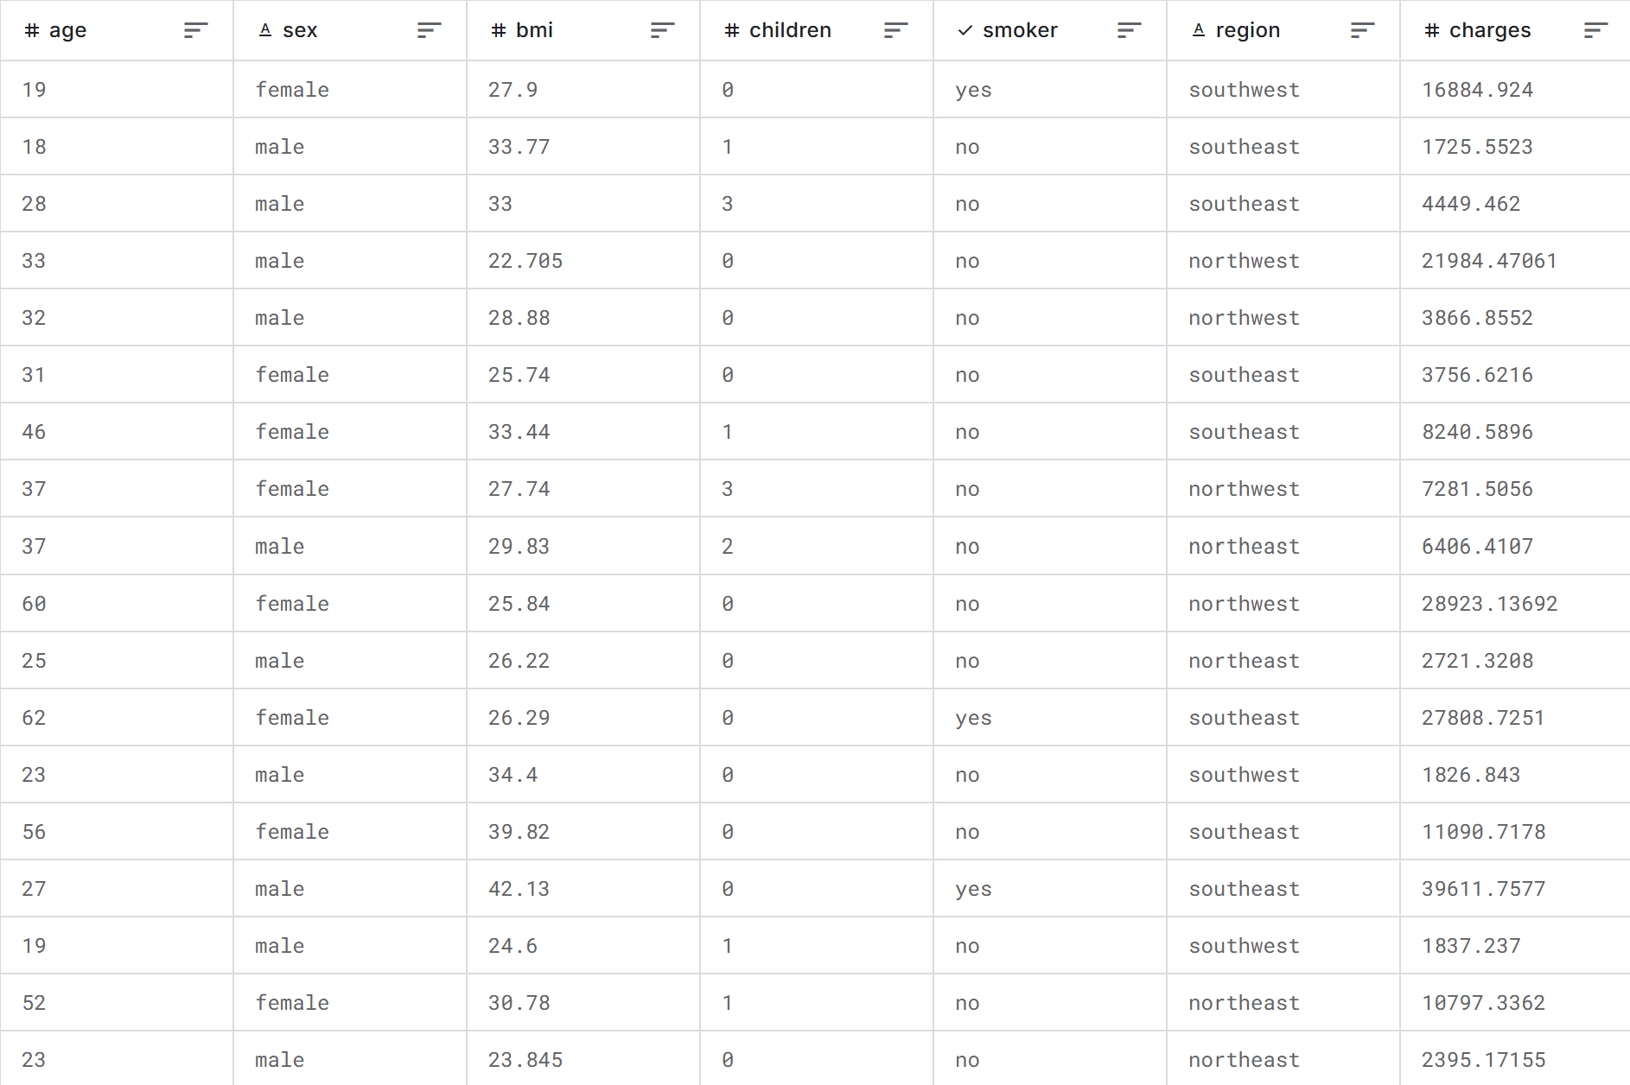
Data Exploration: Key Features
age: Age of the insured (Primary Beneficiary)
sex: Gender of the insured
bmi: Body Mass Index (Indicator of Body Fat)
children: Number of children/dependents covered
smoker: Smoking status (Yes/No)
region: Geographic region of residence (US)
charges: Individual medical costs billed by health insurance (TARGET)
Notes:
Before diving into the modeling process, it's crucial to understand the features within our dataset. The dataset includes several key attributes: Age – How old the person is.
Sex – Male or Female.
BMI – Body Mass Index, an indicator of body fat.
Children – Number of dependents covered by insurance.
Smoker – Whether the person smokes or not.
Region – The geographic location in the U.S.
Charges – The actual medical costs billed by insurance (this is our target variable to predict).
These features provide a rich source of information that can significantly influence medical insurance costs. The target variable, 'charges,' represents the individual medical costs billed by health insurance. Understanding these features helps us build a more accurate and interpretable model.

Slide 7
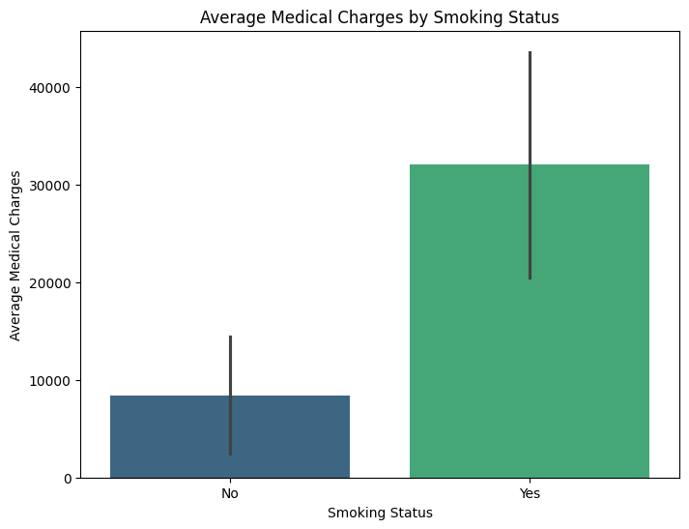
Impact of Smoking on Medical Costs
Notes:
Visualizing the data distribution is an essential step in understanding the relationships between different features and the target variable. For instance, one notable relationship is between smoking status and medical costs. Our visualizations showed that Smokers, on average, have much higher medical charges compared to non-smokers. This makes sense because smoking is linked to various health risks like lung disease and heart conditions, leading to higher medical expenses.

Slide 8
Data Preprocessing: Handling Categorical Features
One-Hot Encoding was used to convert categorical features (sex, smoker, region) into numerical representations.
pd.get_dummies() function was used with drop_first=True to avoid multicollinearity.
Example: sex feature was transformed into a sex_male column.
Notes:
To prepare the data for modeling, we needed to convert categorical features into numerical representations. We achieved this using One-Hot Encoding, which transforms categorical variables into binary columns. For example, the 'sex' feature was converted into 'sex_male' and 'sex_female' columns. This step ensures that our machine learning algorithm can effectively utilize these features without any confusion.

Slide 9
Data Preprocessing: Feature Scaling
To standardize numerical features (age, bmi, children), we applied StandardScaler(). This step prevents features with larger ranges from dominating the model. The scaler was trained on the training data to prevent data leakage.
Notes:
Scaling numerical features is another critical preprocessing step. We used StandardScaler to scale features such as age, BMI, and the number of children. Scaling ensures that features with different scales do not disproportionately influence the model, leading to more accurate predictions. It's important to fit the scaler on the training data only to prevent data leakage and ensure the model generalizes well to new data.

Slide 10
Hyperparameter Tuning with GridSearchCV
I fine-tuned the Random Forest model using GridSearchCV. The best parameters were selected on cross-validation, optimizing Mean Squared Error(MSE)
Hyperparameters tuned:
“n_estimators, max_depth, min_samples_split, min_samples_leaf”
Cross-validation (CV=3) was used to evaluate the performance of each hyperparameter combination.
Scoring metric: Negative Mean Squared Error (neg_mean_squared_error).
Notes:
To optimize the performance of our Random Forest model, I used GridSearchCV for hyperparameter tuning. This involved systematically searching through a predefined set of hyperparameters, using cross-validation to evaluate each combination and selecting the one that yielded the best performance based on the negative mean squared error. This process ensures that we are using the optimal model configuration for our data.
n_estimators (number of trees)
max_depth (depth of each tree)
min_samples_split (minimum samples needed to split a node)
min_samples_leaf (minimum samples needed at a leaf node)

Slide 11
Best Model Parameters (From GridSearchCV)
n_estimators: 300
max_depth: 4
min_samples_split: 2
min_samples_leaf: 3
Notes:
After tuning, the best parameters for our model were:
n_estimators: 300 (meaning the model uses 300 decision trees).
max_depth: 4 (limiting tree depth to avoid overfitting).
min_samples_split: 2 (ensuring splits occur only when needed).
min_samples_leaf: 3 (preventing small splits that reduce generalization). These settings provide the best trade-off between accuracy and computational efficiency

Slide 12
Model Evaluation: Results
Mean Squared Error (MSE): 19515197.63
Average medical cost in the dataset: $13270
R-squared (R²): 87%
Notes:
After training the model with the best parameters, we evaluated its performance using the test set. The Mean Squared Error (MSE) was approximately 19.5 million, and the R-squared (R²) value was 0.8743. An R-squared value of 0.8743 indicates that our model explains approximately 87.43% of the variance in medical insurance costs. This means that 87% of the variability in the 'charges' column in our dataset can be predicted by our model based on the features we included, such as age, BMI, smoking status, and so on. Generally, an R-squared value close to 1 suggests a strong relationship between the features and the target variable, making this a good indicator.
(RMSE)This means that, on average, our model's predictions are about $4417.60 away from the actual medical costs. (The acceptability of this error level depends on the specific application of the model. For premium pricing, a 37% error may be unacceptable, as it could lead to significant financial risk for the insurance company if premiums are set too low. Further model refinement or the incorporation of additional predictive variables may be necessary.)

Slide 13
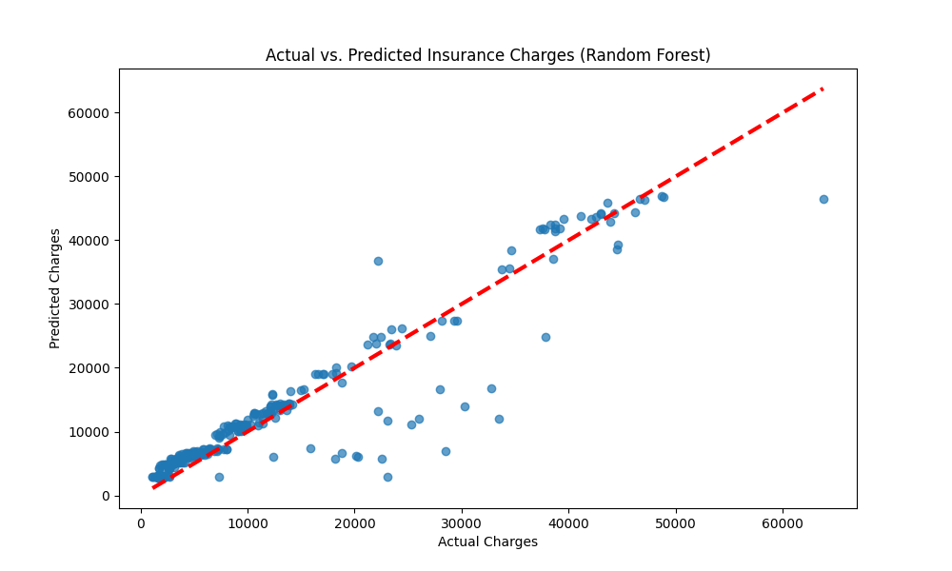
Visualizing Model Performance: Actual vs. Predicted Charges
Notes:
To further assess the model's performance, we compared the actual charges with the predicted charges using a scatter plot. As illustrated in the plot, the predicted values closely align with the actual values, indicating a good fit. The diagonal line represents the ideal scenario where predicted values equal actual values. The closer the points are to this line, the better the model's performance.
To evaluate our model visually, we compared actual vs. predicted charges. A good model will have predicted values close to the actual ones. The plot helps us identify how well our model generalizes across different cost ranges.

Slide 14
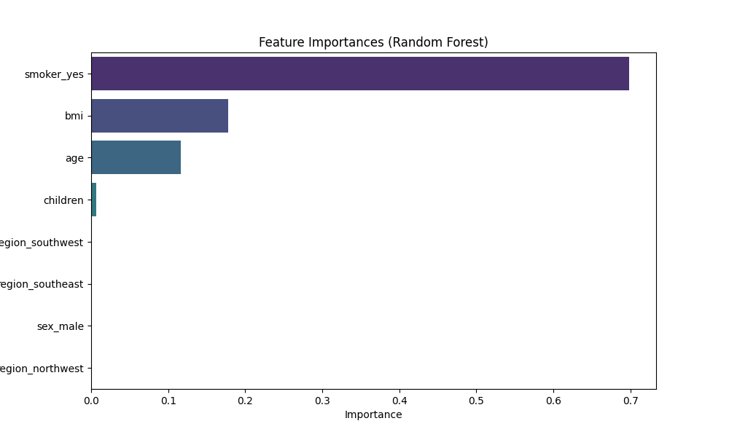
Feature Importance
Notes:
Random Forest's feature importance analysis shows that smoking status, BMI, and age are the most significant predictors of medical costs. These insights can help insurers refine risk assessment strategies.
(Understanding feature importance helps us identify the key drivers of medical insurance costs. In our Random Forest model, smoking status emerged as the most significant predictor, followed by BMI and age. These insights highlight the impact of lifestyle factors and personal characteristics on healthcare expenses. Such information can be invaluable for designing targeted interventions and insurance policies.)

Slide 15

Conclusion
We developed a Random Forest Regression model to predict medical insurance costs, achiving an R² Score of 87%. Smoking,BMI, and age were the most significant cost drivers. The model offers valuable insights for healthcare and insurance industries.
Key Drivers: Smoking status, BMI, and age were identified as the most important predictors.
Model can be used to estimate individual medical costs and identify factors influencing healthcare expenses.
Notes:
In conclusion, we successfully developed a Random Forest Regression model to predict medical insurance costs with an R-squared value of 87%. Key drivers such as smoking status, BMI, and age were identified, providing valuable insights into the factors influencing healthcare expenses. Our model can be used to estimate individual medical costs and inform policy decisions aimed at managing healthcare expenditures.

Slide 16
Limitations & Future Work
Limited Data: The dataset is relatively small and may not capture the full complexity of the healthcare system.
Other factors: Could include socioeconomic factors, pre-existing conditions, and access to healthcare.
Future Work:
Explore additional features and datasets.
Compare performance with other machine learning models (e.g., Gradient Boosting).
Notes:
While our model performs well, it has some limitations. The dataset used is relatively small and may not capture the full complexity of the healthcare system. Additionally, other factors such as socioeconomic status, pre-existing conditions, and access to healthcare were not considered in this analysis. Future work could involve exploring additional features and datasets to improve the model's accuracy. Comparing the performance of different machine learning models, such as Gradient Boosting, could also provide further insights.

Slide 17

Thank you for your attention

