Slide 1
Project-1
By Atoosa Fasihi

Slide 2
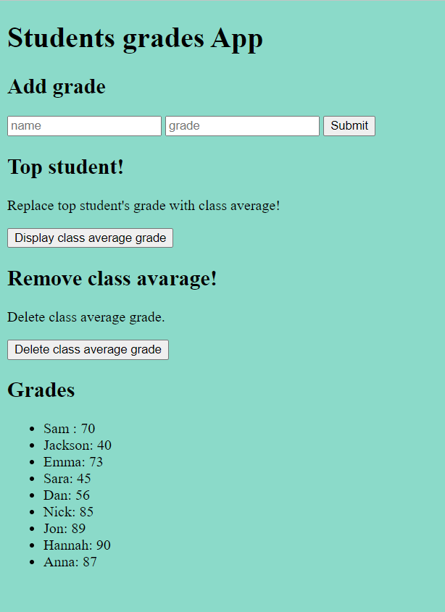
Web App
I created a grade analytics app which users allowed to:
Submit students name and grade
Display the class average
Ability to delete the class average if needed

Slide 3

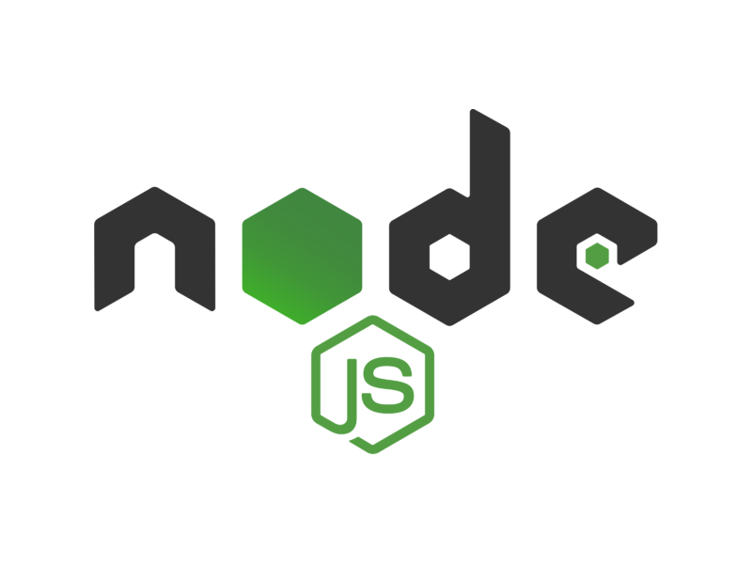


Structure of the web app
Font-end: HTML and, JavaScript
Back-end: NodeJS, ExpressJS
Database: MongoDB
Web App
Show results
Database

Slide 4
The process:
Build the web app:
I used Node JS in this project and created a server.js file and a package.json file which helps in managing dependencies.
Used Express to create a server which browsers can connect to.

Slide 5

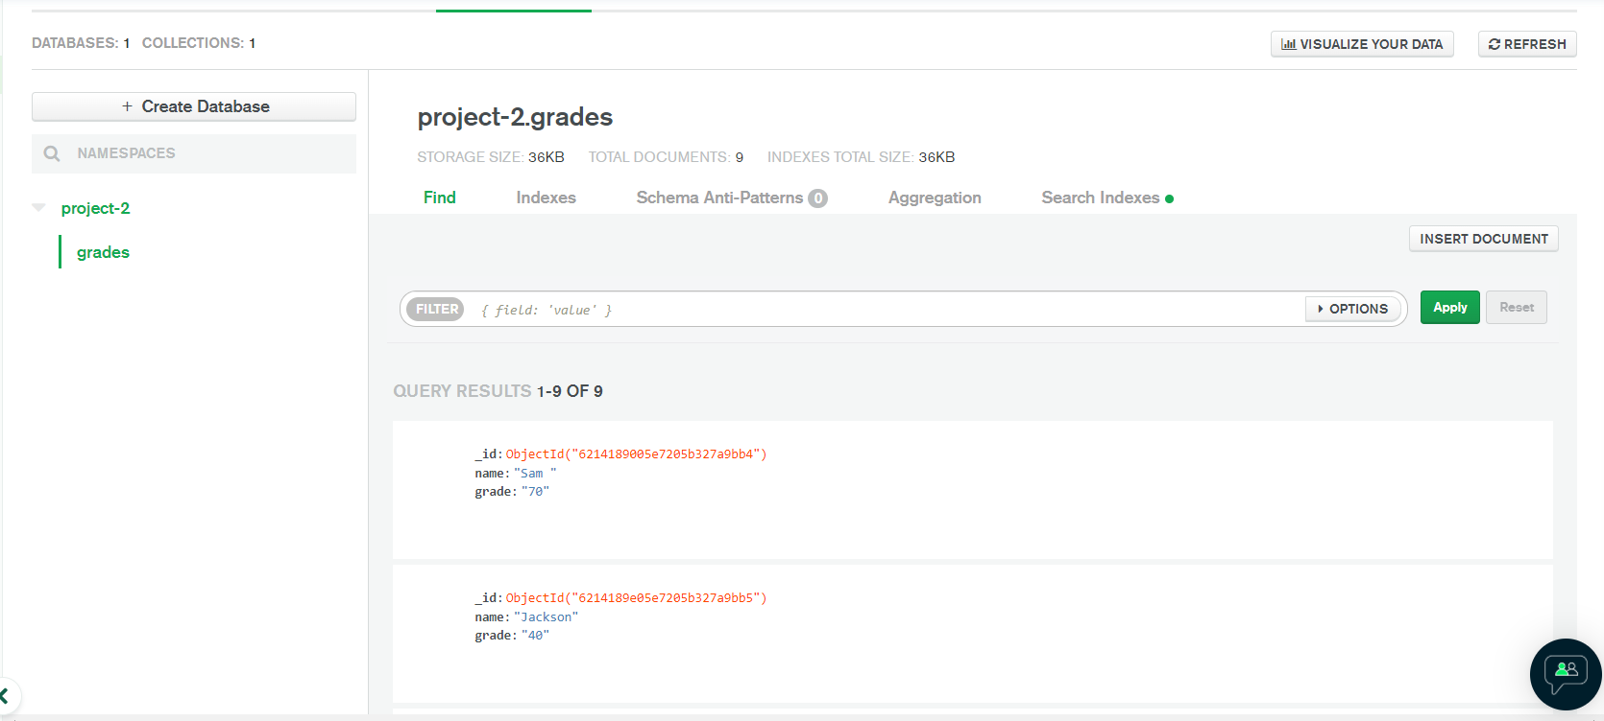
The process:
Creating the database:
I used MongoDB Atlas which is a cloud-based service.
Connect to MongoDB and created a database
Implemented on server.js so we can access the grades that has been stored
Rendering the HTML

Slide 6
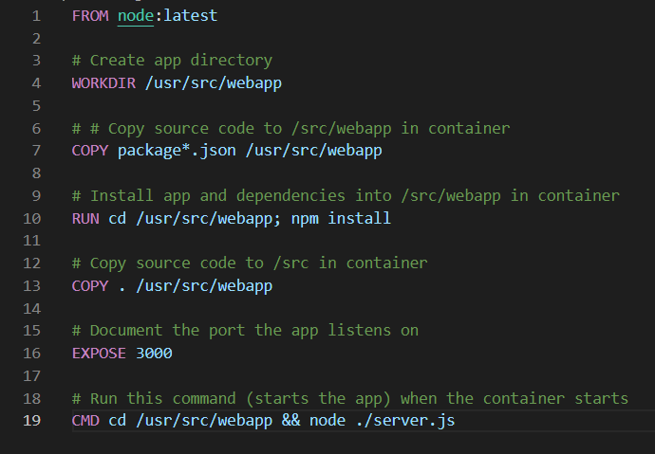
The process:
Creating Docker images:
Created a Dockerfile
Created an image
Run the application using the docker run command.
Created a docker-compose.yml file for the MongoDB database.

Slide 7
Demo

Slide 8
Thank you!
Any questions?

