Slide 1
Developing Microservices
November 2018

Slide 2
Outline
Recap: What is a Microservice?
Labs
Deep Dive into Carts Service
Deploy Microservice to Dev Environment
Deploy Microservice to Staging Environment
Summary

Slide 3
Introduction into the Topic

Slide 4

What is a Microservice (Architecture)?
Architectural style that structures an application as a collection of loosely coupled services
Services are fine-grained and their protocols are lightweight
Improves modularity and makes the application easier to understand, develop, and test
Parallelizes development by enabling small autonomous teams to develop, deploy and scale their respective services independently
Individual service emerge through continuous refactoring
Microservices-based architectures enable continuous delivery and deployment
Building Microservices:
Designing Fine-Grained Systems
Sam Newman

Slide 5
Define the microservices architecture
front-end
Frontend
Backend
Technologies: Node.js
Image: alpine
carts
catalogue
Technologies: Java
Technologies: Go
Image: ubuntu
Image: ubuntu
carts-db
catalogue-db
Technologies: MongoDB
Technologies: MySql

Slide 6
Define the endpoints
front-end
Frontend
Technologies: Node.js
Image: alpine
carts
catalogue
Technologies: Java
Technologies: Go
Image: ubuntu
Image: ubuntu
carts-db
catalogue-db
Technologies: MongoDB
Technologies: MySql

Slide 7
Define the endpoints
front-end
Backend
Technologies: Node.js
Image: alpine
carts
catalogue
Technologies: Java
Technologies: Go
Image: ubuntu
Image: ubuntu
carts-db
catalogue-db
Technologies: MongoDB
Technologies: MySql

Slide 8
Deploy a Microservice on Kubernetes (1/4)
Step 1/4: Create a configuration (.yaml Files)
TODO UI
(Container/Image)
+
SERVICE
(carts-svc.yaml)
sockshop/carts:latest
svc/carts
DEPLOYMENT
(carts-dep.yaml)
dep/carts

Slide 9
Deploy a Microservice on Kubernetes (2/4)
Step 2/4: Create a deployment configuration (carts-dep.yaml)
apiVersion: apps/v1
kind: Deployment
metadata:
name: carts
namespace: dev
spec:
replicas: 1
template:
metadata:
labels:
app: carts
version: v1
spec:
containers:
- image: <your container registry>/library/sockshop/carts-<version>
name: carts
ports:
- containerPort: 8080
env:
- name: JAVA_OPTS
value: -Xms128m -Xmx512m -XX:PermSize=128m -XX:MaxPermSize=128m -XX:+UseG1GC -Djava.security.egd=file:/dev/urandom
Name
Replicas
Container Image
Environment variables

Slide 10
Deploy a Microservice on Kubernetes (3/4)
Step 3/4: Create a service configuration (carts-svc.yaml)
kind: Service
apiVersion: v1
metadata:
name: carts
namespace: dev
spec:
selector:
app: todo-ui
ports:
- protocol: TCP
port: 8080
targetPort: 8080
type: LoadBalancer
Name
Port
Type

Slide 11
Deploy a Microservice on Kubernetes (4/4)
Step 4/4: Execute the configuration (.yaml Files)
$ kubectl create –f namespace.yaml
$ kubectl create –f carts-dep.yaml
$ kubectl create –f carts-svc.yaml

Slide 12
The Liveness Probe and Readiness Probe
Generally, a Probe is a diagnostic performed periodically by the kubelet on a Container
The kubelet can optionally perform and react to two kinds of probes on running Containers:
livenessProbe: Indicates whether the Container is running.
readinessProbe: Indicates whether the Container is ready to service requests.
When should you use liveness or readiness probes?
If the process in your Container is able to crash on its own
If you’d like your Container to be killed and restarted if a probe fails
If you’d like to start sending traffic to a Pod only when a probe succeeds, specify a readiness probe.
If your Container needs to work on loading large data, configuration files, or migrations during startup, specify a readiness probe.
Notes:
livenessProbe: Indicates whether the Container is running. If the liveness probe fails, the kubelet kills the Container, and the Container is subjected to its restart policy. If a Container does not provide a liveness probe, the default state is Success.
readinessProbe: Indicates whether the Container is ready to service requests. If the readiness probe fails, the endpoints controller removes the Pod’s IP address from the endpoints of all Services that match the Pod. The default state of readiness before the initial delay is Failure. If a Container does not provide a readiness probe, the default state is Success.

Slide 13
Lab: Deep Dive into Carts Service
Overview
Learn how a (Java) Microservice is structured from a code perspective
Learn how a Microservice is defined by its service and deployment specification
Deploy Microserivce to Kubernetes
Instructions:
Lab: 1_Deep_Dive_into_Carts_Service
Takeaways
Get familiar with the structure of a Microservice in order to find artifacts needed for further labs.

Slide 14
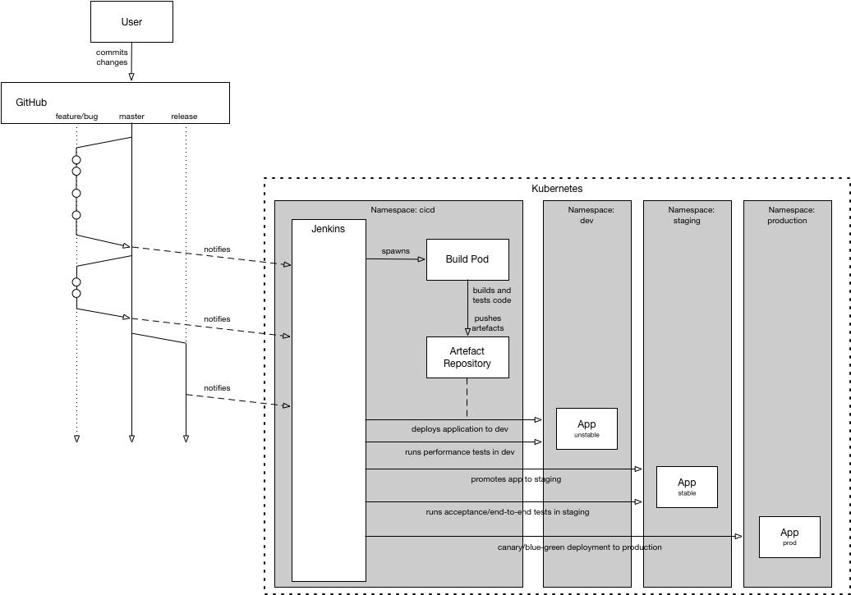
Image from Dirk (master/release)

Slide 15
Lab: Deploy Microservice to Dev Environment
Overview
…
Instructions:
Lab: 2_Deploy_Microservice_to_Dev
Takeaways
…

Slide 16
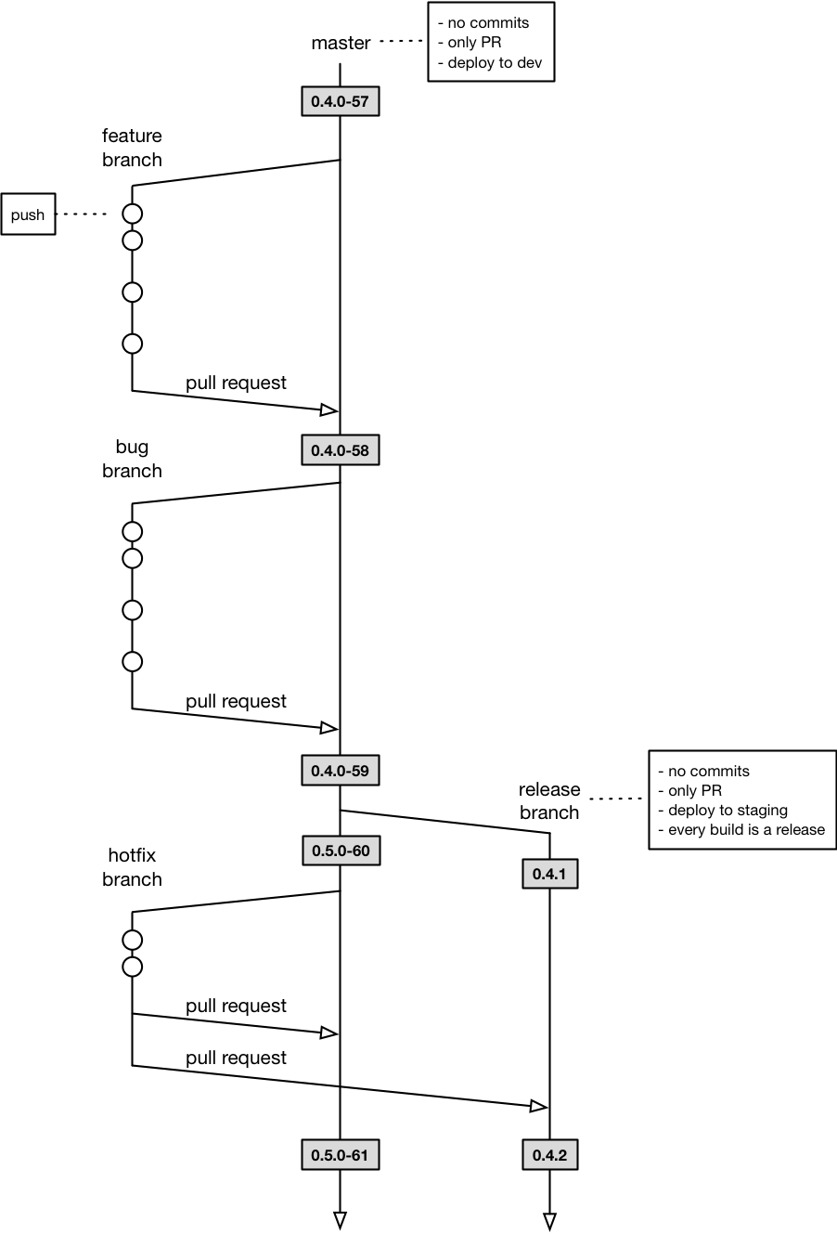
Image from Dirk (master/release)

Slide 17
Lab: Deploy Microservice to Staging Environment
Overview
…
Instructions:
Lab: 3_ Deploy_Microservice_to_Staging
Takeaways
…

Slide 18
Developing Microservices
November 2018

